Slide 1
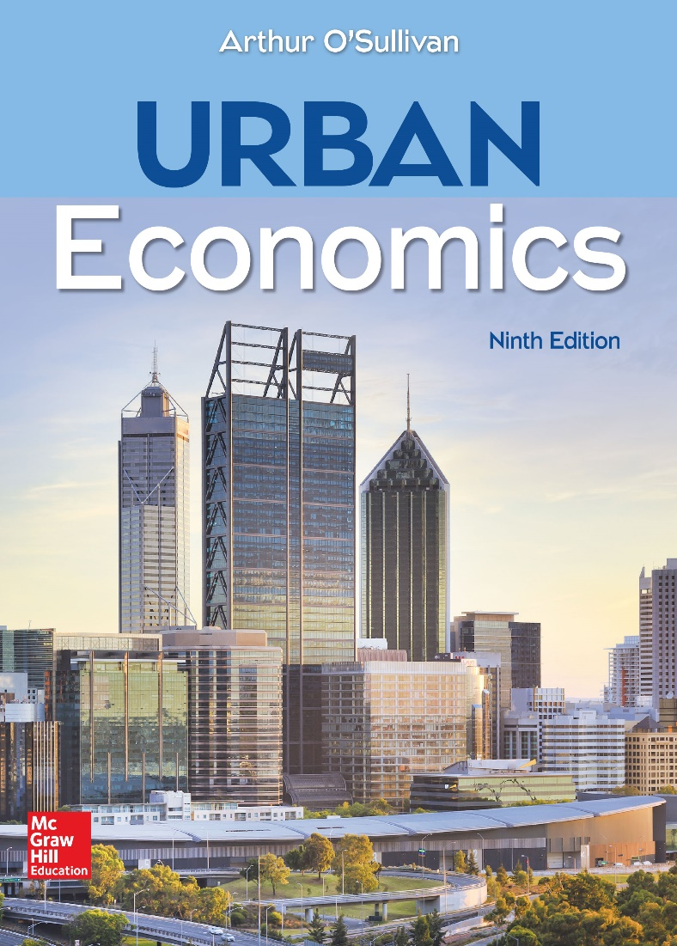
CHAPTER 1
Introduction

Slide 2
Urban Economics: Economics Meets Geography
Urban economics is defined as the intersection of geography and economics.
Geography: studies location and the spatial distribution of activity
Economics: explores choices made within limited resources
Urban economics:
explores profit-max and utility-max location choices
explores causes and consequences of urban problems
studies the efficiency and distributional effects of local government policies.

Slide 3
Urban Economics and Cities
Urban economics is categorized into four related areas:
Area 1: Market Forces in the Development of Cities
Area 2: Land Use Within Cities
Area 3: Urban Transportation
Area 4: Local Government, Education, and Crime
Notes:
Presenter Note: Urban economics is defined as the intersection of geography and economics. Economics explores the choices people make when resources are limited, while geography studies how various activities are arranged across space. Urban economics can be divided into four related areas, providing an organizational framework for this book.

Slide 4
Area 1: Market Forces in the Development of Cities
Why do cities exist?
Why do competing firms cluster?
Why do cities vary in size?
What causes urban growth and decline?
Who benefits from urban growth?

Slide 5
Area 2: Land Use Within Cities
Why does the price of land vary within cities?
Why do people and firms build up instead of out?
Why are there dozens of municipalities in the typical metro area?
What are the consequences of race and income segregation?
What are the effects of land-use controls and zoning?

Slide 6
Area 3: Urban Transportation
What is the marginal external cost of automobile travel?
Why do so few people take mass transit?
What would be required for a light-rail system to pay for itself?

Slide 7
Area 4: Local Government, Education, and Crime
What is the rationale for our fragmented system of local government?
Why do local governments need to provide public K–12 education?
How do local governments control crime?

Slide 8
Geographical Definitions Relevant to Urban Economics
The U.S. Census Bureau has defined the following geographies as relevant to urban economics:
Geography 1: Urban Area
Geography 2: Metropolitan Area
Geography 3: Principal City
In the following slides, we will look at some trends in the U.S. urban population and study the definitions of these geographies.
Notes:
Presenter Note: Much of the empirical work in urban economics is based on census data, and a clear understanding of these definitions is important.
This book uses three terms to refer to spatial concentrations of economic activity: urban area, metropolitan area, and city. These three terms, used interchangeably, refer to the economic city (an area with a relatively high population density that contains a set of closely related activities), not the political city. When referring to a political city, we use the term municipality.

Slide 9
Geographical Definitions Changing Definitions of Metropolitan Areas
SMA 1949
SMSA 1959
MSA 1983
MA 1990 CMSA/PMSA
CBSA 2000
Notes:
Presenter Note: Much of the empirical work in urban economics is based on census data, and a clear understanding of these definitions is important.
This book uses three terms to refer to spatial concentrations of economic activity: urban area, metropolitan area, and city. These three terms, used interchangeably, refer to the economic city (an area with a relatively high population density that contains a set of closely related activities), not the political city. When referring to a political city, we use the term municipality.

Slide 10
Trends in Urban Population: Proportions of U.S. Population by CBSA Status and Size Category
.
Notes:
Presenter Note: This figure shows the shares of the U.S. population in cities of various size. Overall, about 94 percent of the population lives in urban areas, with 84 percent in 366 metropolitan areas and 10 percent in 576 micropolitan areas. Roughly one-quarter of the population lives in the largest metropolitan areas, defined as metropolitan areas with at least 5 million residents, leaving 30 percent in medium metropolitan areas and 30 percent in small metropolitan areas. Together, the two largest metropolitan areas, New York and Los Angeles, have over 10 percent of the U.S. population.

Slide 11
Trends in Urban Population: Top 30 CBSA by Population and GDP Growth
Notes:
Presenter Note: Much of the empirical work in urban economics is based on census data, and a clear understanding of these definitions is important.
This book uses three terms to refer to spatial concentrations of economic activity: urban area, metropolitan area, and city. These three terms, used interchangeably, refer to the economic city (an area with a relatively high population density that contains a set of closely related activities), not the political city. When referring to a political city, we use the term municipality.

Slide 12
Trends in Urban Population: Top 30 CBSA by Population and GDP Growth
Notes:
Presenter Note: Much of the empirical work in urban economics is based on census data, and a clear understanding of these definitions is important.
This book uses three terms to refer to spatial concentrations of economic activity: urban area, metropolitan area, and city. These three terms, used interchangeably, refer to the economic city (an area with a relatively high population density that contains a set of closely related activities), not the political city. When referring to a political city, we use the term municipality.

Slide 13
Trends in Urban Population: Percent of U.S. Population in Urban Areas, 1790–2010
Notes:
Presenter Note: This figure shows the percentage of people living in urban areas in the United States from 1790 to 2010. Over this period, the percentage of the population living in urban areas increased from 5 percent to 81 percent, a remarkable transformation that also occurred in other parts of the world. Urbanization was stagnant later in the 1970s, a decade that included a deep recession in 1973–1975.

Slide 14
Trends in Urban Population: Urban Population as Percentage of Population, 1950–2050
Notes:
Presenter Note: This figure shows the time trends in urbanization as a percentage of population for six major areas in the world. The historical data goes back to 1950 and the projections go to 2050. The proportions are currently less than half in Africa (40 percent) and Asia (47.5 percent), but that is expected to change by 2035 in Africa and 2018 in Asia. In the other areas, the urban percentage ranges from 70.8 percent in Oceania to 81.5 percent in Northern America.

Slide 15
Geography 1: Urban Area
Geographical definitions of urban populations are based on a census block—the smallest geographical unit in census data.
A block is an area bounded by visible and invisible features. It has a few dozen to a few hundred residents.
A block group is a group of contiguous census blocks.
A tract is a contiguous set of census block groups with a target population range of 4,000 residents.

Slide 16
Geography 1: Urban Area (cont.)
The U.S. Census Bureau uses tracts to define two types of urban areas: urbanized areas and urban clusters.
Urbanized Area
densely settled core area of tracts and surrounding tracts that meet minimum density requirements
density of 1,000 per square mile (psm) for core and 500 psm for surrounding area
minimum population of 50,000.
Urban Clusters
scaled-down version of urbanized area with total population between 2,500 and 50,000

Slide 17
Geography 2: Metropolitan Area Core-Based Statistical Area
Each Core-Based Statistical Area (CBSA) contains at least one urban area with at least 10,000 residents.
Metropolitan areas include at least one urbanized area with at least 50,000 people.
Micropolitan areas include at least one urban cluster of 10,000 to 50,000 people.

Slide 18
Geography 2: Metropolitan Area (Core-Based Statistical Area) (cont.)
The building blocks for metropolitan and micropolitan areas are counties.
Central Counties
places where at least 5,000 people reside, or where half the population resides within an urban area with at least 10,000 people.
Additional Outlying Counties
included in the CBSA if at least 25% of residents work in central counties or if at least 25% of jobs in the county are filled by residents of central counties.

Slide 19
Geography 3: Principal City
The largest municipality in each metropolitan or micropolitan statistical area is designated a principal city.
Additional cities qualify if they meet these criteria:
population of at least 250,000 residents
employment of at least 100,000 workers.

