Slide 1
CHAPTER 2
Key Concepts of Urban Economics

Slide 2
Six Key Concepts from Microeconomics
Six key concepts from microeconomics provide a foundation for urban economics:
1. Opportunity Cost
2. Marginal Principle
3. Nash Equilibrium
4. Comparative Statics
5. Pareto Efficiency
6. Self-Reinforcing Changes
Notes:
Presenter Note: The first five concepts are employed in many other fields in economics, while the sixth concept pertains to urban economics and a few other fields in economics.

Slide 3
1. Opportunity Cost
Economic cost is opportunity cost.
The opportunity cost is what you sacrifice to get something.
The opportunity cost of a resource is its value in its next-best use.
Economic cost can be divided into two types:
Explicit cost that involves an explicit monetary payment for an input.
Implicit cost is the opportunity cost of inputs that are not subject to an explicit monetary payment. There are two types of implicit cost:
Opportunity cost of an entrepreneur’s time.
Opportunity cost of an entrepreneur’s funds
Notes:
Presenter Notes: Economic cost is opportunity cost. The opportunity cost of something is what you sacrifice to get it. More precisely, the opportunity cost of using a resource is the value of that resource in its next-best use. For example, the opportunity cost of reading this chapter is the value of your time in its next-best use, such as earning money, playing sports, or studying another subject.

Slide 4
1. Opportunity Cost (cont.)
In the example of building a skyscraper:
What would be the opportunity cost of the entrepreneur’s funds?
What would be the opportunity cost of the entrepreneur’s time?
`

Slide 5
1. Opportunity Cost (cont.)
Examples: urban environment
opportunity cost of travel time is value of time in next best use
opportunity cost of housing is value of capital as factory or school
opportunity cost of open space is value of developed land
opportunity cost of a light-rail system is bus fleet
opportunity cost of prison time is foregone production
opportunity cost of prison facility is value of capital in other use

Slide 6
2. Marginal Principle
Marginal Principle: Choose the level of an activity at which the marginal benefit equals the marginal cost.
Marginal benefit: additional benefit from one more unit
Marginal cost: additional cost requited to provide the benefit of one more unit
Notes:
Presenter Notes: Economic reasoning often focuses on marginal or incremental changes. The marginal benefit of an activity is the additional benefit resulting from a one-unit increase in the activity. The marginal principle provides a simple decision-making rule for choosing the appropriate level of an activity.
If the marginal benefit of some activity exceeds the marginal cost, the marginal rule says to do more: a decision-maker should increase the level of the activity until the marginal benefit equals the marginal cost.

Slide 7
The Marginal Principle (cont.)
Notes:
Presenter Note:
1. Marginal benefit: The marginal benefit of the building height equals the rent collected on the additional floor. The marginal-benefit curve is negatively sloped, because a taller building devotes more space to vertical transportation (stairs and elevators), leaving less rentable space. As the number of floors increases, total rental revenue increases, but at a decreasing rate.
2. Marginal cost: The marginal cost of the building height equals the additional construction cost from building one more floor. The marginal-cost curve is positively sloped because a taller building requires more reinforcement to support its more concentrated weight. As the number of floors increases, construction cost increases at an increasing rate.
The firm maximizes profit at point a, with 20 floors at a marginal cost of $6 million. The firm stops at 20 floors because the cost of adding the 21st floor exceeds the rental revenue from the additional floor.

Slide 8
The Marginal Principle (cont.)
1. Marginal benefit: The marginal benefit of the building height equals the rent collected on the additional floor. The marginal-benefit curve is negatively sloped, because a taller building devotes more space to vertical transportation (stairs and elevators), leaving less rentable space. As the number of floors increases, total rental revenue increases, but at a decreasing rate.
2. Marginal cost: The marginal cost of the building height equals the additional construction cost from building one more floor. The marginal-cost curve is positively sloped because a taller building requires more reinforcement to support its more concentrated weight. As the number of floors increases, construction cost increases at an increasing rate.
The firm maximizes profit at point a, with 20 floors at a marginal cost of $6 million. The firm stops at 20 floors because the cost of adding the 21st floor exceeds the rental revenue from the additional floor.
Notes:
Presenter Note:
1. Marginal benefit: The marginal benefit of the building height equals the rent collected on the additional floor. The marginal-benefit curve is negatively sloped, because a taller building devotes more space to vertical transportation (stairs and elevators), leaving less rentable space. As the number of floors increases, total rental revenue increases, but at a decreasing rate.
2. Marginal cost: The marginal cost of the building height equals the additional construction cost from building one more floor. The marginal-cost curve is positively sloped because a taller building requires more reinforcement to support its more concentrated weight. As the number of floors increases, construction cost increases at an increasing rate.
The firm maximizes profit at point a, with 20 floors at a marginal cost of $6 million. The firm stops at 20 floors because the cost of adding the 21st floor exceeds the rental revenue from the additional floor.

Slide 9
2. Marginal Principle (cont.)
Urban applications:
Households use the marginal principle in choosing a residential location and how to vote in local elections.
Firms use the marginal principle to decide how much to produce, how many workers to hire, and where to locate a production facility.
Local governments use the marginal principle to make decisions on hiring teachers, public-safety programs, buses.

Slide 10
3. Nash Equilibrium
Nash Equilibrium: There is no incentive for unilateral deviation.
Nash equilibrium is achieved if the following occurs.
No single decision-maker has an incentive to change his or her behavior, given the choices made by other participants.
There are no regrets, given the choices of other participants.
Notes:
Presenter Notes: An economic environment has reached an equilibrium if there is no pressure to change things. In microeconomics, a key equilibrium concept is Nash equilibrium, named after John Nash, the recipient of the 1994 Nobel Prize in economics and the subject of the movie A Beautiful Mind.

Slide 11
Nash Equilibrium in a Supply and Demand Model
Key assumptions of the Supply and Demand Model:
Both consumers and producers in a perfectly competitive market are price takers.
Firms cannot unilaterally move the price in a favorable direction.
Consumers cannot move the price in a favorable direction.

Slide 12
Nash Equilibrium in a Supply and Demand Model (cont.)
Equilibrium
Notes:
Presenter Note: This figure shows the market equilibrium in the market for new housing. At the equilibrium price of $300,000, the quantity supplied by firms equals the quantity demanded by consumers at 200 new houses per year.
Individual firm. The market supply curve shows the profit-maximizing responses of individual firms to different prices. At the market equilibrium, each firm is doing the best it can, given the market price.
Individual consumer. The market demand curve shows the utility-maximizing responses of individual consumers to different prices. At the market equilibrium, each consumer is doing the best he or she can, given the market price.

Slide 13
Nash Equilibrium in a Supply and Demand Model (cont.)
Disequilibrium
Notes:
Presenter Note: The figure shows two cases of market disequilibrium. In both cases, there is an incentive for unilateral deviation, so the market has not reached a Nash equilibrium.
1. Excess supply. Firms have an incentive to offer to sell at a lower price. At any price above the equilibrium price, there will be excess supply of the product. At a price of $420,000, the excess supply is shown by the gap between point b on the demand curve and point c on the supply curve. In this case, although firms are willing to sell new houses at a price of $420,000, they cannot find consumers who are willing to pay that relatively high price. These firms have an incentive to unilaterally cut the price to attract consumers.
2. Excess demand. Consumers have an incentive to offer to buy at a higher price. At any price below the equilibrium price, excess demand for the product will be present. At a price of $210,000, the excess demand is shown by the gap between point d on the demand curve and point e on the supply curve. In this case, consumers are willing to buy new houses at the relatively low price but cannot find a firm to build at that price. These consumers have an incentive to unilaterally offer a higher price and thus outbid other consumers for new houses.

Slide 14
Nash Equilibrium in Location Choice
The concept of Nash equilibrium applies to all sorts of decision-making environments.
Example: vendors compete for customers on a beach
Two vendors sell vanilla ice cream along a beach that is 11 blocks long.
Consumers are uniformly distributed along the beach, with one customer on each block.
Each consumer patronizes the closest ice-cream vendor.

Slide 15
Nash Equilibrium in Location Choice (cont.)
Notes:
Presenter Note:
In the initial location pattern shown in the upper panel of the figure, vendors Lefty and Righty divide the beach into two equal market areas, and each locates at the center of his or her market. Lefty’s consumers are in blocks 1 through 5, while Righty’s customers are in blocks 7 through 11. The consumer in block 6 is indifferent and choose a vendor randomly. Each vendor has five customers for certain and a 50-50 chance at a sixth customer. Although the initial location pattern seems sensible, it is not a Nash equilibrium because each vendor has an incentive to unilaterally deviate. The second and third panels show the transition from the initial positions (in the upper panel) to the Nash equilibrium.
Let’s talk about the second/middle panel. Here, Lefty moves to the median location. Suppose Lefty moves to block 6. This is the median location, defined as the location that splits consumers into two equal groups: five consumers are to the left, and five customers are to the right. Lefty’s unilateral deviation increases her number of customers to seven. In contrast, Righty now has only four consumers.

Slide 16
Nash Equilibrium in Location Choice
In the initial location pattern shown in the previous slide, vendors Lefty and Righty divide the beach into two equal market areas, and each locates at the center of his or her market. Lefty’s consumers are in blocks 1 through 5, while Righty’s customers are in blocks 7 through 11. The consumer in block 6 is indifferent and choose a vendor randomly. Each vendor has five customers for certain and a 50-50 chance at a sixth customer. Although the initial location pattern seems sensible, it is not a Nash equilibrium because each vendor has an incentive to unilaterally deviate. The second and third panels show the transition from the initial positions (in the upper panel) to the Nash equilibrium.
Let’s talk about the second/middle panel. Here, Lefty moves to the median location. Suppose Lefty moves to block 6. This is the median location, defined as the location that splits consumers into two equal groups: five consumers are to the left, and five customers are to the right. Lefty’s unilateral deviation increases her number of customers to seven. In contrast, Righty now has only four consumers.

Slide 17
Nash Equilibrium and Spatial Variation in Prices
Location
Higher price for a more desirable location eliminates the incentive for unilateral deviation (move to more desirable location).
Labor markets
Lower wage for a more desirable workplace eliminates the incentive for unilateral deviation (move to more desirable workplace).

Slide 18
4. Comparative Statics
Comparative statics are used to predict the responses of decision-makers and markets to changes in economic circumstances.
The two types of comparative-statics exercises are:
comparative statics for a choice variable
comparative statics for an equilibrium variable.
Notes:
Presenter Note: Comparative statics are used to predict the responses of decision-makers and markets to changes in economic circumstances. The two types of comparative-statics exercises include comparative statics for a choice variable and comparative statics for an equilibrium variable.

Slide 19
Comparative Statics: Choice Variable
Parameter
a variable whose value is taken as given by a decision-maker
Comparative statics
effect of change in the value of a parameter on the value of a choice variable
Example
increase in the price of steel (a parameter to the builder) decreases the profit-maximizing building height (the choice variable)

Slide 20
Comparative Statics: Choice Variable (cont.)
.
Notes:
Presenter Note: This figure illustrates the comparative statics for a choice variable. On the x-axis, is the building height in floors (the choice variable) and on the y-axis, is the price of steel in dollars (a parameter to the builder). The graph illustrates the effects of a change in the price of steel on building height. An increase in the price of steel decreases the profit-maximizing building height.
1. Initial steel price. The marginal principle is satisfied at point a, where the marginal-cost curve intersects the marginal-benefit curve. The profit-maximizing height is 20 floors.
2. Lower steel price. A decrease in the price of steel decreases the marginal cost of building, shifting the marginal-cost curve downward. The marginal principle is satisfied at point b, so the profit-maximizing height increases to 24 floors. The decrease in marginal cost means that for floors 21 through 24, the marginal benefit is now greater than or equal to the marginal cost.
The comparative-statics exercise demonstrates a negative relationship between the price of steel (a parameter) and building height (a choice variable).

Slide 21
Comparative Statics: Choice Variable
The urban economy provides many opportunities to do comparative statics for choice variables.
Other urban comparative-statics exercises include
transport cost and firm location
transit service and transit ridership
change in neighbors and household location
Notes:
Presenter Note: The urban economy provides many opportunities to do comparative statics for choice variables:
For firm location choices, we can explore the effects of changes in transport costs on the profit-maximizing location.
For commuters’ modal choice, we can explore the effects of more frequent mass-transit service on transit ridership.
For household location choices, we can explore the effect of a change in the number of low-income households on the neighborhood choices of high-income households.
In general, whenever people or organizations make rational choices, we can use comparative statics to see how a change in the value of a parameter affects choice.

Slide 22
Comparative Statics: Equilibrium Variable
Parameter
a variable whose value is determined outside the market being studied
Comparative statics
the effect of a change in the value of a parameter on the value of an equilibrium variable
Example
increase in price of fertilizer (parameter for apple market) increases equilibrium price of apples

Slide 23
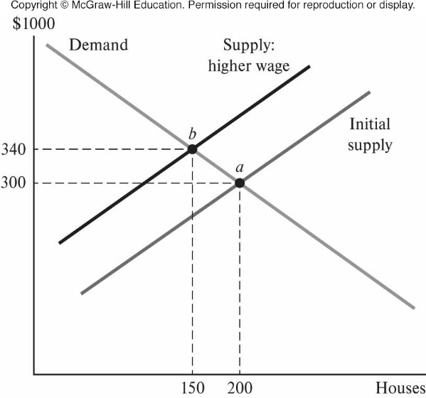
Comparative Statics: Change in Supply
.
Notes:
Presenter Note: This figure illustrates the comparative statics of a change in supply. On the x-axis, is the equilibrium price of new houses (an equilibrium variable) and on the y-axis, is the carpenter wage (a parameter). With the help of this line graph, we can predict the effect of an increase in the carpenter wage on the equilibrium price of new houses. This figure shows that an increase in the carpenter wage increases the marginal cost of production and the increase in the marginal cost of production shifts the market supply curve upward. Thus, an increase in the carpenter wage increases the equilibrium price of houses and decreases the equilibrium quantity of houses.
1. Initial equilibrium: point a. The wage is relatively low, generating an equilibrium house price of $300,000.
2. New equilibrium: point b. An increase in the carpenter wage increases the cost of producing houses, shifting the supply curve upward. The equilibrium price of houses increases to $340,000 and the equilibrium quantity decreases from 200 to 150.
This comparative-statics exercise demonstrates the positive relationship between the carpenter wage (a parameter) and the price of houses (an equilibrium variable).

Slide 24
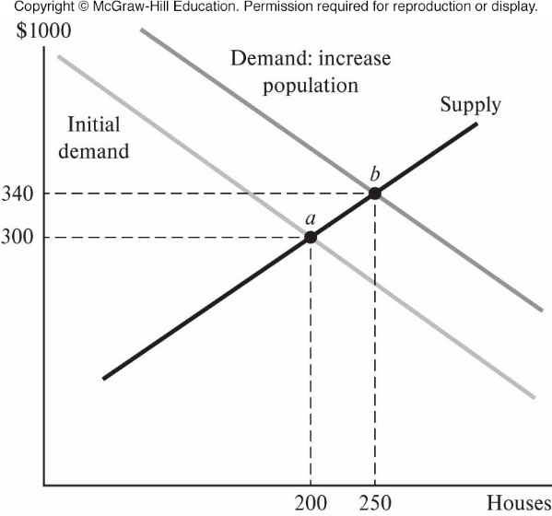
Comparative Statics: Change in Demand
.
Notes:
Presenter Note: This figure illustrates the effect of a change in the value of a demand-side parameter on the market equilibrium. On the x-axis, is the equilibrium price of new houses (an equilibrium variable) and on the y-axis, is the carpenter wage (a parameter). This figure shows the effects of an increase in a city’s population. Increase in population increases housing demand, shifting market demand curve to right.
Initial equilibrium: Point a. The equilibrium price of $300,000 and the equilibrium quantity is 200 houses.
New equilibrium: Point b. An increase in the city’s population increases the demand for new housing, shifting the demand curve to the right. The equilibrium price increases to $340,000 and the equilibrium quantity increases to 250 houses.
This comparative-statics exercise demonstrates the positive relationship between city population (a parameter) and the price of housing (an equilibrium variable).

Slide 25
Comparative Statics: Equilibrium Variable
The urban economy provides many opportunities to do comparative statics for market equilibria.
Other urban comparative-statics exercises include:
labor demand and wage
land policy and price of land
congestion tax and traffic volume
Notes:
Presenter Note: The urban economy provides many opportunities to do comparative statics for market equilibria. In the urban labor market, we can predict the effects of a change in labor demand on the equilibrium wage and equilibrium employment. In the urban land market, we can predict the effects of changes in public policy on land prices and land-use patterns. In the urban transportation sector, we can predict the effects of a congestion tax on the equilibrium number of drivers and transit riders. For any market equilibrium, we can use comparative statics to predict the effect of a change in the value of a parameter on the market equilibrium.

Slide 26
5. Pareto Efficiency
Pareto efficiency is an economic state where resources are allocated in the most efficient manner. It is obtained when a distribution strategy exists where one party’s situation cannot be improved without making another party's situation worse.
Pareto improvement entails a reallocation of resources that makes at least one person better off without making anyone worse off.
An allocation is Pareto inefficient if there is a Pareto improvement.
An allocation is Pareto efficient there is no Pareto improvement.
Notes:
Presenter Note: The notion of economic efficiency is embodied in the concept of Pareto efficiency, named after Italian economist Vilfredo Pareto. Pareto efficiency is an economic state where resources are allocated in the most efficient manner. It is obtained when a distribution strategy exists where one party’s situation cannot be improved without making another party’s situation worse.

Slide 27
Pareto Efficiency: Island Economy
.
Notes:
Presenter Note: In this example, an island economy has 12 coconuts to divide between two people, Abe and Bea. Every allocation of the coconuts between the two people is Pareto efficient because any reallocation of coconuts makes one person better off at the expense of the other. Starting at point b, we can make Abe better off by giving him his first coconut, but only by taking a coconut from Bea and making her worse off. Similarly, starting at point c, Abe could go from 3 to 4 coconuts, but only if Bea goes from 9 to 8 coconuts. Each allocation is Pareto efficient because any change harms someone. This simple example highlights the distinction between economic efficiency and equity or fairness. A 50-50 split of the coconuts may be appealing for reasons of equity or fairness, but an equal division is one of many efficient allocations. In a real economy, there are many efficient allocations of resources and goods across consumers, and reasonable people can disagree about which efficient allocation is the most equitable.

Slide 28
Pareto Efficiency: Island Economy
In this example, an island economy has 12 coconuts to divide between two people, Abe and Bea. Every allocation of the coconuts between the two people is Pareto efficient because any reallocation of coconuts makes one person better off at the expense of the other. Starting at point b, we can make Abe better off by giving him his first coconut, but only by taking a coconut from Bea and making her worse off. Similarly, starting at point c, Abe could go from 3 to 4 coconuts, but only if Bea goes from 9 to 8 coconuts. Each allocation is Pareto efficient because any change harms someone. This simple example highlights the distinction between economic efficiency and equity or fairness. A 50-50 split of the coconuts may be appealing for reasons of equity or fairness, but an equal division is one of many efficient allocations. In a real economy, there are many efficient allocations of resources and goods across consumers, and reasonable people can disagree about which efficient allocation is the most equitable.
.
Notes:
Presenter Note: In this example, an island economy has 12 coconuts to divide between two people, Abe and Bea. Every allocation of the coconuts between the two people is Pareto efficient because any reallocation of coconuts makes one person better off at the expense of the other. Starting at point b, we can make Abe better off by giving him his first coconut, but only by taking a coconut from Bea and making her worse off. Similarly, starting at point c, Abe could go from 3 to 4 coconuts, but only if Bea goes from 9 to 8 coconuts. Each allocation is Pareto efficient because any change harms someone. This simple example highlights the distinction between economic efficiency and equity or fairness. A 50-50 split of the coconuts may be appealing for reasons of equity or fairness, but an equal division is one of many efficient allocations. In a real economy, there are many efficient allocations of resources and goods across consumers, and reasonable people can disagree about which efficient allocation is the most equitable.

Slide 29
Market Equilibrium and Pareto Efficiency
Market equilibrium is Pareto efficient when four conditions are satisfied:
Firms do not control prices but instead take the market price as given.
All the costs of production are incurred by firms.
No external party benefits in consumption and production
There is perfect information for consumers and producers.
Consumers are informed about product characteristics.
Producers are informed about cost of serving customers.

Slide 30
Pareto Inefficiency in the Urban Economy
In an urban economy, the second efficiency condition—no external cost—is sometimes violated, generating Pareto inefficient allocations.
In the example of air pollution caused by one ton of sulphur dioxide:
Health costs of $500 could be avoided at an abatement cost of $100.
Pareto improvement could be achieved by splitting the difference to make both parties better off by $200.

Slide 31
Pareto Inefficiency in the Urban Economy (cont.)
In an urban economy, the second efficiency condition—no external cost—is sometimes violated, generating Pareto inefficient allocations.
In the example of congestion caused by a marginal driver slowing traffic on the high way:
External cost: congestion from marginal driver’s use of road
Each of 100 drivers bears additional time cost of $0.07
Value of trip = $2
Drivers pay $3 ($0.03) to keep marginal driver off road
External benefit: public goods and firm clustering

Slide 32
6. Self-Reinforcing Changes
The typical market analysis in microeconomics involves markets subject to self-limiting changes in market conditions.
Case of self-limiting changes leading to non-extreme outcomes include:
increase in demand causes excess demand, increasing price
increase in price decreases excess demand as quantity demanded increases and quantity supplied increases
new equilibrium—quantity between initial and new (before ∆p)
Notes:
Presenter Note: The typical market analysis in microeconomics involves markets subject to self-limiting changes in market conditions. For example, an increase in the demand for a product initially causes excess demand for the product. The resulting increase in price eliminates excess demand by increasing the quantity supplied and decreasing the quantity demanded. This is a self-limiting change because a change in one direction (excess demand) triggers changes in the opposite direction: the price continues to increase until excess demand is eliminated. Similarly, an increase in supply causes excess supply, and the price continues to decrease until excess supply is eliminated.

Slide 33
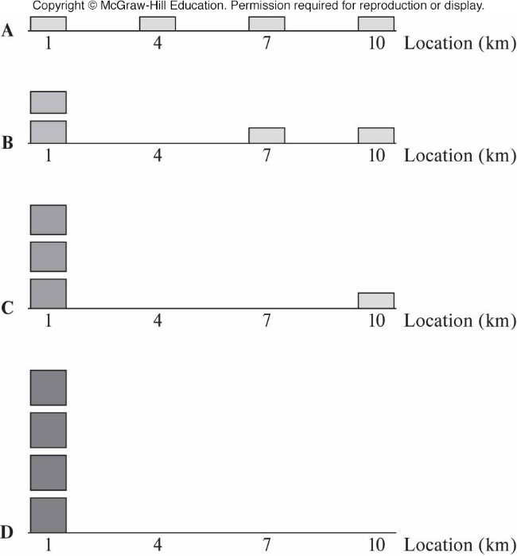
Self-Reinforcing Changes: Auto Row
.
Notes:
Presenter Note: This figure illustrates the effects of self-reinforcing changes by considering the location of automobile sellers. Suppose four sellers are initially distributed uniformly throughout a city and earn the same profit.
Panel A: We see small profit rectangles. If one seller moves to a location next to another seller, what happens next?
Panel B: Auto consumers compare brands before buying. The two-firm cluster will facilitate comparison shopping, so the number of car shoppers at location 1 will more than double. The profit per firm increases, as indicated by the larger profit rectangles for firms in the cluster.
Panel C: The higher profit in the cluster attracts a third firm, causing a disproportionate increase in the number of shoppers, a result of enhanced comparison shopping. The cluster profit increases, increasing the profit gap between a firm in the cluster and the isolated firm at location 10.
Panel D: The fourth firm joins other firms in the cluster, causing a disproportionate increase in the number of shoppers and an increase in profit per firm.

Slide 34
Self-Reinforcing Changes: Auto Row
The previous slide illustrates the effects of self-reinforcing changes by considering the location of automobile sellers. Suppose four sellers are initially distributed uniformly throughout a city and earn the same profit.
Panel A: We see small profit rectangles. If one seller moves to a location next to another seller, what happens next?
Panel B: Auto consumers compare brands before buying. The two-firm cluster will facilitate comparison shopping, so the number of car shoppers at location 1 will more than double. The profit per firm increases, as indicated by the larger profit rectangles for firms in the cluster.
Panel C: The higher profit in the cluster attracts a third firm, causing a disproportionate increase in the number of shoppers, a result of enhanced comparison shopping. The cluster profit increases, increasing the profit gap between a firm in the cluster and the isolated firm at location 10.
Panel D: The fourth firm joins other firms in the cluster, causing a disproportionate increase in the number of shoppers and an increase in profit per firm.
.
Notes:
Presenter Note: This figure illustrates the effects of self-reinforcing changes by considering the location of automobile sellers. Suppose four sellers are initially distributed uniformly throughout a city and earn the same profit.
Panel A: We see small profit rectangles. If one seller moves to a location next to another seller, what happens next?
Panel B: Auto consumers compare brands before buying. The two-firm cluster will facilitate comparison shopping, so the number of car shoppers at location 1 will more than double. The profit per firm increases, as indicated by the larger profit rectangles for firms in the cluster.
Panel C: The higher profit in the cluster attracts a third firm, causing a disproportionate increase in the number of shoppers, a result of enhanced comparison shopping. The cluster profit increases, increasing the profit gap between a firm in the cluster and the isolated firm at location 10.
Panel D: The fourth firm joins other firms in the cluster, causing a disproportionate increase in the number of shoppers and an increase in profit per firm.

Slide 35
Self-Reinforcing Changes: Other Examples
Other examples of self-reinforcing effects in urban area include
clustering of artists to promote exposure and decrease costs
clustering of consumers to consume products with low per-capita demand
clustering of like-minded people (residential segregation)
Notes:
Presenter Note: Self-reinforcing changes also occur in the location decisions of people. The cluster of artists in one city may attract other artists from the region, causing a concentration of artistic production in one city. Self-reinforcing effects in production generate large clusters of employment in cities. In addition, self-reinforcing effects in consumption generate large clusters of consumer activities in large cities. In the residential environment, self-reinforcing effects generate substantial segregation with respect to income, education, and race.

