Slide 1
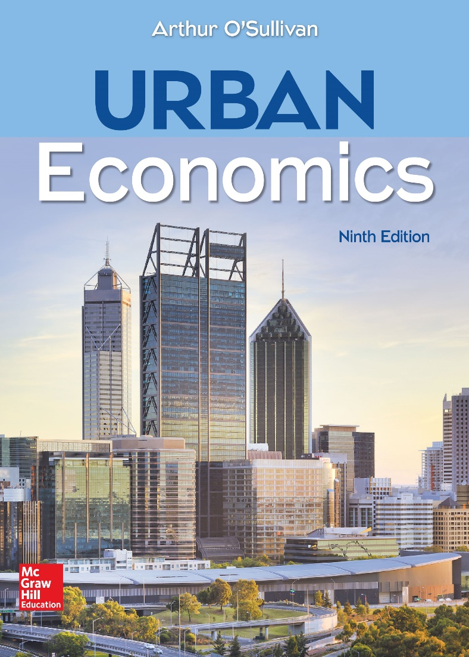
CHAPTER 3
Trading and Factory Towns

Slide 2
A Model of Backyard Production
Three assumptions underlie the backyard-production model
Equal productivity of labor and land
Constant returns to scale in exchange
Constant returns to scale in production
Together, these assumptions eliminate the possibility of exchange and guarantee that each household will be self-sufficient.
The backyard-production model lists assumptions under which cities don’t develop. Dropping the assumptions results in a changing model.
Notes:
Presenter Note: In an economy that experiences comparative advantage in production and scale economies in exchange, a trading town will develop around a trading firm. In an economy with scale economies in production, a factory town will develop around a factory. We start with the model of backyard production, which predicts that all production happens in backyards rather than in shops and factories.

Slide 3
Comparative Advantage and Trade: Production and Opportunity Cost
Discuss the implications of dropping the assumption of equal productivity using the information in the table.
Notes:
Alt-Text: The table has three columns and four rows. The first column lists the following parameters: shoes produced per hour, milk produced per hour in gallons, opportunity cost in the context of shoes, and opportunity cost in the context of milk. The second and third columns indicate the numbers for each parameter for two fictional islands, Stitch and Squeeze. The first two rows show that Stitch produces 12 shoes and 2 gallons of milk per hour and that Squeeze produces 1 shoe and 1 gallon of milk per hour. The third row shows that the opportunity cost for shoe production is 1 gallon of milk per shoe in Squeeze, compared to 1/6 gallon in Stitch. The fourth row shows that the opportunity cost for milk is 1 shoe in Squeeze, compared to 6 shoes in Stitch.
Presenter Note: The first two rows of the table show output per hour: Stitch workers are twice as productive in milk and 12 times as productive in shoes. For shoe production, the opportunity cost is 1 gallon of milk per shoe in Squeeze, compared to 1/6 of a gallon in Stitch. In the time required for a Stitch worker to produce one shoe, he or she could have instead produced 1/6 gallon of milk. Stitch has a lower opportunity cost for shoes, so Stitch has a comparative advantage in shoes. For milk, the opportunity cost is 1 shoe in Squeeze, compared to 6 shoes in Stitch. Therefore, Squeeze has a comparative advantage in producing milk.

Slide 4
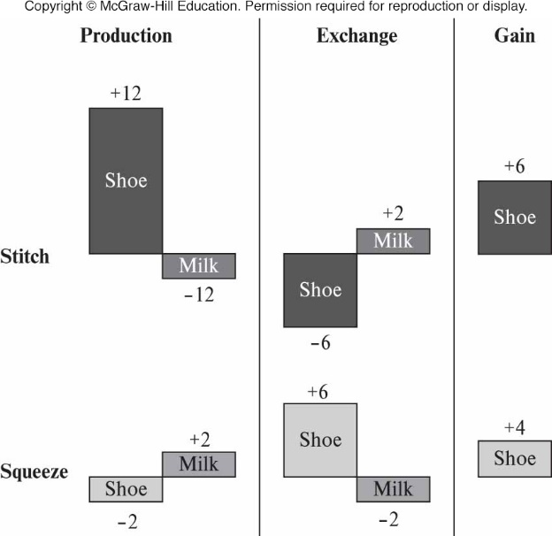
Comparative Advantage and Trade: Gains from Specialization
Discuss the implications of dropping the assumption of equal productivity using this figure.
Notes:
Alt-Text: The illustration shows that in Stitch, change in production of shoe is positive 12 and milk is negative 12, exchange rate of shoe is negative 6 and milk is positive 2, and gain of shoe is positive 6. In Squeeze, change in production of shoe is negative 2 and milk is positive 2, exchange rate of shoe is positive 6 and milk is negative 2, and gain of shoe is positive 4.
Presenter Note:
The figure shows the gains from specialization and trade. Suppose the two islands are initially self-sufficient, with each household producing all the milk and shoes it consumes.
• Production. A Stitch household switches one hour from milk to shoe production, while a Squeeze household switches two hours from shoe to milk production . The changes in production for Stitch are +12 shoes and −2 gallons of milk and −2 shoes and +2 gallons of milk for Squeeze. The switch to exploit comparative advantages increases the total quantity of shoes by 10 (+12 in Stitch −2 in Squeeze) while the total quantity of milk is unchanged.
• Exchange. Suppose the exchange rate is 3 shoes per gallon of milk. The Stitch household trades 6 shoes for 2 gallons of milk, generating a gain of +6 shoes. The Squeeze household trades 2 gallons of milk for 6 shoes, for a gain of 4 shoes.
• Net gains. Each household has just as much milk and more shoes. So far we have ignored transaction cost, defined as the opportunity cost of the time required to exchange products. For Stitch, the opportunity cost per hour is 12 shoes, so the transaction is beneficial as long as it requires less than 1/2 hour (6 shoes). For Squeeze, the opportunity cost is 1 shoe per hour, so the transaction is beneficial as long as it takes fewer than 4 hours. For example, if the exchange time is 1/4 hour, the net gain is 3 shoes for Stitch (6 − 3) and 3.75 shoes for Squeeze (4 − 0.25). In general, trade will occur if the differences in productivity that generate comparative advantage are large relative to transaction cost.
So far we have ignored transaction cost, defined as the opportunity cost of the time required to exchange products. For Stitch, the opportunity cost per hour is 12 shoes, so the transaction is beneficial as long as it requires less than 1/2 hour (6 shoes). For Squeeze, the opportunity cost is 1 shoe per hour, so the transaction is beneficial as long as it takes fewer than 4 hours. For example, if the exchange time is 1/4 hour, the net gain is 3 shoes for Stitch (6 − 3) and 3.75 shoes for Squeeze (4 − 0.25). In general, trade will occur if the differences in productivity that generate comparative advantage are large relative to transaction cost.

Slide 5
Scale Economies in Exchange, Trading Firms, and Trading Towns (1 of 3)
Discuss the implications of dropping the assumption of constant returns to scale in exchange using these points.
Under this assumption, an individual household can exchange shoes and milk just as efficiently as a trading firm, without the need to pay a firm to execute a transaction.
For example, each Stitch household can link up with a Squeeze household to exchange shoes and milk directly.

Slide 6
Scale Economies in Exchange, Trading Firms, and Trading Towns (2 of 3)
A trading firm will emerge if economies of scale are associated with exchange. Scale economies could result from two economic phenomena.
Indivisible inputs
Labor specialization
Notes:
Presenter Note:
Indivisible inputs. A trading firm uses indivisible inputs such as a large wagon to collect and distribute output, and a ship to transport output between the two islands.
Labor specialization. A trading firm that employs many workers can assign each worker a specialized task. Specialization increases productivity through continuity (each worker spends less time switching from one task to another) and repetition (each worker learns the most efficient way to accomplish a specific task). For example, some workers could specialize in driving wagons, while others could specialize in sailing ships.

Slide 7
Scale Economies in Exchange, Trading Firms, and Trading Towns (3 of 3)
The economies of scale from indivisible inputs and labor specialization decrease transaction cost, meaning that a trading firm will be more efficient than an individual in executing trades.
In the context of economies of scale, discuss:
how a trading firm allows further specialization among workers
why a trading firm will locate at a place that can efficiently collect and distribute large volumes of output
why a city has a high population density

Slide 8
Trading Cities in Urban History
Trading cities develop when comparative advantage is combined with scale economies in transport and exchange.
Most of the workers in trading cities didn’t produce goods, but instead collected and distributed goods produced elsewhere.
Discuss how comparative advantage played a role in U.S. urban history, using Eli Whitney’s cotton gin as an example.

Slide 9
Scale Economies and a Factory Town (1 of 2)
Production is subject to constant returns to scale.
The price of factory shoes
The market for shoes is competitive, so the price must be just high enough to cover the average cost of producing shoes
Using the above assumption, discuss how production is subject to constant returns to scale in shoe production.
Notes:
Presenter Note: The third assumption of the backyard-production model is that production is subject to constant returns to scale. We will maintain this assumption for milk production, but assume that shoes are produced with increasing returns to scale. Shoe producers use indivisible inputs and specialized labor, and as a result, a factory worker produces more shoes than a home worker. To continue our example, suppose that a factory worker produces 10 shoes per hour, meaning that each shoe requires just 6 minutes of labor and capital. In contrast, home workers produce 1 shoe or 1 gallon of milk per hour.

Slide 10
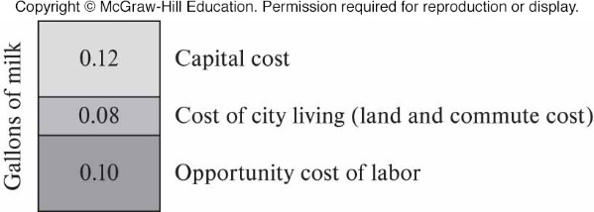
Scale Economies and a Factory Town: Average Production Cost
Notes:
Alt-Text: A vertical panel, divided into three blocks, shows the average production cost of milk, with gallons of milk on the left side. The first or upper block represents capital cost and contains the numerical value 0.12. The second block or middle represents cost of city living (land and commute cost) and contains the numerical value 0.08. The third or lower block represents opportunity cost of labor and contains the numerical value 0.10.
Presenter Note:
The figure summarizes the computation of the average cost of production. The average cost is the sum of the average labor cost and the average capital cost:
Average cost = 0.18 + 0.12 = 0.30 gallons
In a competitive market, a firm will charge a price equal to the average production cost.
Factory price = Average cost = 0.18 + 0.12 = 0.30 gallons
With a factory price of 0.30 gallons of milk per shoe, the factory gets just enough to pay the cost of the labor and capital required to produce shoes.

Slide 11
Scale Economies and a Factory Town (2 of 2)
The market area of a factory
A single shoe factory in a region competes with homemade shoes and will sell shoes to any household, for which the net price of factory shoes is less than the cost of homemade shoes.
Discuss how production is subject to constant returns to scale with reference to a single shoe factory in a region.

Slide 12
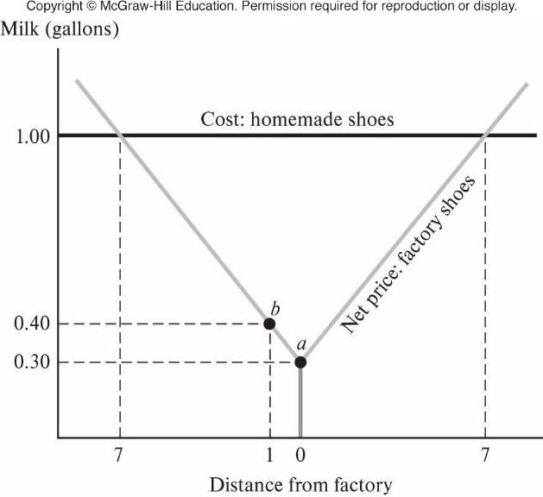
Scale Economies and a Factory Town: Net Price and Market Area of Factory
Notes:
Alt-Text: On a line graph, horizontal axis shows distance from factory, listing 7, 1, 0, and 7 from left to right. Vertical axis shows gallons of milk, listing 0.30, 0.40, and 1.00. The equation of the line for cost of homemade shoes is y = 1.00. The line for net price of factory shoes falls through (7, 1.00), b (1, 0.40), and A (0, 0.30) and rises through (7, 1.00).
Presenter Note:
Suppose there is a single shoe factory in the region. The factory competes with homemade shoes and will sell shoes to any household for which the net price of factory shoes is less than the cost of homemade shoes. The cost of a homemade shoe is the opportunity cost of the time required to make the shoe at home, that is, the one gallon of milk that could be produced instead.
In the figure, the horizontal line shows the cost of homemade shoes. The net price of factory shoes is the sum of the factory price and the household’s opportunity cost of travel to the factory to buy the shoes. The net price is
p(x) = p′ + t · x
where p(x) is the net price, p′ is the factory price (equal to the average production cost), t is the opportunity cost per round-trip mile of travel, and x is the distance from the household to the factory. A round-trip mile involves one mile of travel to a location and one mile back, for a total distance of two miles. Suppose the typical person takes 1/10 of an hour per round-trip mile. In Figure 3–3, the factory price, shown by point a, is 0.30 gallons of milk. The net price curve has a slope of 0.10 per mile. For example, as shown by point b, the net price is 0.40 for a distance x = 1 mile:
p(1) = 0.30 + 0.10 = 0.40
The net price increases to 1.00 at a distance of 7 miles:
p(7) = 0.30 + 0.10 · 7= 1.0
The market area of the factory is the area over which it underprices the home production of shoes. In the figure, the net price of factory shoes is less than the cost of homemade shoes for up to 7 miles from the factory. In other words, the radius of the factory’s market area is 7 miles. Within this area, workers who do not work in the factory will specialize in milk production and use some of the milk they produce to purchase factory shoes. In contrast, factory workers will produce shoes in exchange for milk. Households who live further than 7 miles from the factory will be self-sufficient, producing their own milk and shoes.

Slide 13
Factory Towns (1 of 2)
A factory city develops because scale economies make factory shoes cheaper than homemade shoes. The Industrial Revolution of the 19th century produced innovations in manufacturing and transportation that shifted production from the home to large factories in industrial cities.
A factory town will develop around the shoe factory.
Workers will economize on travel costs by living close to the factory, and competition for land will bid up its price.
The higher price of land will cause workers to economize on land, leading to a higher population density.

Slide 14
Factory Towns (2 of 2)
The replacement of handcraft production with standardized production generated large-scale economies, causing the development of factories and factory cities.
Innovations in intercity transportation contributed to industrialization and urbanization.
Innovations decreased the relative price of factory goods, contributing to the growth of factory cities.

Slide 15
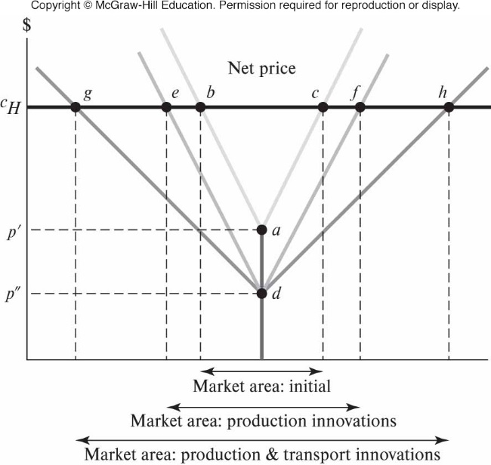
Factory Towns: Industrial Revolution and Market Area
Discuss the effects of the transportation and production innovations of the Industrial Revolution on the market area of a factory.
Notes:
Alt-Text: On a line graph, horizontal axis shows three market areas sharing a common center, such that the left and right ends of the areas are equidistant from the center. Vertical axis shows cost, listing p double prime, p prime, and c subscript H. The market areas in the increasing order of their size under c subscript H are as follows: initial conditions, between points b and c, product innovations, between points e and f, and production and transport innovations, between points g and h. Points a and d are at the midpoint of the market areas, at costs p prime and p double prime respectively. The net price curve for initial conditions falls from b to a and rises to c. The net price curve for production innovation falls from e to d and rises to f. The net price curve for production and transportation innovations falls from g to d and rises to h.
Presenter Note:
The figure illustrates the effects of the transportation and production innovations of the Industrial Revolution on the market area of a factory.
• Initial conditions. The factory price p prime is relatively high because of relatively small economies of scale, and the net-price curve is relatively steep because of relatively high transport cost. The market area (defined by points b and c) is relatively small.
• Innovations in production decrease the factory price from p prime to p double prime and increase the market area, as indicated by points e and f.
• Innovations in transportation flatten the net price curve. The market area increases in size, as indicated by points g and h.

