Slide 1
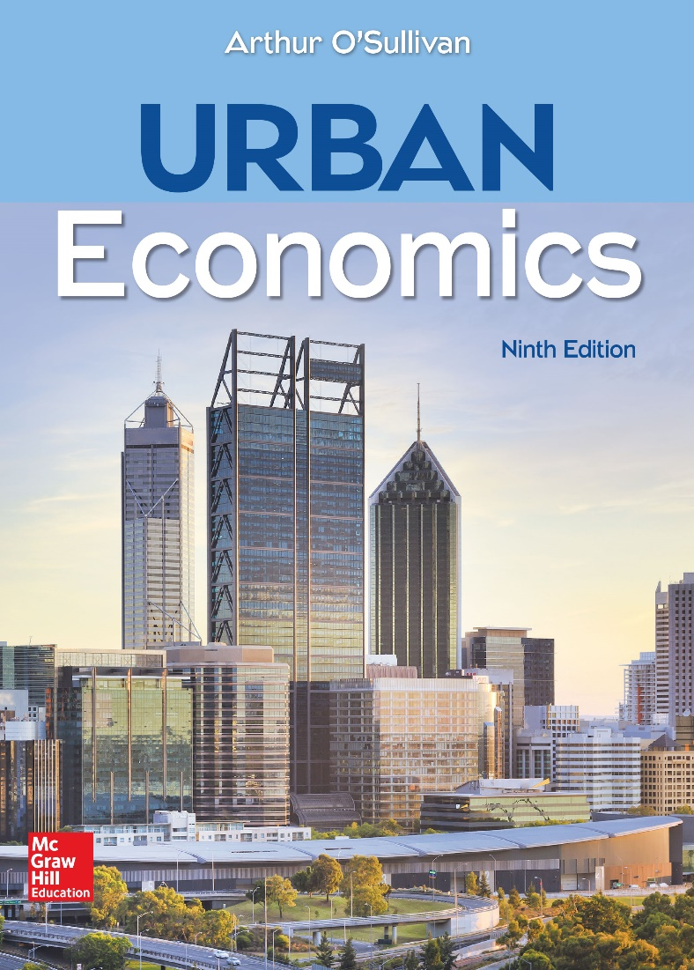
CHAPTER 5
Where Do Cities Develop?

Slide 2
Transport-Intensive Firms
A transport-intensive firm is defined as a firm for which transport costs are responsible for a relatively large fraction of total cost.
For a transport-intensive firm, the dominant location factor is the cost of transporting inputs and outputs.
The firm’s objective is to choose the location that minimizes total transport costs and output transport cost.
Notes:
Presenter Note:
The location decisions of profit-maximizing firms cause the development of cities in different locations. A firm’s location decision is the outcome of a multidimensional tug-of-war. This chapter explores the economic forces pulling a firm in different directions, including low transport costs, productive workers, other firms that generate external economies in production, and low energy costs. The analysis provides important insights into the where of urban development.

Slide 3
Transport-Intensive Firms: Assumptions
The classic model of a transport-intensive firm has four assumptions that make transportation cost the dominant location factor:
Single transportable output
Single transportable input
Fixed-factor proportions
Fixed prices
Using these assumptions, discuss how a firm maximizes its profit by minimizing its transportation costs.
Notes:
Presenter Note:
1. Single transportable output. The firm produces a fixed quantity of a single product, which is transported from the production facility to an output market.
2. Single transportable input. The firm may use several inputs, but only one input is transported from an input source to the firm’s production facility. All other inputs are ubiquitous, meaning that they are available at all locations at the same price.
3. Fixed-factor proportions. The firm produces its fixed quantity with fixed amounts of each input. In other words, the firm uses a single recipe to produce its good, regardless of the prices of its inputs. There is no factor substitution.
4. Fixed prices. The firm is so small that it has no effect on the prices of its inputs or its product.

Slide 4
Resource-Oriented Firms: Monetary Weights for a Resource-Oriented Firm
A resource-oriented firm is a firm that has a relatively high cost of transporting its input.
Using the example of a firm that produces baseball bats, discuss the functioning of a resource-oriented firm.
Notes:
Alt-Text: A table lists monetary weight of the material (wood) and output (bats). Data from the table, presented in the format, transport feature: material (wood), output (bats), are as follows. Row 1. Physical weight (tons): 5, 1. Row 2. Transport cost rate (in dollars per ton per mile): $1, $2. Row 3. Monetary weight = weight times rate: $5, $2.
Presenter Note: The firm uses 5 tons of wood to produce 1 ton of bats, so the firm is involved in a weight-losing activity. Its output is lighter than its materials because the firm shaves logs to make bats. The outcome of the locational tug-of-war is determined by the monetary weights of the firm’s inputs and outputs. The monetary weight of the input equals the physical weight of the input (5 tons) times the transport cost rate ($1 per ton per mile), or $5 per mile. Similarly, the monetary weight of the output is 1 ton times $2, or $2 per mile.
This firm is resource-oriented because the monetary weight of its transportable input exceeds the monetary weight of its output. Although the unit cost of transporting output is higher (because finished bats must be packed carefully, but logs can be tossed onto a truck), the weight loss in the production process dominates the difference in the transport rate, so the monetary weight for the output is lower.

Slide 5
Resource-Oriented Firms: A Resource-Oriented Firm at the Input Source
Notes:
Alt-Text: A line graph plots input, output, and total transport costs of a resource-oriented firm at the input source. Horizontal axis shows x, ranging from 0 to 10. X = Distance to output market. 10 minus x = distance to input source. Vertical axis shows cost in dollars, listing, 0, 20, and 50. The line for input transport cost goes down from m (0, 50) to (10, 0). The line for output transport cost goes up from (0, 0) to i (10, 20). The line for total transport cost goes down from m (0, 50) to i (10, 20).
Presenter Note: The graph shows the firm’s transport costs. The variable x measures the distance from the factory to the output market in a city. If the forest is 10 kilometers from the output market, the distance from the factory to the forest is 10 minus x. The input transport cost equals the monetary weight of the input (the physical weight wi times the transport cost rate ti) times the distance between forest and factory:
Input transport cost = wi · ti · (10 − x)
In the graph, the input transport cost is $50 in the city and decreases at a rate of $5 per km (the monetary weight of the input) to zero at the forest. The firm’s output transport costs are computed in an analogous way. The output transport cost equals the monetary weight of the output (weight wQ times unit transport cost rate tQ) times the distance from the factory to the market:
Output transport cost = wQ · tQ · x
In the graph, output transport cost is $0 at the market and increases at a rate of $2 per km (the monetary weight of the output). At the forest, the output transport cost is $20. Total transport cost is the sum of input and output transport costs. In the graph, total transport cost is minimized at the forest site at $20. Starting at any location except the forest, a 1-kilometer move toward the forest would decrease input transport cost by $5 (the monetary weight of the input) and increase output transport cost by $2 (the monetary weight of the output), for a net reduction of $3. The firm’s total transport cost is minimized at the input source because the monetary weight of the input exceeds the monetary weight of the output.

Slide 6
Market-Oriented Firms: Monetary Weights for a Market-Oriented Firm
A market-oriented firm is a firm that has relatively high costs for transporting its output to the market.
Using the example of a bottling firm, discuss the functioning of a market-oriented firm.
Notes:
Alt-Text: A table lists monetary weight of the material (sugar) and output (beverages). Data from the table, presented in the format, transport feature: material (sugar), output (beverages), are as follows. Row 1. Physical weight (tons): 1, 5. Row 2. Transport cost rate (in dollars per ton per mile): $2, $2. Row 3. Monetary weight = weight times rate: $2, $10.
Presenter Note: The firm uses one ton of sugar and four tons of water (a ubiquitous input) to produce five tons of bottled beverages. It is involved in a weight-gaining activity in the sense that its output is heavier than its transportable input. The monetary weight of the output exceeds the monetary weight of the input, so the market-oriented firm will locate near its market.

Slide 7
Market-Oriented Firms: A Market-Oriented Firm at the Market
Notes:
Alt-Text: A line graph plots input, output, and total transport costs of a market-oriented firm at the market. Horizontal axis shows x, ranging from 0 to 10. X = Distance to output market. 10 minus x = distance to input source. Vertical axis shows cost in dollars, listing, 0, 20, and 100. The line for input transport cost goes down from m (0, 20) to (10, 0). The line for output transport cost goes up from (0, 0) to i (10, 100). The line for total transport cost goes down from m (0, 20) to i (10, 100).
Presenter Note: As shown in the graph, a market-oriented firm’s transport cost is minimized at the market. Because the monetary weight of the output exceeds the monetary weight of the input, a one-mile move away from the market increases output transport cost by more than it decreases input transport cost. Specifically, such a move increases output transport cost by $10 but decreases input transport cost by only $2, for a net increase in cost of $8. For this weight-gaining activity, the tug-of-war between input source and market is won by the market because there is more physical weight on the market side.

Slide 8
The Principle of Median Location
According to the principle of median location, firms that have multiple inputs or markets will have a median location that minimizes total travel distance.
The principle of median location can be used to predict where a firm will locate in complex cases involving multiple inputs or markets.
The median location splits the number of destinations into two equal halves, with half of the destinations in one direction and half in the other direction.

Slide 9
The Principle of Median Location: Intercity Location Choice
Fixit repairs machinery in factories that are located in five cities strung along a highway.
Under the following assumptions, Fixit’s objective is to minimize the total travel distance.
All inputs (tools and parts) are ubiquitous (available at all locations for the same price), so the cost of transporting inputs is zero.
The price of repair service is fixed, and Fixit visits each factory once per week.
Each repair trip to a factory requires a separate trip.

Slide 10
The Principle of Median Location: Intercity Location Choice (cont.)
Using the example of Fixit’s objective to minimize total travel distance, discuss the principle of median location.
Notes:
Alt-Text: A bar graph plots the number of factories in five cities along a highway. There are 2 factories in city A, 4 in city B, 1 each in cities M and C, and 9 in city D. The first four cities are equidistant from each other, while the city D is at a large distance from city C.
Presenter Note: There are two factories in city A, eight factories in city B, one factory in city M, one factory in city C, and nine factories in city D. Cities A, B, M, and C are 20 miles apart, and city D is 100 miles from city C. Fixit will minimize the total travel distance by locating in city M, the median location. City M is the median because there are 10 customers to the west (in cities A and B) and 10 customers to the east (in cities C and D). To show the superiority of the median location, suppose Fixit starts in city M, and then moves 20 miles east to city C. The move reduces the travel distance to factories to the east (in cities C and D) by 200 miles (10 factories times 20 miles) but increases the travel distance to factories to the west (in cities A, B, and M) by 220 miles (11 factories times 20 miles). The total travel distance increases because Fixit moves closer to 10 factories but farther from 11 factories. In general, any move away from the median location will increase travel distances for the majority of factories, so the total travel distance increases.

Slide 11
Median Location and Large Cities: Why Do Big Cities Get Bigger?
Notes:
Alt-Text: A bar graph plots the number of factories in five cities along a highway. There are 2 factories in city A, 8 in city B, 1 each in cities M and C, and 13 in city D. The first four cities are equidistant from each other, while the city D is at a large distance from city C.
Presenter Note: The principle of median location provides another explanation of why large cities become larger. In the graph, suppose the number of factories in city D increases to 13 from the 9 in the prior figure. Now city D is the median location, and Fixit will minimize total travel cost by locating there. If Fixit starts in M and then moves eastward toward D, travel cost increases for a minority of customers (11 factories in A, B, and M) and decreases for a majority (14 factories in C and D), so the total travel cost decreases. Moving eastward beyond C, the travel cost to western cities increases for 12 factories and decrease for 13 factories. Total travel cost is minimized in city D, the median location.
The lesson from this example is that the concentration of demand in large cities causes large cities to grow.

Slide 12
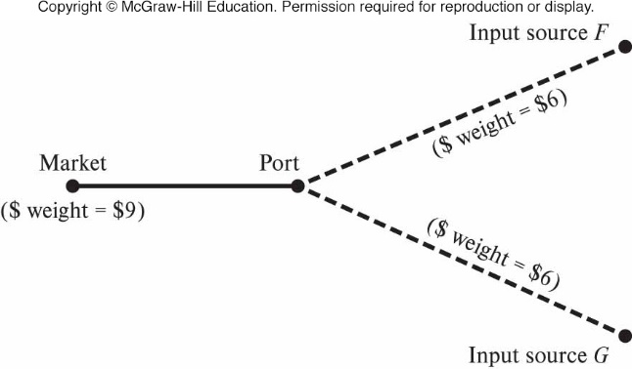
Transshipment Points and Port Cities: Port Location—Transshipment Point
A transshipment point is defined as a place where a good is transferred from one transport mode to another.
Using the example of the furniture factory, discuss why some industrial firms locate at transshipment points.
Notes:
Alt-Text: An illustration shows inputs from sources F and G shipped to the port. The monetary weight of each input is $6. The inputs are transported to market from the port. The monetary weight at the market is $9.
Presenter Note: A furniture factory gets wood from a forest at input source F and cloth from another firm at input source G. To simplify, assume that the monetary weights of the two inputs are equal. The firm processes the wood and cloth into furniture in its factory and sells its furniture in an overseas market at site M. Highways connect input sites F and G to the port, and ships travel from the port to the market at M. Furniture-making is a weight-losing activity: The monetary weights of the inputs ($12=$6+$6) exceeds the $9 monetary weight of the output. Where will the firm locate its factory? Although there is no true median location, the port is the closest to a median location. If the firm starts at the port, it could move either toward one of its input sources or to its market.
1. Toward an Input Source. A one-kilometer move from the port toward input source F will cause offsetting changes in input transport costs: the cost of transporting wood decreases, but the cost of transporting cloth increases. At the same time, the cost of transporting output would increase by $9. Therefore, the port site is superior to locations between the port and input source G. The same logic applies for a move from the port toward input source G. 2. Output Market. A move from the port to the output market M will decrease output transport cost by $9 (the monetary weight of output) times the distance between the market and the port, and increase input transport cost by $12 (the monetary weight of the inputs) times the distance. For this weight-losing activity, the port site is superior to the market site.

Slide 13
Labor, Energy, and Agglomeration Economies
In many historically resource-oriented or market-oriented industries, firms now locate far from their input sources and markets.
These changes in locational orientation resulted from innovations in transportation and production that decreased transport costs.
Transportation technology
Production technology
Notes:
Presenter Note:
1. Transportation technology. The development of fast ocean ships and container technology decreased shipping costs, while improvements in railroads and trucks lowered the cost of overland travel. Faster and more efficient aircraft decreased the cost of air travel.
2. Production technology. Improvements in production techniques decreased the physical weight of inputs. For example, the amount of coal and ore required to produce one ton of steel has decreased steadily, a result of improved production methods and the use of scrap metal (a local input) instead of iron ore (a transportable input).

Slide 14
Labor Cost
On average, labor is responsible for about three-fourths of the cost of production.
Labor is a local input in the sense that it is impractical for workers to commute outside of metropolitan areas.
The long-term trend of declining transportation costs has contributed to the shift in location patterns to areas with relatively low labor costs.
Discuss how
wages affect local decisions at the metropolitan level
weather affects location patterns through its influence on wages

Slide 15
Energy Technology
In the first half of the 19th century, energy was a local input, defined as an input that cannot be transported.
The refinement of the steam engine in the second half of the 19th century made energy a transportable input.
The development of electricity changed the location patterns of factories.
For some production facilities, the availability of cheap energy is still an important location factor.

Slide 16
Agglomeration Economies
Firms cluster to exploit agglomeration economies.
Although locating in a cluster may generate higher wages and other costs, the benefits from agglomeration more than offsets the higher costs.
Agglomeration economies increase firm births and total employment.

Slide 17
U.S. Manufacturing Belt: Growth and Decline
The U.S. manufacturing belt developed in the second half of the 19th century. It had a natural advantage in its access to relatively immobile resources, so manufacturing was concentrated there.
As late as 1947, the manufacturing belt contained 70 percent of the nation’s manufacturing employment. By the year 2000, the manufacturing belt contained only about 40 percent of the nation’s manufacturing employment.
Discuss the decline of the manufacturing belt in the United States.

