Slide 1
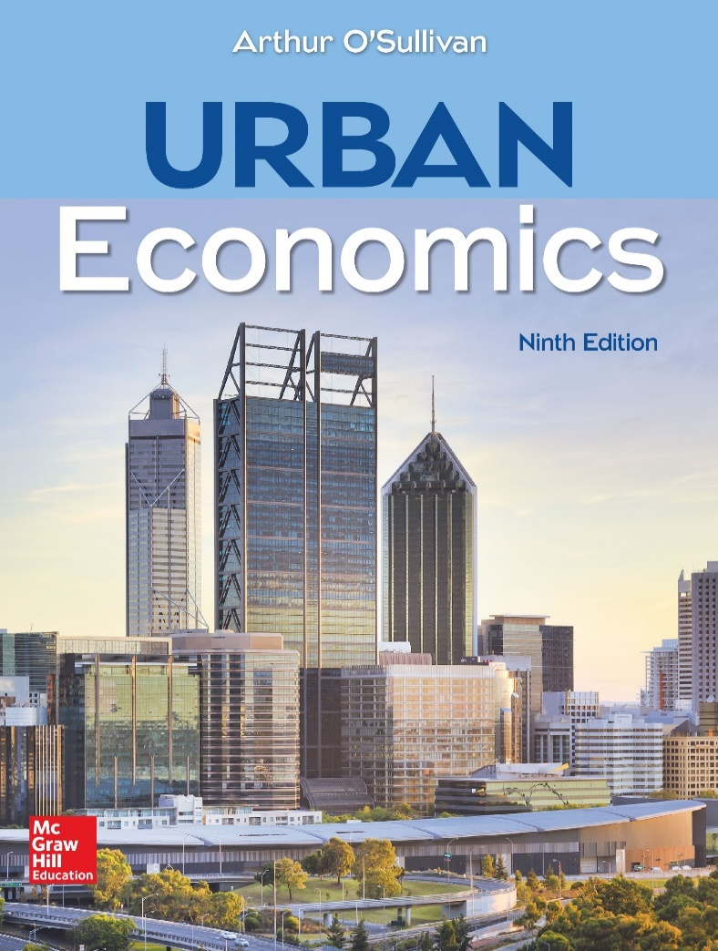
CHAPTER 10
Land Rent and Manufacturing Land

Slide 2
Introduction
This chapter explores the workings of urban land use and housing, with a focus on answering these questions:
What factors determine the price of land?
What is meant by spatial organization of the city?
What makes land the residual claimant?
How does the price of land reflect its fertility?
Notes:
Presenter Note: This chapter starts our exploration of the factors that determine the price of land. Competition for the fixed supply of land means that land is the residual claimant: land rent (the price of land) equals a firm’s total revenue minus the non-land cost of production. In more casual terms, the landowner gets what’s left over after a firm pays for all of its other inputs. The price of agricultural land reflects the land’s fertility, and the price of manufacturing land reflects its accessibility to customers and workers.

Slide 3
Fertility and the Leftover Principle
Competitive bidding among farmers for fertile land drives the land’s price up to the level at which the winning bidder makes zero economic profit. This is known as the leftover principle.
An increase in the fertility of land decreases production cost, so a farmer is willing to pay more to grow crops on the land.
The rent paid by the winning bidder equals total revenue minus non-land cost.
The landowner gets the money left over after the farmer pays for other inputs.
Notes:
Presenter Note: David Ricardo (1821) is credited with the idea that the price of agricultural land is determined by its fertility.

Slide 4
Land Rent, Market Value, and the Price of Land (1 of 3)
Land rent is an annual payment for the right to use a plot of land.
The market value of land is the purchase price for land ownership, that is, the amount of money paid to take ownership of the land.
Discuss some examples related to land rent and market value.

Slide 5
Land Rent, Market Value, and the Price of Land (2 of 3)
The market value of a plot of land is determined by the land rent it generates.
Land is an asset that yields a stream of income (land rent). The maximum amount an investor is willing to pay for the asset equals the present value of the stream of income.
The present value of an asset is the maximum amount an investor is willing to pay for the rights to the income stream of the asset.
Notes:
Alt-text: PV equals R divided by i
Presenter Note: The formula stands for “Present value equals the land rent R divided by the market interest rate I”. The present value incorporates the opportunity cost of investing in land rather than in a bank account.

Slide 6
Land Rent, Market Value, and the Price of Land (3 of 3)
The price of land can be defined as the annual payment in exchange for the right to use the land.
In this case, the price of land is synonymous with land rent. Most other relevant economic variables are defined as streams of revenue or costs.
The translation from land rent to market value can be made by dividing the annual rent by the market interest rate.
Alternatively, if the market value of land is known, the implied price (annual rent) is the market value times the interest rate.
Notes:
Presenter Note: The present value of an asset is the maximum amount an investor is willing to pay for the rights to the income stream of the asset. It incorporates the opportunity cost of investing in land rather than in a bank account.
Most relevant economic variables are defined as streams of revenue or costs. For example, a worker earns an hourly wage or monthly income, and a firm computes its annual profits as annual revenue minus annual cost. Given the simple relationship between rent and market value, it’s easy to make the translation from land rent to market value: just divide the annual rent by the market interest rate. Going the other way, if we know the market value of land, the implied price (annual rent) is the market value times the interest rate.

Slide 7
Willingness to Pay for Agricultural Land
The price of land is determined by the profit that can be earned on the land. For agricultural land, profitability is determined by the land’s fertility. The model of agricultural rent rests on five key assumptions.
Perfect competition in the output market
Common input prices
Land to highest bidder
Zero transport costs
National prices
How does land fertility help determine the willingness to pay for agricultural land?
Notes:
Presenter Note: The price of land is determined by the profit that can be earned on the land. To illustrate, we start with agricultural land, where profitability is determined by the fertility of land.
Consider a region where tenant farmers grow corn on land of varying fertility.
The model of agricultural rent has five key assumptions:
1. Perfect competition in the output market. Farmers are price takers, and economic profit is zero in the long run.
2. Common input prices. The prices of non-land inputs (materials, labor, capital) are the same throughout the region.
3. Land to highest bidder. Landowners rent land to the highest bidder.
4. Zero transport costs. Transport costs are zero.
5. National prices. All prices are determined in the national market and are unaffected by events in the region.

Slide 8
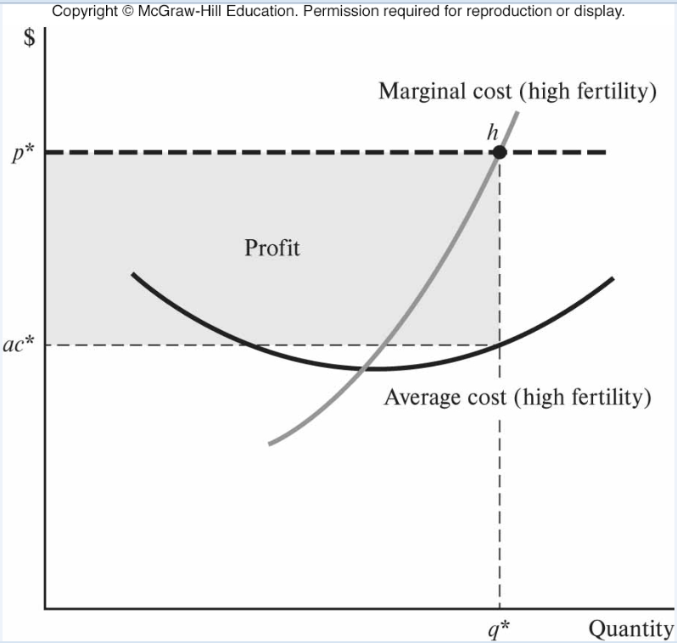
Willingness to Pay for Agricultural Land
Willingness to Pay for
Agricultural Land
Fertility and Willingness to Pay for Agricultural Land
Notes:
Alt-text: The first of two line graphs plots marginal cost and average cost (high fertility). The horizontal axis shows quantity listing q asterisk. The vertical axis shows cost in dollars, listing Ac asterisk and p asterisk. The rectangular region enclosed by the vertical axis, x equals q asterisk, y equals Ac asterisk, and y equals p asterisk is the profit. The marginal cost (high fertility) curve rises through the profit region through point h (q asterisk, p asterisk). The average cost (high fertility) curve falls through the profit region, intersects with the marginal cost curve, and rises through (q asterisk, Ac asterisk).
The second of two line graphs plots marginal cost and average cost (medium fertility). The horizontal axis shows quantity listing q double asterisk. The vertical axis shows cost in dollars, listing Ac double asterisk and p asterisk. The rectangular region enclosed by the vertical axis, x equals q double asterisk, y equals Ac double asterisk, and y equals p asterisk is the profit. The marginal cost (medium fertility) curve rises through the profit region through point m (q double asterisk, p asterisk). The average cost (medium fertility) curve falls through the profit region, intersects with the marginal cost curve, and rises through (q double asterisk, Ac double asterisk).
Presenter Note: The first graph shows how to determine a farmer’s profit on land that is highly fertile and thus has relatively low production cost. The marginal-cost curve is positively sloped and passes through the average total-cost curve at its minimum point. The cost curves include all the non-land costs of production, including the costs of material, capital, hired labor, and the opportunity cost of being a farmer. The national price of corn is p*, as shown by the horizontal green dashed line. Applying the marginal principle, a farmer maximizes profit at quantity q*, where price (marginal revenue) equals marginal cost. The shaded area is the profit rectangle, with height (p* − ac*) and width q*. For example, if p* = 11, ac* = 6, and q* = 100, profit = $500. The economic profit is a farmer’s willingness to pay for high-fertility land.
The second graph shows that the willingness to pay for land is determined by its fertility. The fertility of land determines the positions of the cost curves. A farmer on relatively fertile land can produce the same amount of corn with smaller quantities of non-land inputs. Because the farmer spends less money on seeds, fertilizer, tractors, and labor, the average-cost curves are lower. In general, the higher the fertility, the lower the cost curves.

Slide 9
Willingness to Pay for Agricultural Land: Comparative Analysis of Charts
An analysis of the graphs on the previous slide leads to the conclusion that the cost curves in the graph depicting fertility and willingness to pay for agricultural land are higher than the cost curves in the graph depicting willingness to pay for agricultural land.
Consider the following questions:
What does the shift in the cost curve imply?
What is the relation between fertility and cost curve?
How does a shift from high fertility to low fertility affect the willingness to pay for land?
Notes:
Presenter Note: The cost curves in the graph depicting fertility and willingness to pay for agricultural land are higher than the cost curves in the graph depicting willingness to pay for agricultural land, reflecting less fertile land and thus higher production cost. Given a fixed market price for corn, the higher cost means that the profit-maximizing quantity is lower (q** < q*) and the profit rectangle is smaller. For example, if p* = 11, ac** = 8, and q** = 90, profit = $270. A shift from high fertility to medium fertility decreases the willingness to pay for land from $500 to $270.

Slide 10
Competition and the Leftover Principle
The leftover principle captures the idea that in a competitive land market, a landowner will be paid the difference between a land user’s total revenue and the non-land cost.
Leftover principle: The equilibrium land rent equals total revenue minus non-land cost.
In a competitive environment, competition among prospective farmers bids up the price of land until each farmer earns zero economic profit.
Using an example, discuss how competition among prospective farmers bids up the price of land.
Notes:
Presenter Note:

Slide 11
Leftover Principle Assumptions
Assumptions of the leftover principle:
Individual plots of land may differ in their fertility, but farmers are identical in the sense that they have access to the same production technology and input prices.
There are no restrictions on market entry.
Notes:
Presenter Note: Because the equilibrium land rents make economic profits equal to zero, farmers are indifferent between different plots of land. Although the high-fertility land has lower production costs, the savings in production costs are exactly offset by the higher land costs.

Slide 12
Manufacturing: Land Price and Location
How much a manufacturer is willing to pay for land at different locations in a city is determined by these factors:
In an urban environment, the willingness to pay for a plot of land depends on its accessibility rather than its fertility.
In a market economy, land is allocated to the highest bidder, and so the land bids of manufacturers determine where manufacturing firms locate.
Notes:
Presenter Note:
This part of the chapter considers the intracity location patterns of manufacturing firms. We start by exploring the factors that determine how much a manufacturer is willing to pay for land at different locations in a city. In an urban environment, the willingness to pay for a plot of land depends on its accessibility rather than its fertility. In a market economy, land is allocated to the highest bidder, and so the land bid of manufacturers determines where manufacturing firms locate. Urban manufacturing employment is decentralized and dispersed, with most firms locating close to highways connected to the intercity highway system.

Slide 13
Freight Cost Versus Labor Cost
A simple model of a manufacturing sector can be used to develop the basic concepts of the land bids of manufacturers. The model’s assumptions about inputs and outputs are:
fixed input and output quantities
fixed input and output prices
central freight terminal
intracity freight
labor cost.
Using the graphs on the following slide, discuss how spatial variation in labor and freight cost generates spatial variation in the manufacturing bid for land.
Notes:
Presenter Note:
We can use a simple model of a manufacturing sector to develop the basic concepts of the land bids of manufacturers. Suppose manufacturing firms produce bicycles, using land, labor, and intermediate inputs such as spokes, frames, and tires.
1. Fixed input and output quantities. Each firm produces a fixed quantity of bicycles with a fixed quantity of each input, including one hectare of land.
2. Fixed input and output prices. The price of bicycles is fixed, and so are the prices of intermediate inputs.
3. Central freight terminal. Firms import intermediate inputs from other cities and export bicycles to other cities. Imports and exports both go through a central freight terminal (a train terminal or port).
4. Intracity freight. Firms use horse carts to transport intermediate inputs and bicycles between a factory site and the central freight terminal. For the typical firm, freight cost per kilometer is f = $10; if a firm moves 1 kilometer farther from the center, its freight cost increases by $10.
5. Labor cost. The wage paid to bicycle workers compensates workers for commuting costs. The wage is highest at the city center and decreases as a firm moves toward its suburban workforce. For the typical firm, a 1 kilometer move away from the center decreases the labor cost by c = $2.

Slide 14
Freight Cost versus Labor Cost: Manufacturing Rent in a Horse Cart City
Notes:
Alt-text: Graph 1: Two line graphs plot the various costs associated with manufacturing rent in a horse cart city. In both graphs, the horizontal axis shows kilometers from center, listing 0 to 5 in increments of 1. In the first graph, the vertical axis shows dollars, listing 10, 20, 40, 50, and 80. Intermediate output cost is a horizontal line, y equals 10. Total revenue is a horizontal line, y equals 92. Total cost rises from (0, 50) to (5, 80). At 1 kilometer from the center, the difference between total cost and total revenue is 36. At 5 kilometers from the center, the difference is 12. Labor cost falls from (0, 40) to (5, 20). Freight cost rises from (0, 0) to (5, 50).
Alt-Text: Graph 2: In the second graph, the vertical axis shows cost, listing 12 and 36. The bid for land falls through (1, 36) and (5, 12).
Presenter Note: The figure shows that spatial variation in labor and freight cost generates spatial variation in the manufacturing bid for land.
Spatial variation in cost. The horizontal measures the distance to the central freight terminal. The lower horizontal line is the cost of intermediate inputs. Freight cost increases linearly at a rate f = $10 per km. Labor cost is $40 at the center, and decreases at a rate c = $4 per km. Total cost increases linearly from $50 at the center to $80 at a distance of 5 km. The slope of the total-cost curve is $6: a one-unit increase in distance increases freight cost by $10 and decreases labor cost by $4, for a net increase of $6.
Bid for land. By assumption, total revenue (price times quantity) is the same at all locations. The vertical arrows show the bids for land, equal to the excess of total revenue over total cost. At the central freight terminal, the bid is $42 = $92 − $50. As the distance to the terminal increases, total cost increases at a rate of $6 per km, so the bid decreases by $6 per km. For example, the bid is $36 at a distance of 1 km and $12 at a distance of 5 km.

Slide 15
Freight Cost Versus Labor Cost
Applying the leftover principle, a firm’s willingness to pay for land at location x equals total revenue minus non-land cost:
The bid per unit of land is simply the firm’s willingness to pay divided by the lot size:
Notes:
Alt-text: r left parenthesis x right parenthesis times T equals Total revenue minus Freight cost left parenthesis x right parenthesis minus Labor cost left parenthesis x right parenthesis minus Intermediate input cost
Alt-text: r left parenthesis x right parenthesis equals Total revenue minus Freight cost left parenthesis x right parenthesis minus Labor cost left parenthesis x right parenthesis minus Intermediate input cost divided by T
Presenter Note: We can use some simple algebra to gain insights into the position and slope of the bid curve.

Slide 16
Freight Cost Versus Labor Cost
Freight cost and labor cost vary with distance x (at a rate f for freight and c for labor), so the slope of the bid curve is
The simple model incorporates the transportation technology of the early 20th century.
Discuss how the transition from horse cart to intracity truck affected the intracity freight cost.
Notes:
Alt-text: Capital delta r divided by capital delta x equals minus f plus c divided by T
Presenter Note: The simple model incorporates the transportation technology of the early 20th century, when intracity freight was by horse cart, a relatively slow and costly freight system. Intercity freight was by ship or train, so manufacturers were tied to a central port or railroad terminal. In contrast, workers commuted on relatively fast streetcars from suburban residential areas to central core areas. In other words, the cost of transporting inputs and outputs (represented by f) was high relative to the cost of transporting workers (represented by c). Because f > c, the manufacturing bid curve is negatively sloped, and manufacturers outbid other land users for sites close to the central freight terminal.

Slide 17
The Intracity Truck: Manufacturing Rent in a Truck City
Notes:
Alt-text: Graph 1: Two line graphs plot the various costs associated with manufacturing rent in a truck city. In both graphs, the horizontal axis shows kilometers from center, listing 0 to 5 in increments of 1. In the first graph, total revenue is a horizontal line corresponding to high cost. Total cost falls. At 1 kilometer from the center, the difference between total cost and total revenue is 45. At 5 kilometers from the center, the difference is 57. The line for labor cost is parallel to total cost above it. Freight cost rises from (0, 0).
Alt-text: Graph 2: In the second graph, the vertical axis shows cost, listing 45 and 57. The bid for land rises through (1, 45) and (5, 57).
Presenter Note: The figure shows manufacturing rent in a city with intracity trucks. The change from the figure in the slide 14 is that the freight-cost curve is flatter, reflecting the lower freight cost per km. The total-cost curve is now negatively sloped because as a firm moves away from the center, the savings in labor cost dominates the increase in freight cost. As a result, the rent curve is positively sloped.
When the cost of transporting inputs and outputs is low relative to the cost of transporting workers, a firm bids more for land farther from the freight terminal, and thus closer to its suburban workforce.

Slide 18
Intercity Truck and Highways in a Beltway City: Manufacturing Land Rent in a Beltway City
Using the graph:
Discuss the implications of introducing an intercity highway network on the bidding of land.
Compare the land bid for the central and highway location.
Notes:
Alt-text: A line graph plots the bids associated with the manufacturing land rent in a beltway city. The horizontal axis shows kilometers from center, listing x double prime. The vertical axis shows bid for land in dollars, listing r prime and r double prime. The bid for port rises gently from (0, r prime) through point a. The bid for highway rises sharply through point a, peaks at point b (x double prime, r double prime), and falls.
Presenter Note: The graph shows the effects of a circumferential highway at x″. The bid curve peaks at the highway. As a firm moves toward the highway, the bid for land increases because both freight cost and labor cost decrease. Beyond the highway at x″, a move away from the center and highway increases freight cost and decreases labor cost. The bid curve in the figure is drawn under the assumption that once the firm reaches the suburban highway, an additional move away from the center has a relatively small effect on labor cost, so the bid curve is negatively sloped.
It will be useful to compare the land bid for the central location (x = 0) to the bid for the highway location (x = x″). At both locations, freight cost is zero because the firm is located next to either the central terminal or the highway. The difference between the two locations is that workers demand a higher wage at the center to compensate for longer commuting distances. The central location has a higher labor cost, so manufacturers’ bid for land is lower: r′ < r″. This is consistent with the leftover principle: a higher wage generates a lower bid for land.

Slide 19
Intercity Truck and Highways in a Beltway City: Land Rent Surface in a Beltway City
Notes:
Alt-text: A three-dimensional surface graph, plotting rent, distance, and distance, shows a circular depression at the center. The walls of the depression increase uniformly in all directions, reach a maximum value, and then fall.
Presenter Note: The three-dimensional surface graph shows the land bid surface in a highway-based city. With no port or central rail terminal, manufacturers rely on highways to import intermediate inputs and export output. An intercity highway runs through the city center and a circumferential highway is connected to the intercity highway. Wages incorporate commuting costs, so labor cost per firm decreases as the distance to the center increases. Starting from the center, a move along the intercity highway increases the bid for land because labor cost decreases. The bid for land reaches its maximum at the beltway, where the freight cost is zero and the labor cost is lower than at highway locations closer to the center. Beyond the beltway, labor cost decreases at a relatively low rate, so the bid for land decreases as freight cost increases.

Slide 20
Spatial Distribution of Manufacturing Employment in Denver, Colorado, 2015
Discuss the relevance of highways in developing manufacturing units.
Notes:
Alt-text: A three-dimensional bar chart shows small bars of similar heights at the center. A taller bar is to the north of the center, and a small cluster of small bars is northeast from the center.
Presenter Note: The figure shows the spatial distribution of manufacturing in Denver, Colorado, in 2015. The maps show census tracts as jigsaw pieces, which are extruded (pushed up) to a height equal to their manufacturing employment density. The manufacturing density equals the number of manufacturing workers per hectare in the census tract. Recall that a hectare is a 100-meter square, roughly twice the area of a football field. The ribbons in the chart represent the freeways that run through the metropolitan area. As in many large metropolitan areas, the bulk of manufacturing employment is in areas accessible to highways.

