Slide 1
Chapter-2-1C-Property-Cost-Recovery
Howard Godfrey, Ph.D., CPA
Professor of Accounting
©Howard Godfrey-20156

Slide 3
Big Picture – Cost Recovery.
Buildings (Realty) (long life)
Straight line, life of 27.5 or 39 years
Equipment, other personal property
DDB and other methods, various lives
Natural resources (oil, coal, timber)
Deduct depletion based on cost of each ton of coal, etc.
Intangible assets (patents, good will)
Amortize, often over 15 years

Slide 4
Asset Cost: $1,000, life is 5 years
What info do you need.
Cost
Life
Salvage
Depreciation method
Convention
(computation for part-year)

Slide 8
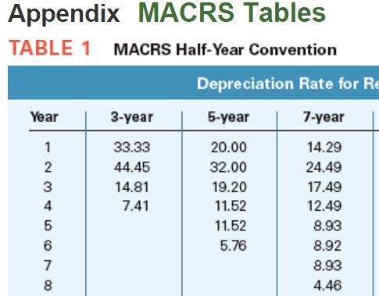

Slide 10
Teton bought a machine on July 22 at a cost of $510,000, which has a recovery period of 7 years. [Page 10-9]
The company will NOT claim:
(1) bonus depreciation [Pg. 10-22, expired)] or
(2) immediate expensing under
section 179 [Page 10-17].
Teton’s cost recovery deduction?

Slide 13
Teton bought a used delivery truck [weighing 8,000 pounds – Pg 10-28 luxury auto rules not applicable] on July 22 at a cost of $15,000, which has a recovery period of 5 years. (Page 10-9).
The company will NOT claim:
(1) bonus depreciation [pg. 10-22, expired] or
(2) immediate expensing
under section 179 [Page 10-17].
Teton’s cost recovery deduction?

Slide 16
Teton Company bought the used delivery truck in the preceding question on December 22. This was the only asset acquisition in the year. This means the asset(s) placed in service in the fourth quarter exceeds 40% of the cost of all assets placed in service in the year. The mid-quarter rules applies in this case. Teton’s cost recovery deduct.? (Page 10-10+)

Slide 22
Witt Processing Corporation places $2,125,000 of Section 179 property in service for use in its business. What is the amount of Witt Processing's maximum Section 179 deduction for 2015?

Slide 26
Henry purchases $40,000 of equipment. The taxable income of the business is $20,000 [before sec. 179 deduction]. What is Henry's maximum Section 179 deduction for current year?

Slide 27
Shirley pays $170,000 for an office building on August 27, to use in her consulting business.
She properly allocates $150,000 to the building and $20,000 to the land.
What is Shirley's depreciation deduction on the property in the second year of ownership?

Slide 30
Anderson bought an apartment building on March 27, 2015, at a cost of $2,000,000 (exclusive of the
cost allocated to land). What is Anderson's cost recovery
deduction on the building in 2015?

Slide 34
Pet Guard Co. bought and placed into service a company auto costing $60,000 in April, 2015. The auto
is used 100% for business travel. What is the depreciation deduction for 2015 on the auto? (Use textbook)

Slide 35
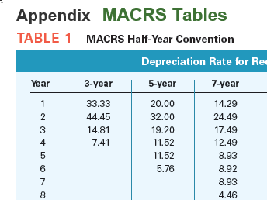

Slide 36
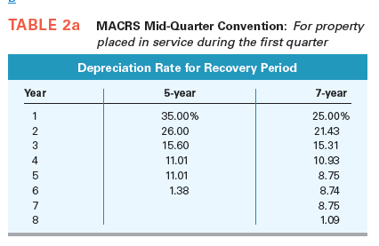

Slide 37
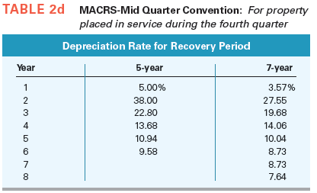

Slide 38
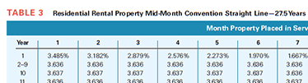

Slide 39
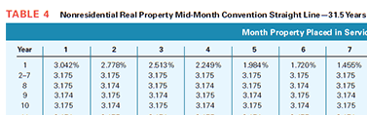

Slide 40
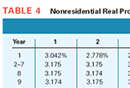

Slide 41
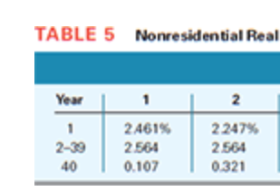

Slide 42
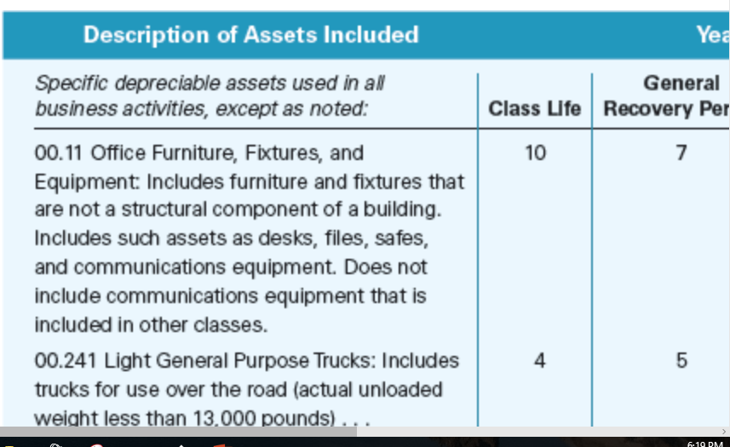

Slide 43
End

