Slide 1
Chapter 9-1C. Lecture File Howard Godfrey, Ph.D., CPA Professor of Accounting Copyright 2016

Slide 6
May the following entities elect to be taxed as partnerships?
LLC with one owner
LLC with two owners
Newly formed corporation with two owners

Slide 7
May the following entities elect to be taxed as partnerships?
LLC with one owner? No
LLC with two owners? Yes
Newly formed corporation with two owners? No

Slide 8
Which provides protection for partners in a CPA firm from malpractice claims related to work of another partner:
General Partnership,
Limited Partnership,
Limited Liability Partnership?

Slide 21
See questions at bottom of the spreadsheet

Slide 34
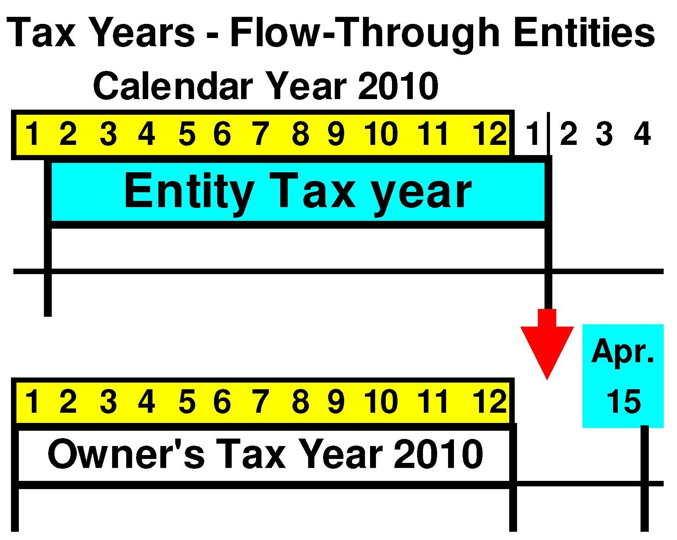

Slide 43
The
End

