Slide 1
Global Tax System
Foreign Tax Credit,
Foreign Income Exclusion,
Transfer Pricing,
Subpart F.
Howard Godfrey, Ph.D., CPA
Professor of Accounting
Copyright © 2013

Slide 2
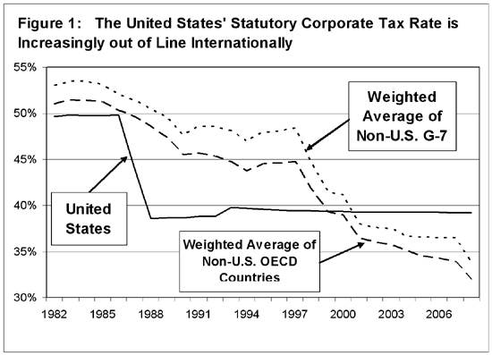

Slide 3
Note: some of these slides have dates and amounts applicable to past years.
The slides will nevertheless be helpful in illustrating important points.

Slide 4
International Taxation
The U.S. imposes taxes on “worldwide” income of U.S. taxpayers (citizens, resident aliens and corporations organized in the U.S.).
The U.S. imposes taxes on non-resident aliens (not U.S. citizens) and non-resident entities on income earned in the U.S.
A foreign person, who becomes a U.S. resident, is taxed like a U.S. citizen (on worldwide income).
A foreign owned corp. that is organized in this country is subject to U.S. income taxes. Etc.

Slide 7
Notes for case for Bud
Please note that the case for Bud involves a U.S. tax person.
Same principles apply for a U.S. corporation with a branch in the foreign country, or a U.S. proprietorship with a branch operation in the foreign country.
These concepts do not apply to a foreign person with income earned in the U.S. (Alien working in U.S., etc.)

Slide 9
Please note the variety of ways the tax systems of various countries may interact with each other.
In a territorial system,
each country imposes taxes on income earned in its territory.
In a world-wide or global system,
a county taxes income earned worldwide by its citizens.
This may cause income to be taxed in more than one country.
Double taxation. Credits allowed, etc.

Slide 10
The following slides involve the taxation of income earned in the U.S. and income earned in the U.K.
The tax rates are hypothetical and various assumptions are made regarding the nature of the tax systems: territorial, world-wide, etc.
The examples are designed to illustrate important concepts and may not accurately reflect the tax systems actually in effect in the countries.

Slide 20
Note: you can repeat the slides above for a U.S. Corporation. The U.S. corporation has net income from U.S. operations of $100,000 and net income from a branch office in a foreign country.
The same principles apply.
Other rules apply for foreign Sub.

Slide 21
Note: The first slide (results) for Bud involves him simply excluding the income earned in a foreign country.
That is the essence of Sec. 911, which allows a U.S. worker in a foreign country to exclude approx. $95,000 (inflation adjusted) per year, as well as certain housing costs.

Slide 22
How Foreign Tax Credit Works
A U.S. Corp. opens a branch in Australia.
U.S. Corp.-net income in Australia: $100,000.
U.S. Corp.-net income in U.S. $200,000.
Australia has a 40% income tax rate.
U.S. Corp.- pays Australian income tax of $40,000.
Assume the U.S. has a 50% income tax rate.
Is the global tax burden equal to
$140,000 or $150,000?
Notes:
Vertical Equity.
Look at the basic computations page for Susan and Sam.
Susan had twice as much taxable income as Sam.
Did Susan pay twice as much tax as Sam?
How would a flat tax (everybody pays same tax rate) change the tax liabilities of Susan and Sam?
Does the Susan-Sam example illustrate a progressive tax system?

Slide 28
Foreign Tax Credit [FTC]
Jackson Corp.’s taxable income for 2012 from its global operations was $500,000, resulting in U.S. federal income tax of $200,000 before credits.
Jackson’s taxable income from foreign sources was $125,000 during 2012. Jackson paid income taxes of $60,000 to foreign governments.
What is Jackson’s FTC limit for 2012?
a. $200,000 b. $60,000
c. $50,000 d. $12,500

Slide 30
Foreign Earned Income Exclusion
Choose Deduction, Credit Or Exclusion
A taxpayer (individual) should carefully choose between:
(1) a deduction for foreign income taxes,
(2) a credit on for foreign income taxes, or
(3) an exclusion up to approx. $95,000 of foreign earnings from U.S. gross income.

Slide 31
Case 1.
A U.S. citizen has the opportunity to earn an extra $100,000, and that income is earned in a foreign country. (Assume 100% exclusion is available on U.S. Return.)
The taxpayer’s U.S. income tax is $30,000 (marginal rate of 30%) on the foreign income and the foreign government imposes an income tax of $20,000 on that income.

Slide 33
Case 1. The Code provides a deduction for foreign income taxes paid.
A deduction of $20,000 for these taxes will generate a tax savings of $6,000 (30% of $20,000).
However, a tax credit for these foreign taxes will yield a savings on U.S. income tax of $20,000.
The greatest saving is realized by excluding $100,000 from U.S. income, thereby saving U.S. income tax of $30,000.

Slide 34
Case 1
Best to earn tax-free income in foreign country and exclude it from the U.S. income tax computations.

Slide 35
Transfer Pricing
Under section 482, the Secretary of the Treasury is authorized to re-determine the income of an entity subject to U.S. taxation, when it appears that an improper shifting of income between that entity and a commonly controlled entity in another country has occurred.
See excellent figure on text page 9-1.

Slide 39
US Corp and Subsidiary
The following slide summarizes the transactions of a U.S. parent corp. (USC) and its wholly owned subsidiary corporation organized and operating in the Cayman Islands (CSub).
Parent (USC) makes widgets in the U.S. & sells them to its Cayman Subsidiary (CSub).
The Cayman Subsidiary sells the widgets in other parts of the world.
Initially, we ignore transfer pricing limits and subpart F.

Slide 42
What happens if we change our intercompany pricing policy, and sell the widgets to the Cayman subsidiary at our cost, so that we break-even in the United States?

Slide 45
Subpart F
Suppose in the preceding slide,
USC is actually selling its product to various customers throughout the world.
The Cayman Islands sub is a sales agent (paper corporation) that technically buys from USC for $600,000 and sells to USC’s customers for $1,000,000.
The products are shipped directly to USC’s customers and USC actually handles the billing, etc.
If CSub does not produce in the Cayman Islands and does not sell in the Cayman Islands,
Subpart F comes into play.
Subpart F. USC is treated as receiving a distribution of CSub earnings on the last day of the year. See bottom of page 9-22+

Slide 46
Subpart F. Suppose in the preceding slide, USC is actually selling its product to a wholly owned German Subsidiary.
USC uses the Cayman Islands sub as a sales agent to buy from USC for $600,000 and sell to the German Subsidiary for $1,000,000.
German subsidiary will sell the products in Germany for $1,000,000.
Without transfer pricing limits or Subpart F, there would be no profit to be taxed in the U.S. or in Germany.

Slide 47
The
End

