Slide 1
Chapter-2-1D-Property-Cost-Recovery Howard Godfrey, Ph.D., CPA Professor of Accounting ©Howard Godfrey-2017

Slide 3
MACC Mid-Year Social
Please join your fellow MACC students and faculty at Legion Brewing on Friday, on January 20th from 4:00 pm-6:00pm. Legion is located in the Plaza Midwood area, features a great selection of craft beers, and is a great place to gather. Directions are at http://www.legionbrewing.com/
Why you should come:
1. Classes just started! It’s only going to get busier
2. You always need to have a little fun!
3. It's a chance to check out one of Charlotte's coolest new venues.
4. Brewery tours available for the curious.
5. We'll be serving a selection of drinks and great food.
RSVP to sgomes2@uncc.edu let us know you are coming.

Slide 4
Big Picture – Cost Recovery.
Buildings (Realty) (long life) Straight line, life of 27.5 or 39 years
Equipment, other personal property
DDB and other methods, various lives
Natural resources (oil, coal, timber)
Deduct depletion based on cost of each ton of coal, etc.
Intangible assets (patents, good will)
Amortize, often over 15 years

Slide 5
Asset Cost: $1,000, life is 5 years
What info do you need.
Cost
Life
Salvage $0
Depreciation method
Convention (compute for part-year) Mid-Year (1/2 Yr. of Deprec-1st Yr.)
Mid-Quarter (1/2 Qtr. of Dep-1st Yr.)
Mid-Month ( Real Estate )

Slide 6
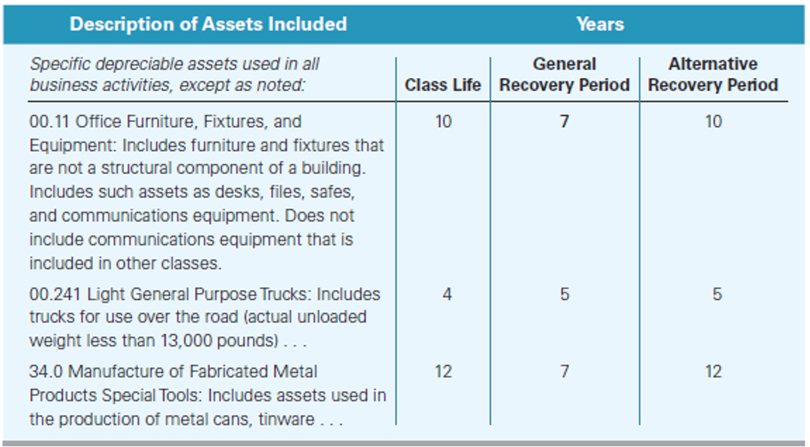

Slide 9
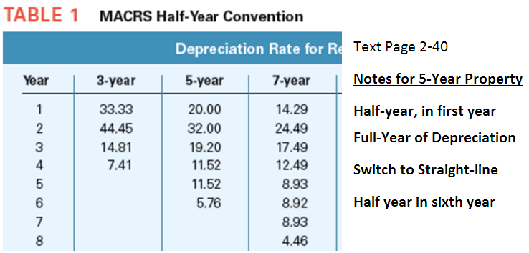

Slide 11
Teton bought a machine on July 22 at a cost of $510,000, which has a recovery period of 7 years. [Page 2-9]
The company will NOT claim:
(1) bonus depreciation [Pg. 2-22)] or
(2) immediate expensing under Section 179 [Page 2-17].
Teton’s cost recovery deduction?

Slide 20
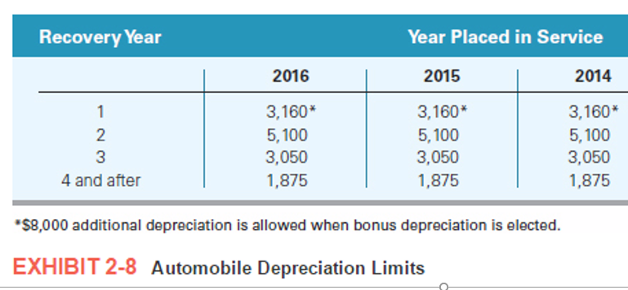

Slide 21
Teton bought a used delivery truck [weighing 8,000 pounds – Pg. 2-27 luxury auto rules not applicable] on July 22 at a cost of $15,000, which has a recovery period of 5 years. (Page 2-9). The company will NOT claim: (1) bonus depreciation [pg. 2-22] or (2) immediate expensing under section 179 [Page 2-18]. Teton’s cost recovery deduction?

Slide 24
Teton Company bought the used delivery truck in the preceding question on December 22. This was the only asset acquisition in the year. This means the asset(s) placed in service in the fourth quarter exceeds 40% of the cost of all assets placed in service in the year. The mid-quarter rules applies in this case. Teton’s cost recovery deduct.? (Page 2-10+)

Slide 30
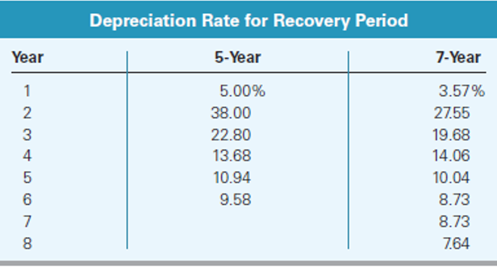
Mid-Quarter Convention

Slide 31
Witt Processing Corporation places $2,125,000 of Section 179 property in service for use in its business. What is the amount of Witt Processing's maximum Section 179 deduction for 2016?

Slide 35
Henry purchases $40,000 of equipment. The taxable income of the business is $20,000 [before sec. 179 deduction]. What is Henry's maximum Section 179 deduction for current year?

Slide 36
Shirley paid $1,200,000 for an office building on August 27, to use in her consulting business. She properly allocated $1000,000 to the building and $200,000 to the land. What is Shirley's depreciation deduction on the property in the second year of ownership?

Slide 38
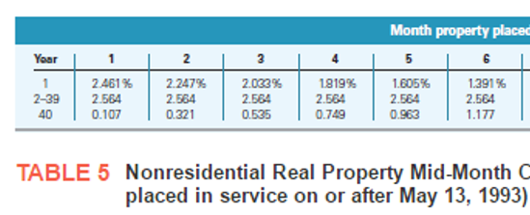

Slide 40
Anderson bought an apartment building on March 27, 2016, at a cost of $2,000,000 (exclusive of the cost allocated to land). What is Anderson's cost recovery deduction on the building in 2016?

Slide 44
Pet Guard Co. bought and placed into service a company auto costing $60,000 in April, 2016. The auto is used 100% for business travel. What is the depreciation deduction for 2016 on the auto? (Use textbook)

Slide 47
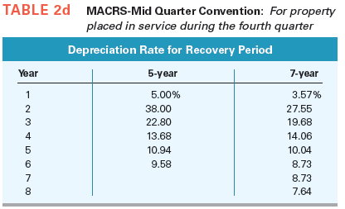

Slide 48
End

