Slide 1
Chapter 2
Property Acquisition and Cost Recovery

Slide 2
Learning Objectives
Explain the concept of basis and adjusted basis and describe the cost recovery methods used under the tax law to recover the cost of personal property, real property, intangible assets, and natural resources.
Determine the applicable cost recovery (depreciation) life, method, and convention for tangible personal and real property and calculate the deduction allowable under basic MACRS.
Explain the additional special cost recovery rules (§179, bonus, listed property) and calculate the deduction allowable under these rules.
Explain the rationale behind amortization, describe the four categories of amortizable intangible assets, and calculate amortization expense.
Explain cost recovery of natural resources and the allowable depletion methods.

Slide 3
Cost Recovery
Businesses must capitalize the cost of assets with a useful life of more than one year on the balance sheet rather than expense the cost immediately
Also known as depreciation, amortization, or depletion – depending upon the underlying nature of asset
Business use these methods to recover cost of assets due to wear, tear and obsolescence of assets

Slide 4
Cost Recovery
Different methods to recover the costs of assets
Depreciation – Deducting the cost of tangible personal and real property (other than land) over a specific period of time
Amortization – Deducting the cost of intangible property over a specific period of time
Depletion – Deducting the cost of natural resources over time

Slide 5
Cost Recovery
Basis for Cost Recovery –
Once the use of purchased assets is started, recouping the cost of assets also starts
Cost basis reduces when cost is recovered through Cost Recovery Deductions which is called Assets Adjusted Basis or Tax Basis
Assets Adjusted Basis = Assets Initial Cost or Historical basis minus Accumulated Depreciation (Amortization or Depletion)

Slide 6
Basis Example
Scrap-Happy Inc., a scrapbooking retail chain, purchased an old office building for $175,000 for use in expanding its current operations. An additional $15,000 was spent painting and remodeling the building in preparation for its opening.
Two years later, a Scrap-Happy employee discovered that several leaks in the roof were causing serious water damage to the store’s inventory; the company spent $50,000 to re-roof the building.
Every six months, Scrap-Happy pays $500 to have the carpet professionally cleaned.

Slide 7
Basis Example (cont.)
What is the original basis of the building?
$175,000 initial cost
+ $15,000 painting and remodeling
$190,000 Original Basis
What effects do the other two transactions have on the original basis?
$50,000 re-roofing expense: Added to basis (results in a restoration of a major component of the building)
$500 biannual carpet cleaning: No effect on basis (Expensed immediately → routine maintenance)

Slide 8
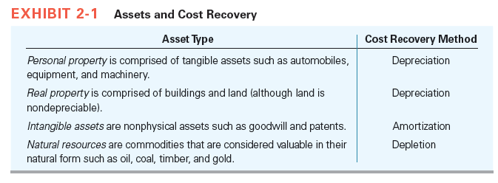
Cost Recovery

Slide 9
Depreciation
Before 1981, tax depreciation methods closely resembled financial accounting methods which required businesses to determine “Salvage Values” and “Useful Lives”
In 1981, ACRS – Accelerated Cost Recovery System was introduced to depreciate assets over predetermined, fixed recovery periods
Today, businesses calculate their tax depreciation using the MACRS – Modified Accelerated Cost Recovery System – which is pronounced “makers” by tax accountants

Slide 10
Depreciation
To compute MACRS depreciation for an asset, following are to be known
asset’s original cost,
applicable depreciation method,
asset’s recovery period (or depreciable “life”),
applicable depreciation convention (depreciation deductible in the year of acquisition and the year of disposition)

Slide 11
Depreciation
Personal Property Depreciation
Includes all tangible property such as computers, automobiles, furniture, machinery and equipment, other than real property
Personal property (not real property) and personal use property (used for personal purposes) not the same

Slide 12
Depreciation
Depreciation Method
Three acceptable methods for depreciating personal property
200 percent (double) declining balance
150 percent declining balance
straight-line

Slide 13
Depreciation
Depreciation Recovery Period
For financial accounting purposes an assets recovery period (depreciable life) is based on its taxpayer-determined estimated useful life
For tax purposes, an assets recovery period is predetermined by IRS in the Rev. Proc. 87-56 which helps payers to categorize each of their assets based upon the property’s description

Slide 14
Depreciation
Once the business has determined the appropriate categories for its assets, it can use the Revenue Procedure to identify the recovery period for all assets in a particular category

Slide 15
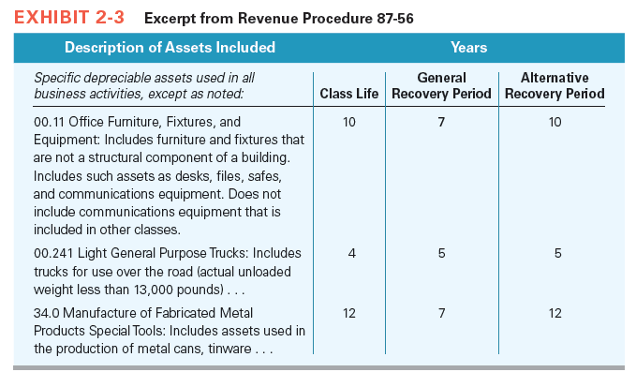
Depreciation

Slide 16
Depreciation

Slide 17
Depreciation
Depreciation Conventions
Half-year Convention
One-half year’s depreciation is allowed in first and last year of an asset’s life
An IRS depreciation tables automatically account for the half-year convention in year of purchase and disposition
If an asset is disposed of before it is fully depreciated, only one-half of the table’s applicable depreciation percentage is allowed in the year of disposition

Slide 18
Depreciation
Mid–Quarter Convention
Steps to determine whether the mid-quarter convention applies
Sum of the total basis of tangible personal property that was placed in service during the year
Sum of the total basis of tangible personal property that was placed in service during the fourth quarter
Divide step (2) by step (1), if the quotient is more than 40%, then the business must use this method or else half–year convention is used

Slide 19
Depreciation
Calculating depreciation for personal property
Locate the applicable table provided in Rev. Proc. 87-57
Select the column that corresponds with the assets recovery period
Find the row identifying the year of the assets recovery period
Applying the half-year and mid–quarter convention
Half-year convention for year of disposition
Mid-quarter convention for year of disposition

Slide 20
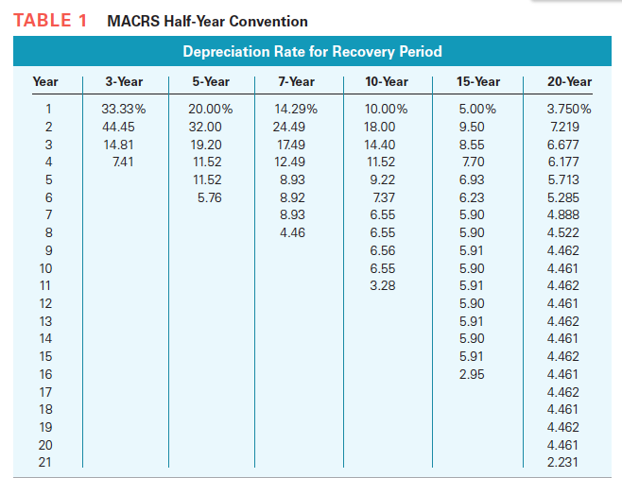
Depreciation

Slide 21
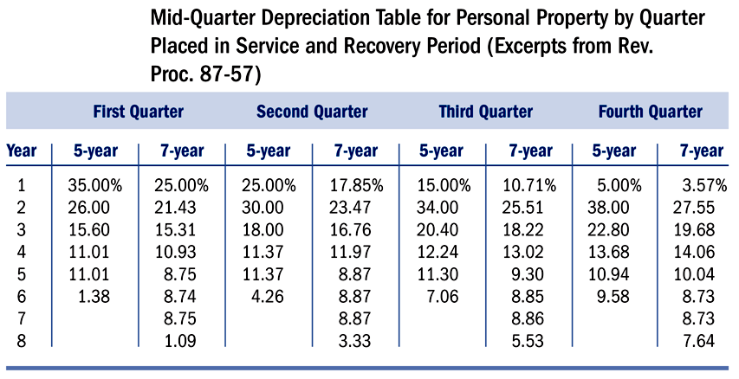
Depreciation

Slide 22
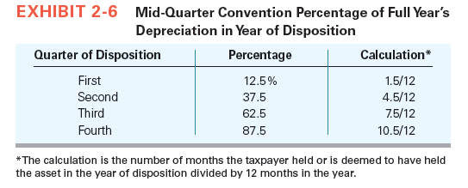
Depreciation

Slide 23
Depreciation Example
In 2016, Scrap-Happy purchased and placed in service the following assets:
Asset | Cost | Date placed in service
Di-Cut Machine | $3,500 | February 2 (1st Qtr.)
Computer | $1,200 | October 25 (4th Qtr.)
What is the recovery period for each of the assets?
Computer = 5 years
Di-Cut Machine = 7 years
Which convention should Scrap-Happy use to determine depreciation for 2016?
Answer: Half-year
→ $1,200 4th qtr. assets/$4,700 total assets = 25.53% < 40%

Slide 24
Depreciation Example
Now assume all the same facts, except that the computer was purchased in February and the machine in October, as shown:
Asset | Cost | Date placed in service | Recovery Period
Computer | $1,200 | February 2 (1st Qtr.) | 5 Years
Di-Cut Machine | $3,500 | October 25 (4th Qtr.) | 7 Years
What convention should be used in computing depreciation for the year?
Answer: Mid-quarter
→ $3,500 4th qtr. assets/$4,700 total assets = 74.46% > 40%
How much depreciation can they take for each of the assets in 2016?
Computer: $1,200 × 35%* = $420
Di-Cut Machine: 3,500 × 3.57%* = $125
*See respective mid-quarter MACRS tables for rates

Slide 25
Depreciation
Real Property
It uses mid–month convention and depreciated using straight line method

Slide 26
REAL PROPERTY: Depreciation Example
On July 12, Scrap-Happy purchases and places in service a warehouse and the land it resides on for $170,000 ($120,000 is allocated to the building and $50,000 to the land).
What is the amount of depreciation on the property for the first year?
Answer: $120,000 × 1.177% = $1,412
1.177% is the rate given in the nonresidential real property MACRS table under the column for the 7th month*
Land is not included in the calculation because it is not depreciable

Slide 27
Depreciation
Immediate Expensing
This incentive is commonly referred as §179 expense or immediate expensing election
Limits on immediate expensing
Choosing the assets to immediately expense
Bonus Depreciation
To stimulate the economy, policy makers occasionally implement bonus depreciation

Slide 28
Depreciation
Listed Property
Business can use the following steps to determine its current depreciation expense for the asset
Compute depreciation for the year if it drops to 50% or below using the straight-line method
Compute amount to be deducted if straight line method is used over ADS recovery period for all prior years (limited to business – use percentage)
Compute the amount of depreciation, taxpayer actually deducted on the assets for all prior years
Subtract amount of step 2 from step 3, which is prior year accelerated depreciation in excess of straight line depreciation
Subtract amount of step 4 from step 1 which is business’s allowable depreciation expense on the asset for that year

Slide 29
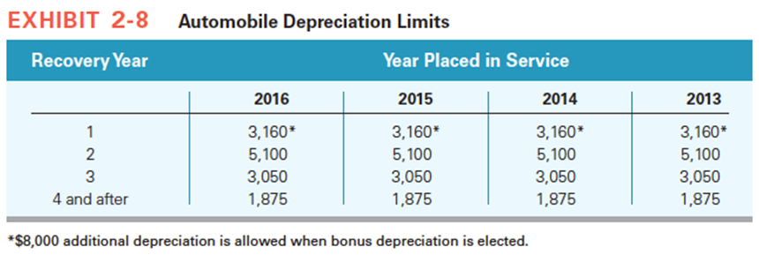
Depreciation
Luxury Automobiles

Slide 30
Amortization
For intangible assets businesses recover cost of the asset through amortization
Intangible assets in the form of capitalized expenditures, such as capitalized research and experimentation (R&E) costs or covenants do not have physical characteristics
Intangible assets has one of the following characteristics
Section 197 Intangibles
Start-up expenditures and organizational costs
Research and experimentation costs
Patents and Copyrights

Slide 31
Amortization
Section 197 intangibles
According to §197, these assets have a recovery period of 180 months (15 years), regardless of their actual life
Uses full month convention allows taxpayers to deduct an entire month’s worth of amortization for the month of purchase and all subsequent months in the year

Slide 32
Amortization
Organizational Expenditures and Start-up Costs
Organizational expenditures include expenditures to form and organize a business in the form of a corporation or a partnership and are incurred prior to the starting business
Start-up costs are costs businesses incur to, start up a business

Slide 33
Amortization
Research and Experimentation Expenditures
To stay competitive, businesses often invest in activities which will generate innovative products or significantly improve their current products or processes
Businesses may immediately expense these costs or they may elect to capitalize and amortize these costs using the straight-line method over a period of not less than 60 months, beginning in the month benefits are first derived from the research

Slide 34
Amortization
Patents and Copyrights
It depends on the way how business directly purchases the patent or copyright or whether itself creates the intangibles
Businesses directly purchasing patents or copyrights amortize the cost over the remaining life of the patents or copyrights
Businesses receiving “self-created” patents or copyrights amortize the cost or basis of the self-created intangible assets over the shorter of the legal life or remaining useful life

Slide 35
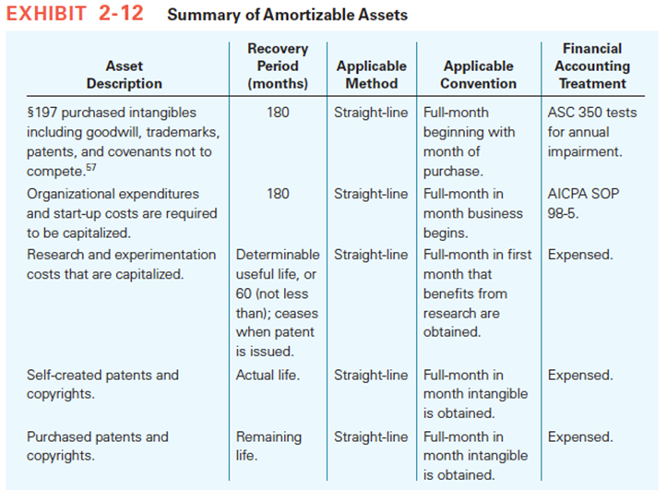
Amortization

Slide 36
Depletion
A method used to recover their capital investment in natural resources
Businesses compute annual depletion expense under both the cost and percentage depletion methods and they deduct the larger of the two
Taxpayers must estimate or determine the number of units or reserves that remain at the beginning of the year and allocate a pro rata share of that basis to each unit that is extracted during the year

Slide 37
Cost Depletion Example
Scrap-Happy purchases a tract of forest land which they plan to use to harvest trees for the production of scrapbook paper. It is estimated that the tract contains 30,000 board feet of timber. The original cost of the property is $75,000, of which $60,000 is allocated to the timber and $15,000 to the land.
What is the cost depletion per board foot?
Answer: $60,000 basis/30,000 ft = $2/ft
If the company uses 10,000 board feet during the first year, how much will they expense under the cost depletion method?
Answer: 10,000 ft × $2/ft = $20,000
OR $60,000 basis × 33.33% resource used = $20,000

Slide 38
Depletion
Once entire cost is recovered, businesses are not allowed to use cost depletion to determine depletion expense
The amount of percentage depletion for a natural resource business activity is determined by multiplying the gross income from the resource extraction activity by a fixed percentage based on the type of natural resource as indicated in Exhibit 10-14

Slide 39
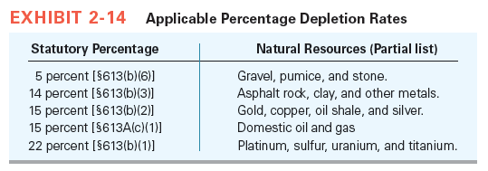
Depletion

