Slide 1
Chapter 3
Property Dispositions

Slide 2
Learning Objectives
Calculate the amount of gain or loss recognized on the disposition of assets used in a trade or business.
Describe the general character types of gain or loss recognized on property dispositions.
Explain the rationale for and calculate depreciation recapture.
Describe the tax treatment of unrecaptured §1250 gains and determine the character of gains on property sold to related persons.
Describe the tax treatment of §1231 gains or losses, including the §1231 netting process.
Explain common exceptions to the general rule that realized gains and losses are recognized currently.

Slide 3
Dispositions
Amount Realized
  Amount realized by a taxpayer from the sale or other disposition of an asset is everything of value received from the buyer less any selling costs
  Taxpayers typically receive cash when they sell property, they may also accept marketable securities, notes receivable, similar assets, or any combination of these items as payment

Slide 4
Determination of Adjusted Basis
An asset’s initial adjusted basis depends on how the asset was acquired. Generally, purchased asset’s initial basis is its initial cost.
Gifts
    If, at date of gift, FMV > donor’s basis, then donee’s basis is a carryover basis
    If, at date of gift, FMV < donor’s basis, then done uses a carryover basis if the asset is later sold for a gain. If asset is later sold for a loss, the done uses the FMV as of the date of gift for the basis.

Slide 5
Determination of Adjusted Basis
Inherited property
  The heir’s basis in property passing from a decent to the heir is the FMV on the date of the decedent’s death.
  An alternative valuation date (6-months after date of death) may be used to determine the basis to the heirs if elected by the estate.

Slide 6
Determination of Adjusted Basis
Property converted from personal use to business use
  Basis depends on whether the property appreciated or declined in value during the time the property was used personally
    Appreciated: taxpayer uses the basis
    Declined in value: taxpayer uses FMV at the date of conversion for calculating loss

Slide 7
Dispositions
The adjusted basis for determining gain or loss on the sale of an asset:
  Initial basis reduced by depreciation or other types of cost recovery deductions allowed (or allowable) on the property

Slide 8
Example: Adjusted Basis
Scrap-Happy owns a computer (5-yr MACRS recovery period), which it purchased 2 years ago for $1,200. For financial statement purposes, the computer is depreciates over 3 years using the half-year convention and straight-line method, with no salvage value. What is the adjusted book and tax bases for the computer (after 2 years of depreciation)?
  Answer: Book Tax
  Cost Basis: $1,200 $1,200
  Yr 1 Dep. (HY): (200) (240)
  Yr 2 Dep.: (400) (384)
  Adjusted Basis: $600 $576

Slide 9
Dispositions
Realized Gain or Loss on Disposition
  The amount of gain or loss taxpayers realize on a sale or other disposition of assets is simply the amount they realize minus their adjusted basis in the disposed assets

Slide 10
Example
Scrap-Happy sells the computer in the previous example (adjusted tax basis = $576) for $400. What is the realized gain or (loss) on the sale?
  Answer: $400 Amount realized
  (576) Adjusted basis
  ($176) (Loss) realized

Slide 11
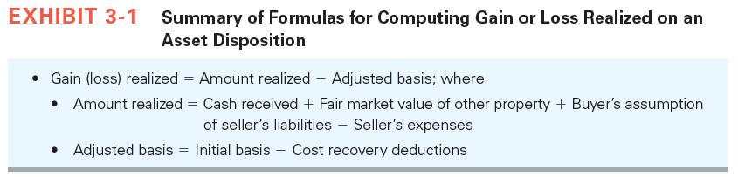
Dispositions

Slide 12
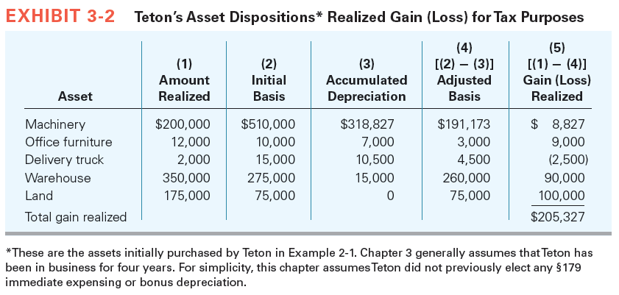
Dispositions

Slide 13
Dispositions
Recognized Gain or Loss on Disposition
  Gains (losses) that increase (decrease) taxpayers’ gross income
  Taxpayers must immediately recognize the vast majority of realized gains and losses, they may be allowed to permanently exclude the gains from taxable income

Slide 14
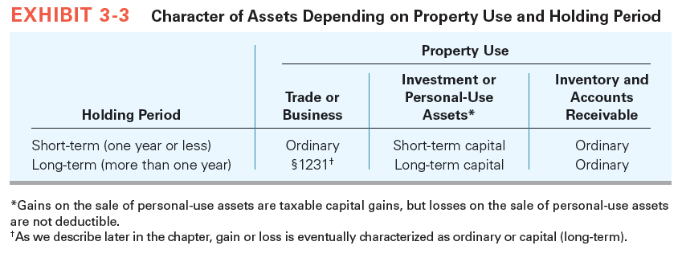
Character of Gain or Loss

Slide 15
Character of Gain or Loss
Ordinary Assets
  Assets created or used in a taxpayer’s trade or business
  Business assets held for less than a year
  Example – Inventory, Accounts Receivable, Machinery and Equipment
  If taxpayers sell ordinary assets at a gain, they recognize an ordinary gain that is taxed at ordinary rates
  If taxpayers sell ordinary assets at a loss, they deduct the loss against other ordinary income

Slide 16
Character of Gain or Loss
Capital Assets
  Assets held for investment, for the production of income, or for personal use
  Qualification as capital asset depends on the purpose for which taxpayers uses the assets
  Both individual and corporate taxpayers prefer capital gains to ordinary income

Slide 17
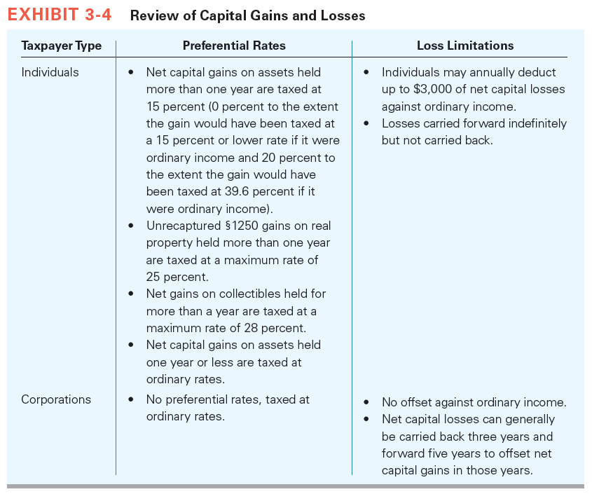
Character of Gain or Loss

Slide 18
Character of Gain or Loss
§1231 Assets
  Depreciable assets and land used in a trade or business held for more than one year
  If the taxpayer recognizes a net §1231 gain, the net gain is treated as a long-term capital gain
  If the taxpayer recognizes a net §1231 loss, the net loss is treated as an ordinary loss
  §1231 gains on individual depreciable assets may be recharacterized as ordinary income under the depreciation recapture rules

Slide 19
Depreciation Recapture
Potentially applies to gains (not losses) on the sale of depreciable or amortizable business property
When applied, it recharacterizes the gain on the sale of a §1231 asset
Does not affect §1231 losses
Computation depends on the type of §1231 assets the taxpayer is selling (personal or real property)
Changes only the character but not the amount of gain that taxpayers recognize when they sell a depreciable asset

Slide 20
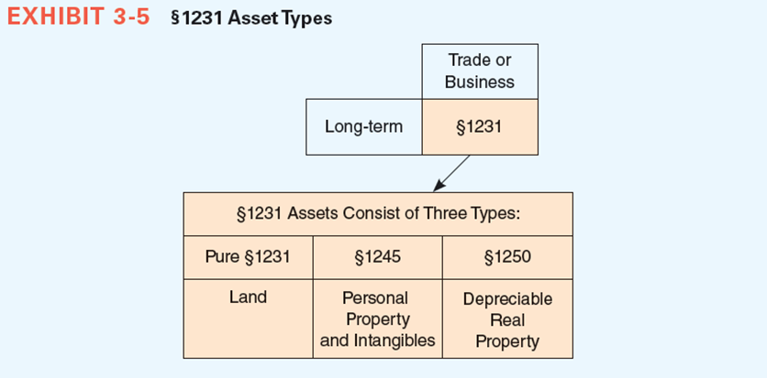
Depreciation Recapture

Slide 21
Depreciation Recapture
§1245 Property
  Personal property and amortizable intangible assets are §1245 assets
  The lesser of
    gain recognized or
    accumulated depreciation is recaptured (characterized) as ordinary income under §1245
  Any remaining gain is §1231 gain
  There is no depreciation recapture on assets sold at a loss

Slide 22
Depreciation Recapture
When taxpayers sell or dispose of §1245 property, they encounter one of the following three scenarios of gain or loss
  recognize a gain created solely through depreciation deductions
  recognize a gain created through both depreciation deductions and actual asset appreciation
  recognize a loss

Slide 23
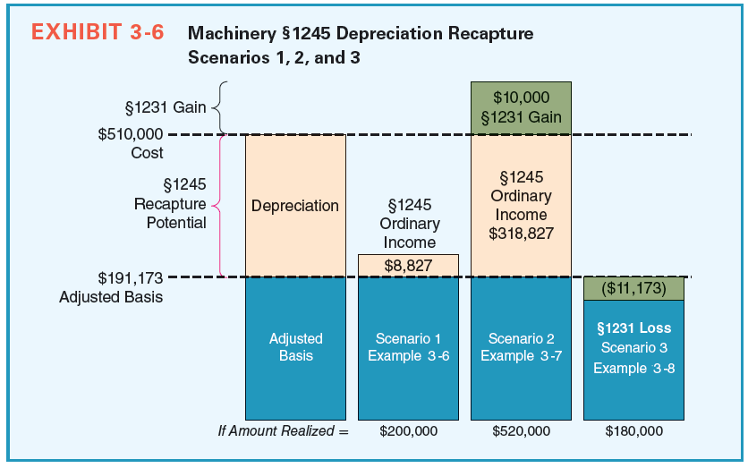
Depreciation Recapture

Slide 24
§1231 ASSETS:
§1245 Recapture Example
Scrap-Happy sells a machine with an adjusted basis of $6,000 for $10,000. Depreciation taken on the machine amounts to $2,500. What amount of gain is recaptured as ordinary and what amount is §1231 gain?
  Answer: $10,000 Selling price
  – 6,000 Adjusted basis
        $4,000 Gain realized
  Depreciation recapture = Lesser of:
    Depreciation taken: $2,500
    Gain realized: $4,000
  Depreciation recapture (ordinary income) = $2,500
  §1231 gain (capital gain) = $4,000 Gain realized
  – 2,500 Depreciation recapture
  $1,500 §1231 gain

Slide 25
Depreciation Recapture
§1250 Depreciation Recapture for Real Property
  Depreciable real property (an office building or a warehouse), sold at a gain is subject to recapture called §1250 depreciation recapture
  A modified version of the recapture rules called §291 depreciation recapture applies to corporations but not to other types of taxpayers
    §291, corporations selling depreciable real property recapture as ordinary income 20 percent of the lesser of the recognized gain or the accumulated depreciation

Slide 26
Other Provisions Affecting The Rate at which Gains are Taxed
Unrecaptured §1250 Gain for Individuals
  Depreciable real property sold at a gain is §1250 property, but is generally no longer subject to §1250 recapture
  The gain that would be §1245 recapture if the asset were §1245 property is called unrecaptured §1250 gain
  Unrecaptured §1250 gain is §1231 gain that, if ultimately characterized as a long-term capital gain, is taxed at a maximum rate of 25 percent

Slide 27
Other Provisions Affecting The Rate at which Gains are Taxed
Characterizing Gains on the Sale of Depreciable Property to Related Persons (§1239)
  All gain recognized from selling property i.e., a depreciable asset to a related-person buyer is ordinary income
  Seller is required to recognize ordinary income for depreciation deductions the buyer will receive in the future
  The tax laws are designed to provide symmetry between the character of deductions an asset generates and the character of income the asset generates when it is sold

Slide 28
Other Provisions Affecting The Rate at which Gains are Taxed
  Includes an individual and his or her controlled (more than 50 percent owned) corporation or partnership or a taxpayer and any trust in which the taxpayer (or spouse) is a beneficiary
  Also includes two corporations that are members of the same controlled group, a corporation and a partnership if the same person owns more than 50 percent of both entities, two S corporations controlled by the same person, and an S corporation and a C corporation controlled by the same person

Slide 29
Calculating Net §1231 Gains or Losses
Taxpayer could benefit from this strategy in three ways
  accelerating losses into year 1
  deferring gains until year 2
  characterizing the gains and losses due to the §1231 netting process
§1231 Look-Back Rule
  A nondepreciation recapture rule
  Affects the character but not the amount of gains on which a taxpayer is taxed

Slide 30
Calculating Net §1231 Gains or Losses
  Gains and losses from individual asset dispositions are annually netted together
  Net §1231 gains may be recharacterized as ordinary income under the §1231 look-back rule

Slide 31
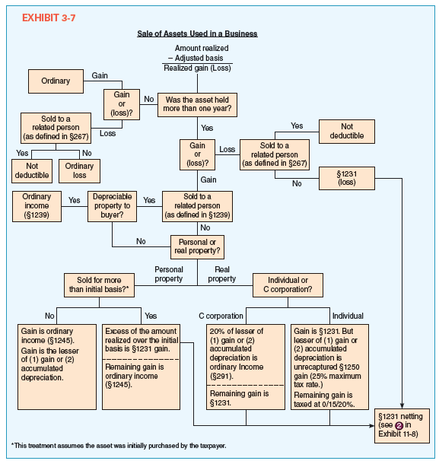
Calculating Net §1231 Gains or Losses

Slide 32
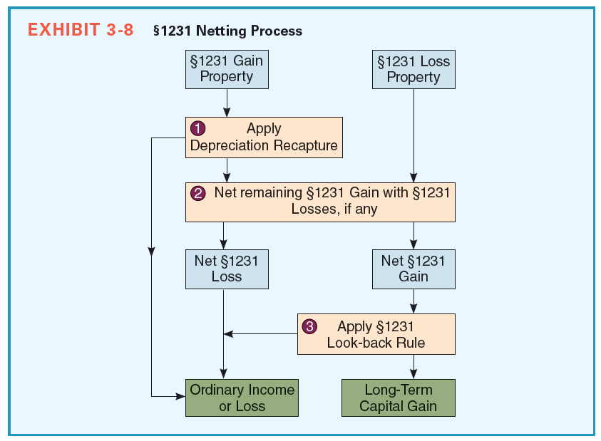
Calculating Net §1231 Gains or Losses

Slide 33
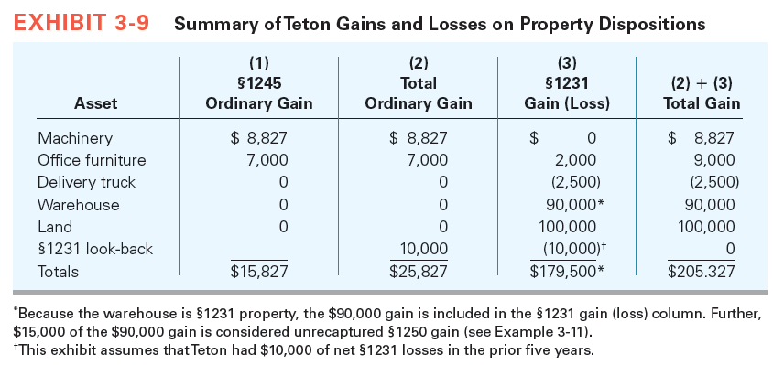
Calculating Net §1231 Gains or Losses

Slide 34
Nonrecognition Transactions
Like-Kind Exchanges
  For an exchange to qualify as a like-kind exchange for tax purposes, the transaction must meet the following three criteria
    The property is exchanged “solely for like-kind” property.
    Both the property given up and the property received in the exchange by the taxpayer are either “used in a trade or business” or are “held for investment,” by the taxpayer
    The “exchange” must meet certain time restrictions

Slide 35
Nonrecognition Transactions
Definition of Like-Kind Property
  Real Property
    Used in a trade or business or held for investment is considered “like- kind” with other real property used in a trade or business or held for investment
  Personal Property
    Considered “like-kind” if it has the same general use and is used in a business or held for investment

Slide 36
Nonrecognition Transactions
  Property Ineligible for Like-Kind Treatment
    Includes inventory, most financial instruments, partnerships interests, domestic property exchanged for property used in a foreign country and all property used in a foreign country
Property Use
Timing Requirements for a Like-Kind Exchange
  Like-kind property exchanges may involve intermediaries
  Taxpayers must identify replacement “like-kind” property within 45 days of giving up their property

Slide 37
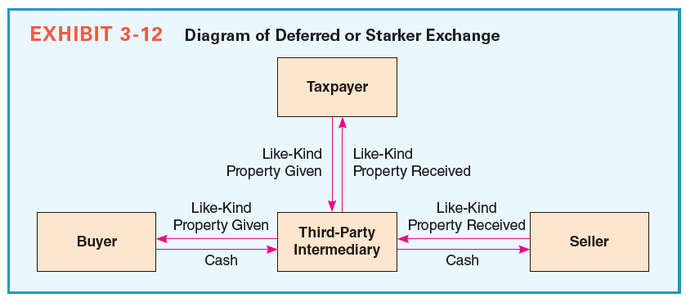
Nonrecognition Transactions
  “Like-kind” property must be received within 180 days of when the taxpayer transfers property in a “like-kind” exchange

Slide 38
Nonrecognition Transactions
Tax Consequences When Like-Kind Property Is Exchanged Solely for Like-Kind Property
Tax Consequences of Transfers Involving Like-Kind and Non-Like-Kind Property (Boot)
  Non-like-kind property is known as boot
  When boot is given as part of a like-kind transaction:
    The asset received is recorded in two parts: property received in exchange for like-kind property and property received in a sale (bought by the boot)

Slide 39
Nonrecognition Transactions
  When boot is received:
    Boot received usually creates recognized gain
    Gain recognized is lesser of gain realized or boot received
  Adjusted basis of like-kind property received:
  The basis of boot received is the fair market value of the boot

Slide 40
Nonrecognition Transactions
Reporting Like-Kind Exchanges
  Involuntary Conversions
    Gain is deferred when appreciated property is involuntarily converted in an accident or natural disaster
    Basis of property directly converted is carried over from the old property to the new property
    In an indirect conversion, gain recognized is the lesser of: Gain realized, or Amount of reimbursement the taxpayer does not reinvested in qualified property
    Qualified replacement property must be of a similar or related use to the original property

Slide 41
Nonrecognition Transactions
Installment Sales
  Sale of property where the seller receives the sale proceeds in more than one period
  Must recognize a portion of gain on each installment payment received
  Inventory, marketable securities, and depreciation recapture cannot be accounted for under installment sale rules
  Does not apply to losses

Slide 42
Nonrecognition Transactions
Gains Ineligible for Installment Reporting
Other Nonrecognition Provisions
  Related-person Loss Disallowance Rules
    Tax laws essentially treat related persons as though they are the same taxpayer
    Related persons are defined in §267 and include certain family members, related corporations, and other entities (partnerships)
    Losses on sales to related persons are not deductible by the seller
    Related person may deduct the previously disallowed loss to the extent of the gain on the sale to the unrelated third person

