Slide 1
Chapter 4
Entities Overview

Slide 2
Learning Objectives
Discuss the legal and nontax characteristics of different types of legal entities.
Describe the different types of entities for tax purposes.
Identify fundamental differences in tax characteristics across entity types.

Slide 3
Entity Legal Classification and Nontax Characteristics
Legal Classification
  Corporation, limited liability company (LLC), general partnership (GP), limited partnership (LP), sole proprietorship
  Business owners legally form
    Corporation – file articles of incorporation
    LLC – file articles of organization
    GP – written agreement called partnership agreement
    LP – written agreement and file a certificate of limited partnership
  Sole proprietors are not required to formally organize their business with the state

Slide 4
Entity Legal Classification and Nontax Characteristics
Nontax Characteristics
  Responsibility for Liabilities
    Corporations and LLCs are solely responsible
    Partnerships – GPs are ultimately responsible and LPs are not responsible
    Sole proprietorships – Individual owners are responsible (unless single member LLC)
  Rights, Responsibilities, and Legal Arrangement among Owners

Slide 5
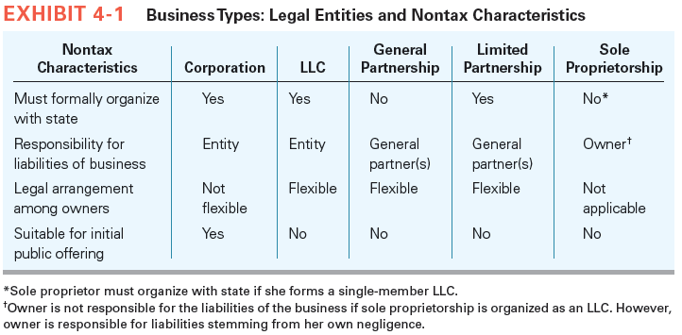
Entity Legal Classification and Nontax Characteristics

Slide 6
Entity Tax Classification
Business entities classification for tax purposes
  Check the box regulations
  Taxpaying entities
  Flow-through entities
Corporations are C corporations unless shareholders make a valid S election
Unincorporated entities
  taxed as partnerships if they have more than one owner
  taxed as sole proprietorships if owned by an individual or as disregarded entities if held by some other entity
  may elect to be taxed as C corporations

Slide 7
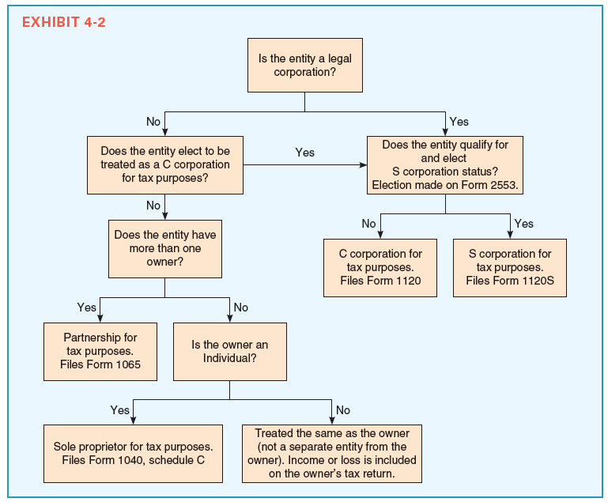
Entity Tax Classification
Check the box regulations summary

Slide 8
Entity Tax Characteristics
Double Taxation
  Income generated by flow-through entities is taxed only once while income of C corporations is taxed twice
  Flow-through entity owners pay tax on their share of income as if they had earned it themselves
  Corporations pay first level of tax on their taxable income at the corporate marginal tax rate
  Current marginal tax rate
    Lowest – 15 percent and highest – 39 percent
    Most profitable corporations – 35 percent
  Shareholders are subject to double taxation when second level of tax is paid

Slide 9
Entity Tax Characteristics
  After-Tax Earnings Distributed
    Individual Shareholders
      Pay second tax at 0, 15, or 20 percent depending on taxpayers income level
        May also pay 3.8 net investment income tax, depending on income level
      Individual shareholders’ overall tax rates will be higher with a corporation when the corporation’s marginal tax rate is expected to be greater than or equal to the shareholders’ marginal tax rates

Slide 10
Double Tax Example
Assume that Nicole did some income projections to help her determine the taxable form of her business. She makes the following assumptions:
  CCS earns taxable income of $350,000.
  CCS will pay out all of its after-tax earnings annually as a dividend.
  Her ordinary marginal tax rate is 33 percent and her dividend tax rate is 18.8 (including 3.8% net investment income tax).
Given these assumptions, if Nicole organizes CCS as a corporation, what would be the overall tax rate on CCS’s income (corporate-level tax + shareholder-level tax)/taxable income)?

Slide 11
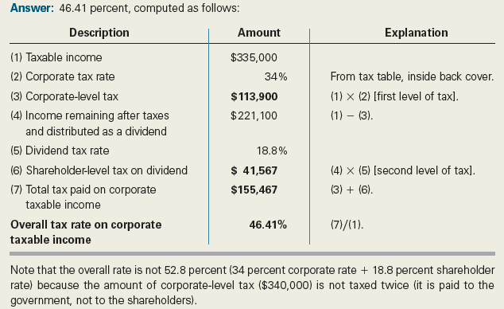
Double Tax Example
Solution

Slide 12
Entity Tax Characteristics
  After-Tax Earnings Distributed
    Corporate Shareholders
      Dividends are subject to corporate ordinary rates
      Corporations receiving dividends are potentially subject to third level of tax
      Dividend received deduction (DRD) can be claimed for dividends
      DRD percentage is 70, 80, or 100% depending on the extent of recipient corporation’s ownership in the dividend-paying corporation

Slide 13
Entity Tax Characteristics
  After-Tax Earnings Distributed
    Institutional Shareholders
      Do not pay shareholder-level tax on dividends
    Tax- Exempt and Foreign Shareholders
      Organizations like churches and universities are exempt from tax on investment income including dividend income
Notes:
13

Slide 14
Entity Tax Characteristics
  Some or all After-Tax Earnings Retained
    Individual shareholders
      Share value (capital gains) increases when after-tax earnings are retained
      Capital gains are taxed at 0, 15, or 20 percent rate depending on taxpayer’s income level
        May also pay 3.8 percent on net investment income, depending on income level
      Taxes on capital gains must be discounted to reflect their present value
    Personal holding company tax and accumulated earnings taxes prevent corporations from unnecessarily retaining earnings

Slide 15
Entity Tax Characteristics
  Mitigating the Double Tax
    Strategies for reducing the corporate-level tax
      Paying salaries to shareholders
      Paying fringe benefits to shareholders
      Leasing property to shareholders
      Pay interest on loans to shareholders
    Strategies for reducing the shareholder-level tax
      Retain earnings
      Hold stock before selling

Slide 16
Entity Tax Characteristics
Deductibility of Entity Losses
  C corporations with NOL for the year can carry back the loss to offset taxable income reported in the two preceding years and carry it forward for up to 20 years
  Losses from C corporations are not available to offset their shareholders’ personal income

Slide 17
Entity Tax Characteristics
Deductibility of Entity Losses
  Losses generated by flow-through entities are generally available to offset the owners’ personal income, subject to certain restrictions
  Ability to deduct flow-through losses against other sources of income can be a significant issue for owners of new businesses as they tend to report losses early on as they get established

Slide 18
Entity Loss Example 1
Assume that Nicole will organize CCS as a C corporation and that in spite of her best efforts as CEO of the company, CCS reports a tax loss of $50,000 in its first year of operation (year 1). Also, recall Nicole’s marginal tax rate is 35 percent and assume she will have ordinary taxable income of $200,000 from her husband’s salary in year 1. How much tax will CCS pay in year 1 and how much tax will Nicole (and her husband) pay on the $200,000 of other taxable income if CCS is organized as a C corporation?

Slide 19
Entity Loss
Example 1 Solution
Answer: CCS will pay $0 in taxes because it reports a loss for tax purposes. Because Nicole may not use the CCS loss to offset her other income, she must pay $70,000 in taxes ($200,000 × 35%).
Notes:
19

Slide 20
Entity Loss Example 2
Suppose CCS is organized as an S corporation and Nicole’s basis in CCS before the year 1 loss is $100,000. How much tax will CCS pay in year 1, and how much tax will Nicole (and her husband) pay on the $200,000 of other income?

Slide 21
Entity Loss
Example 2 Solution
Answer: CCS pays $0 taxes (S corporations are not taxpaying entities) and Nicole pays $52,500 in taxes.
Notes:
21

Slide 22
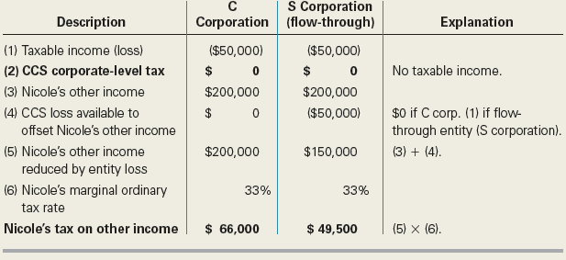
Entity Loss
Examples 1 and 2 Summary

Slide 23
Entity Loss Example 3
Suppose CCS is organized as an S corporation and Nicole’s basis before the $50,000 year 1 loss is $100,000. Further, assume that Nicole does not participate in CCS’s business activities; that is, assume she is a passive investor in the business entity. How much tax will Nicole (and her husband) pay on the $200,000 of other income?
Notes:
23

Slide 24
Entity Loss
Example 3 Solution
Answer: $70,000. Because Nicole is a passive investor, she is not allowed to deduct the loss allocated to her this year. She must carry it over and use it in future years (this assumes neither Nicole nor her husband have income from other investments in which they are passive investors).
Notes:
24

Slide 25
Entity Tax Characteristics
Other differences between entities (See Exhibit 15-3)
  Owner limitations (see Ch. 22)
  Owner contributions of appreciated property to entity (see Chs. 19, 20, and 22)
  Accounting periods (see Chs. 8, 20, and 22)
  Overall accounting method (see Chs. 8, 16, 20, and 22)
  Allocation of income or loss items to owners (see Chs. 20 and 22)
Notes:
25

Slide 26
Entity Tax Characteristics
Other differences between entities (See Exhibit 15-3)
  FICA and self-employment tax (see Chs. 20 and 22)
    .9% additional Medicare tax
  Share of flow-through entity debt included in basis of owner’s equity interest (see Chs. 20 and 22)
  Nonliquidating distributions of noncash property (see Chs. 18, 21, and 22)
  Liquidating entity (see Chs. 19, 21, and 22)
Notes:
26

Slide 27
Entity Tax Characteristics
Converting to Other Entity Types
  C corporations
    Make election to S corporation
      May not qualify to make S election
    May liquidate and form as entity taxed as a partnership but tax cost of liquidation prohibitive
  Entities taxed as partnerships or sole proprietorships
    Generally tax free to form as a corporation
    Very common in advance of IPO
Notes:
27

