Slide 1
Chapter 5
Corporate Operations

Slide 2
Learning Objectives
Describe the corporate income tax formula, compare and contrast the corporate to the individual tax formula, and discuss tax considerations relating to corporations’ accounting periods and accounting methods.
Identify common book-tax differences, distinguish between permanent and temporary differences, and compute a corporation’s taxable income and regular tax liability.
Describe a corporation’s tax return reporting and estimated tax payment obligations.
Calculate a corporation’s alternative minimum tax liability.
5-2

Slide 3
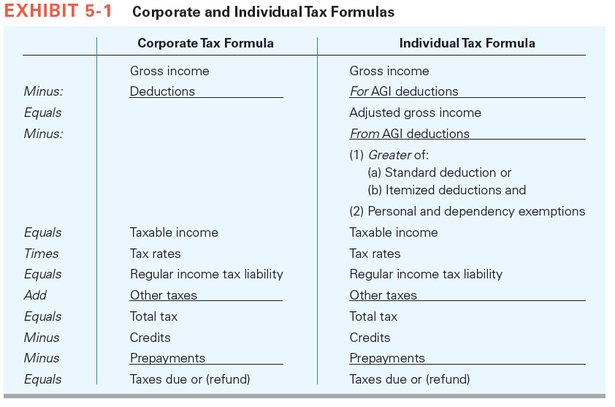
Corporate Taxable Income Formula
5-3

Slide 4
Book-Tax Adjustments
Financial income typically is the starting point for computing taxable income
  Reconcile to taxable income
  Book-tax adjustments for differences between financial accounting rules
  Companies preparing financial statements with tax accounting methods won’t have book-tax differences
5-4

Slide 5
Book-Tax Adjustments
Unfavorable Adjustments:
  Add back to book income to compute taxable income
Favorable Adjustments:
  Subtract from book income to compute taxable income
Permanent differences
Temporary differences
5-5

Slide 6
Common Permanent
Book-Tax Differences
Interest income from municipal bonds (Fav)
Death benefit from life insurance on key employees (Fav)
Life insurance premiums (UnFav)
Half of meals and entertainment expense (UnFav)
Fines and penalties and political contributions (UnFav)
Excess compensation to executives (UnFav)
Federal income taxes (UnFav)
Dividends received deduction (Fav)
Domestic manufacturing deduction (Fav)
5-6

Slide 7
Common Temporary
Book-Tax Differences
Dividends
Depreciation
Gain/loss on sale of depreciable asset
Bad debt expense
§263A uniform inventory capitalization costs
Organizational or start-up costs
Unearned rent revenue
Deferred compensation
Stock options
Net capital loss
  Carry back three years and forward five years
Net operating loss carryover
Goodwill acquired in an asset acquisition
5-7

Slide 8
Book-Tax Differences from Dividends
Dividends
  Included in gross income for tax purposes
  Under the general rule, income included in financial income depends on ownership
    If ownership < 20%, no book tax difference
    If ownership is at least 20% but not more than 50%, the receiving corporation does not include the dividend in book income but includes a pro-rata share of the distributing corporation’s income in its income
    If ownership > 50%, consolidated financial reporting
5-8

Slide 9
Dividends Book-Tax Difference Example
Assume that PCC owned 30 percent of the stock of BCS corporation. During 2016, BCS distributed a $40,000 dividend to PCC. BCS reported $100,000 of net income for 2016. Based on this information, what is PCC’s 2016 book-tax difference relating to the dividend and its investment in BCS (ignore the dividends received deduction)? Is the difference favorable or unfavorable?
5-9

Slide 10
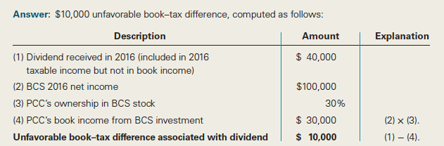
Dividends Book-Tax Difference Example Solution
5-10

Slide 11
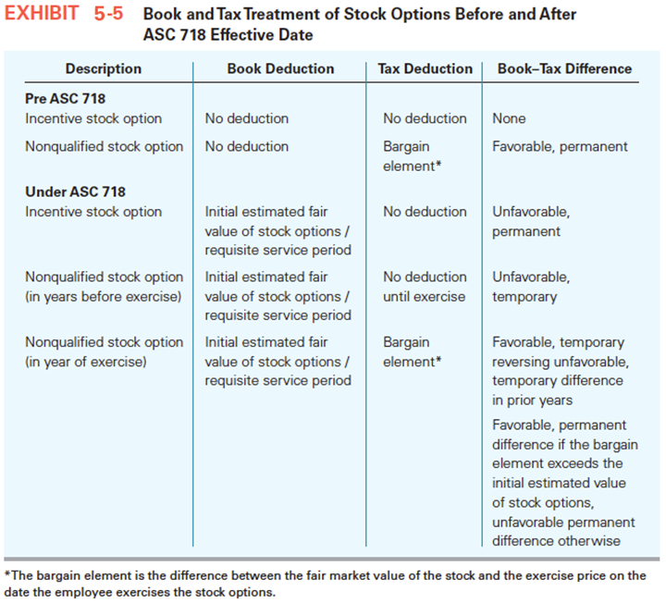
Stock Option-Related Book-Tax Differences
5-11

Slide 12
Stock Option Example 1
On January 1, 2016, PCC granted 20,000 nonqualified options with an estimated $5 value per option ($100,000 total value). Each option entitled the owner to purchase one share of PCC stock for $15 a share (the per share price of PCC stock on January 1, 2016, when the options were granted). The options vested at the end of the day on December 31, 2016 (employees could not exercise options in 2016).
What is PCC’s book-tax difference associated with the nonqualified options in 2016? Is the difference favorable or unfavorable? Is it permanent or temporary?
5-12

Slide 13
Stock Option Example 1 Solution
Answer: $100,000 unfavorable, temporary book-tax difference. PCC amortizes the compensation expense ratably over the vesting period (2016). PCC expenses $100,000 for book purposes in 2016 and reports a $0 compensation deduction for tax purposes (the options were not exercised).
5-13

Slide 14
Stock Option Example 2
Assume the same facts in Example 1 and that on March 1, 2017, employees exercised all 20,000 options at a time when the PCC stock was trading at $20 per share.
What is PCC’s book-tax difference associated with the stock options in 2017? Is it a permanent difference or a temporary difference? Is it favorable or unfavorable?
5-14

Slide 15
Stock Option Example 2 Solution
Answer: $100,000 favorable, temporary book-tax difference in 2017. The favorable book-tax difference is a complete reversal of the unfavorable book-tax difference in 2016. The 2016 and 2017 book-tax differences completely offset each other because the estimated value of $5 per option is equal to the bargain element ($20 FMV minus $15 exercise price per share).
5-15

Slide 16
Stock Option Example 3
Assume that on March 1, 2017, employees exercised all 20,000 options at a time when the
PCC stock was trading at $24 per share. What is PCC’s book-tax difference associated with the stock options in 2017? Is it a permanent difference or a temporary difference? Is it favorable or unfavorable?
5-16

Slide 17
Stock Option Example 3 Solution
Answer: $180,000 favorable book-tax difference in 2017. The $180,000 difference consists of a $100,000 favorable, temporary difference (the reversal of the prior year unfavorable, temporary difference) and an $80,000 permanent, favorable difference. The permanent difference is the bargain element on the 20,000 options in excess of the estimated value of the options for book purposes [($24 − $20) × 20,000 options].
5-17

Slide 18
Net Capital Losses
No current deduction for net capital losses (capital losses in excess of capital gains)
Carry back net capital losses three years and carry forward five years.
  Use carryover amounts on FIFO basis
Unfavorable, temporary book-tax difference in year of net capital loss
Favorable, temporary book-tax difference in year carryback or carryover is utilized
5-18

Slide 19
Net Operating Loss Deduction
5-19
No current benefit from current year loss (NOL)
Carry NOL back two years and forward 20 to offset taxable income in those years
May elect to forgo carry back
  Why would a corporation do this?

Slide 20
Net Operating Loss Deduction
5-20
To compute NOL for year no deduction for
  NOL carrybacks or carryovers from other years
  Capital loss carrybacks (carryovers are allowed)

Slide 21
NOL Example
5-21
XYZ Inc. has a net operating loss of $20,000 for the 2016 tax year. XYZ reported the following taxable income from 2013 through 2015:
  2013: $10,000
  2014: $17,000
  2015: $8,000
What options does XYZ have with respect to the current year NOL?

Slide 22
NOL Example Solution
5-22
Could carry back $17,000 to 2014, then $3,000 to 2015.
  Immediate refund (file Form 1139)
Or, could forgo carryback and carry loss forward 20 years

Slide 23
Charitable Contributions
Amount of deduction
  Capital gain property
    Generally fair market value
  Ordinary income property
    Generally adjusted basis
Accrual method corporation
  Deduct when accrue if
    Approved by board of directors before year end
    Paid within 3 ½ months after end of year (beginning in 2016)
5-23

Slide 24
Charitable Contributions
Deduction limited to 10% of taxable income before deducting
  Any charitable contribution deduction
  The dividends received deduction (DRD)
  NOL carrybacks
  Domestic production activities deduction (DPAD)
  Capital loss carrybacks
Carry forward excess contributions for five years
5-24

Slide 25
Charitable Contribution Example
In 2016, PCC donated a total of $700,000 of cash to the American Red Cross. PCC’s taxable income before the charitable contribution deduction, NOL carryover ($24,000), DRD ($21,000), and DPAD ($465,000) was $6,287,000. What is PCC’s charitable contribution deduction for the year? What is its charitable contribution carryover to next year, if any?
5-25

Slide 26
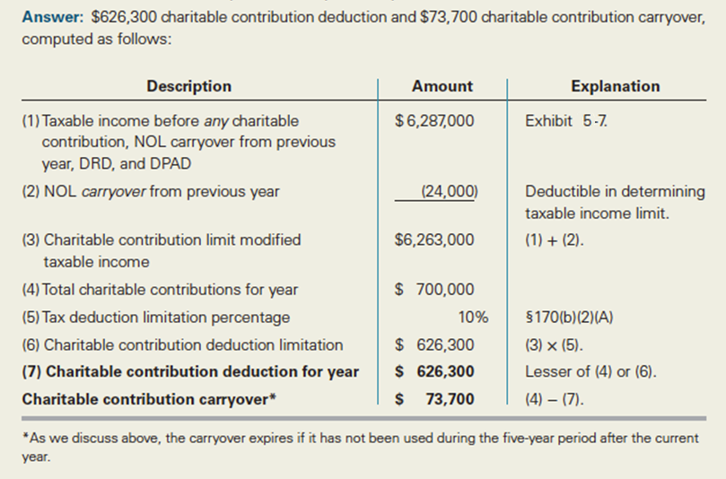
Charitable Contribution Example Solution
5-26

Slide 27
Dividends Received Deduction
Deduction to mitigate more than two levels of tax
  Own less than 20%: 70% DRD
  Own at least 20% but less than 80%: 80% DRD
  Own 80% or more: 100% DRD
Limitation: Deduction is limited to the lesser of
  (1) Dividend × DRD % or
  (2) DRD modified taxable income × DRD %
    Modified taxable income = taxable income before DRD, any NOL, DPAD, and capital loss carrybacks
    If full DRD extends or creates NOL, this limit does not apply
Creates favorable, permanent book-tax difference
5-27

Slide 28
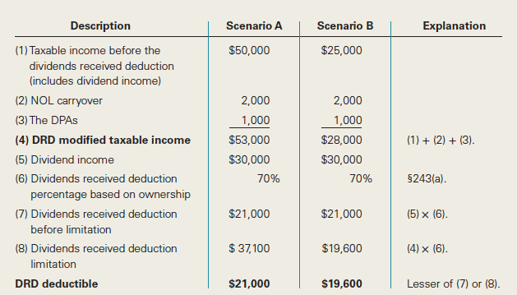
Dividends Received Deduction Example
5-28

Slide 29
Regular Tax Liability
Marginal tax rates range from 15% to 39%.
  Larger corporations generally pay flat 34% or 35% rate
Controlled groups
  Group of corporations treated as one for determining certain tax benefits
  Parent-Subsidiary
  Brother-Sister
  Combined
5-29

Slide 30
Compliance
Corporations report taxable income on Form 1120.
  Small corporations complete Schedule M-1
  Large corporations complete Schedule M-3
  Book-tax differences referred to as M adjustments
Corporate returns are due 3½ months after the close of the tax year (June 30 year-end exception).
  Automatic six month extension for filing (10/15 for calendar year)
Consolidated tax returns
  Affiliated groups essentially treated as one corporation
5-30

Slide 31
Form 1120
Schedule M-1
5-31

Slide 32
Estimated Payments
Corporations with a federal income tax liability of $500 or more are required to pay their estimated income tax in four monthly installments.
  Installments due on the 15th day of:
    4th month (25% of required annual payment)
    6th month (50% of required annual payment)
    9th month (75% of required annual payment)
    12th month (100% of required annual payment)
Corporations may owe a penalty for underpayment
  Payments based on required annual payment
5-32

Slide 33
Estimated Payments
Required annual payment
  100% of tax liability on prior year return
    Doesn’t apply if no liability in prior year
  100% of current year tax liability
  100% of estimated current year tax liability using annualized method
Rules for large corporations
  $1,000,000 of taxable income in prior three years
  May use prior year liability for first quarter payment only
5-33

Slide 34
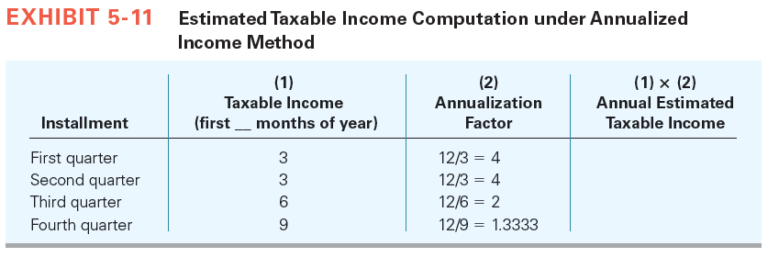
Estimated Payments
5-34

Slide 35
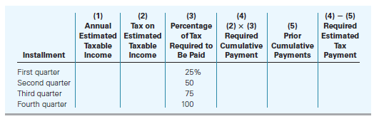
Estimated Payments
5-35

Slide 36
Alternative Minimum Tax
Tax paid in addition to regular tax liability
Does not apply to small corporations
  Average annual gross receipts < $7.5 million for three years prior to current taxable year
  Once fail small corporation test, subject to AMT for all subsequent years
5-36

Slide 37
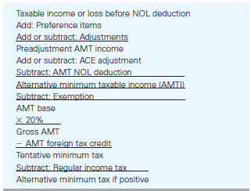
Alternative Minimum Tax
5-37

Slide 38
Alternative Minimum Tax
Preference items
  Added to taxable income to determine AMTI
  Tax exempt interest income from private activity bond (issued in years other than 2009 or 2010)
  Percentage depletion in excess of cost basis
  Others
5-38

Slide 39
Alternative Minimum Tax
Adjustments
  Depreciation
  Gain or loss on disposition of depreciable assets
  Adjusted current earnings adjustment (ACE)
    75% of difference between AMTI and adjusted current earnings (or 75% of net amount of modifications)
    Adjusted current earnings determined by making modifications to AMTI
    Adjustment can be positive or negative in a given year
      Negative adjustment limited to cumulative positive prior adjustments
5-39

Slide 40
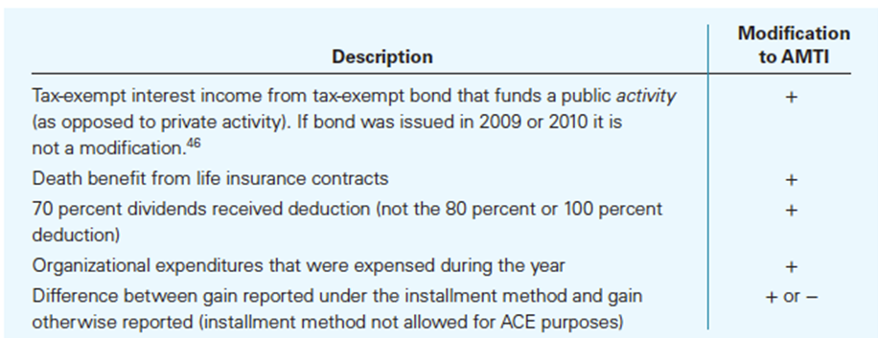
Alternative Minimum Tax
5-40

Slide 41
Adjusted Current Earnings Example
Assume PCC did not receive any dividends and that it received $12,000 in interest from a San Diego bond that is not a private activity bond and the bond was not issued in 2009 or 2010. Further, assume that PCC reported $5,000 of organizational expenses this year and it reported $20,000 of gain this year from an installment sale it executed two years ago. Assuming PCC’s cumulative ACE adjustment as of the beginning of the year is $100,000, what is its current year ACE adjustment under these circumstances?
5-41

Slide 42
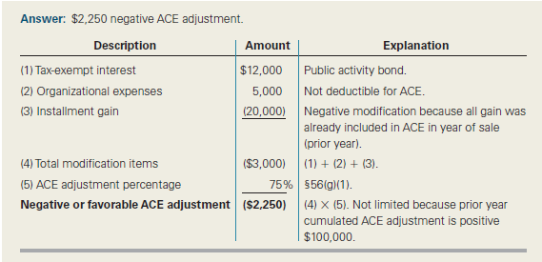
Adjusted Current Earnings Example Solution
5-42

Slide 43
AMT Exemption
Full exemption is $40,000
  Phased out by 25% of AMTI in excess of $150,000
  Fully phased out when AMTI reaches $310,000
5-43

Slide 44
Alternative Minimum Tax
AMTI × 20% = Tentative minimum tax
AMT = Tentative minimum tax minus regular tax liability
Minimum tax credit
  Amount of AMT creates credit
  Carry forward indefinitely
  When regular tax > Tentative minimum tax, credit can offset regular tax down to tentative minimum tax amount
5-44

Slide 45
Minimum Tax Credit Example
Assume that in year 1, PCC has a TMT of $1,152,690 and a regular tax liability of $1,000,000. PCC would owe $152,690 of AMT and $1,000,000 of regular tax. It would also generate a $152,690 minimum tax credit. Further, assume that in year 2 PCC reports a tentative minimum tax of $900,000 and a regular tax liability of $1,000,000. What is PCC’s tax liability after applying the minimum tax credit?
5-45

Slide 46
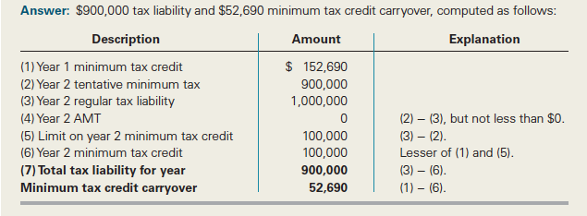
Minimum Tax Credit Example Solution
5-46

