Slide 1
Chapter 7
Corporate Taxation: Nonliquidating Distributions

Slide 2
Learning Objectives
Explain the framework that applies to the taxation of property distributions from a corporation to a shareholder.
Compute a corporation's earnings and profits and a shareholder's dividend income.
Identify when a corporation may be deemed to have paid a "constructive dividend" to a shareholder.
Explain the taxation of stock dividends.
Comprehend the tax consequences of stock redemptions.
Describe the tax consequences of a partial liquidation to the corporation and its shareholders.

Slide 3
Framework for Property Distributions
Distributions to shareholders will be taxed in one of the following ways:
Taxed as income (albeit at a lower tax rate)
Return of capital
Capital gains
When distributions from corporations are taxed to shareholders, this creates double taxation of corporate income

Slide 4
Framework for Property Distributions
Some payments to shareholders are deductible by the corporation
Examples are payments for services (salary), interest, and rent
To be deductible, payments to shareholders must be reasonable in amount
Unreasonable payments (e.g., excessive salary) are taxed as “constructive” dividends to shareholders

Slide 5
Constructive Dividends
Examples of constructive dividends
Unreasonable compensation
Shareholder use of corporate assets without an arm’s-length payment
Interest paid to shareholder at excessive interest rates
Payments made by the corporation on behalf of a shareholder

Slide 6
Computing Earnings and Profits
Overview of distributions:
Dividend distributions are included in the shareholder’s gross income
Non-dividend distributions are a return of capital (reduce the shareholder’s tax basis in the corporation’s stock)
Non-dividend distributions in excess of the shareholder’s stock tax basis constitute a gain from sale or exchange of the stock

Slide 7
Determining the Dividend
A “dividend” for tax purposes is:
any distribution of property made by a corporation to its shareholders out of its earnings and profits (E&P)
Two separate E&P accounts to be maintained
Current earnings and profits (CE&P)
Accumulated earnings and profits (AE&P)
Undistributed current E&P is added to the balance of accumulated E&P on the first day of the next tax year

Slide 8
Determining the Dividend
Computing Earnings and Profits begins with taxable income
Taxable income is adjusted as follows:
Income that is excluded from taxable income
Disallowed deductions that do not require an economic outflow
Deduction of expenses that require an economic outflow but are not deducted for computing taxable income
Adjustment of timing for deductions or income because of accounting methods required for E&P computation

Slide 9
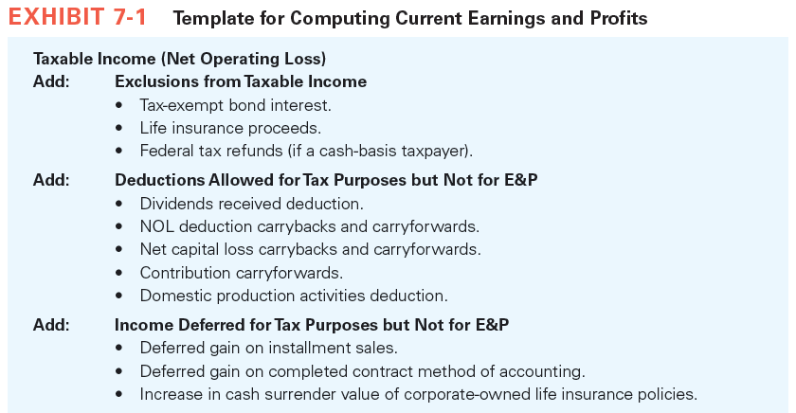

Slide 10
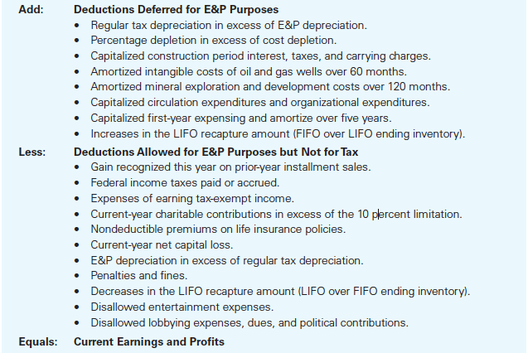

Slide 11
Determining the Dividend
Ordering of E&P Distributions
Positive Current E&P and Positive Accumulated E&P
Positive current E&P, negative accumulated E&P
Negative current E&P, positive accumulated E&P
Negative current E&P, negative accumulated E&P

Slide 12
Determining the Dividend
Example 1
Current E&P = $1,000,000
Accumulated E&P = ($500,000)
The corporation distributes $1,000,000 on July 1.
The entire distribution is deemed to come from current E&P and is a dividend to the shareholders.

Slide 13
Determining the Dividend
Example 2
Current E&P = ($1,000,000)
Accumulated E&P = $1,000,000
The corporation distributes $1,000,000 on July 1.
Current E&P is apportioned on a per day basis
AE&P as of July 1 = $1M − ½($1M) = $500,000
$500,000 is a treated as a dividend.

Slide 14
Determining the Dividend
Distributions of Noncash Property to Shareholders

Slide 15
Determining the Dividend
Tax Consequences to a Corporation Paying Noncash Property as a Dividend
The corporation recognizes gains (but not losses) on the distribution of noncash property as a dividend
Gain is recognized to the extent of fair market value in excess of tax basis in the property
Liabilities
If the property’s fair market value is less than liabilities assumed by the shareholder, the fair market value is deemed to be the liability

Slide 16
Determining the Dividend
Example 3
Cher Holder receives a property distribution from Sunny Corporation with a fair value of $200. Cher assumes a $100 mortgage attached to the property. Sunny’s basis in the property distributed is $100.
Sunny Corporation reports a gain of $100 on the distribution ($200 − $100).

Slide 17
Determining the Dividend
Example 4
Cher Holder receives a property distribution from Sunny Corporation with a fair value of $200. Cher assumes a $300 mortgage attached to the property. Sunny’s basis in the property distributed is $100.
Sunny Corporation reports a gain of $200 on the distribution ($300 − $100).
The property’s FMV is deemed to be the amount of the liability assumed because it exceeds the property’s fair market value.

Slide 18
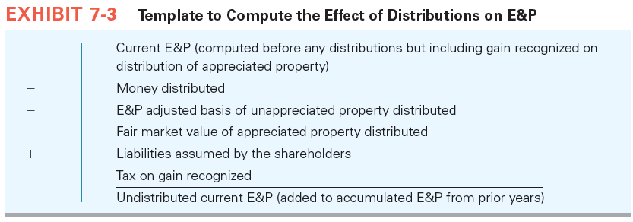
Determining the Dividend
Noncash Property Distributions affect E&P

Slide 19
Stock Dividends
A stock dividend increases the number of shares outstanding
Stock dividends can also take the form of a stock split (e.g., 2-for-1 stock split)
Stock dividends are nontaxable to shareholders if two conditions are met:
Made with respect to common stock and
Pro rata (proportionate interests maintained)

Slide 20
Stock Dividends
Non-pro rata stock dividends usually are taxable as dividends

Slide 21
Stock Redemptions
Form of a Stock Redemption
A redemption occurs when a corporation acquires its stock from a shareholder in exchange for property
A redemption results in either a dividend or a sale of the redeemed shares
Individuals prefer exchange treatment because of the preferential tax rates for capital gains
Corporate shareholders prefer dividend treatment because of the dividends received deduction

Slide 22
Stock Redemptions
Three types of redemptions are treated as exchanges:
Redemptions that are Substantially Disproportionate are treated as sales
Redemptions in Complete Redemption of all of the Stock of the Corporation Owned by the Shareholder
Redemptions that are not Essentially Equivalent to a Dividend

Slide 23
Stock Redemptions
Stock ownership tests are required for treatment as substantially disproportionate:
Shareholder does not control the corporation after the exchange (less than 50 percent of voting power)
Shareholder’s percentage of voting stock and aggregate value is less than 80 percent of the percentage before the redemption
Constructive ownership rules must be considered:
Family attribution
Attribution from entities to owners or beneficiaries
Attribution from owners or beneficiaries to entities
Option attribution

Slide 24
Stock Redemptions
Example 5
Tom owns 60 of the corporation’s 100 shares of voting common stock.
1. What percentage ownership test(s) must be met for the Tom to receive exchange treatment?
2. How many shares of stock must the corporation redeem to have Tom treat the redemption as an exchange?

Slide 25
Stock Redemptions
Example 5 Solution Part 1:
Two tests must be met:
First, after the redemption Tom must own less than 50% of the outstanding shares.
Second, Tom’s percentage ownership after the redemption must be less than 80 percent of his percentage ownership before the redemption.
In this case, Tom ’s 60 percent ownership must drop to less than 48% (80% × 60% = 48%).

Slide 26
Stock Redemptions
Example 5 Solution Part 2:
To determine the minimum number of shares to be redeemed, solve the following inequality where x=number of redeemed shares:
This reduces to the following expression:
Hence, by redeeming 24 of Tom’s shares his ownership interest in the corporation will drop to 47.4% ([60-24] / [100 − 24] = 36/76).
(60 – x) / (100 – x) < .48
.52x > 12 and x > 24 shares

Slide 27
Stock Redemptions
If the redemption is treated as an exchange the shareholder tax consequences are:
Gain is always recognized
Loss is recognized unless the shareholder is a related person to the corporation
The redeemed shareholder may be related if they owns more than 50% of the stock’s value
Note that ownership is determined using the §267(c) attribution rules

Slide 28
Stock Redemptions
Tax Consequences to the Distributing Corporation
Current E&P is reduced dividend distributions (cash and fair market value of other property adjusted for gain recognized and liabilities distributed)
For an exchange, current and accumulated E&P is reduced by the percentage of stock redeemed (limited to the fair market value of the property distributed)
Current E&P is reduced by dividends before reducing its current E&P for redemptions treated as exchanges

Slide 29
Stock Redemptions
Example 6
Acme Inc. has AE&P at 1/1/15 of $100,000 and CE&P for 2015 is $75,000. Acme redeems all of Bill’s stock on July 1 for $60,000. The stock redeemed represents 25% of Acme stock. On December 31, Acme pays its remaining shareholders dividends of $25,000. Bill treats the redemption as an exchange.
What is the effect on Acme’s AE&P and CE&P?
1. CE&P after the dividends is $50,000 ($75,000 − $25,000)
2. AE&P at 7/01/14 is $100,000 + ½($50,000) = $125,000
3. Acme reduces AE&P to the lesser of: 25% × $125,000 = $31,250 or $60,000 (fair value of the distribution)

Slide 30
Partial Liquidations
Corporations can contract either by:
Distributing stock of a subsidiary to shareholders
Selling a business and distributing the proceeds to shareholders in partial liquidation
Distributions may require the shareholders to exchange some shares of stock or may be pro rata to all the shareholders without an actual exchange of stock
Noncorporate shareholders receive exchange treatment
Corporate shareholders determine their tax consequences using the change-in-stock ownership rules that apply to stock redemptions

