Slide 1
Chapter 9
Forming and Operating Partnerships

Slide 2
Learning Objectives
Determine whether a flow-through entity is taxed as a partnership or S corporation, and distinguish the entity approach from the aggregate approach for taxing partnerships.
Resolve tax issues applicable to partnership formations and other acquisitions of partnership interests, including gain recognition to partners and tax basis for partners and partnerships.
Determine the appropriate accounting periods and methods for partnerships.
Calculate and characterize a partnership’s ordinary business income or loss and its separately stated items, and demonstrate how to report these items to partners.
Explain the implications of a partner’s tax basis and the adjustments that affect it.
Apply the basis, at-risk, and passive activity loss limits to losses from partnerships.
9-2

Slide 3
Flow-Through Entities
Income earned by flow-through entities is not taxed at the entity level
Owners of flow-through entities are taxed on the entity-level share of income allocated to them
Income from flow-through entities is taxed only once when it “flows through” to owners of these entities
Aggregate and Entity Concepts
Entity approach
9-3

Slide 4
Flow-Through Entities
Treats tax partnerships as entities separate from their partners
Aggregate approach
Treats tax partnerships as an aggregation of partners separate interests in the assets and liabilities of the partnership
One of the most basic tenets of partnerships tax law - “Partnerships don’t pay taxes” - reflects the “aggregate approach”
Partnerships, rather than partners, making most tax elections represents the entity concept
9-4

Slide 5
Partnership Formations and Acquisitions of Partnership Interests
Acquiring partnership interests when partnerships are formed
Partnership interest
When a partnership is formed, partners may transfer cash, other tangible or intangible property, and services to it in exchange for an equity interest
Partnership rights
Right to receive a share in the partnership assets if the partnership were to liquidate, called a capital interest
Right or obligation to receive a share of future profits or future losses, called a profits interest
Partners who contribute services instead of property, frequently receive only profits interests
9-5

Slide 6
Partnership Formations and Acquisitions of Partnership Interests
Contributions of Property
Depending on the transaction, realized gains and losses from the exchange of contributed property for partnership interests are either fully or partially deferred for tax purposes
Similar to rationale for permitting tax deferral when corporations are formed
Follows aggregate theory of partnership taxation
9-6

Slide 7
Partnership Formations and Acquisitions of Partnership Interests
Gain and loss recognition
Generally, neither partnerships nor partners recognize gain or loss when they contribute property to partnerships
Definition of property includes a wide variety of both tangible and intangible assets but not services
General rule facilitates
Contributions of property with built-in gains (FMV > tax basis)
General rule discourages
Contributions of property with built-in losses (FMV < tax basis)
9-7

Slide 8
Partnership Formations and Acquisitions of Partnership Interests
Partner’s initial tax basis
Required to compute partners taxable gains and losses when they sell their partnership interests
Partner’s initial tax basis when partnership doesn't have any debt = sum of tax basis of property and cash contributed by partners
Computation of partner’s initial tax basis when partnership's have debt
Each partner must include his/her share of the partnership’s debt in calculating the tax basis in her partnership interest
Outside basis of partner contributing property must also reflect partner’s debt relief and any gain recognized from debt relief
9-8

Slide 9
Partnership Formations and Acquisitions of Partnership Interests
Partnership may have recourse debt
Debts for which partners have economic risk of loss
Usually allocated to the partners who will ultimately be responsible for paying it
Partnership may have nonrecourse debt
If secured by real property gives lenders the right to obtain the secured property in the event the partnership defaults on the debt
Usually allocated according to partners’ profit-sharing ratios
9-9

Slide 10
Partnership Formations and Acquisitions of Partnership Interests
Partner contributing property secured by debt recognizes gain when debt relief exceeds the partner’s basis in her partnership interest before debt relief
Contributing partner’s holding period in a partnership interest depends on the type of property contributed
Contributing partner’s tax basis and holding period in contributed property carries over to the partnership
9-10

Slide 11
Allocating Partnership Debt
Example 1
When CCS was organized early in 2010, Nicole contributed $10,000 of cash and land with a fair market value of $150,000 and adjusted basis of $20,000 to CCS. The land was encumbered by a $40,000 nonrecourse mortgage executed three years before. Recalling that CCS already had $60,000 in bank debt before Nicole’s contribution, what tax bases do Nicole, Sarah, and Chanzz Inc. initially have in their CCS interests?
9-11

Slide 12
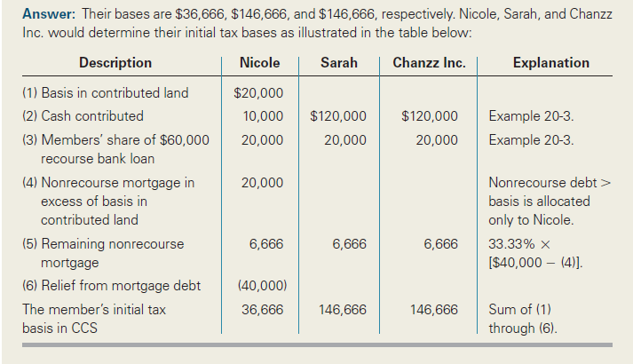
Allocating Partnership Debt
Example 1 Solution
9-12

Slide 13
Gain on Contributed Property
Example 2
Assume Sarah and Chanzz Inc., but not Nicole, personally guarantee all $100,000 of CCS’s
debt ($60,000 bank loan + $40,000 mortgage on land). How much gain, if any, would Nicole recognize on her contribution to CCS and what would be the basis in her CCS interest?
9-13

Slide 14
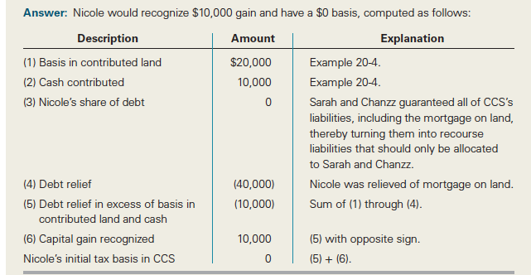
Gain on Contributed Property
Example 2 Solution
9-14

Slide 15
Partnership Formations and Acquisitions of Partnership Interests
Contribution of Services
Capital interest represents a current economic entitlement amenable to measurement
Service partners receiving capital interests report ordinary income
Service partner’s tax basis in the capital interest = amount of ordinary income she recognizes
Profits interests
No liquidation value when received
Service partner will not recognize income and non-service partners will not receive deductions
9-15

Slide 16
Services for Capital Interest
Example 3
On December 31, 2010, all members of CCS agreed Sarah would receive an additional capital interest in CCS with a liquidation value of $20,000 and an increase in her profit-and-loss-sharing ratio from 33.33 percent to 40 percent (leaving the other members with a 30 percent share of profits and losses),to compensate her for the time she would spend on an additional project. At this point, CCS’s debt was $100,000. What are the tax consequences to Sarah and CCS of giving her an additional capital interest?
9-16

Slide 17
Services for Capital Interest
Example 3 Solution
9-17

Slide 18
Services for Profits Interest
Example 4
Assuming Sarah received only a profits interest for her services instead of the capital interest she received in the previous example, what are the tax consequences to Sarah, Nicole, Chanzz Inc., and CCS?
9-18

Slide 19
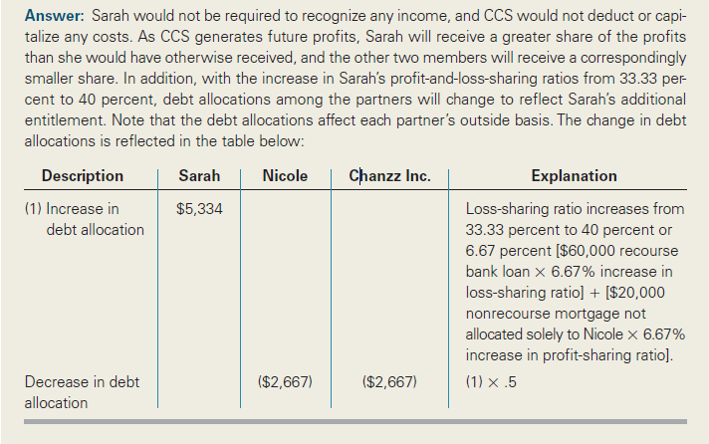
Services for Profits Interest
Example 4 Solution
9-19

Slide 20
Partnership Formations and Acquisitions of Partnership Interests
Tax basis of a purchased partnership interest = purchase price + partnership debt allocated to partner, and the holding period begins on purchase date
Organization, Start-up, and Syndication Costs
For benefit of the partnership and for tax purposes some costs must be capitalized rather than expensed
Expenses includes
Organization costs
Syndication costs
Start-up costs
9-20

Slide 21
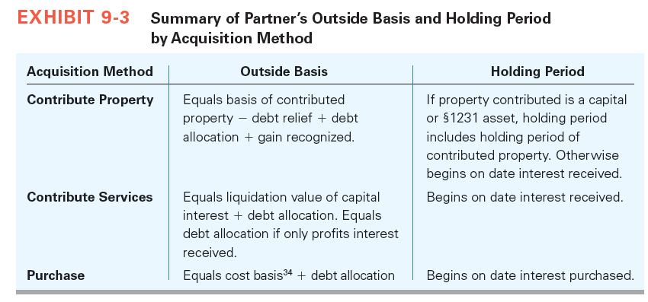
Partnership Formations and Acquisitions of Partnership Interests
Acquisitions of Partnership Interests
9-21

Slide 22
Partnership Accounting Periods, Methods, and Tax Elections
Tax Elections
Includes
Election of overall accounting method
Election to expense a portion of organization and start-up costs
Election to expense tangible personal property
Partnership makes most tax elections
Accounting Methods
Partnerships are generally eligible to use the cash method unless they have average gross receipts greater than $5 million and have corporate partners
9-22

Slide 23
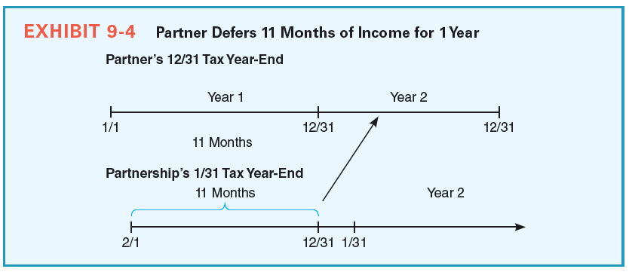
Partnership Accounting Periods, Methods, and Tax Elections
9-23

Slide 24
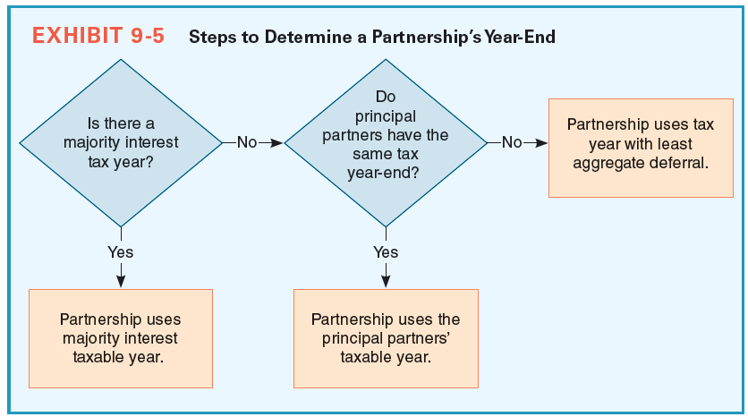
Partnership Accounting Periods, Methods, and Tax Elections
9-24

Slide 25
Reporting the Results of Partnership operations
Ordinary Business Income (Loss) and Separately Stated Items
Separately stated items change partners’ tax liabilities when they are separately stated
Partnership ordinary business income (loss) is all partnership income (loss) exclusive of any separately stated items of income (loss)
Separately stated items share one common characteristic
Are treated differently from a partner’s share of ordinary business income (loss) for tax purposes
9-25

Slide 26
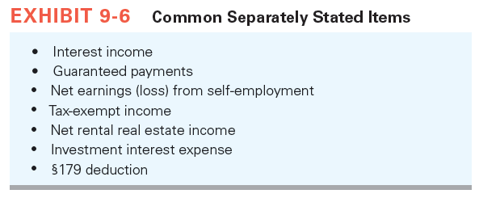
Reporting the Results of Partnership Operations
9-26

Slide 27
Reporting the Results of Partnership Operations
Guaranteed Payments
Fixed amounts paid to partners regardless of profit or loss earned by partnership
Treated as ordinary income by partners receiving them
Generally deducted in computing a partnership’s ordinary income or loss for the year
Separately stated to the partners receiving them
Self-Employment Tax
Shares of ordinary business income (loss) may or may not be treated by LLC members as self-employment income (loss), depending on the extent of their involvement with the LLC
9-27

Slide 28
Reporting the Results of Partnership Operations
Shares of ordinary business income (loss) are always
Treated as self-employment income (loss) by general partners
Not treated as self-employment income (loss) by limited partners
LLC members that should be classified as general partners when applying the self-employment tax rules are the members who have
Personal liability for the debts of the LLC by reason of being an LLC member,
Authority to contract on behalf of the LLC, or
Participated in more than 500 hours in the LLC’s trade or business
9-28

Slide 29
Reporting the Results of Partnership Operations
Partnership Items Included in Computation of Net Investment Income Tax
Individual partner’s share of interest, dividends, annuities, royalties, rent
Individual partner’s share of income from a trade or business that is a passive activity
Individual partner’s share of gains from the disposition of property not used in an active trade or business
Separately stated to the partners receiving them
9-29

Slide 30
Reporting the Results of Partnership Operations
Partnership Compliance Issues
Although partnerships don’t pay taxes, they are required to file Form 1065, U.S. Return of Partnership Income, with the IRS by April 15 for a calendar year partnership
Page 1 of Form 1065 shows details of calculation of the partnership’s ordinary business income (loss) for the year
Page 3, Schedule K, lists the partnership’s ordinary business income (loss) and separately stated items
Schedule K-1s are included with Form 1065 when it is filed, and Schedule K-1s are also separately provided to all partners
9-30

Slide 31
Partner's Adjusted Tax Basis in Partnership Interest
Partners make the following adjustments to the basis in their partnership interests annually:
Increase for actual and deemed cash contributions to the partnership during the year
Increase for partner’s share of ordinary business income and separately stated income/gain items and tax-exempt income
Decrease for actual and deemed cash distributions during the year
Decrease for partner’s share of nondeductible expenses (fines, penalties, etc.), ordinary business loss and separately stated expense/loss items
9-31

Slide 32
Partner's Adjusted Tax Basis in Partnership Interest
Cash Distributions in Operating Partnerships
Partners are taxed on income when partnership earns it but not when distributed
If cash is distributed when partners have a positive tax basis in their partnership interests, the distribution effectively represents
Distribution of profits that have been previously taxed
Return of capital previously contributed by the partner to the partnership
Distribution of cash the partnership has borrowed, or some combination of the three
Cash distributions (deemed or actual) in excess of a partner’s basis are taxable and are generally treated as capital gains
9-32

Slide 33
Loss Limitations
Operating losses, can generate current tax benefits when partners can deduct them against other sources of taxable income
Ordinary losses from partnerships are deductible against any type of taxable income
Losses are deductible on the partner’s tax return only when they clear three separate hurdles
Tax basis
At-risk amount
Passive activity loss hurdles
9-33

Slide 34
Loss Limitations
Tax Basis Limitation
In a sense, partner’s basis represents the amount a partner has invested in a partnership or may have to invest to satisfy her debt obligations
Partners may not utilize partnership losses in excess of their outside basis in their partnership interests
Losses allocated in excess of their basis must be suspended and carried forward indefinitely until partners have sufficient basis to utilize the losses
Partners may create additional tax basis by making capital contributions
9-34

Slide 35
Loss Limitations
At-Risk Limitation
More restrictive when compared to tax basis limitation
Adopted to limit the ability of partners to use nonrecourse debt as a means of creating tax basis
Limits partners’ losses to their at-risk amount
Only nonrecourse debt considered to be at-risk is nonrecourse real estate mortgages from commercial lenders called “qualified nonrecourse financing”
Partners are considered to be at-risk for
Amount equal to cash and the tax basis of property contributed to the partnership and
Recourse debt and qualified nonrecourse financing allocated to them
9-35

Slide 36
Loss Limitations
Passive Activity Loss Limitation
Enacted as a backstop to the at-risk rules and are applied after the tax basis and at-risk limitation
Applies primarily to individuals and also to estates, trusts, closely held C corporations, and personal service corporations
Limits the ability of partners in rental real estate partnerships and other partnerships they don’t actively manage from using their ordinary losses from these activities to reduce other sources of taxable income
Passive activity
Activity which involves the conduct of a trade or business, and in which the taxpayer does not “materially participate”
9-36

Slide 37
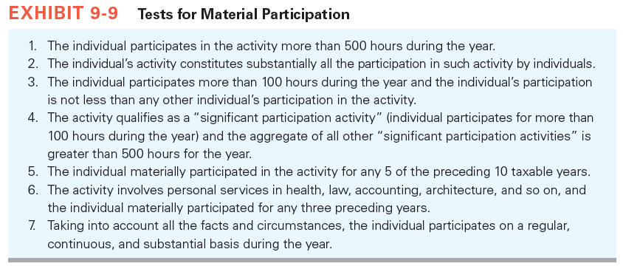
Loss Limitations
9-37

Slide 38
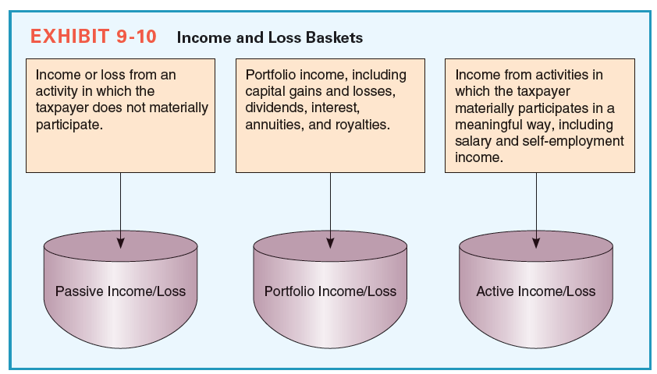
Loss Limitations
9-38

