Slide 1
Chapter 10
Dispositions of Partnership Interests and Partnership Distributions

Slide 2
Learning Objectives
Determine the tax consequences to the buyer and seller of the disposition of a partnership interest, including the amount and character of gain or loss recognized.
List the reasons for distributions, and compare operating and liquidating distributions.
Determine the tax consequences of proportionate operating distributions.
Determine the tax consequences of proportionate liquidating distributions.
Explain the significance of disproportionate distributions.
Explain the rationale for special basis adjustments, determine when they are necessary, and calculate the special basis adjustment for dispositions and distributions.
2
2

Slide 3
Basics of Sales of Partnership Interests
Raises unique issues because of the flow-through nature of the entity
If tax rules follow an entity approach, the interest is considered a separate asset and sale of partnership interest would be very similar to the sale of corporate stock
If tax rules use the aggregate approach, the disposition represents a sale of the partner’s share of each of the partnership’s assets

Slide 4
Basics of Sales of Partnership Interests
Seller Issues
Primary tax concern is calculating the amount and character of gain or loss on the sale
Selling partner determines gain or loss as the difference between the amount realized and his/her outside basis in partnership
Hot Assets
Unrealized receivables include the right to receive payment for “goods delivered, or to be delivered” or “services rendered, or to be rendered”

Slide 5
Basics of Sales of Partnership Interests
For cash-method taxpayers, unrealized receivables include amounts earned but not yet received
For accrual-method taxpayers accounts receivable are not considered unrealized receivables because accrual-method taxpayers have already realized and recognized these items as ordinary income
Inventory items include classic inventory, defined as property held for sale to customers in the ordinary course of business. Inventory items also include any assets that are not capital assets or §1231 assets.

Slide 6
Basics of Sales of Partnership Interests
Process for determining gain or loss
Step 1: Total gain or loss = Amount realized – Outside basis
Step 2: Calculate the partner’s share of gain or loss from hot assets as if the partnership sold these assets at their fair market value. This represents the ordinary portion of the gain or loss
Capital gain or loss = Step 1 – Step 2

Slide 7
Basics of Sales of Partnership Interests
Buyer and Partnership Issues
For sale transaction, the new investor’s outside basis will be equal to his cost of the partnership interest
To the extent that the new investor shares in the partnership liabilities, his share of partnership liabilities increases his outside basis
Varying Interest Rule
Partners’ interests increase when they contribute property or cash to a partnership or purchase a partnership interest

Slide 8
Basics of Sales of Partnership Interests
Partners’ interests decrease when they receive partnership distributions or sell all or a portion of their partnership interests
Two methods for allocating income or loss to partners when their interests change during the year
Allows the partnership to prorate income or loss to partners with varying interests
Sanctions an interim closing of the partnership’s books

Slide 9
Operating Distributions
Are usually paid to distribute the business profits to the partners but can also reduce a partner’s ownership
Operating Distributions of Cash Only
Partners generally do not recognize gain or loss on the distribution of property or money
One exception is when the distribution is greater than the partner’s outside basis. Partners will recognize gain in this case

Slide 10
Operating Distributions
Partner simply reduces his/her (outside) basis in the partnership interest by the amount of the distribution
Partnership’s basis in its remaining assets remains unchanged
Partner never recognizes a loss from an operating distribution

Slide 11
Operating Distributions
Operating Distributions That Include Property Other Than Money
Partners must reallocate their outside basis to the distributed assets (including money) and their continuing partnership interests
Carryover basis - Partner takes a basis in the distributed property equal to the partnership basis in the property

Slide 12
Operating Distributions
Order in which to allocate outside basis to the bases of distributed assets
First, the partner allocates the outside basis to any money received and then to other property as a carryover basis
Remainder is the partner’s outside basis after the distribution
When the partnership distributes property other than money with a basis that exceeds the remaining outside basis, the partner assigns the remaining outside basis to the distributed assets, and the partner’s outside basis is reduced to zero

Slide 13
Liquidating Distributions
Tax issues are basically:
to determine whether the terminating partner recognizes gain or loss and
to reallocate his or her entire outside basis to the distributed assets
Rationale behind the rules for liquidating distributions is simply to replace the partner’s outside basis with the underlying partnership assets distributed to the terminating partner

Slide 14
Liquidating Distributions
In theory, there would be no gain or loss on the distribution, and the asset bases would be the same in the partner’s hands as they were inside the partnership however this rarely occurs
So the rules are designed to determine when gain or loss must be recognized and to allocate the partner’s outside basis to the distributed assets

Slide 15
Liquidating Distributions
Gain or Loss Recognition in Liquidating Distributions
Generally partners and partnerships do not recognize gain or loss
Exception
Gain - Partner recognizes gain when partnership distributes money (includes debt relief) and the amount exceeds the partner’s outside basis in the partnership interest

Slide 16
Liquidating Distributions
Loss - Partner recognizes loss when two conditions are met
Distribution consists of only cash and hot assets, and
Partner’s outside basis exceeds the sum of the bases of the distributed assets
Basis in Distributed Property
Primary objective is to allocate the partner’s entire outside basis in the partnership to the assets the partner receives in the liquidating distribution

Slide 17
Liquidating Distributions
Allocation essentially depends on two things
the partnership’s bases in distributed assets relative to the partner’s outside basis and
the type of property distributed—whether it is money, hot assets, or other property

Slide 18
Liquidating Distributions

Slide 19
Liquidating Distributions
Partner’s Outside Basis Is Greater Than Inside Basis of Distributed Assets
Scenario 1: Distributions of money, inventory, and /or unrealized receivables
Suppose Greg has an outside basis of $334,000, including his share of liabilities of $66,000. In a liquidating distribution, he receives $159,000 cash and inventory with a fair market value and basis of $49,000. Will Greg recognize a gain or loss? (Example 21-16).

Slide 20
Liquidating Distributions
Answer: Yes, to prevent the conversion of a capital loss to an ordinary loss, Greg recognizes a $60,000 capital loss. If the inventory distributed to Greg is also considered inventory in his hands, the eventual sale of the inventory will generate ordinary income. If the inventory is a capital asset to Greg, a sale of the asset within five years of the distribution will generate ordinary income. After five years, the gain or loss would be capital.

Slide 21
Liquidating distributions
Partner’s Outside Basis is Greater than Inside Basis of Distributed Assets
Scenario 2: Other property included in distributions
Partner allocates entire outside basis to distributed assets.
Partner may increase the bases of any “other” property (not hot assets) but does not recognize gain or loss.

Slide 22
Liquidating Distributions
Procedure:
Step 1: Assign outside basis to distributed assets in amount equal to the assets’ inside basis.
Step 2: Allocate the required increase to assets with unrealized appreciation.
Step 3: Allocate any remaining required increase to the distributed assets in proportion to their relative FMVs using
Basis Allocation = Required basis × (FMV _{asset} / Sum of FMV _{distributed other property})

Slide 23
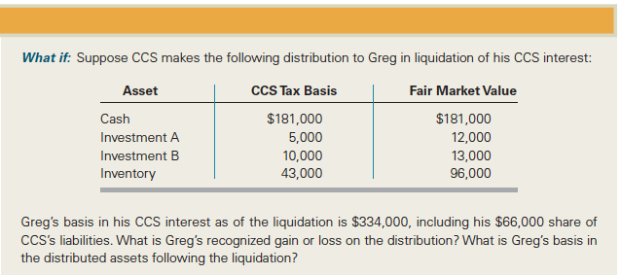
Liquidating distributions

Slide 24
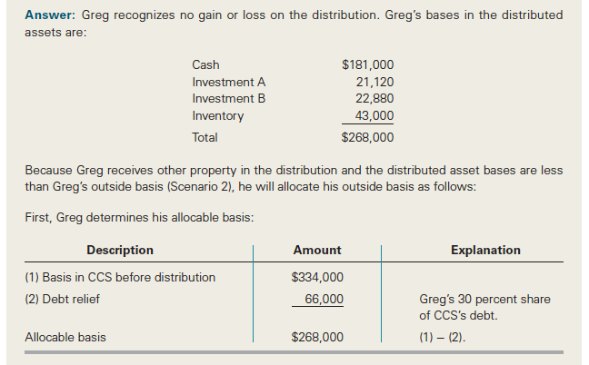
Liquidating Distributions

Slide 25
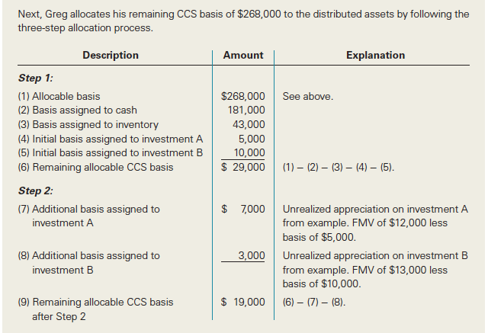
Liquidating Distributions

Slide 26
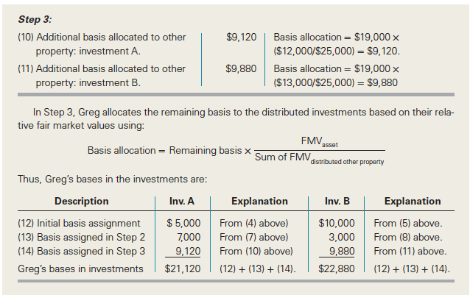
Liquidating Distributions

Slide 27
Liquidating Distributions
Partner’s Outside Basis Is Less Than Inside Basis of Distributed Assets
Scenario 3: Distributions of money only
Same tax consequences as in operating distributions of only money

Slide 28
Liquidating Distributions
Partner’s Outside Basis Is Less Than Inside Basis of Distributed Assets
Scenario 4: Distributions of money, inventory, and /or unrealized receivables
Partner reduces the basis in the distributed assets other than money but does not recognize gain or loss

Slide 29
Liquidating Distributions
Procedure:
Step 1: Assign outside basis to distributed assets in amount equal to the assets’ inside basis
Step 2: Allocate the required decrease to assets with unrealized depreciation
Step 3: Allocate any remaining required decrease to the distributed assets in proportion to their adjusted bases using
Basis Allocation = Required Decrease × (AB _{asset} / Sum of AB _{distributed assets})

Slide 30
Liquidating Distributions
Partner’s Outside Basis Is Less Than Inside Basis of Distributed Assets
Scenario 5: Other property included in distributions
Terminating partner does not recognize gain or loss but rather decreases the basis in the property distributed
Procedure is similar to the procedure under Scenario 4 except the required decrease reduces bases in other property rather than hot assets

Slide 31
Liquidating Distributions
Character and Holding Period of Distributed Assets
Generally, character stays the same to the partner as it was in the partnership
Inventory retains “taint” of ordinary income for five years after distribution
Partner’s holding period includes the partnership’s holding period

Slide 32
Disproportionate Distributions
Both operating and liquidating distributions can be disproportionate distributions
When distribution changes a partner’s relative ownership of partnership hot assets
To prevent partners from converting ordinary income into capital gains through distributions
Partner must treat a portion of the distribution as a sale or exchange, which results in recognition of gain (or loss)

Slide 33
Special Basis Adjustments
Helps to eliminate discrepancies between the inside and outside bases and correct artificial income or loss at the partnership level
Basis discrepancies arise in two situations:
Following sales of partnership interests, and
Following distributions when the basis of distributed property is increased or decreased and when the distributee partner recognizes a gain or loss on the distribution

Slide 34
Special Basis Adjustments
Partnership makes §754 election. Once made, special basis adjustments are required for:
Subsequent sales of partnership interests
Partnership distributions
Even without §754 election, special basis adjustments are required in some cases
For sales of partnership interests if the partnership has a “substantial built-in loss” at the time of the sale
For distributions if there is a substantial basis reduction

Slide 35
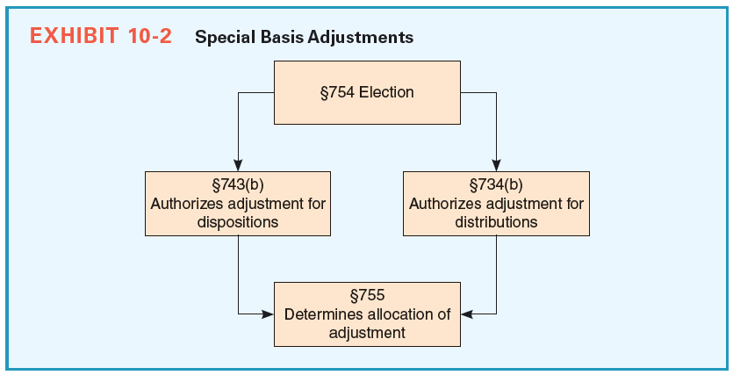
Special Basis Adjustments

Slide 36
Special Basis Adjustments
Special Basis Adjustments for Dispositions
Special basis adjustment partnership makes when a partner sells his/her partnership interest designed to give the new partner a share in the partnership assets equal to her outside basis
Inside bases of the continuing partners remain unchanged so their income and losses will continue to be accurately allocated

Slide 37
Special Basis Adjustments
Adjustment is equal to the difference between the new investor’s outside basis and his share of inside basis
New investor’s outside basis is generally equal to the cost of his partnership interest plus his share of partnership liabilities
When a new partners' special basis adjustment is allocated to depreciable or amortizable assets, the new investor will benefit from additional depreciation or amortization

Slide 38
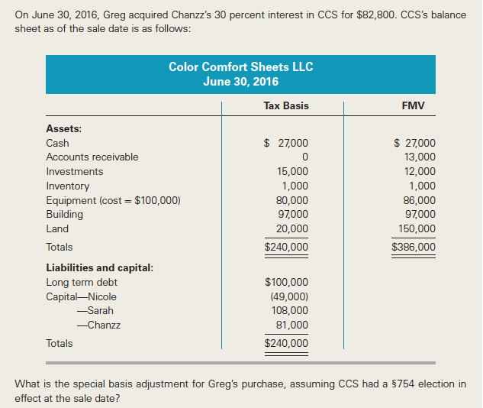
Special Basis Adjustments
Notes:
Example 21-26

Slide 39
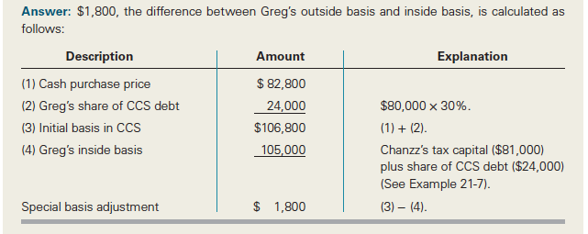
Special Basis Adjustments

Slide 40
Special Basis Adjustments
Special Basis Adjustments for Distributions
Potential problem exists when the partnership distributes property to the partners and the basis of the distributed property is changed as a result of the distribution
Affects the common basis of partnership property and not merely one partner’s basis
Positive basis adjustment will increase the basis in the partnership assets

Slide 41
Special Basis Adjustments
When a partner receiving distributed property recognizes a gain on the distribution
When a partner receiving distributed property takes a basis in the property less than the partnership’s basis in the property
Negative basis adjustment will decrease the basis in partnership assets
When a partner receiving distributed property in a liquidating distribution recognizes a loss on the distribution, and

Slide 42
Special Basis Adjustments
When a partner receiving distributed property takes a basis in the property greater than the partnership’s basis in the property
Allocation of special basis adjustment among the partnership’s assets for distributions is intended to offset any inequitable gain or loss the partners would have realized absent the adjustment

