Slide 1
Chapter 11
S Corporations

Slide 2
Learning Objectives
Describe the requirements and process to elect S corporation status.
Explain the events that terminate the S corporation election.
Describe operating issues relating to S corporation accounting periods and methods, and explain income and loss allocations and separately stated items.
Explain stock-basis calculations, loss limitations, determination of self-employment income, and fringe benefit rules that apply to S corporation shareholders.
Apply the tax rules for S corporation operating distributions and liquidating distributions.
Describe the taxes that apply to S corporations, estimated tax requirements, and tax return filing requirements.

Slide 3
S Corporation Elections
Formation – §351
Qualification requirements
  Shareholder type and number
  limits on corporation type
  1 class of stock
Filing the election
Effective date

Slide 4
S Corporation Election?
Suppose CCS was formed with Nicole Johnson, Sarah Walker, and Chanzz Inc., a corporation owned by Chance Armstrong, as shareholders. Would CCS be eligible to elect S corporation status?
  (No. Because one of its shareholders is a corporation (Chanzz Inc.), CCS would not be eligible to elect S corporation status)
Suppose Nicole, Sarah, and Chance recruited 97 U.S. residents to become shareholders of CCS. Meanwhile, Nicole gave several of her CCS shares to her grandfather and his bride as a wedding gift. After the transfer, CCS had 102 shareholders. Can CCS elect S corporation status?
  Yes. Nicole (descendant of common ancestor), her grandfather (common ancestor), and her grandfather’s wife (spouse of common ancestor) are treated as one shareholder for purposes of the 100-shareholder limit

Slide 5
S Corporation Terminations
Voluntary Terminations
  Elected by shareholders with > 50% stock
  Effective date
Involuntary Terminations
  Failing S corporation requirements
  Passive investment income in excess of 25 percent of gross receipts for 3 years
    Restricted to S corporations with “earnings and profits”
    Passive investment income; Gross receipts
  Effective date

Slide 6
S Corporation Terminations
Short tax years
  Allocation of income across S and C corporation years
  Daily method
  Specific identification method
  Tax return due dates
S corporation reelections
  Generally available at the beginning of the 5th year after year of termination
  Early IRS consent

Slide 7
Operating Issues
Accounting periods and methods:
  Elected at entity level
  Methods carryover from C corporation years
  May choose cash, accrual, or hybrid methods
  Must use a calendar year-end unless establish business purpose for alternative year-end or natural business year-end

Slide 8
Operating Issues
Income and loss allocations:
  Allocate profit and loss pro rata, based on shares owned each day of the year
  If sell shares during the year, pro rata, per day allocations
  If all shareholders with changing ownership percentages agree, the S corporation can use its normal accounting rules to allocate income and loss to the specific periods in which it realized income and losses

Slide 9
Income and Loss Allocations
Assume CCS was formed as a calendar-year S corporation with Nicole Johnson, Sarah Walker, and Chance Armstrong as equal (one-third) shareholders. On June 14, 2016, Chance sold his CCS shares to Nicole. CCS reported business income for 2016 as follows:
January 1 through June 14 (166 days) $100,000
June 14 through December 31 (200 days) 266,000
January 1 through December 31, 2016 (366 days) $366,000
How much 2016 income is allocated to each shareholder if CCS uses the daily method of allocating income?
  Nicole’s allocation is $188,667; Sarah’s is $122,000; and Chance’s is $55,333

Slide 10
Operating Issues
Separately stated items:
  Form 1120S, Schedule K-1
  Ordinary business income vs. separately stated items

Slide 11
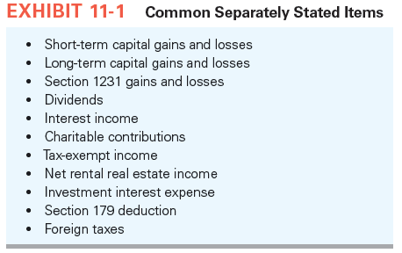
Operating Issues

Slide 12
Shareholder’s Basis
Initial basis:
  Exchange:
    Tax basis of property transferred, less any liabilities assumed by the corporation on the property contributed (substituted basis)
    Increased by any gain recognized; Reduced by the fair market value of any property received other than stock
  Purchase:
    Purchase price of the stock

Slide 13
Shareholder’s Basis
Annual basis adjustments:
  Increase for:
    Contributions
    Shareholder’s share of income/gain items (including tax-exempt income
  Decrease for:
    Distributions
    Shareholder’s share of nondeductible expenses
    Shareholder’s share of expense/loss items
  Basis can never be < 0

Slide 14
Shareholder’s Basis
Assume that Nicole’s beginning of year basis in CCS is $115,000. This year, her allocated share of S corporation items are: $80,000 business income; $2,000 interest income; $1,000 dividends; $400 tax-exempt interest income. What is Nicole’s basis at the end of 2016?
Description | Nicole
Initial tax basis | $115,000
(2) Ordinary business income | 80,000
(3) Interest income | 2,000
(4) Dividends | 1,000
Tax basis in stock at end of 2016 | $198,000

Slide 15
Loss Limitations
Tax Basis Limitation:
  Losses limited first to the shareholder’s tax basis in stock shares
  and then to any basis in any direct loans made to their S corporations
  In subsequent years, any net increase in basis for the year first restores the shareholder’s debt basis and then the shareholder’s stock basis
  Any loan repayment in excess of the shareholder’s debt basis triggers a taxable gain to the shareholder

Slide 16
Loss Limitations
Tax Basis Limitation (cont.):
  Losses not deductible due to the tax basis limitation are suspended until the shareholder generates additional basis
  If the shareholder sells the stock before creating additional basis, the suspended loss disappears unused
At risk Limitation
  shareholders may deduct S corporation losses only to the extent of their at-risk amount (§465)

Slide 17
Loss Limitations
At risk Limitation (cont.):
  S corporation shareholders are deemed at risk only for direct loans they make to S corporations
  S corporation shareholder’s at-risk amount is generally the same as stock basis
  Losses limited under the at-risk rules are carried forward indefinitely until the shareholder generates additional at-risk amounts to utilize them or sells the S corporation stock

Slide 18
Loss limitations
Suppose at the beginning of 2017, Nicole’s basis in her CCS stock was $14,000. During 2017, Nicole loaned $8,000 to CCS and CCS reported a $60,000 ordinary business loss and no separately stated items. How much of the $20,000 ordinary loss allocated to Nicole clears the tax basis hurdle for deductibility in 2017?
  All $20,000. The first $14,000 of the loss reduces her stock basis to $0, and the remaining $6,000 reduces her debt basis to $2,000 ($8,000 – $6,000).
Suppose in 2018, CCS allocated $9,000 of ordinary business income to Nicole and no separately stated items. What are Nicole’s CCS stock basis and debt basis at the end of 2018?
Her stock basis is $3,000; her debt basis is $8,000. The income first restores debt basis to its original amount and then increases her stock basis.

Slide 19
Loss Limitations
Post-termination Transition Period (PTTP) Loss Limitation:
    §1366(d) allows shareholders to treat suspended losses existing at the S termination date as occurring on the last day of the PTTP
    This rule allows shareholder to create stock basis (by capital contributions) during PTTP to utilize suspended losses
    PTTP period
    Any suspended losses not utilized during PTTP are lost

Slide 20
Loss Limitations
Passive Activity Loss Limitation:
    As in partnerships, the passive activity loss rules limit the ability of S corporation shareholders to deduct losses unless they are involved in actively managing the business
    No differences in the application of these rules for S corporations

Slide 21
Self-Employment Income
S corporation shareholder’s allocable share of ordinary business income (loss) is not classified as self-employment income
Shareholder salary as employees is subject to social security taxes
Tax planning incentives

Slide 22
Net Investment Income Tax
S corporation shareholders are subject to the 3.8% Net Investment Income tax on their share of an S corporation’s net investment income
Common types of investment income include interest, dividends, annuities, royalties, rents, passive income, and gains from disposing property

Slide 23
Fringe Benefits
For shareholder-employees who own 2 percent or less of the S corporation, the S corporation gets a tax deduction and the benefit is nontaxable to shareholder-employee
For shareholder-employee who own > 2 percent of the S corporation, the S corporation gets a tax deduction but many benefits are taxable to the shareholder-employee

Slide 24
Operating Distributions
S Corporations with No E & P
  Distributions are tax-free to the extent of shareholder’s basis
  Excess distribution is capital gain

Slide 25
Operating Distributions
S Corporations with E & P
  Distributions come from (1) AAA account, (2) E & P, and then (3) any remaining shareholder stock basis
  Distributions from AAA are nontaxable to extent of shareholder’s basis; any excess is capital gain
  Distributions from E & P are taxed as dividends
  Distributions from shareholder basis are nontaxable to extent of basis; any excess is capital gain

Slide 26
Operating Distributions
AAA account – calculation
  Beginning of year AAA balance
  + Separately stated income/gain items (excluding tax exempt income)
  + Ordinary income
  − Separately stated losses and deductions
  − Ordinary losses
  − Nondeductible expenses that are not capital expenditures (except deductions related to generating tax-exempt income)
  − Distributions out of AAA
  = End of year AAA balance
  AAA may have a negative balance but distributions may not cause the AAA to go negative or become more negative

Slide 27
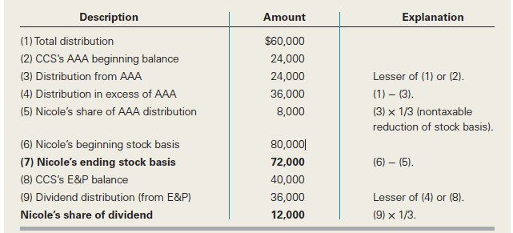
Operating Distributions
Before considering distributions, CCS’s AAA was $24,000 and its accumulated E&P from 2015 was $40,000. Also assume Nicole’s basis in her CCS stock is $80,000. If CCS distributes $60,000 on July 1 ($20,000 to each shareholder), what is the amount and character Nicole (a 1/3 shareholder) must recognize on her $20,000 distribution, and what is her stock basis in CCS after the distribution?

Slide 28
Property Distributions
S corporation consequences:
  recognizes gain on distribution of appreciated property
  does not recognize loss on distribution of property whose value has declined
Shareholder consequences:
  recognizes distributive share of the deemed gain and increase stock basis accordingly
  the property distribution is the FMV of the property received
  taxability of distribution is determined based on distribution rules discussed previously
  basis is FMV of property

Slide 29
Post-termination Transition Period (PTTP) Distributions
§1371(e) provides that cash distributions after an S election termination and during the PTTP are tax-free to the extent they do not exceed the corporation’s AAA balance and the shareholder’s basis in the stock
The PTTP for post-termination distributions is generally the same as the PTTP for deducting suspended losses

Slide 30
Liquidating Distributions
S corporation rules follow C corporation rules
S corporations generally recognize gain or loss on each asset they distribute in liquidation
These gains and losses are allocated to the S corporation shareholders, increasing or decreasing their stock basis
In general, shareholders recognize gain on the distribution if the value of the property exceeds their stock basis; they recognize loss if their stock basis exceeds the value of the property

Slide 31
S Corporation Taxes
Built-in gains tax
  Only applies if have net unrealized built-in gain at conversion and if recognize net built-in gains during first five years as S corporation
  Definitions of net unrealized built-in gains and net recognized built-in gains
  Limit on net recognized unrealized built-in gains
  Applicable tax rate
  Allocation of built-in gains tax to shareholders

Slide 32
S Corporation Taxes
Excess net passive income tax
  Only applies to S corporations with C corporation E&P
  Levied on excess net passive income calculated as:
  Net Passive Income × [(Passive Investment Income – (25% × Gross Receipts)) / Passive Investment Income]
  Limit on excess net passive income
  Applicable tax rate
  Allocation of excess net passive income tax to shareholders
  S corporation termination if tax applies three consecutive years

Slide 33
S Corporation Taxes
LIFO recapture tax
  C corporation must include the LIFO recapture amount (FIFO basis – LIFO basis) in gross income in the last year it operates as a C corporation
  Applicable tax rate
  Tax paid in four annual installments
  The LIFO recapture amount increases the corporation’s adjusted basis in its inventory at the time it converts to an S corporation

Slide 34
Estimated Taxes & Filing Requirements
Estimated taxes
  Generally follow C corporation rules: S corporations with a federal income tax liability of $500 or more due must make quarterly estimated tax payments
  Not required to make estimated tax payments for the LIFO recapture tax
Filing requirements
  Form 1120S due by the 15th day of the third month after the S corporation’s year end
  Automatic, six-month extension by filing Form 7004

Slide 35
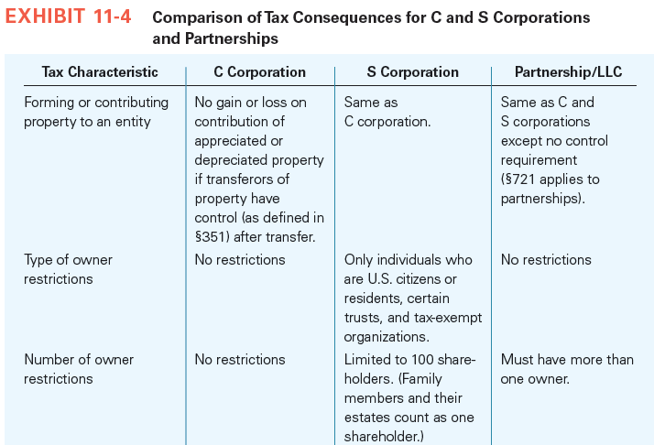
Comparing C and S Corporations and Partnerships

Slide 36
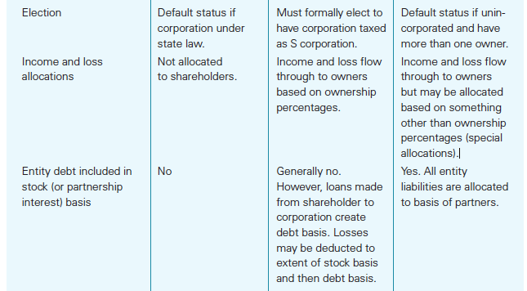
Comparing C and S Corporations and Partnerships

Slide 37
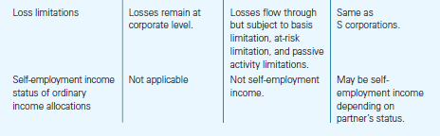
Comparing C and S Corporations and Partnerships

Slide 38
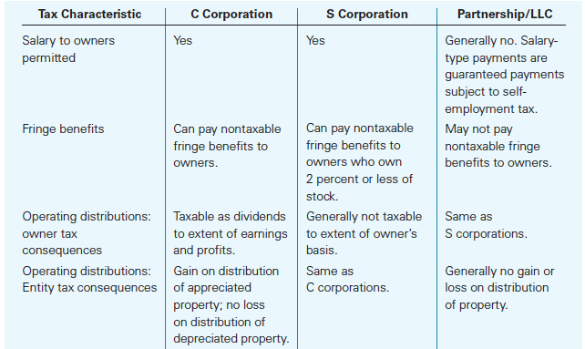
Comparing C and S Corporations and Partnerships

Slide 39
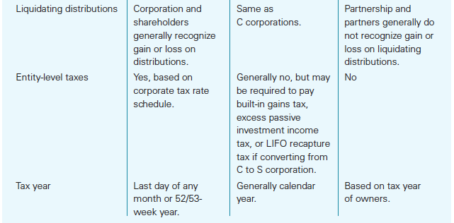
Comparing C and S Corporations and Partnerships

