Slide 1
Chapter 12
State and Local Taxes

Slide 2
Learning Objectives
Describe the primary types of state and local taxes.
Determine whether a business has sales and use tax nexus and calculate its sales tax withholding responsibilities.
Identify whether a business has income tax nexus and determine its state income tax liabilities.

Slide 3
State and Local Taxes
Purpose
Raise revenue to finance state governments
Subject to taxes if:
Taxpayer’s commercial domicile
State where a business is headquartered and directs operations
Taxpayer has nexus
Nexus is the sufficient (or minimum) connection between a business and a state that subjects the business to the state’s tax system

Slide 4
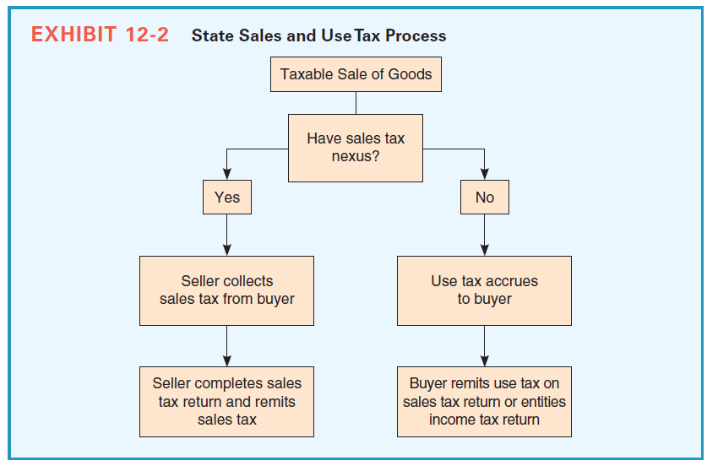
State and Local Taxes

Slide 5
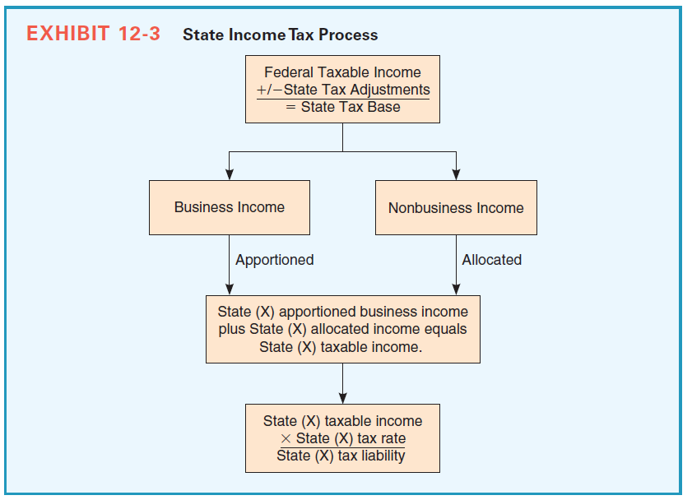
State and Local Taxes

Slide 6
Sales and Use Taxes
Sales of tangible personal property are generally subject to the sales and use tax
Taxable items vary from state to state
Nexus
Businesses create sales tax nexus when they have a physical presence in the state
Business is required to collect sales tax from customers in a state only if it has sales and use tax nexus with that state

Slide 7
Sales and Use Taxes
Businesses that establish sales and use tax nexus with a state but fail to properly collect sales tax can create significant liabilities that need to be disclosed for financial reporting purposes
Sellers with nexus, collect and remit sales tax
When seller doesn’t have nexus, customer is responsible for paying a use tax to the state in which the property is used

Slide 8
Sales and Use Taxes: Example
Kay Bailey Corporation is a Texas corporation engaged in the business of selling rare books. The only activity that Kay Corporation performs in New Mexico is the solicitation of sales through independent agents who visit residents of New Mexico to sell the company’s products.
Does Kay have New Mexico sales and use tax nexus?

Slide 9
Solution
Kay Corporation creates physical presence through its independent agents in New Mexico. Therefore, Kay is required to collect and remit sales tax. Kay’s facts are similar to the facts of Scripto and Scholastic Books.

Slide 10
Sales and Use Taxes: Example
Perry Corporation is a Texas corporation principally engaged in the sale of fly fishing equipment. Perry’s only activity in Colorado is the solicitation of orders for their sporting equipment through catalogues and flyers. Perry delivers the sporting equipment via USPS to its customers in Colorado.
Does Perry have Colorado sales and use tax nexus?

Slide 11
Solution
Perry is not required to collect Colorado sales tax because it has no physical presence in Colorado. Moreover, it delivers via common carrier. Perry’s facts are similar to Quill.

Slide 12
Income Taxes
Businesses must pay income tax in their state of commercial domicile
The Supreme Court spelled out four criteria for determining whether states can tax nondomiciliary companies and to what extent
Sufficient connection or nexus exists between the state and the business
State may tax only a fair portion of a business’s income
Tax cannot be constructed to discriminate against nonresident businesses
Taxes paid must be fairly related to the services the state provides

Slide 13
Income Taxes
Nexus
Businesses must file income tax returns in states where they have income tax nexus
Rules for determining income tax nexus are not necessarily the same as those for determining sales and use tax nexus
Physical presence creates income tax nexus for service providers, sellers of real property, and businesses licensing intangibles—but not for tangible personal property

Slide 14
Income Taxes
Physical presence does not create nexus for sellers of tangible personal property if their activities in the state are limited to “protected” activities as described by Public Law 86-272
Public Law 86-272
Businesses are protected from income tax nexus if (and only if) all the following apply
Tax is based on net income (not gross receipts or revenue)

Slide 15
Income Taxes
(continued)
Taxpayer sells only tangible personal property
Taxpayer’s in-state activities are limited to solicitation of sales
Taxpayer participates in interstate commerce
Taxpayer is nondomiciliary
Taxpayer approves orders outside the state
Taxpayer delivers goods from outside the state
Providing services along with tangible personal property, violates the criteria and creates nexus

Slide 16
Income Taxes
Solicitation
Public Law 86-272 protects solicitation of tangible personal property
Supreme Court determined the following activities meet the definition of solicitation
Soliciting by any form of advertising
Carrying samples and promotional materials for display or distribution without charge
Passing inquiries or complaints to the home office
Checking customer’s inventory for reorder
Maintaining a sample room for two weeks or less; this is known as the trade show rule

Slide 17
Income Taxes
(continued)
Recruiting, training, and evaluating salespeople using homes or hotels
Owning or furnishing personal property and autos used in sales activities

Slide 18
Income Taxes
Supreme Court held the following activities do not meet the definition of solicitation and, therefore, create income tax nexus with the state in which they take place
Making repairs
Collecting delinquent account
Installing or supervising the installation of property
Training for employees other than sales representatives
Approving or accepting orders
Repossessing property
Securing deposits
Maintaining an office other than in-home

Slide 19
Income Taxes: Example
Mark Corporation, incorporated in Colorado, engages in the sale and distribution of copiers and fax machines across several states. Mark also has a copy center design team that provides comprehensive services to large clients. A description of Mark’s activities in the following states follows:

Slide 20
Income Taxes: Example
Mark sells copiers in Utah through its local sales force. Mark maintains no public sales office and maintains no inventory in Utah. All orders are approved in Colorado and delivered via common carrier. To be competitive with a local copier company, Mark has its sales agents on site to supervise installation and perform a two day seminar on proper use of the equipment.
Does Mark have Utah income tax nexus?

Slide 21
Solution
Mark solicits for the sale of tangible personal property. In addition, the orders are approved out of state (Colorado) and ships via common carrier. However, the installation and training services provided by the sales personnel exceed the “solicitation” standard allowed under PL 86-272. In addition, it is unlikely that these services can be considered ancillary to solicitation or de minimis. Thus, Mark has income tax nexus.

Slide 22
Income Taxes: Example
Mark sells copiers in Arizona through its sales force. For the past 25 years all orders are approved in Colorado and delivered via common carrier. One local sales representative won a large contract in the current year. To help facilitate the sale, Mark reduced its normal fee for its copy center design team by 50% and had them do an onsite visit to customize and integrate the clients new center and equipment.
Does Mark have Arizona income tax nexus?

Slide 23
Solution
Mark solicits for the sale of tangible personal property. In addition, the orders are approved out of state (Colorado) and ships via common carrier. However, the copy center design team sells services—which are not protected under PL 86-272. As a consequence, Mark will have income tax nexus unless that it can demonstrate that the services are “ancillary” (which would be unlikely) or that the services are de minimis (has occurred only once and is immaterial).

Slide 24
Income Taxes
Income Tax Nexus for Other Business Types or Nonincome-Based Taxes
Public Law 86-272 does not protect
Service providers, sellers of real property, or businesses licensing intangibles
Businesses from non income-based taxes
Establishing income tax nexus for nonprotected activities, and nexus for nonincome based taxes, requires physical presence just like sales and use tax nexus

Slide 25
Economic Nexus
Economic Nexus is a new assertion by states
Businesses generally must have a physical presence in a state to establish income tax nexus with that state (P.L. 86-272 is the exception)
However, many states are currently asserting a business without a physical presence in the state may establish income tax nexus if it has an economic presence in the state
MTC Factor Presence Test

Slide 26
Income Taxes
Entities Included on Income Tax Return
Separate tax return
Require only those businesses with nexus in a state to file an income tax return
Unitary tax return
Companies not filing a federal consolidated tax return can become a unitary group
Unitary tax return group includes all members meeting the unitary criteria—whether they have nexus or not
States west of the Mississippi River (and Illinois) are unitary return states

Slide 27
Income Taxes
Supreme Court identified three factors that can be used to determine whether a group of businesses is unitary
Functional integration (vertical or horizontal integration or knowledge transfer)
Centralization of management (interlocking directors, common officers, or rotation of management)
Economies of scale (group discounts or other efficiencies due to size)
Unitary concept pervades activities in the entire income tax system, including computing taxable income, computing apportionment percentages, and determining tax return filing requirements

Slide 28
Income Taxes
State Taxable Income
Businesses must calculate state taxable income for each state in which they must file tax returns
Federal taxable income is generally the starting point for computing state taxable income
Businesses must reconcile from federal taxable income to state taxable income
Requires them to identify federal/state adjustments (differences) for each specific state before apportioning the income to a particular state where they have income tax nexus

Slide 29
Income Taxes
Because states do not tax federal interest income, all states require a negative adjustment for federal interest income
Most states require a positive adjustment for state income taxes, as they don’t allow businesses to deduct state income taxes, and they require a positive adjustment for state and local bond interest income, if the bond is from another state

Slide 30
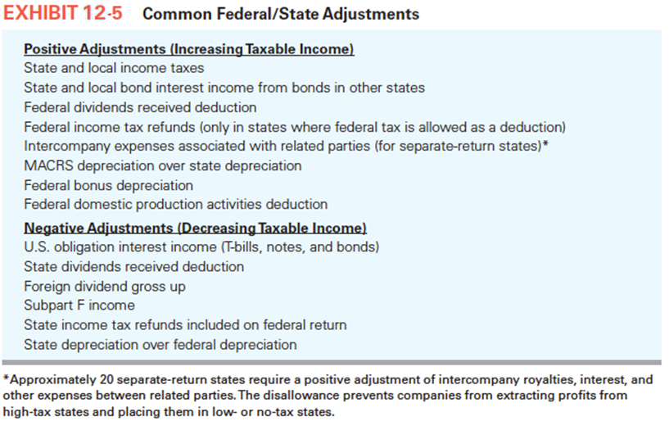
Income Taxes

Slide 31
Income Taxes
Dividing State Tax Base Among States
All state taxable income is taxed in the state of commercial domicile unless the business is taxable in more than one state
An interstate business must separate its business income from nonbusiness income
A business must apportion its business income among the states in which it conducts business, whereas it allocates nonbusiness income

Slide 32
Income Taxes
Business Income
Includes all revenues earned in the ordinary course of business—sales less cost of goods sold and other expenses
Fairly apportioned or divided across the states where nexus exists
Business may apportion, even if the state does not actually impose tax, and has nexus in that state

Slide 33
Income Taxes
Apportionment formula
States determine the apportionment formula for income, and most rely on some combination of three factors:
Sales
Payroll
Property

Slide 34
Income Taxes
Apportionment formula
States determine the apportionment formula for income, and most rely on three factors:
Sales
Payroll
Property
Business determines the factors as the ratio of

Slide 35
Income Taxes
Sales factor includes:
All gross business receipts net of returns,
Allowances
Discounts
The general rules for determining the amount of sales to include in the sales factor calculation are:
Tangible personal property sales are sourced (included) in the destination state, the location the property is delivered to and used in

Slide 36
Income Taxes
If the business does not have nexus in the destination state, sales are generally “thrown back” to the state from which the property is shipped; this is called the throwback rule
Dock sales (sales picked up by the customer) are generally sourced in the destination state rather than the state where they are picked up
Sales of services are sourced in the state where the services are performed (Illinois is an exception to this rule)
Government sales are sourced in the state from which they were shipped

Slide 37
Income Taxes
Payroll
Defined as total compensation paid to employees
Includes salaries, commissions, bonuses, and other forms of compensation
Does not include amounts paid to independent contractors
Payroll for each employee is apportioned to a single state
Property
Includes both real and tangible personal property, but not intangible property

Slide 38
Income Taxes
General rules for determining the property factors are
Use the average property values for the year [(beginning + ending)/2]
Value property at historical cost rather than adjusted basis
Include property in transit in the state of destination and also business property (values of rented investment properties are excluded)
Include rented or leased property by multiplying the annual rent by eight and adding this value to the average owned-property factor

Slide 39
Income Taxes
Nonbusiness Income
Common types of nonbusiness income, and the rules for allocating them to specific states are
Allocate interest and dividends to the state of commercial domicile (except interest on working capital, which is business income)
Allocate rental income to the state where the property generating the rental income is located

Slide 40
Income Taxes
Allocate royalties to the state where the property is used (if the business has nexus in that state; if not, allocate royalties to the state of commercial domicile)
Allocate capital gains from investment property to the state of commercial domicile
Allocate capital gains from selling rental property to the state where the rental property was located

Slide 41
Income Taxes
State Income Tax Liability
State taxable Income = (Business income × Apportionment factor) + Nonbusiness income allocated to the state

Slide 42
Income Taxes
Non (Net) Income-Based Taxes
Several states have nonincome-based taxes
Ohio Commercial Activity Tax
Texas Margin Tax
Washington Business & Occupation Tax
These taxes are deductible for calculating taxable income for net income-based taxes
Public Law 86-272 doesn’t apply to nexus for nonincome based taxes such as gross receipts taxes or property taxes

