Slide 1
Chapter 13
The U.S. Taxation of Multinational Transactions

Slide 2
Learning Objectives
Understand the basic U.S. framework for taxing multinational transactions and the role of the foreign tax credit limitation.
Apply the U.S. source rules for common items of gross income and deductions.
Recall the role of income tax treaties in international tax planning.
Identify creditable foreign taxes and compute the foreign tax credit limitation.

Slide 3
Learning Objectives
Distinguish between the different forms of doing business outside the United States and list their advantages and disadvantages.
Comprehend the basic U.S. anti-deferral tax regime and identify common sources of subpart F income.

Slide 4
U.S. Framework for Taxing Multinational Transactions
The U.S. taxes citizens and residents on their worldwide income and nonresidents on their U.S. source income
The criteria chosen by a government to assert its right to tax a person or transaction is called nexus

Slide 5
U.S. Framework for Taxing Multinational Transactions
Source-based jurisdiction
The United States taxes only the U.S. source income of non-U.S. resident individuals and corporations
Residence-based jurisdiction
The United States taxes the worldwide income of U.S. citizens and residents (individuals and corporations)
Primary jurisdiction : U.S. source income
Residual jurisdiction : non-U.S. source income

Slide 6
U.S. Framework for Taxing Multinational Transaction
U.S. Taxation of a Nonresident
U.S. source income earned by a nonresident is classified into two categories
Effectively connected income (ECI)
Taxed on a net basis using the U.S. graduated tax rates
Fixed and determinable, annual or periodic Income (FDAP)
Taxed on a gross basis through a flat withholding tax

Slide 7
U.S. Framework for Taxing Multinational Transaction
Definition of a resident for U.S. tax purposes
A noncitizen is treated as a U.S. resident alien for income tax purposes if the individual is a permanent resident (has a green card) or meets a substantial presence test
Substantial presence test
The individual is physically present in the United States for at least 31 days during the current year, and
Days present in the current year + (1/3 × number of days during first preceding year) + (1/6 × number of days during the second preceding year) ≥ 183

Slide 8
U.S. Framework for Taxing Multinational Transaction
Example
Guido Geerts is a citizen of Belgium. He has a full-time job in Belgium and has lived there with his family for the past 10 years. In 2014, Guido came to the United States for business and stayed for 210 days. Guido came to the United States again on business in 2015 and stayed for 180 days. In early 2016 he came back to the United States on business and stayed for 70 days. Does Guido satisfy the 183 day test for purposes of the substantial presence test in 2016?

Slide 9
U.S. Framework for Taxing Multinational Transaction
Example (continued)
Answer: Yes. Guido meets the 31 day test in 2016. Under the formula, the number of days he is deemed in the U.S. over the current and prior two years is 200, computed as 70 + 1/3 (180) + 1/6 (210).
Guido could argue he has a “closer connection” to Belgium (he has a tax home there) and avoid being a U.S. resident for tax purposes. Also, the “tie breaker” rules of Article 4 of the U.S. – Belgium treaty would treat Guido as a resident of Belgium for tax purposes because he has his permanent home there.

Slide 10
U.S. Framework for Taxing Multinational Transaction
Overview of U.S. foreign tax credit (FTC) system
Double taxation of foreign source income earned by a U.S. person (U.S. and host country) is mitigated through the foreign tax credit mechanism
To preserve the U.S. right to assert primary taxing jurisdiction over U.S. source income, the foreign tax credit is limited to the U.S. tax that would have been paid had the income been earned in the U.S.
The mechanism through which this principle is achieved is the foreign tax credit limitation

Slide 11
U.S. Framework for Taxing Multinational Transaction
FTC limitation formula
Computed separately for two different categories (“baskets”) of foreign source income
Passive income
General income
A taxpayer can carry any excess FTC for the current year to the previous tax year (mandatory) and then to the next 10 future tax years

Slide 12
U.S. Source Rules for Gross Income and Deductions
Multinational transactions require taxpayers to determine the jurisdictional source of their gross income
Source of income rules
Determine if income or deductions are treated as U.S. source or foreign source
For a U.S. taxpayer, the source rules primarily determine foreign source taxable income in the calculation of the FTC limitation

Slide 13
U.S. Source Rules for Gross Income and Deductions
For a non-U.S. taxpayer, the source rules determine what income is subject to U.S. taxation
The source rules are definitional in nature – they do not impose a tax liability, create income, or allow a deduction

Slide 14
U.S. Source Rules for Gross Income and Deductions
Interest
General rule: The source of interest income is determined by the residence of the borrower at the time the interest is paid
Although interest income paid by a U.S. bank to a nonresident is U.S. source income, it is exempt from U.S. withholding or other income taxation under section 871(i)
This exception is designed to attract foreign capital to U.S. banks

Slide 15
U.S. Source Rules for Gross Income and Deductions
Dividends
Source of dividend income is determined by the residence of the corporation paying the dividend
Compensation for services
Source is determined by the location where the service is performed
Compensation for “labor and personal services” includes
Activities of employees, independent contractors, artists, entertainers, and athletes

Slide 16
U.S. Source Rules for Gross Income and Deductions
Limited commercial traveler exception
Individual was present in the United States for not more than 90 days during the current taxable year
Compensation for the services does not exceed $3,000
Services are performed for a nonresident alien, foreign corporation, or foreign partnership or for the foreign office of a domestic corporation
Treaties often modify the exempt compensation amounts and the maximum length of stay.
Maximum amount of compensation: Unlimited
Length of stay modification: Not more than 183 days

Slide 17
U.S. Source Rules for Gross Income and Deductions
Rents and royalties
Rent has its source where the property generating the rent is located
Royalty income has its source where the intangible property or rights generating the royalty is used
Gain on the sale of realty is sourced based on where the property sold is located

Slide 18
U.S. Source Rules for Gross Income and Deductions
Gain or loss from sale of purchased personal property
Has its source based on the seller’s residence
Exception
Gross income from the sale of purchased inventory is sourced where title passes

Slide 19
U.S. Source Rules for Gross Income and Deductions
Inventory manufactured within the United States and sold outside the united states (§863 Sales)
Has special apportionment rules found in regulations issued by the U.S. treasury
50/50 method
Taxpayer sources one-half each for the gross income from sales based on where the inventory is manufactured and on where title passes to the inventory
Provides U.S. manufacturers with the opportunity to “create” foreign source income on export sales

Slide 20
U.S. Source Rules for Gross Income and Deductions
Source of deduction rules
General principles of allocation and apportionment
Definitely related deductions
Not definitely related deductions
Special apportionment rules
Apply to nine categories of deductions
Interest, research and experimental expenses, stewardship expenses, supportive expenses, state and local income taxes, losses on property disposition, legal and accounting fees, charitable contributions

Slide 21
U.S. Source Rules for Gross Income and Deductions
Interest expense is allocated to all gross income using as a basis the assets that generated such income
Interest can be apportioned based on average tax book value or average fair market value for the year
Research and experimental (R&E) expenditures are apportioned between U.S. and foreign source income using either a sales method or a gross income method
The amount of R&E that can be sourced exclusively based on where the R&E is performed is 50 percent if the sales method is elected and 25 percent if the gross income is elected

Slide 22
Treaties
Treaties are designed to encourage cross-border trade by reducing the double taxation of such income by the countries that are parties to the treaty
Treaties define when a resident of one country has nexus in the other country
Treaties reduce or eliminate the withholding tax imposed on cross border payments such as interest, dividends, and royalties

Slide 23
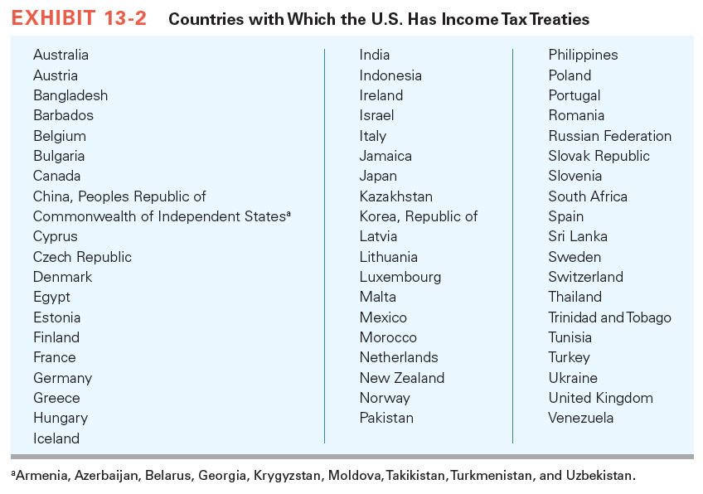

Slide 24
Foreign Tax Credits
Only income taxes can be claimed as a credit on a U.S. tax return
A U.S. corporation owning 10 percent or more of a foreign corporation is eligible for an indirect FTC for taxes paid by the foreign corporation on dividends paid
Current year foreign tax credit cannot exceed the FTC limitation

Slide 25
Foreign Tax Credits
Two categories of FTC income
Passive category income
Investment-type income that traditionally is subject to low foreign taxes
Includes interest, certain dividends, rents, royalties, and annuities
Dividends received from 10-50 percent owned joint ventures and from more than 50 percent owned subsidiaries are subject to “look-through” rules – the dividend recipient characterizes the dividend for FTC basket purposes based on the sources of income from which the dividend is paid

Slide 26
Foreign Tax Credits
Example
USCo owns 100% of Tulip B.V., a Dutch corporation. Tulip earned $1,000 of income from its active business and paid income taxes of $300. Tulip paid USCo a $700 dividend out of net profits. The dividend received by USCo would be placed in the basket that corresponds to the income out of which the dividend was paid (general category income).

Slide 27
Foreign Tax Credits
General category income
Includes gross income from an active trade or business, financial services income, and shipping income
Application of the FTC limitation formula can result in an excess credit if the taxpayer’s creditable foreign taxes exceed the FTC limitation amount
The IRC allows taxpayers to carry back an excess FTC one year and carry forward an excess credit 10 years

Slide 28
Foreign Tax Credits
Creditable foreign taxes
Direct taxes (paid by the taxpayer directly)
In lieu of taxes (withholding taxes imposed on FDAP income paid to the taxpayer)
Indirect (deemed paid) taxes (paid by a subsidiary or joint venture on income paid to a 10% corporate shareholder as a dividend)

Slide 29
Foreign Tax Credits
Subsidiary operations – deemed paid tax
1120
Canco
Dividend $ 60
§78 gross-up 40
Total income $ 100
U.S. tax rate × .35
× Precredit tax $ 35
− DPC (§902) − 40
− FTC (§903) − 3
Net U.S. tax $ 0
Excess FTC $ 8
Pretax income $100
Foreign tax 40
E&P $ 60
$60
5% w/h tax
USCo

Slide 30
Planning for International Operations
A U.S. taxpayer doing business outside U.S. can choose between a branch, partnership, corporation, or hybrid entity
Hybrid entity
Entity that is treated as a flow-through entity for U.S. tax purposes and a corporation for foreign tax purposes (or vice versa)

Slide 31
Planning for International Operations
Organizational form chosen can help a U.S. person reduce worldwide taxation through the following means
Defer U.S. taxation of foreign source income not repatriated to U.S.
Maximize FTC limitation on distributions
Reduce foreign taxes in high-tax jurisdictions through tax-deductible payments (rent, interest, royalties, and management fees) to lower-tax jurisdictions

Slide 32
Planning for International Operations
Use transfer pricing to shift profits from a high-tax jurisdiction to a low-tax jurisdiction
Take advantages of tax treaties to reduce withholding taxes on cross-border payments can be taken
Check-the-box hybrid entities
U.S. taxpayer elects the U.S. tax status of a hybrid entity by “checking the box” on Form 8832
“Per se” entities are not eligible for the check-the-box election

Slide 33
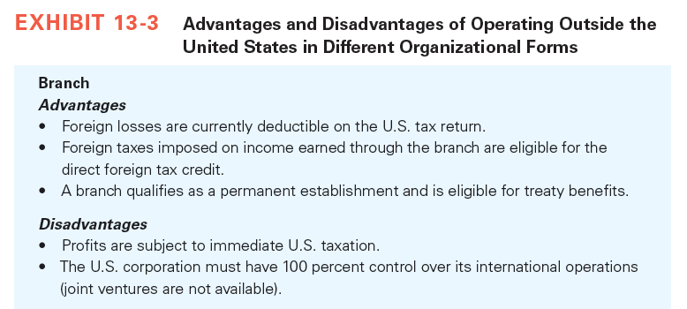
Planning for International Operations

Slide 34
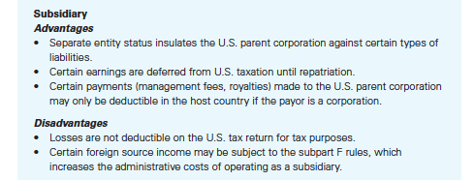
Planning for International Operations

Slide 35
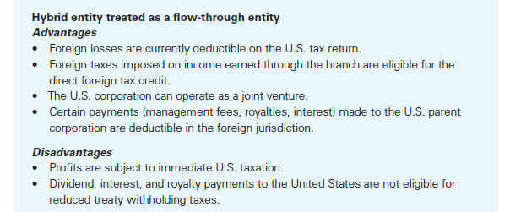
Planning for International Operations

Slide 36
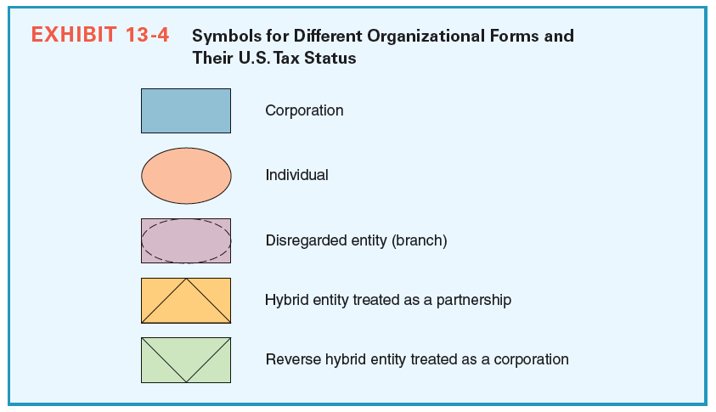
Planning for International Operations
36

Slide 37
U.S. Anti-Deferral Rules
Subpart F requires U.S. shareholders of a CFC to include in gross income currently their pro rata share of the CFC’s:
Subpart F income
Increase in (deferred) earnings invested in United States property during the current year
Subpart F applies only if the corporation is a CFC for 30 consecutive days during its tax year

Slide 38
U.S. Anti-Deferral Rules
Controlled foreign corporation
Any foreign corporation in which U.S. shareholders collectively own more than 50% of the total combined voting power of all classes of stock entitled to vote or the total value of the corporation’s stock on any day during the CFC’s tax year
A U.S. shareholder for CFC purposes is a U.S. person owning stock in the corporation constituting 10% or more of all classes of stock entitled to vote

Slide 39
U.S. Anti-Deferral Rules
Foreign
Corp.
US
Corp.
US
Corp.
US
Citizen
16%
30%
9%
45%
Foreign
Corp.
US Citizen is not a US shareholder
because of < 10% ownership
Both US Corps are US Shareholders
Foreign Corp is not US Shareholders
US Shareholders own 46% of Foreign
Corp thus it is NOT a CFC
Notes:
Use this example to point out that ownership by US persons is not enough to make a foreign corporation a CFC. The US persons must be “US Shareholders” in order to count toward CFC status.

Slide 40
U.S. Anti-Deferral Rules
Subpart F income
Includes foreign personal holding company income and foreign base company sales income
Applies only to U.S. shareholders of a CFC
De minimus and full inclusion rules apply to limit or expand whether a CFC’s income is subject to the deemed dividend regime

Slide 41
U.S. Anti-Deferral Rules
Planning to avoid subpart F income
U.S. multinational corporations expanding outside U.S. often use hybrid entities as a tax-efficient means to avoid the subpart F rules
Tax aligning a U.S. corporation’s international supply chain has become a frequent objective in international tax planning

Slide 42
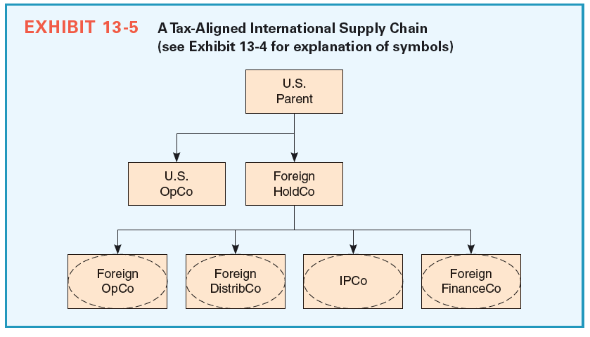
U.S. Anti-Deferral Rules

