Slide 1
Accounting 6160
Investments
Howard Godfrey, Ph.D., CPA
Professor of Accounting
©Howard Godfrey-2017

Slide 2
Major topics
Portfolio income: Int. and Div.
Basic capital gain/loss rules
Special Cap. Gain rules– 1231, etc.
Limits on cap. losses-Personal use assets, related parties, wash sales, Sec. 1244
Tax-exempt income
Investment expenses
Passive activities

Slide 3
Nick and Rachel paid $150,000 for undeveloped land as an investment. They paid $50,000 and borrowed $100,000 from the bank at an interest rate of 6 percent per year. At the end of year-1, they paid $6,000 of interest to the bank. In year 1, the Suttons only source of income was salary.
On December 31 of year 2, the Suttons paid $6,000 of interest to the bank and sold the land for $210,000. They used $100,000 of the sale proceeds to pay off the $100,000 loan.
The Suttons itemize deductions and have a marginal ordinary income tax rate of 35 percent.

Slide 4
163(d) Limit on investment interest
(1) In general. In the case of a taxpayer other than a corporation, the amount allowed as a deduction under this chapter for investment interest for any taxable year shall not exceed the net investment income of the taxpayer for the taxable year.
(2) Carryforward of disallowed interest
The amount not allowed as a deduction for any taxable year by reason of paragraph (1) shall be treated as investment interest paid or accrued by the taxpayer in the succeeding taxable year.

Slide 5
163(d) Limit on investment interest
(3) Investment interest. For purposes of this subsection-
(A) In general. The term “investment interest” means any interest allowable as a deduction under this chapter (determined without regard to paragraph (1)) which is paid or accrued on indebtedness properly allocable to property held for investment.
(B) Exceptions. “investment interest” does not include-
(i) any qualified residence interest…, or
(ii) any interest which is taken into account under section 469 in computing income or loss from a passive activity of the taxpayer.

Slide 6
Section 469 (e) .. [Limit on Passive Activity Losses]
(1) …In determining the income or loss from any activity-
(A) In general. There shall not be taken into account—
(i) any-
(I) gross income from interest, dividends, annuities, or royalties not derived in the ordinary course of a trade or business,
(II) expenses (other than interest) … allocable to such gross income, and
(III) interest expense properly allocable to such gross income, …

Slide 7
(B) Investment income. The term “investment income” means the sum of—
…
(iii) so much of the net capital gain …as the taxpayer elects to take into account under this clause.
Such term shall include qualified dividend income (as defined in section 1(h)(11)(B)) only to the extent the taxpayer elects to treat such income as investment income for purposes of this subsection.

Slide 17
Monica

Slide 18
Monica

Slide 41
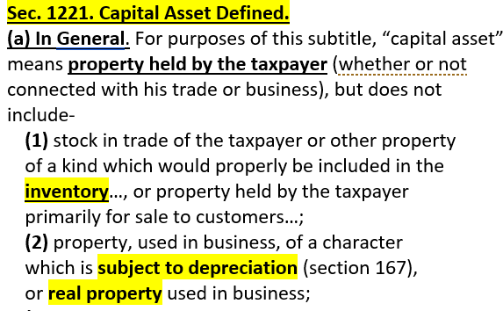

Slide 42
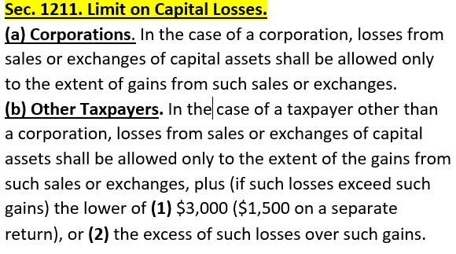

Slide 43
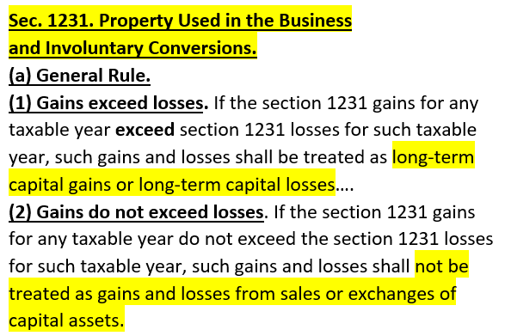

Slide 44
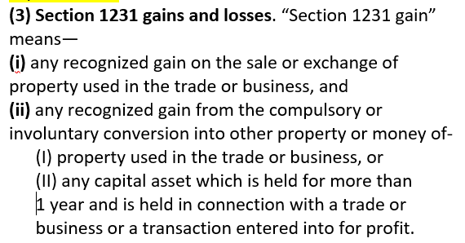

Slide 45
Section 1231 loss.
The term “section 1231 loss”
means any recognized
loss from a sale or
exchange or conversion
[of such assets].

Slide 46
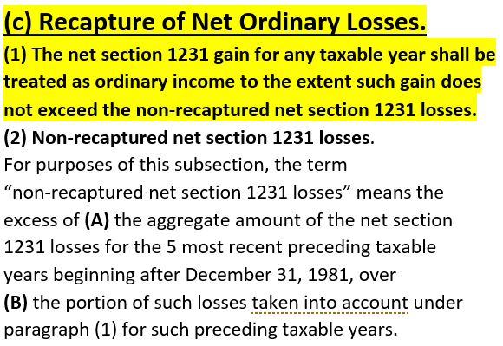

Slide 47
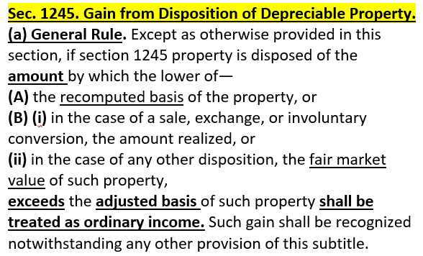
Basically means original cost minus adjusted basis.

Slide 48
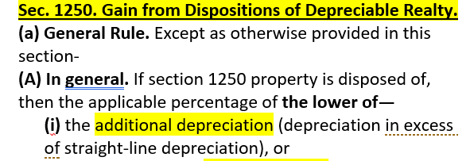

Slide 55
End

