Slide 1
Accounting 6160 Tax Computation Howard Godfrey, Ph.D., CPA Professor of Accounting ©Howard Godfrey-2017

Slide 2
Carryover period-for excess amounts
Limit? Carryback? Forward? Rules?
Capital losses-Individual
Capital losses – Corporate
Net operating losses
Passive losses
Investment interest
Charitable contributions-Individuals
Charitable contributions-Corporations
AMT credit

Slide 3
Federal Income Tax Computation
Exceptions to ordinary tax rates
Long-term capital gains (net capital gains)
Generally 0%,15%, or 20%, but can be as high as 28%
Two different tax rates on one gain is possible
Dividends
Qualified dividends generally taxed at 0%,15%, or 20%
Two different tax rates on one dividend is possible
8-3

Slide 4
Tax Computation Example
Assume that Courtney’s taxable income is $451,000 including $15,000 of qualifying dividends taxed at the preferential rate.
What would be Courtney’s tax liability under these circumstances?
8-4

Slide 5
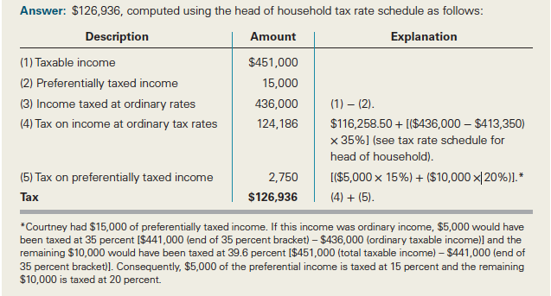
Tax Computation Example Solution
8-5

Slide 6
Net Investment Income Tax
3.8% tax imposed on lesser of:
Net investment income (e.g., interest, dividends, annuities, royalties, rents, passive activity income, net gains from disposing of property, less related allowed deductions) or
Excess of modified AGI over $250,000 (MFJ), $125,000 (MFS), and $200,000 (all others)

Slide 12
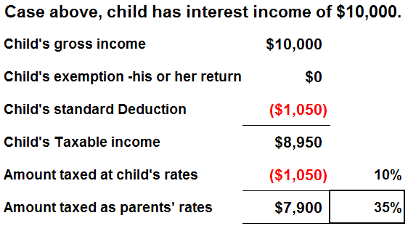

Slide 13
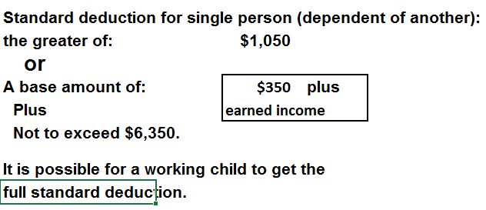

Slide 14
8-14

Slide 15
Federal Income Tax Computation
Kiddie tax
Net unearned income taxed at parents’ marginal rate
Net unearned income = unearned income in excess of $2,100
Parents can elect to actually include this income on their tax return.
Applies if
Child is under age 18 at year end,
Child is 18 at year end but earned income not greater than half of child’s support, or
Child is over age 18 but under age 24, is a full-time student, and child’s earned income not greater than half of child’s support.
8-15

Slide 16
Kiddie Tax Example
Suppose that during 2016, Deron received $1,100 in interest from an IBM bond, and he received another $2,200 in interest income from a money market account that his parents have been contributing to over the years. What is Deron’s taxable income and corresponding tax liability? (Deron’s mother Courtney is subject to a 25% marginal tax rate.)
8-16

Slide 17
Kiddie Tax Example Solution
Because Deron is younger than 18 years of age at the end of the year and his net unearned income exceeds $2,100, he is potentially subject to the kiddie tax.
8-17

Slide 18
x
8-18

Slide 19
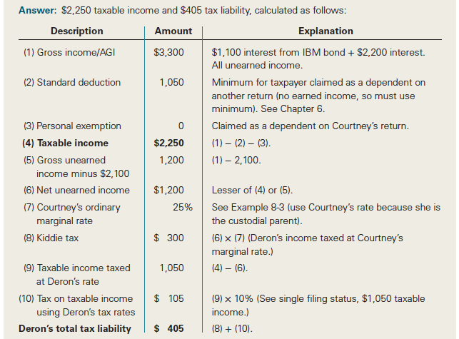
Kiddie Tax Example Solution (cont.)
8-19

Slide 20
8-20

Slide 21
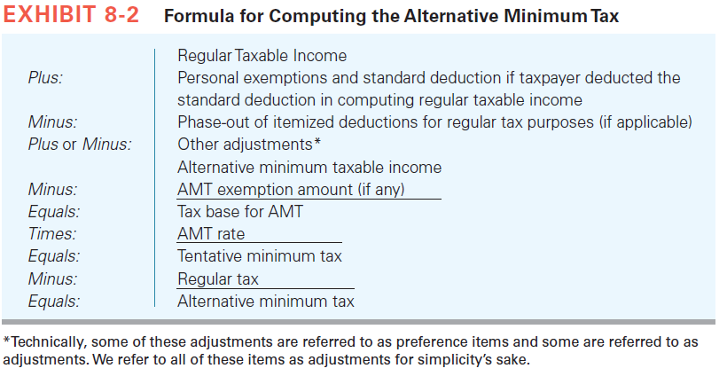
Alternative Minimum Tax Formula
8-21

Slide 22
Alternative Minimum Tax
Items commonly added back to regular taxable income in computing AMT income
Personal and dependency exemptions
State income taxes
Real property taxes
Home-equity loan interest expense (if proceeds not used to improve home)
Miscellaneous itemized deductions in excess of 2% floor
8-22

Slide 23
Alternative Minimum Tax
Items commonly added back to regular taxable income in computing AMT income
Personal and dependency exemptions
State income taxes
Real property taxes
Home-equity loan interest expense (if proceeds not used to improve home)
Miscellaneous itemized deductions in excess of 2% floor
8-23

Slide 24
Alternative Minimum Tax
Exemption phased out 25 cents for each dollar over threshold
8-24

Slide 25
Alternative Minimum Tax
AMT is a tax based on an alternative more inclusive tax base than regular taxable income.
Meant to ensure that taxpayers are paying some minimum level of tax.
Who is most likely to pay it and why?
High state taxes
Multiple children
Capital gains
8-25

Slide 26
Alternative Minimum Tax
Why is AMT so prevalent?
Individual tax rates have decreased since AMT enacted
AMT rates 26% or 28% vs. individual ordinary rates: 10%, 15%, 25%, 28%, 33%, 35%, 39.6%
8-26

Slide 27
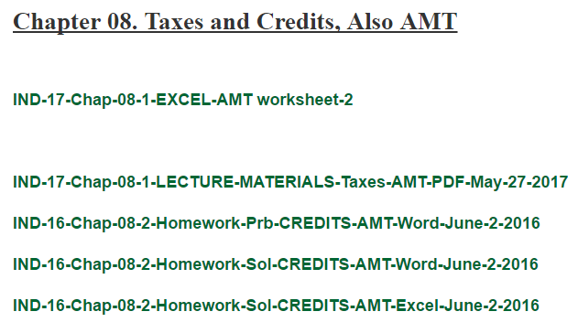

Slide 36
8-36

Slide 37
8-37

Slide 38
8-38

Slide 39
8-39

Slide 40
8-40

Slide 41
8-41

Slide 42
8-42

Slide 43
8-43

Slide 45
End

