Slide 1
Chapter 12
Compensation

Slide 2
Learning Objectives
Discuss and explain the tax implications of compensation in the form of salary and wages from the employee’s and employer’s perspectives.
Describe and distinguish the tax implications of various forms of equity-based compensation from the employee’s and employer’s perspectives.
Compare and contrast taxable and nontaxable fringe benefits and explain the employee and employer tax consequences associated with fringe benefits.

Slide 3
Salary and Wages
Employee Considerations for Salary and Wages
  Fixed amount of compensation for the current year no matter how many hours worked
  Salaried employees eligible for bonuses
  Employees receiving wages generally get paid by the hour
  Salary, bonus, and wages taxed as ordinary income
  They report their wages on page 1, line 7, of the 1040 federal tax return

Slide 4
Salary and Wages (2)
  Tax Withholding
    Employees complete a Form W-4 to supply the information the firm needs to withhold the correct amount of tax and also to indicate
      Whether to withhold at the single rate or at the lower married rate
      The number of withholding or “personal” allowances the employee chooses to claim
      Whether the employee wants an additional amount of tax withheld each period above the amount based on the number of allowances claimed

Slide 5
Salary and Wages (3)
Form W-2
  Summarizes an employee’s taxable salary and wages
  Provides annual federal and state withholding information
  Generated by employer on an annual basis
Form W-4
  Supplies an employee’s withholding information to employer
  Generated by employee
  Remains constant unless employee makes changes

Slide 6
Salary and Wages (4)
Employer Considerations for Salary and Wages
  Deductibility of Salary Payments – General Rule
    Employers computing taxable income under
      Cash method of accounting generally deduct salary and wages when they pay the employee
      Accrual method generally deduct wages payable to employees as the employees earn the wages
    Compensation expense accrued at end of year is deductible in year accrued if
      Paid to an unrelated party
      Paid within 2½ months of year-end

Slide 7
Salary and Wages (5)
    Compensation expense accrued at end of year is deductible when
      Paid to related party
      Related party (employee) owns > 50 percent of the value of the employer corporation
    After-tax cost of providing this salary is generally much less than the before-tax cost as the employer deducts the salary and associated FICA taxes paid
    After-tax cost of salary formula

Slide 8
After-Tax Cost of Salary Question
XYZ, Inc. paid one of its employees $80,000. They are in the 35% tax bracket. What is the after-tax cost of the salary to XYZ, Inc.?

Slide 9
After-Tax Cost of Salary Solution
Before-tax cost = Salary
  Total cost = $80,000
After-tax cost = $80,000 × (1 − 35%)
  So the after-tax cost = $52,000

Slide 10
Salary and Wages (6)
  Limits on salary deductibility
    Determining whether compensation is reasonable in amount is a “facts and circumstances test” that involves
      Considering the duties of the employee
      Complexities of the business, and
      Amount of salary compared with the income of the business among other things
    $1,000,000 maximum annual compensation deduction per person
    Limited—applies to CEO and three other highest compensated officers, not including CFO
    Does not apply to performance-based compensation

Slide 11
Equity-Based Compensation
Stock Options
  Incentive stock options – Provide favorable tax treatment to employees
  Nonqualified stock options – Options that don’t meet the requirements for being classified as incentive stock options
  Grant date – Date on which employees are initially allocated stock options
  Exercise date – Date that employees purchase stock using their options
  Exercise price – Amount paid to acquire shares with stock options

Slide 12
Equity-Based Compensation (2)
  Bargain element – Difference between the fair market value of stock and the exercise price on the exercise date
  Vesting date – Time when stock options granted can be exercised
  Employee Considerations for Stock Options
    Nonqualified stock options
      When exercising NQOs, employees report ordinary income equal to the total bargain element on the shares of stock acquired (whether they hold the shares or sell them immediately)

Slide 13
Equity-Based Compensation (3)
      Taxpayer’s basis in NQOs acquired is the fair market value on the date of exercise
      Basis includes the exercise price plus the ordinary income the taxpayer recognizes on the bargain element
    Incentive stock options
      Basis in shares acquired with ISOs is the exercise price
      Holding period for stock acquired with NQOs and ISOs begins on the exercise date
      Here bargain element is added to taxpayers alternative minimum taxable income
    For either type of options, employees experience no tax consequences on the grant date or vesting date

Slide 14
Equity-Based Compensation (4)
    Any future appreciation or depreciation of the stock will be treated as either short-term or long-term capital gain or loss depending on the holding period (begins on the date of exercise)
  Employer Considerations for Stock Options
    Nonqualified options
      No tax consequences on grant date
      On exercise date, bargain element is treated as ordinary (compensation) income to employee
      Employee holds stock with holding period beginning on date of exercise
      Employers deduct bargain element as compensation expense on exercise date

Slide 15
Equity-Based Compensation (5)
    Incentive stock options
      No tax consequences on grant date and exercise date (if employee holds for two years after grant date and one year after exercise date)
      If holding requirements are not met (if there is a disqualifying disposition), option becomes an NQO
      When employee sells stock, employee recognizes long-term capital gain
      No deduction for employers unless employee doesn’t meet holding requirements
      Employers typically don’t view ISOs as favorable as NQOs, because
        ISOs don’t provide them with the same tax benefits (no tax deduction)
        IRS regulatory requirements for ISOs can be cumbersome

Slide 16
Equity-Based Compensation (6)
      Firms with high marginal tax rates may lose significant tax benefits by issuing ISOs rather than NQOs
      On the other hand, start-up companies or firms with net operating losses may actually benefit by issuing ISOs instead of NQOs
    Accounting issues
      For tax purposes, employer deducts bargain element on exercise date
      For GAAP purposes, employer expenses the estimated value of the option pro rata over the vesting period

Slide 17
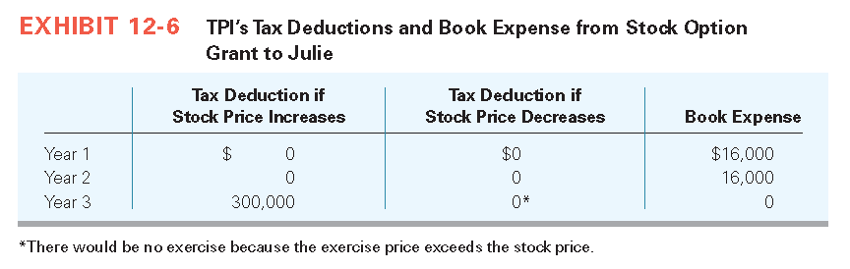
Equity-Based Compensation (7)

Slide 18
Stock Options Question
Mary is offered 7,000 options on Jan. 1, 2013. They vest on Jan. 1, 2016. The exercise price is $10 per share. On Jan. 1, 2016, she exercises all 7,000 options when the price is $17 per share. She holds the stock for two years and sells all 7,000 shares for $20 per share. She is in the 30% tax bracket. What is her tax liability on the grant date, exercise date, and date of sale
  if the options are ISOs?
  if the options are NQOs?

Slide 19
Stock Options Solution
If the options are ISOs:
  Grant date: no tax liability
  Exercise date: no tax liability
  Sale date: Because she held the stock for 1 year after exercise date she will be taxed on the full appreciation from the exercise price at preferential rates. $10 per share appreciation times 7,000 shares = 70,000 gain
    Tax liability = 70,000 × .15 = $10,500 tax

Slide 20
Stock Options Solution (2)
If options are NQOs:
  Grant date: no tax liability
  Exercise date: $7 bargain purchase × 7,000 shares = $49,000 × 30% = $14,700
  Sale date: $3 appreciation × 7,000 shares = $21,000 × 15% = $3,150

Slide 21
Equity-Based Compensation (8)
Restricted Stock
  Can’t be sold or otherwise treated as owned by employees until employees legally have the right to sell the shares on the vesting date
  Employees receive restricted stock on the vesting date without having to pay for it, after which they can either sell it immediately or retain it
  Employee Considerations for Restricted Stock
    Restricted stock is taxed on the full fair market value of the shares on the date the restricted stock vests

Slide 22
Equity-Based Compensation (9)
    Without §83(b) Election
      No tax consequences on grant date
      Employee recognizes ordinary income on value of stock on vesting date
      Holding period for stock begins on vesting date
      Employer deducts value of stock on vesting date
    With Section §83(b) Election
      On grant date, employee recognizes market value of stock as ordinary income
      Employee takes fair market value basis in stock
      Holding period for stock begins on grant date
      If employee never vests, no deduction for basis in stock
      Employer deducts value of stock on grant date

Slide 23
Equity-Based Compensation (10)
  Employer Considerations for Restricted Stock
    Timing of the deduction is determined by the employee’s decisions regarding the §83(b) election
    Other nontax issues
      For tax purposes, employers deduct the market value of stock when the employee recognizes income
      For GAAP purposes, employers deduct the grant date value over the vesting period

Slide 24
Restricted Stock Question
James received 4,000 shares of restricted stock on June 1, 2015, when the stock was valued at $3 per share. The shares vest on June 1, 2016, when the shares are valued at $8 per share. He sells the shares on the vesting date. He is in the 30% tax bracket. What is his tax liability on the grant date and vesting date
  if he doesn’t make an 83(b) election?
  if he makes an 83(b) election?

Slide 25
Restricted Stock Solution
If 83(b) election not made:
  Grant date: no tax liability
  Vesting date: $8 per share × 4,000 shares = $32,000 × .3 = $9,600 tax liability
If 83(b) election is made:
  Grant date: $3 per share × 4,000 shares = $12,000 × .3 = $3,600 tax liability
  Vesting date/sales date: $5 appreciation × 4,000 shares = $20,000 × .15 = $3,000 tax liability

Slide 26
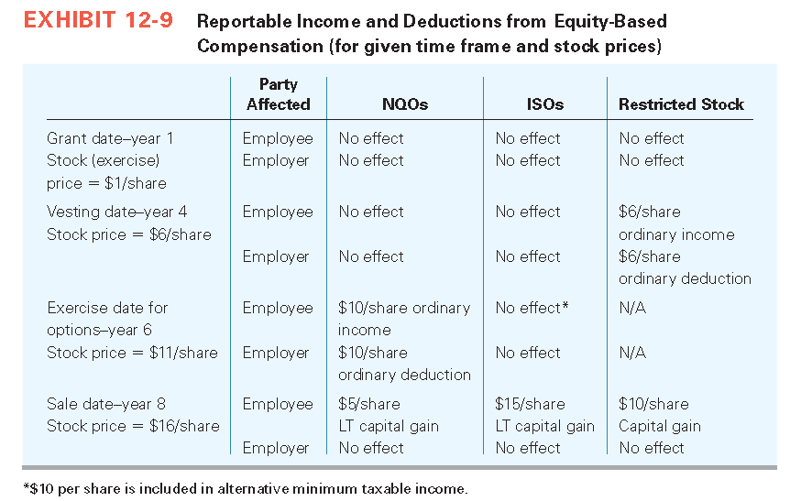
Equity-Based Compensation (11)

Slide 27
Fringe Benefits
  Employers often provide noncash benefits to employees in addition to their cash compensation
  Ranges from common (health insurance) to the exotic (use of a corporate aircraft)
  Taxable to the employee on receipt
  IRC §61(a) indicates that, “gross income means all income from whatever source derived, including
    Compensation for services, including fees, commissions, fringe benefits, and similar items”

Slide 28
Fringe Benefits (2)
Taxable Fringe Benefits
  Employees recognize compensation income on all benefits received unless specifically excluded by tax laws
  Treat benefits received like taxable cash compensation
  Employer deducts cost and pays employee’s share of FICA taxes on benefit
Employee Considerations for Taxable Fringe Benefits
  Employees may prefer a taxable benefit to an equivalent amount of cash when they benefit from employer-provided quantity or group discounts associated with the benefit

Slide 29
Fringe Benefits (3)
  Employees must recognize a certain amount of gross income when employers pay life insurance premiums for the employee for policies with a death benefit in excess of $50,000
  To compute the annual taxable benefit, taxpayers use the following steps:
    Step 1: Subtract $50,000 from the death benefit of their employer-provided group-term life insurance policy.
    Step 2: Divide the Step 1 result by $1,000.
    Step 3: Multiply the result from Step 2 by the cost per $1,000 of protection for one month from the table provided in the Treasury Regulations based on the taxpayer’s age.
    Step 4: Multiply the outcome of Step 3 by 12 (months).

Slide 30
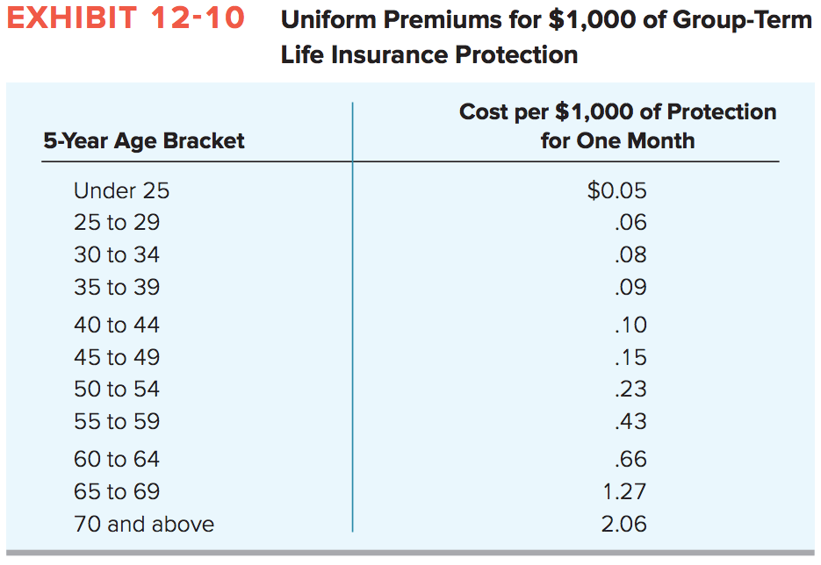
Fringe Benefits (4)

Slide 31
Fringe Benefits (5)
  Employer Considerations for Taxable Fringe Benefits
    Treats taxable fringe benefits just like cash compensations
    Has an outlay for the cost of the benefit and must pay the employer’s share of FICA taxes on the taxable portion of benefits it provides to employees
    Deducts its cost of the benefit (plus FICA taxes), not the value of the benefit to the employee
    Is often able to purchase fringe benefits at a lower cost than can individual employees

Slide 32
Fringe Benefits (6)

Slide 33
Fringe Benefits (7)
  Nontaxable Fringe Benefits
    Specifically identified in the Code
    Employee excludes benefit from taxable income
    Employer deducts cost when benefit is paid
    Group-term life insurance
    Health and accident insurance and benefits
    Meals or lodging for the convenience of the employer
    Employee educational assistance
    Dependent care benefits

Slide 34
Fringe Benefits (8)
    No-additional-cost services
    Qualified employee discounts
    Working condition fringe benefits
    De minimis fringe benefits
    Qualified transportation fringe
    Qualified moving expense reimbursement
    Cafeteria plans and flexible spending accounts (FSAs)
    Employee and employer considerations for nontaxable fringe benefits

Slide 35
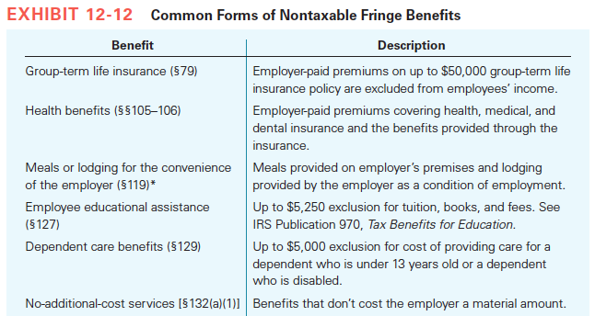
Fringe Benefits (9)

Slide 36
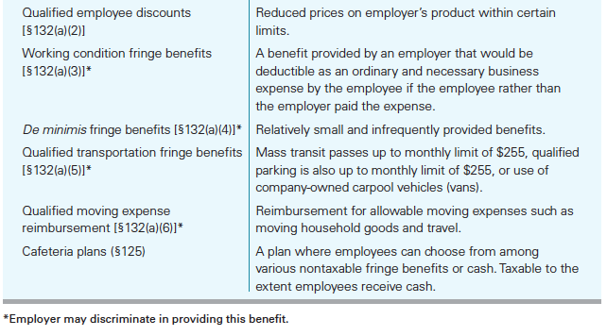
Fringe Benefits (10)

Slide 37
Fringe Benefits (11)
  Tax Planning with Fringe Benefits
    Example
      Employer proposed to reimburse employee $200 a month for his parking costs. What amount of this reimbursement would be a nontaxable qualified transportation fringe to employee?
      Answer: All $2,400. Employee can exclude up to $250 per month ($3,000 per year) as a qualified transportation fringe
    IRS publication 15-B “Employer’s Tax Guide to Fringe Benefits” (available at the IRS website) provides tax guidance for employers providing fringe benefits

Slide 38
Fringe Benefits (12)
  Fringe Benefits Summary
    Both taxable and nontaxable, can make up a significant portion of an employee’s compensation
    Are taxable unless the tax laws specifically exclude them from gross income
    Taxable fringe benefits usually represent a luxury perk, while nontaxable fringe benefits are generally excluded for public policy reasons
    At this point, you should be able to distinguish between taxable and nontaxable fringe benefits

Slide 39
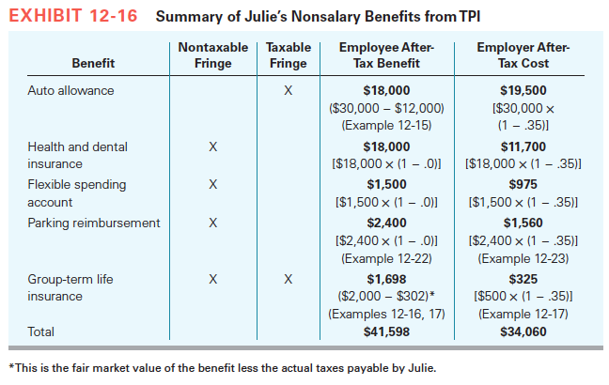
Fringe Benefits (13)

