Slide 1
Accounting 6160 Home Slides Howard Godfrey, Ph.D., CPA Professor of Accounting ©Howard Godfrey-2017

Slide 2
Qui Van Phan v. Commissioner., U.S. Tax Court, T.C. Summary Opinion 2015-1,
(Jan. 12, 2015)

Slide 3
Qui Van entered into an oral agreement with his mother and his siblings that
he would pay the mortgage loan and the property taxes and
these payments would increase his equity interest in the home.
Qui Van 's sister and sister-in-law refinanced the mortgage loan for the property in 2011.
In 2013 Qui Van 's name was added to the legal title to the property.

Slide 4
163(h) Disallowance of Deduction for Personal Interest.
(1) In general. In the case of a taxpayer other than a corporation, no deduction shall be allowed under this chapter for personal interest paid or accrued during the taxable year.

Slide 5
(2) Personal interest. …“personal interest” means any interest allowable as a deduction under this chapter other than-
(A) interest paid or accrued on indebtedness properly allocable to a trade or business (other than the trade or business of performing services as an employee),
(B) any investment interest (within the meaning of subsection (d)),
(C) any interest which is taken into account under section 469 in computing income or loss from a passive activity,
(D) any qualified residence interest (within the meaning of paragraph (3)),

Slide 6
(E) any interest payable under section 6601 on any unpaid portion of the tax imposed by section 2001 for the period during which an extension of time for payment of such tax is in effect under section 6163, and
(F) any interest allowable as a deduction under section 221 (relating to interest on educational loans).

Slide 7
(3) Qualified residence interest. For purposes of this subsection—
(A) In general. The term “qualified residence interest” means any interest which is paid or accrued during the taxable year on-
(i) acquisition indebtedness with respect to any qualified residence of the taxpayer, or
(ii) home equity indebtedness with respect to any qualified residence of the taxpayer.
For purposes of the preceding sentence, the determination of whether any property is a qualified residence of the taxpayer shall be made as of the time the interest is accrued.

Slide 8
(B) Acquisition indebtedness.
(i) In general. The term “acquisition indebtedness” means any indebtedness which—
(I) is incurred in acquiring, constructing, or substantially improving any qualified residence of the taxpayer, and
(II) is secured by such residence.

Slide 9
Such term also includes any indebtedness secured by such residence resulting from the refinancing of indebtedness meeting the requirements of the preceding sentence (or this sentence); but only to the extent the amount of the indebtedness resulting from such refinancing does not exceed the amount of the refinanced indebtedness.

Slide 10
(ii) $1,000,000 limitation. The aggregate amount treated as acquisition indebtedness for any period shall not exceed $1,000,000 ($500,000 in the case of a married individual filing a separate return).

Slide 11
(C) Home equity indebtedness.
(i) In general. The term “home equity indebtedness” means any indebtedness (other than acquisition indebtedness) secured by a qualified residence to the extent the aggregate amount of such indebtedness does not exceed-
(I) the fair market value of such qualified residence, reduced by
(II) the amount of acquisition indebtedness with respect to such residence.

Slide 12
(C) Home equity indebtedness.
(ii) Limitation—The aggregate amount treated as home equity indebtedness for any period shall not exceed $100,000 ($50,000 in the case of a separate return by a married individual).

Slide 13
(E) Mortgage insurance premiums treated as interest.
(i) In general. Premiums paid or accrued for qualified mortgage insurance by a taxpayer during the taxable year in connection with acquisition indebtedness with respect to a qualified residence of the taxpayer shall be treated for purposes of this section as interest which is qualified residence interest.

Slide 14
(E) Mortgage insurance premiums treated as interest.
(ii) Phase-out. The amount otherwise treated as interest under clause (i) shall be reduced (but not below zero) by 10 percent of such amount for each $1,000 ($500 in the case of a married individual filing a separate return) (or fraction thereof) that the taxpayer's adjusted gross income for the taxable year exceeds $100,000 ($50,000 in the case of a married individual filing a separate return).

Slide 15
(4) Other definitions and special rules.
For purposes of this subsection—
(A) Qualified residence.
(i) In general. The term “qualified residence” means—
(I) the principal residence (within the meaning of section 121) of the taxpayer, and
(II) 1 other residence of the taxpayer which is selected by the taxpayer for purposes of this subsection for the taxable year and which is used by the taxpayer as a residence (within the meaning of section 280A(d)(1)).

Slide 16
Sec. 280A Disallowance…
(d) Use as Residence.--
(1) In General.--For purposes of this section, a taxpayer uses a dwelling unit during the taxable year as a residence if he uses such unit (or portion thereof) for personal purposes for a number of days which exceeds the greater of--

Slide 17
Sec. 280A Disallowance…
(d) Use as Residence.--
(A) 14 days, or 10 percent of the number of days during such year for which such unit is rented at a fair rental. For purposes of subparagraph (B), a unit shall not be treated as rented at a fair rental for any day for which it is used for personal purposes.

Slide 18
(ii) Married individuals filing separate returns. If a married couple does not file a joint return for the taxable year—
(I) such couple shall be treated as 1 taxpayer for purposes of clause (i), and
(II) each individual shall be entitled to take into account 1 residence unless both individuals consent in writing to 1 individual taking into account the principal residence and 1 other residence.

Slide 19
(iii) Residence not rented. For purposes of clause (i)(II), notwithstanding section 280A(d)(1), if the taxpayer does not rent a dwelling unit at any time during a taxable year, such unit may be treated as a residence for such taxable year.

Slide 20
(4) Other definitions and special rules.
For purposes of this subsection—
(A) Qualified residence.
(B) Special rule for cooperative housing corporations. Any indebtedness secured by stock held by the taxpayer as a tenant-stockholder (as defined in section 216) in a cooperative housing corporation (as so defined) shall be treated as secured by the house or apartment which the taxpayer is entitled to occupy as such a tenant-stockholder.

Slide 21
(F) Special rules for prepaid qualified mortgage insurance. Any amount paid by the taxpayer for qualified mortgage insurance that is properly allocable to any mortgage the payment of which extends to periods that are after the close of the taxable year in which such amount is paid shall be chargeable to capital account and shall be treated as paid in such periods to which so allocated.

Slide 22
Reg. 1.121-1. (b) Residence. (1) In general. Whether property is used by the taxpayer as the taxpayer's residence depends upon all the facts and circumstances. A property used by the taxpayer as the taxpayer's residence may include a houseboat, a house trailer, or the house or apartment that the taxpayer is entitled to occupy as a tenant-stockholder in a cooperative housing corporation (as those terms are defined in section 216(b)(1) and (2)).

Slide 24
Hobby expense are summarized because there is a lot of similarity between the hobby loss rules and the limits on deduction of losses from rental of vacation homes.

Slide 25
ACTIVITIES NOT … FOR PROFIT
183(a) GENERAL RULE. --In the case of an activity engaged in by an individual or an S corporation, if such activity is not engaged in for profit, no deduction attributable to such activity shall be allowed under this chapter except as provided in this section.

Slide 26
Hobby Expenses
If a profit is realized in 3 out of 5 years (2 out of 7 years for horses) then burden of proof shifts to IRS to prove activity is a hobby
Taxpayer can deduct expenses, even if a net loss results, by showing activity is run in a businesslike manner
If activity is a hobby, the deduction for expenses is limited to hobby income

Slide 27
Hobby Expenses
Expenses deducted in this order:
Otherwise allowable expenses (mortgage interest, taxes, and casualty losses)
Expenses that do not reduce the tax basis of the assets used in the hobby (advertising, insurance, utilities and maintenance)
Depreciation and amortization
Excess expenses are lost - no carryover

Slide 28
Sec. 183 Activities Not.. For Profit -1
(b) Deductions Allowable.--
In the case of an activity not engaged in for profit to which subsection (a) applies, there shall be allowed--
(1) the deductions which would be allowable … without regard to whether or not such activity is engaged in for profit, and

Slide 29
Sec. 183 Activities Not … For Profit -2
(b) Deductions Allowable.--
(2) a deduction equal to the amount of the deductions which would be allowable … … only if such activity were engaged in for profit, but only to the extent that the gross income derived from such activity for the taxable year exceeds the deductions allowable by reason of paragraph (1).

Slide 31
Vacation Homes

Slide 33
Residential Rental Property
When property is converted from personal to rental property, expenses must be divided between rental and personal use
No depreciation or insurance deduction allowed for personal-use part of year
Mortgage interest and real estate taxes for personal-use can be deducted as itemized deductions

Slide 34
Rental of a Vacation Home
If the residence is rented for less than 15 days during the year a de minimis exception applies
No rental income is reported and
No deductions are allowed for expenses other than mortgage interest and property taxes as itemized deductions
See Sec. 280(g)

Slide 35
Rental of a Vacation Home
If rental period is greater than 14 days and
If personal use does not exceed the greater of 14 days or 10% of the rental days
All rent is included in income
Expenses are allocated between rental and personal use
All expenses related to the rental use are deductible (even if this creates a loss)
But see passive loss rules. Sec. 469

Slide 36
Rental of a Vacation Home
If rental period is greater than 14 days but
Personal use exceeds the greater of 14 days or 10% of the rental days
Rental expenses limited to rental income (no loss)
Nondeductible rental expenses can be carried forward to the future years
Real estate taxes and mortgage interest for personal-use portion allowed as itemized deductions

Slide 37
Sec. 280A Disallowance of Certain
Expenses … Business Use of Home,
Rental of Vacation Homes, etc.
(a) General Rule.-- Except as otherwise provided in this section, in the case of a taxpayer who is an individual or a S corporation, no deduction otherwise allowable … shall be allowed with respect to the use of a dwelling unit which is used by the taxpayer during the taxable year as a residence.

Slide 38
Sec. 280A Disallowance of Certain
Expenses … Business Use of Home,
Rental of Vacation Homes, etc.
(b) Exceptions for Interest, Taxes, Casualty Losses, Etc.--
Subsection (a) shall not apply to any deduction allowable to the taxpayer without regard to its connection with his trade or business (or with his income-producing activity).

Slide 39
Sec. 280A Disallowance…
(d) Use as Residence.--
(1) In General.--For purposes of this section, a taxpayer uses a dwelling unit during the taxable year as a residence if he uses such unit (or portion thereof) for personal purposes for a number of days which exceeds the greater of--

Slide 40
Sec. 280A Disallowance…
(d) Use as Residence.--
(A) 14 days, or 10 percent of the number of days during such year for which such unit is rented at a fair rental. For purposes of subparagraph (B), a unit shall not be treated as rented at a fair rental for any day for which it is used for personal purposes.

Slide 41
Sec. 280A Disallowance…
(g) Special Rule for Certain Rental Use.--
Notwithstanding any other provision of this section or section 183, if a dwelling unit is used … by the taxpayer as a residence and
… rented for less than 15 days during the taxable year, then--

Slide 42
Sec. 280A Disallowance…
(g) Special Rule...--
…
(1) no deduction otherwise allowable … because of the rental use of such dwelling unit shall be allowed, and (2) the income derived from such use for the taxable year shall not be included in the gross income of such taxpayer under section 61.

Slide 43
(e) Expenses Attributable To Rental.--
(1) In General.--…where .. an individual or an S corp. uses a dwelling unit for personal purposes on any day .. (whether or not he is treated under this section as using such unit as a residence), the amount deductible.. with respect to expenses attributable to the rental of the unit (or portion thereof) .. shall not exceed an amount which bears the same relationship to such expenses as
the number of days during each year that the unit (or portion thereof) is rented at a fair rental bears to the total number of days .. that the unit (or portion thereof) is used.

Slide 44
(e) Expenses Attributable To Rental.--
(2) Exception for Deductions Otherwise Allowable.--This subsection shall not apply with respect to deductions which would be allowable under this chapter for the taxable year whether or not such unit (or portion thereof) was rented.

Slide 45
Sue rents her vacation home for 60 days and lives in the home for 30 days. Sue's gross Rental income is $5,000
Expenses for the entire year:
Real estate taxes $2,300
Mortgage interest expense $7,000
Utilities and maintenance $2,400
Depreciation $9,000
How much depreciation will Sue
deduct on her tax return?
a. $1,871 b. $6,000 c. $3,000 d. $1,400

Slide 50
Tax Consequences of Home Ownership
Requirements to qualify for home office deductions Compute deduction limits on home office deductions.

Slide 52
Bud is single & received wages of $140,000 from IBM in 2011. Bud is a 50% partner in a partnership engaged in a rental real estate activity w/ $60,000 loss for the partnership. Bud was an active participant in the rental real estate activity. He had no other income.
How much of the partnership rental loss may Bud deduct on his 2011 income tax return? (Sec. 469(i))
a. $0 b. $5,000 c. $15,000 d. $25,000

Slide 55
x

Slide 56
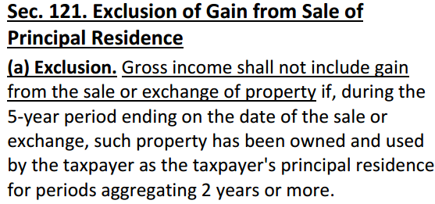

Slide 57
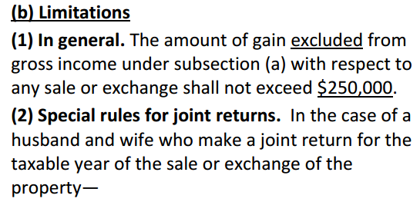

Slide 58
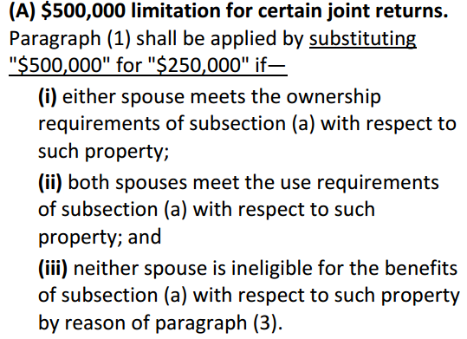

Slide 59
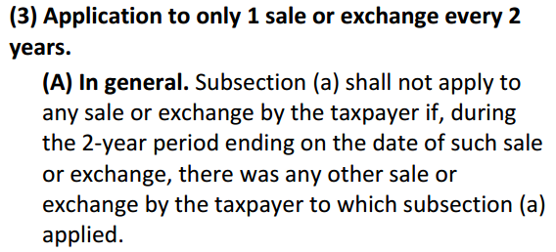

Slide 60
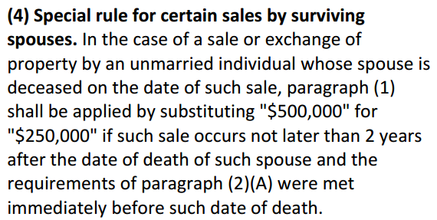

Slide 61
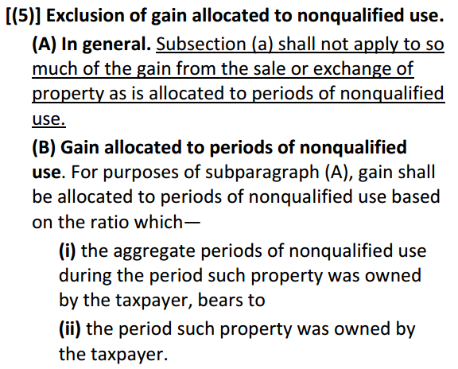

Slide 62
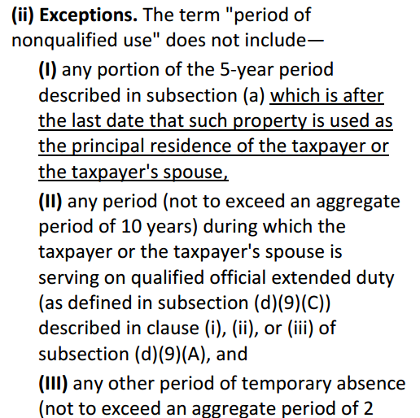

Slide 63
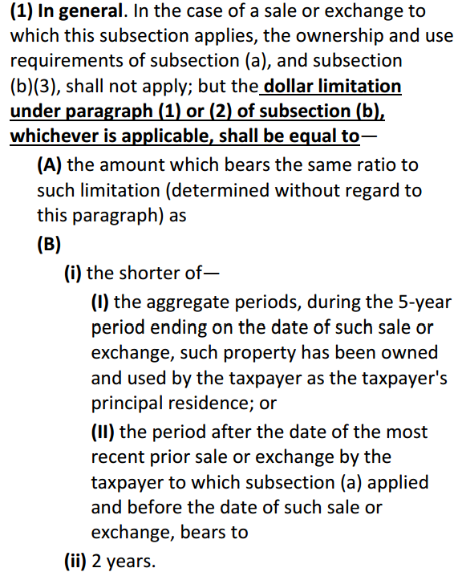

Slide 64
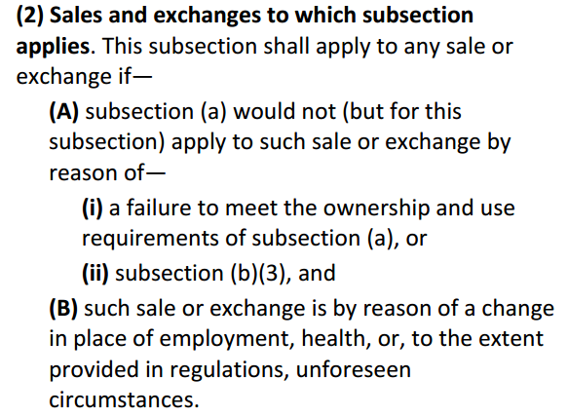

Slide 65
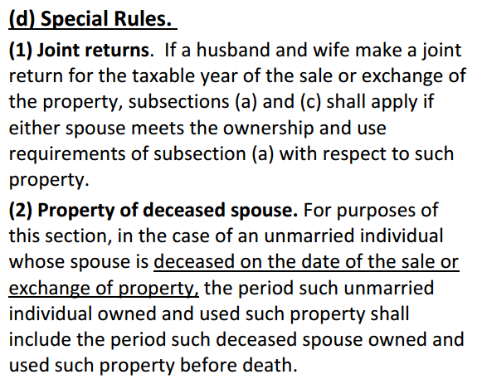

Slide 66
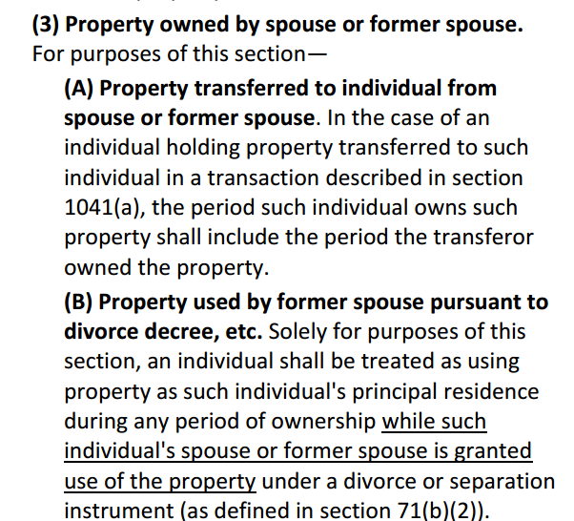

Slide 67
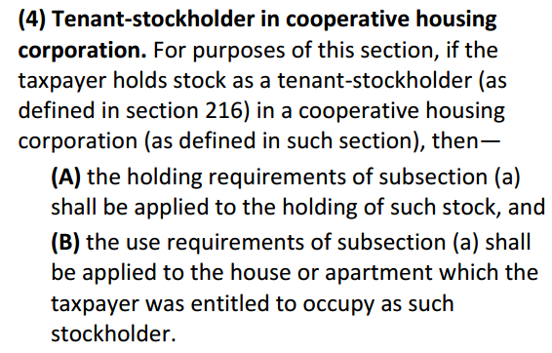

Slide 68
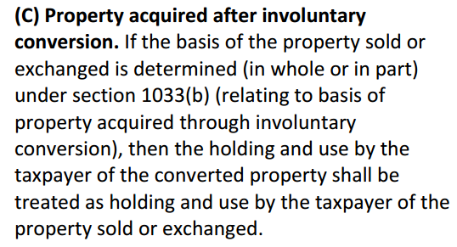

Slide 69
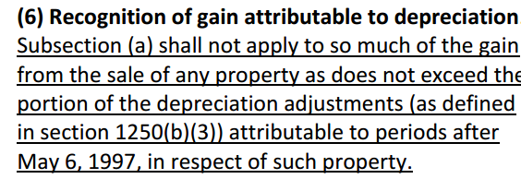

Slide 70
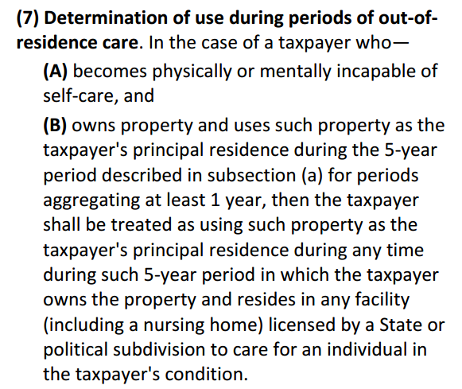

Slide 71
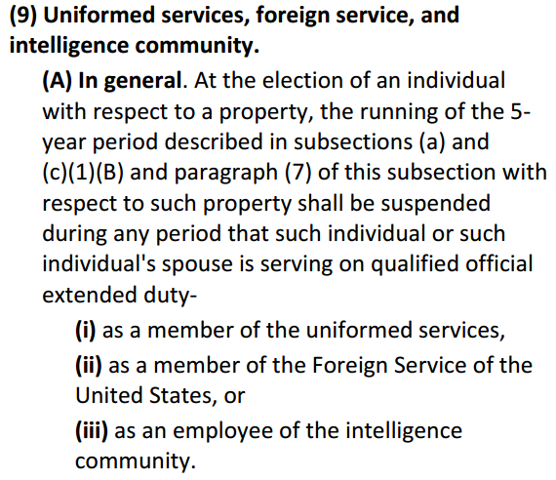

Slide 72
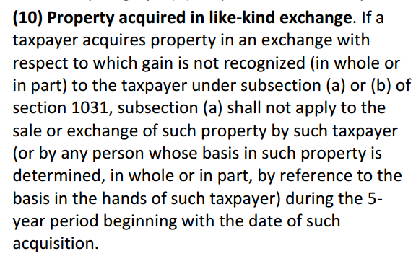

Slide 74
End

