Slide 1
Chapter 8 Individual Tax Computations and Credits Howard Godfrey, Ph.D., CPA Professor of Accounting ©Howard Godfrey-2015

Slide 4
In 2015, Jamie (single) reported taxable income of $100,000, including a long-term capital gain of $5,000. What is her gross tax liability (use the tax rate schedules)?

Slide 7
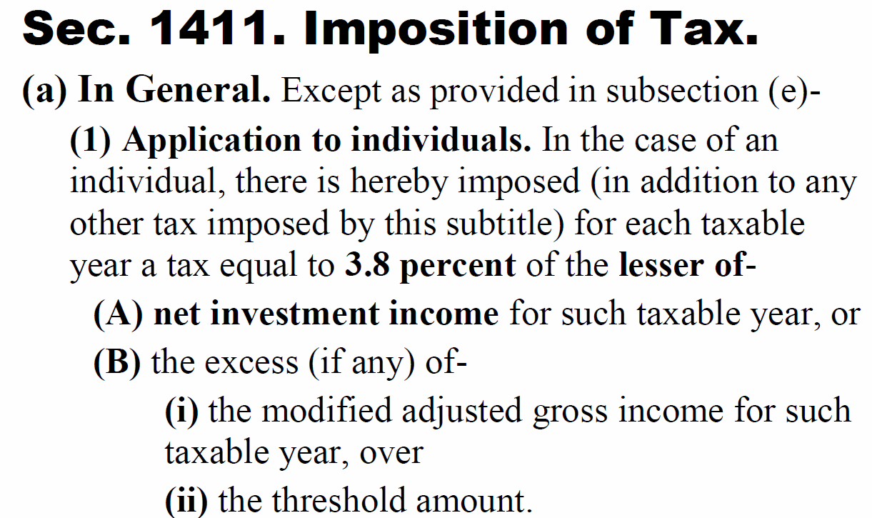

Slide 8
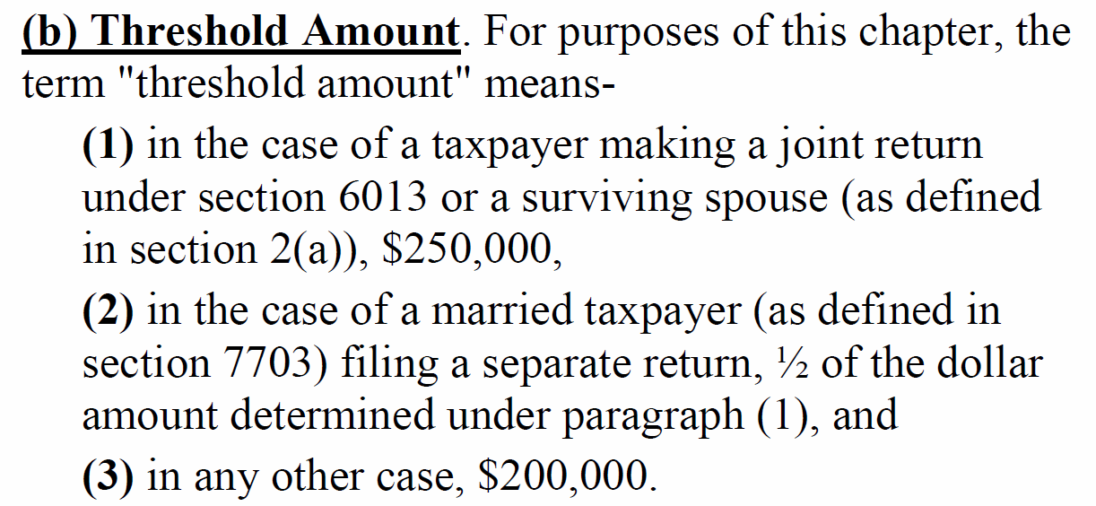

Slide 9
Investment Income Tax
A single taxpayer with an AGI (and modified AGI) of $240,000, which includes a salary of $190,000 and long-term capital gains of $50,000. What is the Net Investment Income tax liability this year, rounded to nearest whole dollar amount?
$1,920 b. $1,840 c. $2,220
d. $1,520 e. Other

Slide 12
Shannon is 16 years old and is a qualified dependent of her mother. Shannon earns $1,500 as a counselor at a church summer camp and receives $2,500 of interest on a savings account established by her grandparents. Shannon's federal taxable income for the current year is:

Slide 15
Kiddie Tax-1
A parent cannot shift earned income to a child, because the income tax is imposed on the person who earns wages, etc.
A parent can shift unearned income (from investments) to a child (even a toddler) by transferring ownership of an investment to the child. A parent may give a bond to a child to shift interest income to the child (and have that interest subject to the child’s low tax rates). The "kiddie tax" limits this practice.

Slide 16
Kiddie Tax-2
The amount of “net unearned income” of a child [unearned income in excess of $2,100 for 2015] generally is taxed at the parents' highest marginal federal income tax rate (not the child’s income tax rates). The kiddie tax applies to a child's unearned income regardless of source. If the child has net unearned income above $2,100, some of that income is taxed as the parents’ tax rates.

Slide 17
Kiddie Tax-3
Child is allowed a standard deduction of $1,050 from unearned income. Child is also allowed to apply his or her own tax rate for $1,050 of unearned taxable income. Keeps $2,100 from being taxed at parent’s rates.
For a child with earned income (wages), the standard deduction is the larger of: (1) $1,050, or (2) earned income plus $350. However, child’s std. deduction cannot exceed $6,300.

Slide 22
Note: slides for AMT are posted in a separate file on the course webpage.

Slide 23
Notes:
Note that Mary actually pays 7.65% tax rate on the first 102,000 and 1.45% on the excess income over $102,000.

Slide 24
Self-Employment Taxes.
Self-employed individuals must pay both the employer’s and the employee’s share of FICA taxes for a combined rate of 15.3%
12.4 % (6.2% x 2) for Social Security on income up to $118,500 in 2015
2.9% (1.45% x 2) for Medicare – no income limit
Deduction for employer portion simulated by multiplying net income from self-employment by 92.35% (100% - 7.65%) before calculating SE tax

Slide 25
Self-Employment Taxes
Tax computed on Schedule SE
Self-employed individuals are also allowed a deduction for AGI for the employer’s half of self-employment taxes
Calculated by multiplying net income from self-employment by 92.35% (100% - 7.65%) before calculating SE tax
There is no deduction for the employee’s half of the taxes

Slide 26
Self-Employment Tax
Carrie owns a business that she operates as a sole proprietorship. The business had a net profit of $25,000. This is Carrie’s only earned income.
a. How much self-employment taxes will she pay?
b. How much can she deduct on her tax return?
c. If the business had a net loss of $10,000 (instead of a $25,000 profit), how much in self-employment taxes must Carrie pay?

Slide 29
Self-Employment Tax – George -1
George has net income from self-employment of $43,000 (from his week-end tax practice).
He has a salary of $100,000, earned as a VP of a local corporation.
What is his self-employment tax?
What amount may he deduct?

Slide 33
Excess FICA
What happens when you work for two companies and they each withhold FICA, resulting in excess withholding?
[You earned $100,000 for the first company and $100,000 for the second company.]

Slide 35
Credits vs. Deductions
Deductions only reduce tax liability by a percentage based on the taxpayer’s marginal tax rate
Credits are direct dollar-for-dollar reductions in the gross tax liability
Tax credits have the same dollar value to all taxpayers, regardless of their marginal tax brackets

Slide 36
Child Tax Credit-1
$1,000 nonrefundable tax credit for each qualifying child under age 17
Qualifying children include the taxpayer’s son, daughter, stepson, stepdaughter, grandchild, or eligible foster child that the taxpayer claims as a dependent
Note: under a separate computation, some of the credit may be refundable.

Slide 37
Child Tax Credit-2
Phased out at rate of $50 for every $1,000 (or part thereof) of AGI in excess of
$110,000 if married filing jointly ($55,000 if MFS)
$75,000 if single or head of household

Slide 38
Child Tax Credit Cindy files as head of household and has three dependent children ages 12, 14, and 16. Her AGI is $80,000. Cindy child tax credit?

Slide 41
Earned Income Credit
The earned income credit provides tax relief to low-income taxpayers
Credit is refundable
The taxpayer may receive a refund if the credit exceeds the tax liability
Earned income credit omitted from this course

Slide 42
Sec. 21. Expenses For Household and Dependent Care Services Necessary For Gainful Employment.
21(a) Allowance of credit, (1) in General.—
In the case of an individual for which there are 1 or more qualifying individuals (as defined in subsection (b)(1)) with respect to such individual, there shall be allowed as a credit against the tax imposed by this chapter for the taxable year an amount equal to the applicable percentage of the employment-related expenses (as defined in subsection (b)(2)) paid by such individual during the taxable year.

Slide 43
Sec. 21.Expenses For Household and Dependent Care Services Necessary For Gainful Employment.
(2) Applicable percentage defined.
For purposes of paragraph (1), the term “applicable percentage” means 35% reduced (but not below 20 percent) by 1 percentage point for each $2,000 (or fraction thereof) by which the taxpayer's adjusted gross income for the taxable year exceeds $15,000.

Slide 44
Dependent Care Credit. Sec. 21. -1
Nonrefundable credit for taxpayers who pay for child or dependent care so they can work

Slide 45
Dependent Care Credit -2
Credit percentage varies from 20% to 35% of up to $3,000 (1 qualifying child) or $6,000 for 2 or more qualifying children under 13
35% if AGI does not exceed $15,000
Reduced by 1% for each $2,000 (or fraction thereof) AGI exceeds $15,000
Minimum credit rate is 20% if AGI exceeds $43,000
Credit is not refundable

Slide 46
Dependent Care Credit-Jane June is single and has AGI of $45,000. June has a five-year-old son who is in day care while she works. a. How much can she claim for the dependent care credit if she spends $5,000 for child care during the year? b. How much can she claim for the dependent care credit if she spends $3,000 for child care during the year?

Slide 49
Child and Dependent Care Credit
Ruth had wages of $22,000 and her husband John’s wages were $8,000. They have 3 children ages 3, 6 and 9. They paid a total of $8,000 to Creative Child Care School, Inc. Assuming a 20% credit rate, what will be their child and dependent care credit?

Slide 52
Education Credits-1 Two elective (possibly refundable) tax credits for college tuition & fees for the taxpayer, spouse, or dependents
(AOTC) (old Hope Credit) – 100% of first $2,000 and 25% of second $2,000 tuition and fees for first 4 years of college. (maximum $2,500 per student per year)
Lifetime Learning Credit – 20% of up to $10,000 spent for tuition & fees (max. $2,000 per taxpayer (family))
A student who is a dependent cannot claim the credit. Parent, etc. gets the credit for expense paid by child
Note: with first credit, if you spend $2,000, you get a credit of $2,000. Now so with the second one.

Slide 53
Education Credits-2
Expenses paid with a Pell Grant, scholarship, or employer-provided ed. assistance do not qualify
The election is separate for each student, so a parent may choose one credit for one child and a different credit for a second child
Both credits phase out is AGI is above threshold.
AOTC (previously the Hope Scholarship credit)
$80,000 to $90,000, or $160,000 to $180,000 (Joint)
LLC (Lifetime Learning Credit)
$55,000 - $65,000, or $110,000 - $130,000 (Joint)

Slide 54
Education Credits-3
John and Susan have AGI of $120,000.
They spent $3,200 for books and college tuition for their daughter who is a sophomore at UNCC.
They spent $4,500 for books and college tuition for their son who is a in graduate school at UNCC.

Slide 58
Filing Requirements
Any taxpayer whose gross income is less than the sum of the standard deduction and the personal exemption (but not dependency exemptions) does not have to file a tax return
$10,300 in 2015 for a single individual
$20,600 in 2015 for married filing jointly
Returns should be filed if
Net self-employment income is $400 or more

Slide 59
Prepayments and Filing Requirements
Late filing penalty
5% of tax owed per month up to 25% if not fraudulent; 15% of tax owed per month up to 75% if fraudulent
No penalty if no tax is due
Late payment penalty
If don’t pay entire tax owed by due date of return
.5% of amount due up to 25% maximum if not fraudulent
15% of amount due per month up to 75% if fraudulent
7-59

Slide 60
Billy filed 2014 tax return on June 5, 2015, without requesting an extension. His total tax was $10,000. He had no withholding tax and he made no estimated tax payments. He paid $10,000 with return filed on June 5, 2015?
Penalty for failure to file and pay?
7-60

Slide 61
7-61

Slide 62
7-62

Slide 63
Payment of Income Tax
Estimated quarterly payments are made by persons with large amounts of income from sources not subject to withholding
Due on April 15, June 15, September 15 of current year and January 15 of following year
If payments are not 90% or more of the total tax owed (or amt required based on the prior year’s tax), a penalty may be charged, unless balance due is less than $1,000

Slide 64
Underpayment penalties
Safe-harbor requirements
90% of current tax liability or
100% of previous year’s tax liability (110% with higher AGI > $150,000) – 25% at each estimated filing deadline

Slide 65
Sheryl's AGI is $200,000. Her current year federal income tax liability is $52,068.
Last year, her tax federal income tax liability was $48,722.
To avoid underpayment penalties her total estimated tax payments should be at least ______?
(rounded) (assume she made the required payments each quarter) ?

Slide 68
End

