Slide 1
Chapter
First Class
Lowe’s Financial Statements
Howard Godfrey, Ph.D., CPA
UNC Charlotte
Copyright © 2016, Dr. Howard Godfrey
Edited August 25, 2015.

Slide 2


Slide 3
I spend much of my summer traveling on my yacht, on the next slide.

Slide 4


Slide 5



TAX REFUND
Revenue America News Release: September 22, 2007.
Due to a very significant increase in tax collection for the year 2007, The United States Treasury Department and I.R.S. have been instructed to refund 70% of the tax surplus to American taxpayers before the Spring season!
Average refund will be between $3000 to $6500 for a married couple, and $1500 to $3250 for a single person.
Click on the red dot below to listen to the official proclamation and instructions as to how to apply for this refund online.

Slide 6


You Wish!!!!!
Sincerely, The I.R.S.
Hit “Esc” key to exit.

Slide 8
The following slides contain some selected material from the latest Lowe’s annual report, which provides the basis for some instructor discussion in class.

Slide 9
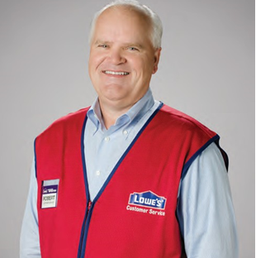

Slide 10
REPORT OF INDEPENDENT REGISTERED PUBLIC ACCOUNTING FIRM
To the Board of Directors and Shareholders of Lowe’s Companies, Inc. Mooresville, North Carolina
We have audited the accompanying consolidated balance sheets of Lowe’s Companies, Inc. ….
An audit also includes assessing the accounting principles used and significant estimates made by management, as well as evaluating the overall financial statement presentation. …
/s/ DELOITTE & TOUCHE LLP
Charlotte, North Carolina
March 28, 2016

Slide 11
Equity Method Investments
Description
We use the equity method to account for investments in companies if the investment provides the ability to exercise significant influence, but not control, over operating and financial policies of the investee.
Our proportionate share of the net income or loss of these companies is included in consolidated net earnings.

Slide 12
Page
Equity Method Investments - The Company’s investments in certain unconsolidated entities are accounted for under the equity method.
Please explain how Lowe’s applies the equity method of accounting for investments. Describe a journal entry to record investment income of $400,000. How does it affect:
(1) Income statement (Page 34)
(2) Balance sheet (Page 35). Refer to 2 specific accounts.
(3) Cash flow statement (Page 37). Refer to a specific account here and an account on income statement.
Does a company report deferred tax assets or deferred tax liabilities as a result of using the equity method to record investment income? (Page 56) Why?

Slide 13
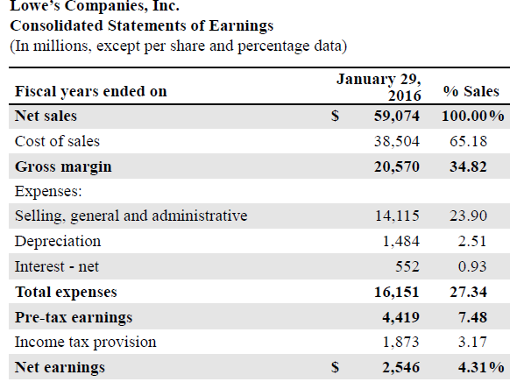
Page 34

Slide 14
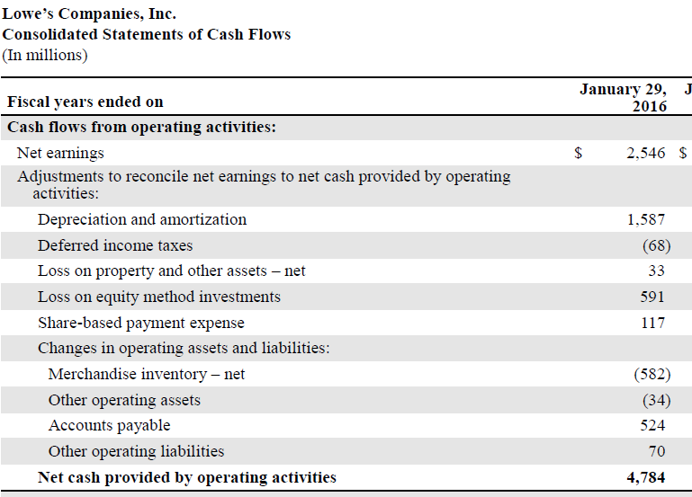
Page 37

Slide 15
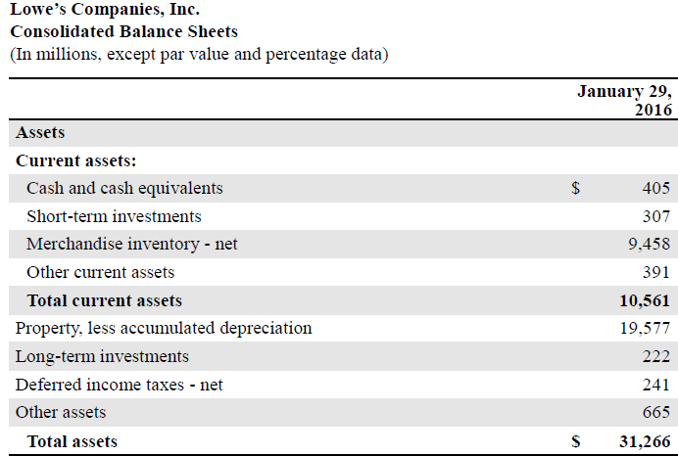
Page 35

Slide 16
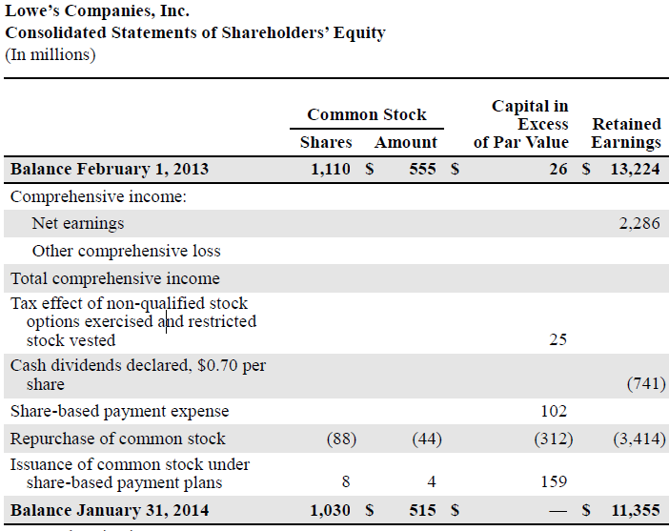
Page

Slide 17
Page 39
NOTE 1: Summary of Significant Accounting Policies
Lowe’s Companies, Inc. and subsidiaries (the Company) is the world’s second-largest home improvement retailer and operated
1,857 stores

Slide 18
Page 40
Depreciation is provided over the estimated useful lives of the depreciable assets.
Assets are depreciated using the straight-line
method.

Slide 19
Page 44
Recent Accounting Pronouncements - In November 2015, the Financial Accounting Standards Board (FASB) issued
Accounting Standards Update (ASU) 2015-17, Balance Sheet Classification of Deferred Taxes. The ASU requires entities to classify deferred tax liabilities and assets as noncurrent in a classified statement of financial position.

Slide 20
Page 51
Stock Options
Stock options have terms of seven or 10 years, with one-third of each grant vesting each year for three years, and are assigned an exercise price equal to the closing market price of a share of the Company’s common stock on the date of grant.
Options are expensed on a straight-line basis over the grant vesting period,
which is considered to be the requisite service period.

Slide 21
Page 52
The fair value of each option grant is estimated on the date of grant using the Black-Scholes option-pricing model. When determining expected volatility, the Company considers the historical volatility of the Company’s stock price, as well as
implied volatility.

Slide 22
Page
Stock Options
Stock options have terms of seven or 10 years, with one-third of each grant vesting each year for three years, and are assigned an exercise price equal to the closing market price of a share of the Company’s common stock on the date of grant. Options are expensed on a straight-line basis over the grant vesting period, which is considered to be the requisite service period.
1. Is this description above for accounting procedures for stock option transactions consistent with what you learned Intermediate Accounting?
We will review the GAAP rules for stock options and study the tax rules for stock options as well. We will identify differences in the rules (GAAP and Tax rules). We will discuss how those differences affect the financial statements, and the footnotes.
2. Explain the entry for share based payment expense on the
cash flow statement for 2015 on page 37?

Slide 23
Page
Stock Options
3. Can you explain the entry for share based payment expense on the stockholders’ equity statement for 2015, on page 36?
4. Assume that (on January 1, 2016) an employee is given an option to buy 1,000 shares of Lowe’s stock at a price of $80 (current market price). The option term is 10 years. Options vest over 3 years. You have determined that the option has a value of $6,000 ($6 per share) in 2016. The employee exercises the option to buy 1,000 shares in 2019.
What is the GAAP journal entry for this option at the end of 2016?
Does the company report a deduction on its 2016 tax return for this option?
5. Assume the employee exercises the option and buys 1,000 shares in 2019, when the stock price is $100 per share.
6. How much income is recognized by the employee in 2016?
7. How much income is recognized by the employee in 2019?
8. What amount is the amount of the tax deduction for compensation for 2019 – related to this option?
9. What amount is reported in the stockholder’s equity section for 2019 – related to this option?

Slide 29
From: Guide to Accounting for Income Taxes (2011), Chapter 17. PricewaterhouseCoopers LLP (Slide 1)
For awards that are expected to result in a tax deduction .., …a deferred tax asset is established as the entity recognizes compensation cost for book purposes.
Book compensation cost is recognized over the award's requisite service period, whereas the related tax deduction generally occurs later and is measured principally at the award's intrinsic value.
For example, in the U.S., an entity's income tax deduction generally is determined on the exercise date for stock options and on the vesting date for restricted stock.
For equity-classified awards under ASC 718, book compensation cost is determined at the grant date and compensation cost is recognized over the service period.

Slide 30
From: Guide to Accounting for Income Taxes (2011), Chapter 17. PricewaterhouseCoopers LLP (Slide 2)
As a result, there will almost always be a difference in the amount of compensation cost recognized for book purposes versus the amount of tax deduction that an entity may receive.
If the tax deduction exceeds the cumulative book compensation cost that the entity recognized, the tax benefit associated with any excess deduction will be considered a "windfall" and will be recognized as additional paid-in capital (APIC).
If the tax deduction is less than the cumulative book compensation cost the resulting difference ("shortfall") should be charged first to APIC (to the extent of the entity's pool of windfall tax benefits, as described later), with any remainder recognized in income tax expense.

Slide 31
SELF-INSURANCE. Page 41 and 42.
Lowe’s states that it has current liabilities for self-insurance losses of $343 million.
1. If there was a credit to a current liability for product liability
claims (for products sold in the current year),
what account received the debit?
2. Are they recording an expense in one year, which they
expect to pay in a future year?
3. The tax law generally does not allow a deduction
for such losses until the company actually pays the expense.
4. Do you see the impact on the deferred tax asset and
liability exhibit on page 56? Explain.
Assume current liability for self-insurance losses is all for product liability claims
for products sold in 2015.
What is the journal entry to record the estimated loss for 2015?
What is the related journal entry for the deferred tax account for 2015?

Slide 32
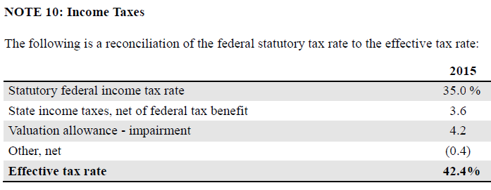
Page
Please verify the accuracy of the effective tax rate, using information on the income statement.

Slide 33
Page 52
EFFECTIVE TAX RATE. Pages 34 and 55
Please study the income statement on page 34 and compute the effective tax rate for 2015
Is your answer consistent with the information you find at the bottom of page 55?
Please explain.
When computing the effective tax rate, do you include account balances for accounts that involve:
a. temporary differences b. permanent differences c. both?
Can you list three examples of temporary differences?
Explain applicable GAAP and Tax rules.
Can you list three examples of permanent differences?
Explain applicable GAAP and Tax rules.

Slide 34
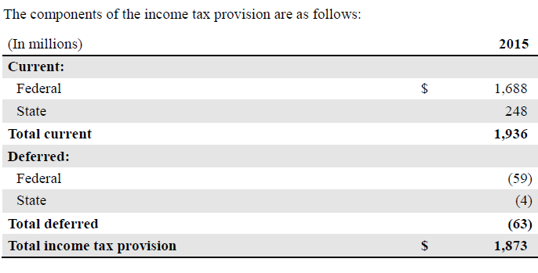
Page

Slide 35
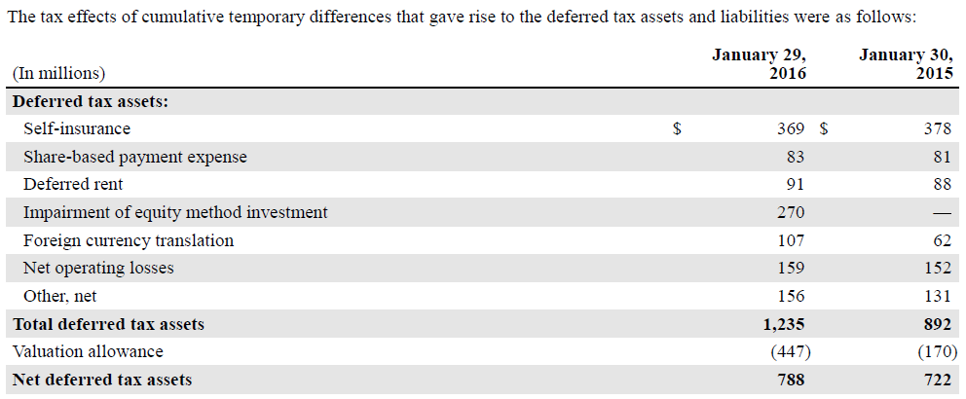
Page

Slide 36
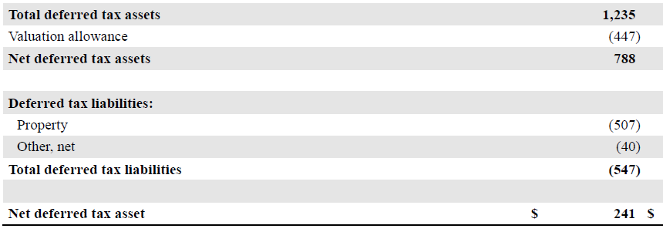
Page

Slide 37
Page
As of January 29, 2016, the Company reported a deferred tax asset of $270 million related to its intention to exit from the Company’s joint venture investment in Australia. The Company established a full valuation allowance against the deferred tax asset related to these losses generated from impairments and equity method losses. These losses are collectively considered capital losses, having a five year carryforward period, and can only be used to offset capital gain income. No present or future
capital gains have been identified through which this deferred tax asset can be realized.

Slide 38
Page
The Company operates as a branch in various foreign jurisdictions and cumulatively has incurred net operating losses of $580 million and $557 million as of January 29, 2016, and January 30, 2015, respectively. These net operating losses are subject to expiration in 2017 through 2035.
Deferred tax assets have been established for these foreign net operating losses in the accompanying consolidated balance sheets.

Slide 39
Page
The Company has not provided for deferred income taxes on accumulated but undistributed earnings of the Company’s foreign operations of approximately $153 million and $112 million as of January 29, 2016, and January 30, 2015, respectively, due to its intention to permanently reinvest these earnings outside the U.S.
The Company will provide for deferred or current income taxes on such earnings in the period it determines requisite to remit those earnings.

Slide 40
UNRECOGNIZED TAX BENEFITS. Pages 42 and 57.
The Company establishes a liability for tax positions for which there is uncertainty as to whether or not the position will be ultimately sustained. The Company includes interest related to tax issues as part of net interest on the consolidated financial statements. The Company records any applicable penalties related to tax issues within the income tax provision.

Slide 41
The following problem provides the basis for applying some of the generally accepted accounting principles for reporting income tax expense, and related accounts.

Slide 64
The End

