Slide 1
Chapter 2-Part A. Filing Requirements, Estimated Tax Statute of Limitations Penalties Edited September 7, 2016 Howard Godfrey, Ph.D., CPA Professor of Accounting Copyright 2016. Howard Godfrey

Slide 7
Filing requirements-income tax returns
Penalties – late filing or payment
Statute of limitations for assessment.
Estimated income tax payments.
5. Penalties for taxpayer & CPA.

Slide 9
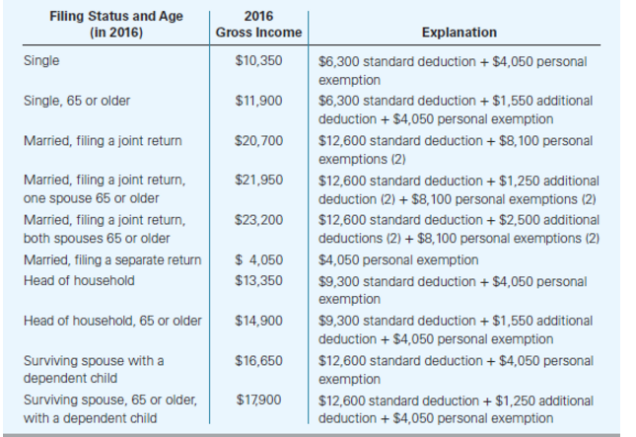

Slide 11
Statute of Limitations-1
Regardless of the nature of the mistake, the taxpayer is obligated to file an amended return to correct the error (and request a refund or pay a deficiency) if the statute of limitations has not expired for the tax return. Likewise, the IRS can propose adjustments to the taxpayer's return if the statute of limitations for the return has not expired.

Slide 12
Statute of Limitations -2
Statute of limitations defines the period in which the taxpayer can file an amended tax return or the IRS can assess a tax deficiency.
The statute of limitations generally ends three years from the later of
the date the tax return was actually filed or
the tax return's original due date.

Slide 13
Statute of Limitations-3
A 6-year statute of limitations applies to IRS assessments if the taxpayer omits items of gross income that exceed 25% of the gross income reported on the tax return.
For fraudulent returns, or if the taxpayer fails to file a tax return, the statute of limitations never expires.

Slide 15
Billy filed 2015 tax return on June 5, 2016, without requesting an extension. His total tax was $10,000.
He had no withholding tax and he made no estimated tax payments.
He paid $10,000 with return filed on June 5, 2016?
What is the total amount of his failure to file and failure to pay penalties?

Slide 17
The required annual payment is the smaller of the following amounts:
90% of the tax shown on current year return.
100% of the tax shown on preceding year return.
(The prior return must cover the full 12 months of the preceding year). If the AGI on preceding year's return exceeds $150,000 ($75,000 if married filing separately), the 100 percent requirement is increased to 110 percent.
No installment is required, if tax for the year, less amounts withheld by employer is less than $1,000.

Slide 18
Mary’s tax for prior year was $10,000.
Mary’s tax on current year return is $8,000.
Mary made estimated tax payments of $7,000, in equal annual installments.
What was her required annual payment?

Slide 19
Sheryl's AGI was $200,000 last year. Her current tax liability is $52,068. Last year, her tax liability was $48,722. She will not owe underpayment penalties if her total estimated tax payments are at least which of the following (rounded) amounts (assume she makes the required payments each quarter)?
a. $46,861 b. $48,722

Slide 27
The
End

