Slide 1
Least-Squares Regression Computations
Appendix 2A
Notes:
Appendix 2A: Least-Squares Regression Computation.
In this appendix, we will show you how to use Microsoft Excel to determine the key variable necessary for least-squares regression. As you have seen, we need three pieces of information: the estimated variable cost per unit (the slope of the line), the estimated fixed cost (the intercept), and R squared.

Slide 2
Learning Objective 8
Analyze a mixed cost using a scattergraph plot and the least-squares regression method.
Notes:
Learning objective number 8 is to analyze a mixed cost using a scattergraph plot and the least-squares regression method.

Slide 3
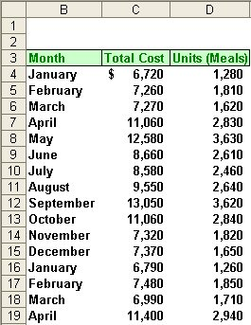
Simple Regression Analysis
Matrix, Inc. wants to know its average fixed cost and variable cost per meals served.
Using the data to the right, let’s see how to do a regression using Microsoft Excel.
Notes:
Assume that you have the following data set and that you wish to use Microsoft Excel to estimate the variable and fixed cost components of your total meals cost.
Matrix, Inc. has gathered 16 months of information concerning the number of meals prepared and the total cost of preparing them each month. We will use these data in our least-squares regression model. Using Microsoft Excel, we will estimate the variable and fixed cost components of the total meals cost.

Slide 4
Simple Regression Using Excel
You will need three pieces of information from your regression analysis:
Estimated Variable Cost Per Unit (line slope)
Estimated Fixed Costs (line intercept)
Goodness of fit, or R²
To get these three pieces information we will need to use three Excel functions.
SLOPE, INTERCEPT, and RSQ
Notes:
You will need to calculate three pieces of information: the estimated variable cost per unit (called the slope of the line), the estimated fixed cost (called the intercept), and the R squared value. To get these three pieces of information you will need three Excel functions. These functions are named SLOPE, INTERCEPT, and RSQ.
“SLOPE” provides us with the slope of the line; “INTERCEPT” gives us the fixed cost intercept; and “RSQ” yields the R squared value.
Load Excel on your computer and enter the data shown in the table on the right side of your screen. Start with the headings in cell B3, C3, and D3. Enter the months in column B, the total cost in column C, and the number of meals in column D. When finished entering this data, go to the next screen.

Slide 5
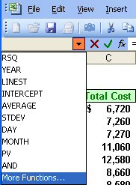
Simple Regression Using Excel
Place your cursor in cell F4 and press the = key. Click on the pull down menu and scroll down to “More Functions . . .”
Notes:
The first step within Excel is to place your cursor in cell F4 and press the = key. Look to the left of your screen and you will see the “Special Functions” pull-down menu. Click on the pull-down arrow to the right of the “Special Functions” tab and scroll down to select “More Functions.”

Slide 6
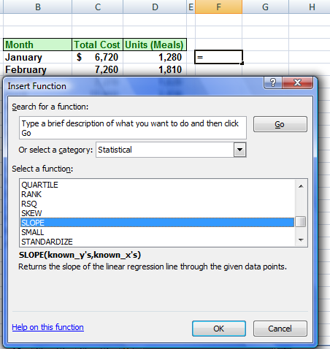
Simple Regression Using Excel
Scroll down to the “Statistical” functions. Now scroll down the statistical functions until you highlight “SLOPE”
Notes:
When the function box opens, click on the “Statistical” category and then on “SLOPE.”

Slide 7
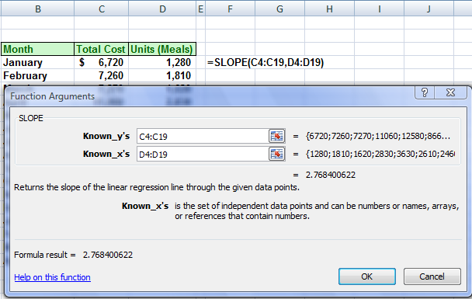
Simple Regression Using Excel
1. In the Known_y’s box, enter C4:C19 for the range.
2. In the Known_x’s box, enter D4:D19 for the range.
Notes:
The “Function Arguments” window will pop-up for “SLOPE.” The first blank space is for “Known_y’s.” We want to enter the total cost for each month in this space. To do this, click on cell C4, hold down the mouse button and drag down to cell C19. Now, release the mouse button and C4:C19 will appear in the first space. We have now entered the total cost.
Move your cursor down to the second space named “Known_x’s.” We want to enter the number of meals in this space. Click on cell D4, hold down the mouse button and drag down to cell D19 (D4:D19). Release the mouse button and you have entered the number of meals.

Slide 8
Simple Regression Using Excel
Here is the estimate of the slope of the line.
1. In the Known_y’s box, enter C4:C19 for the range.
2. In the Known_x’s box, enter D4:D19 for the range.
Notes:
The slope, or estimated variable cost per unit, is identified on the screen as shown.
Look at your screen to locate the 2.76840062. This is the estimate of the slope of the line. Now look at your cell F4 and make sure it looks just like the cell contents on this screen. If you have 2.77 rounded and your cell F4 looks like the one on your screen, press the enter key. You have calculated the slope of the line, which is the first piece of vital information.

Slide 9
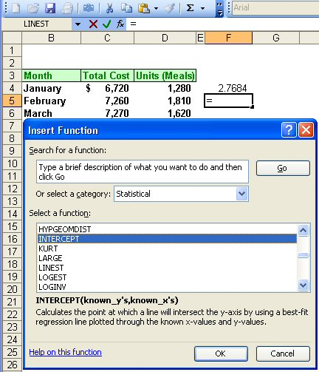
Simple Regression Using Excel
With your cursor in cell F5, press the = key and go to the pull down menu for “Special Functions.” Select Statistical and scroll down to highlight the INTERCEPT function.
Notes:
Move your cursor to cell F5 and press the = key. Return to the “Special Functions” area and click on the down arrow. The “Statistical” function should now be selected. Scroll the “Select a Function” window until you find “INTERCEPT.” Click on “INTERCEPT” to select this function.

Slide 10
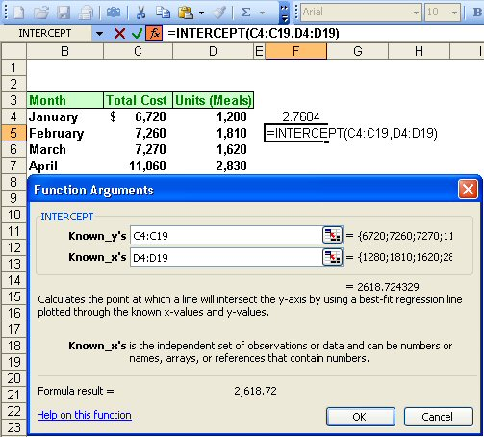
Simple Regression Using Excel
Here is the estimate of the fixed costs.
1. In the Known_y’s box, enter C4:C19 for the range.
2. In the Known_x’s box, enter D4:D19 for the range.
Notes:
Once again, we are asked to enter the “Known_y’s” and “Known_x’s.” Follow the same procedures we used earlier to enter the total cost in the “Known_y’s” and the number of meals in the “Known_x’s” spaces.
The estimated fixed cost is identified on the screen as shown. This is the second piece of information needed.
Notice that Excel has already calculated the estimated fixed costs at $2,618.72. If you find this amount and your cell F5 looks like the one on the screen, press the enter key.

Slide 11
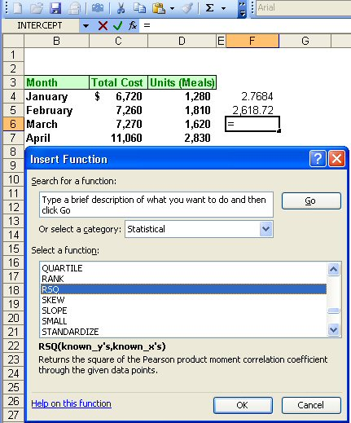
Simple Regression Using Excel
Finally, we will determine the “goodness of fit”, or R², by using the RSQ function.
Notes:
Move your cursor to cell F6, press the equal key, and select the “Special Functions” section of Excel. You are already in “Statistical,” so scroll until you find the special function “RSQ” (or R squared). Click on “RSQ” and you are ready to enter the necessary data.

Slide 12
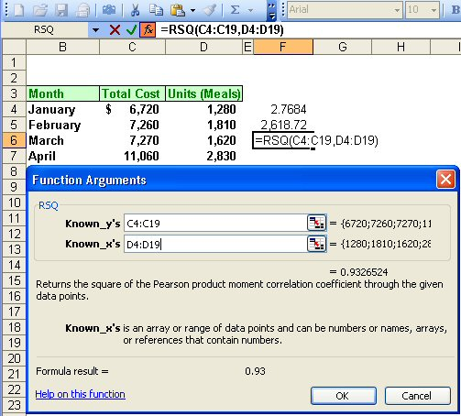
Simple Regression Using Excel
Here is the estimate of R².
1. In the Known_y’s box, enter C4:C19 for the range.
2. In the Known_x’s box, enter D4:D19 for the range.
Notes:
Once again, the function arguments window asks you to enter the “Known_y’s” and “Known_x’s.” Follow the same procedure to enter total cost in the “Known_y’s” and the number of meals in the “Known_x’s.”
Look in the arguments window and notice that the R squared is equal to 93.3%. That is an excellent R squared. If you calculated this value for R squared and your cell F6 looks like the one on your screen, press the enter key. You have now completed gathering all the information necessary. Using Excel to solve a least-squares regression problem is very easy. It is very important that you understand the output from these special functions.

Slide 13
We plug data from a table into excel to calculate the following values: Slope = 2.5; Intercept = 25; and R-square = .95 Assuming q = quantity produced, then the cost equation would be:
TC = .95 + 25(q)
TC = .95 + 2.5(q)
TC = 2.5 + 25(q)
TC = 25 + 2.5(q)

Slide 14
If we had a data table with output by machine hours that had a r-square of .45; and a data table with output by labor hours of .92; which reflects a better “goodness of fit”?
Machine hours
Labor hours

