Slide 1
Master Budgeting
Chapter 8

Slide 2
Learning Objective 1
Understand why organizations budget and the processes they use to create budgets.

Slide 3
The Basic Framework of Budgeting
A budget is a detailed quantitative plan for acquiring and using financial and other resources over a specified forthcoming time period.
The act of preparing a budget is called budgeting.
The use of budgets to control an organization’s activities is known as budgetary control.

Slide 4


Difference Between Planning and Control
Planning –
involves developing objectives and preparing various budgets to achieve those objectives.
Control –
involves the steps taken by management to increase the likelihood that the objectives set down while planning are attained and that all parts of the organization are working together toward that goal.

Slide 5
Advantages of Budgeting
Define goals
and objectives
Communicate
plans
Think about and
plan for the future
Advantages
Coordinate
activities
Means of allocating
resources
Uncover potential
bottlenecks

Slide 6
Responsibility Accounting
Managers should be held responsible for those items - and only those items - that they can actually control
to a significant extent. Responsibility accounting enables organizations to react quickly to deviations from their plans and to learn from feedback.

Slide 7
Choosing the Budget Period
Operating Budget
2014
2015
2016
2017
Operating budgets ordinarily
cover a one-year period
corresponding to a company’s fiscal year. Many companies divide their annual budget
into four quarters.
A continuous budget is a
12-month budget that rolls
forward one month (or quarter)
as the current month (or quarter)
is completed.

Slide 8
Self-Imposed Budget
A self-imposed budget or participative budget is a budget that is prepared with the full cooperation and participation of managers at all levels.

Slide 9
Advantages of Self-Imposed Budgets
Individuals at all levels of the organization are viewed as members of the team whose judgments are valued by top management.
Budget estimates prepared by front-line managers are often more accurate than estimates prepared by top managers.
Motivation is generally higher when individuals participate in setting their own goals than when the goals are imposed from above.
A manager who is not able to meet a budget imposed from above can claim that it was unrealistic. Self-imposed budgets eliminate this excuse.

Slide 10
Self-Imposed Budgets
Self-imposed budgets should be reviewed by higher levels of management to prevent “budgetary slack.”
Most companies issue broad guidelines in terms of overall profits or sales. Lower level managers are directed to prepare budgets that meet those targets.

Slide 11
Human Factors in Budgeting
The success of a budget program depends on three important factors:
Top management must be enthusiastic and
committed to the budget process.
Top management must not use the budget to
pressure employees or blame them when
something goes wrong.
Highly achievable budget targets are usually
preferred when managers are rewarded based on
meeting budget targets.

Slide 12
The Master Budget: An Overview
Sales budget
Selling and
administrative
budget
Ending inventory
budget
Production budget
Direct materials
budget
Direct labor
budget
Manufacturing
overhead budget
Cash Budget
Budgeted
income
statement
Budgeted
balance sheet

Slide 13

Seeing the Big Picture
To help you see the “big picture” keep in mind that the 10 schedules in the master budget are designed to answer the 10 questions shown on the next screen.

Slide 14

Seeing the Big Picture
How much sales revenue will we earn?
How much cash will we collect from customers?
How much raw material will we need to purchase?
How much manufacturing costs will we incur?
How much cash will we pay to our suppliers and our direct laborers, and how much cash will we pay for manufacturing overhead resources?
What is the total cost that will be transferred from finished goods inventory to cost of good sold?
How much selling and administrative expense will we incur and how much cash will be pay related to those expenses?
How much money will we borrow from or repay to lenders – including interest?
How much operating income will we earn?
What will our balance sheet look like at the end of the budget period?

Slide 15
The Master Budget: An Overview
A master budget is based on various estimates and assumptions. For example, the sales budget requires three estimates/assumptions as follows:
What are the budgeted unit sales?
What is the budgeted selling price per unit?
What percentage of accounts receivable will be collected in the current and subsequent periods.

Slide 16
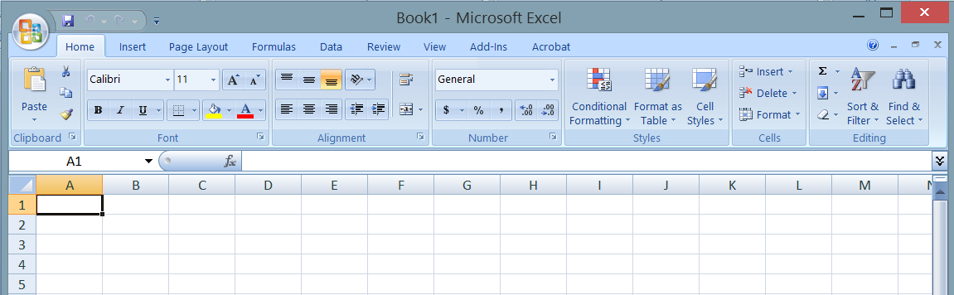
The Master Budget: An Overview
When Microsoft Excel© is used to create a master budget, these types of assumptions can be depicted in a Budget Assumptions tab, thereby enabling Excel-based budget to answer “what-if” questions.

Slide 17
Learning Objective 2
Prepare a sales budget, including a schedule of expected cash collections.

Slide 18
Budgeting Example
Royal Company is preparing budgets for the
quarter ending June 30th.
Budgeted sales for the next five months are:
  April 20,000 units
  May 50,000 units
  June 30,000 units
  July 25,000 units
  August 15,000 units
The selling price is $10 per unit.

Slide 19
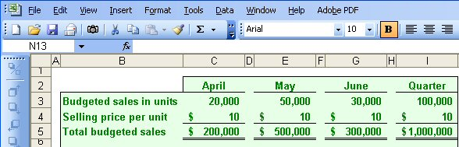
The Sales Budget
The individual months of April, May, and June are summed to obtain the total budgeted sales in units and dollars for the quarter ended June 30th

Slide 20
Expected Cash Collections
All sales are on account.
Royal’s collection pattern is:
  70% collected in the month of sale,
  25% collected in the month following sale,
  5% uncollectible.
In April, the March 31st accounts receivable balance of $30,000 will be collected in full.

Slide 21
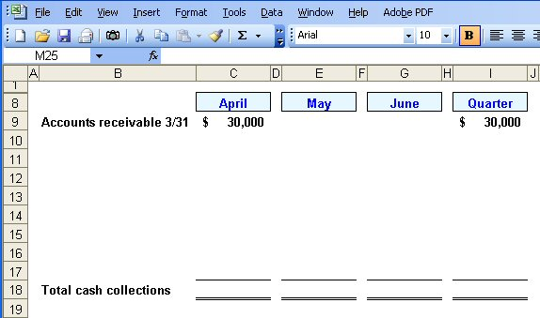
Expected Cash Collections

Slide 22
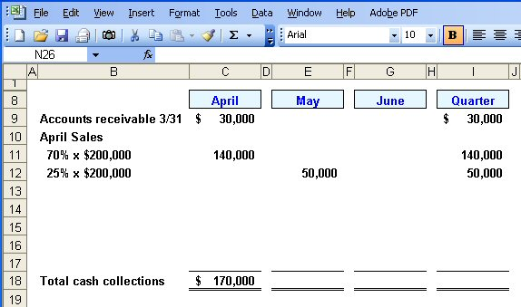
Expected Cash Collections
From the Sales Budget for April.

Slide 23
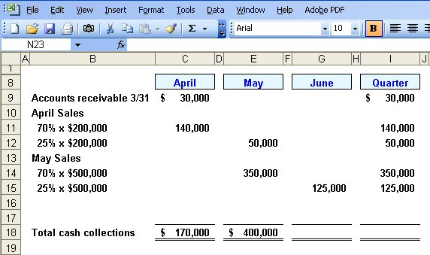
Expected Cash Collections
From the Sales Budget for May.

Slide 24
Quick Check ✓
What will be the total cash collections for the quarter?
  a. $700,000
  b. $220,000
  c. $190,000
  d. $905,000

Slide 25
Quick Check ✓
What will be the total cash collections for the quarter?
  a. $700,000
  b. $220,000
  c. $190,000
  d. $905,000

Slide 26
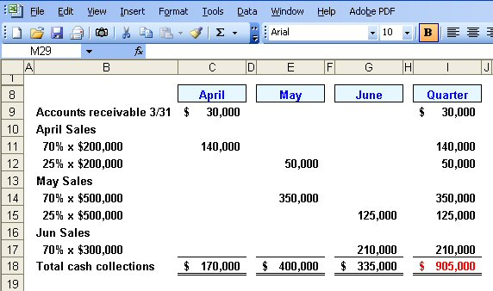
Expected Cash Collections

Slide 27
Learning Objective 3
Prepare a production budget.

Slide 28
The Production Budget
Sales
Budget
and
Expected
Cash
Collections
Production
Budget
Completed
The production budget must be adequate to
meet budgeted sales and to provide for
the desired ending inventory.

Slide 29
The Production Budget
The management at Royal Company wants ending inventory to be equal to 20% of the following month’s budgeted sales in units.
On March 31st, 4,000 units were on hand.
Let’s prepare the production budget.
If Royal was a merchandising company it would prepare a merchandise purchase budget instead of a production budget.

Slide 30
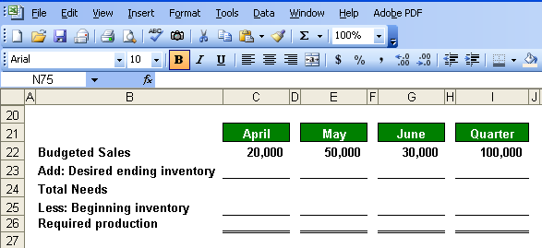
The Production Budget

Slide 31
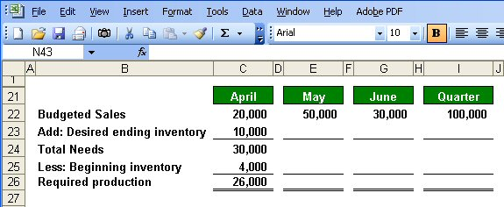
The Production Budget
March 31
ending inventory.

Slide 32
Quick Check ✓
What is the required production for May?
  a. 56,000 units
  b. 46,000 units
  c. 62,000 units
  d. 52,000 units

Slide 33
Quick Check ✓
What is the required production for May?
  a. 56,000 units
  b. 46,000 units
  c. 62,000 units
  d. 52,000 units

Slide 34
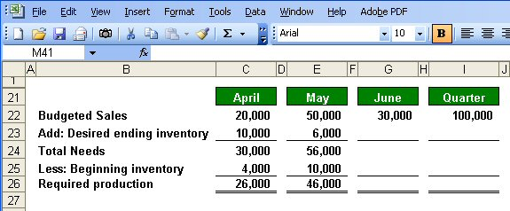
The Production Budget

Slide 35
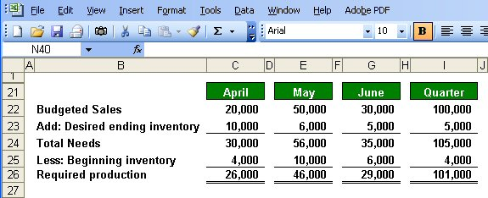
The Production Budget
Assumed ending inventory.

Slide 36
Learning Objective 4
Prepare a direct materials budget, including a schedule of expected cash disbursements for purchases of materials.

Slide 37
The Direct Materials Budget
At Royal Company, five pounds of material are required per unit of product.
Management wants materials on hand at the end of each month equal to 10% of the following month’s production.
On March 31, 13,000 pounds of material are on hand. Material cost is $0.40 per pound.
Let’s prepare the direct materials budget.

Slide 38
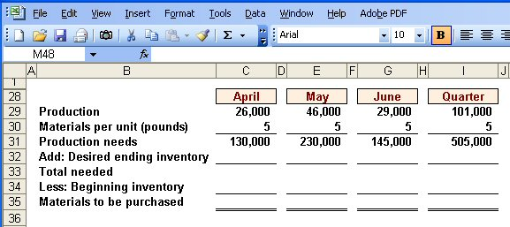
The Direct Materials Budget
From production budget.

Slide 39
The Direct Materials Budget

Slide 40
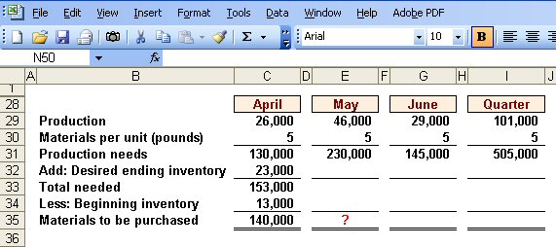
The Direct Materials Budget
March 31 inventory.
10% of following month’s production needs.
Calculate the materials to
be purchased in May.

Slide 41
Quick Check ✓
How much materials should be purchased in May?
  a. 221,500 pounds
  b. 240,000 pounds
  c. 230,000 pounds
  d. 211,500 pounds

Slide 42
Quick Check ✓
How much materials should be purchased in May?
  a. 221,500 pounds
  b. 240,000 pounds
  c. 230,000 pounds
  d. 211,500 pounds

Slide 43
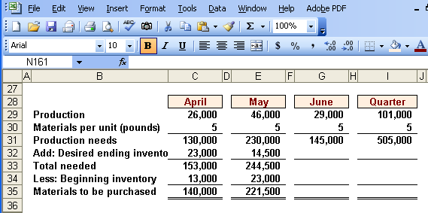
The Direct Materials Budget

Slide 44
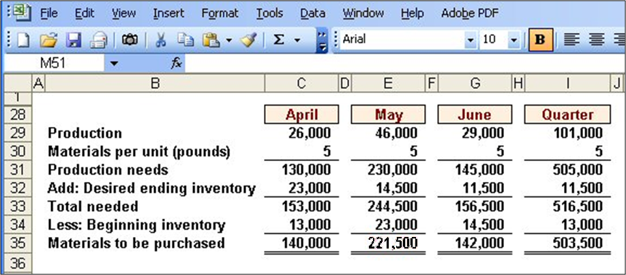
The Direct Materials Budget
Assumed ending inventory.

Slide 45
Expected Cash Disbursement for Materials
Royal pays $0.40 per pound for its materials.
One-half of a month’s purchases is paid for in the month of purchase; the other half is paid in the following month.
The March 31 accounts payable balance is $12,000.
Let’s calculate expected cash disbursements.

Slide 46
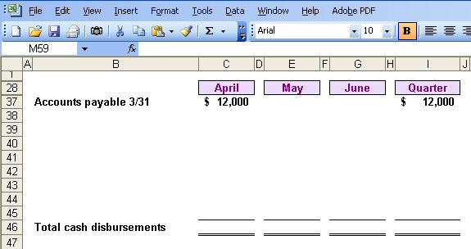
Expected Cash Disbursement for Materials

Slide 47
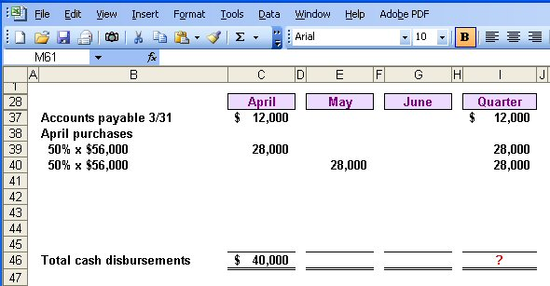
Expected Cash Disbursement for Materials
Compute the expected cash
disbursements for materials
for the quarter.
140,000 lbs. × $0.40/lb. = $56,000

Slide 48
Quick Check ✓
What are the total cash disbursements for the quarter?
  a. $185,000
  b. $ 68,000
  c. $ 56,000
  d. $201,400

Slide 49
Quick Check ✓
What are the total cash disbursements for the quarter?
  a. $185,000
  b. $ 68,000
  c. $ 56,000
  d. $201,400

Slide 50
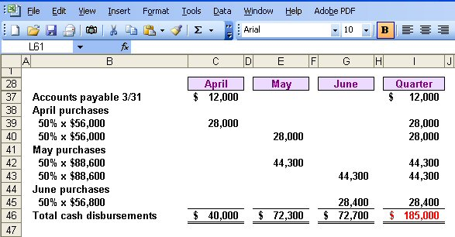
Expected Cash Disbursement for Materials

Slide 51
Learning Objective 5
Prepare a direct labor budget.

Slide 52
The Direct Labor Budget
At Royal, each unit of product requires 0.05 hours (3 minutes) of direct labor.
The Company has a “no layoff” policy so all employees will be paid for 40 hours of work each week.
For purposes of our illustration assume that Royal has a “no layoff” policy, workers are paid at the rate of $10 per hour regardless of the hours worked.
For the next three months, the direct labor workforce will be paid for a minimum of 1,500 hours per month.
Let’s prepare the direct labor budget.

Slide 53
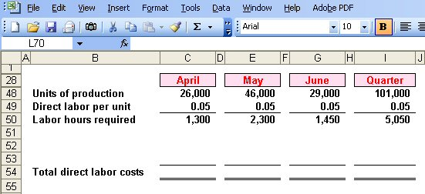
The Direct Labor Budget
From production budget.

Slide 54
The Direct Labor Budget

Slide 55
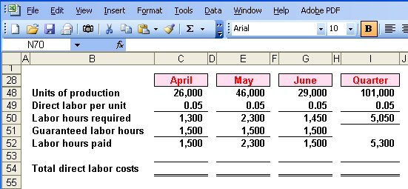
The Direct Labor Budget
Greater of labor hours required
or labor hours guaranteed.

Slide 56
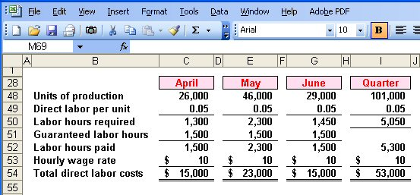
The Direct Labor Budget

Slide 57
Quick Check ✓
What would be the total direct labor cost for the quarter if the company follows its no lay-off policy, but pays $15 (time-and-a-half) for every hour worked in excess of 1,500 hours in a month?
  a. $79,500
  b. $64,500
  c. $61,000
  d. $57,000

Slide 58
Quick Check ✓
What would be the total direct labor cost for the quarter if the company follows its no lay-off policy, but pays $15 (time-and-a-half) for every hour worked in excess of 1,500 hours in a month?
  a. $79,500
  b. $64,500
  c. $61,000
  d. $57,000

Slide 59
Learning Objective 6
Prepare a manufacturing overhead budget.

Slide 60
Manufacturing Overhead Budget
At Royal, manufacturing overhead is applied to units of product on the basis of direct labor hours.
The variable manufacturing overhead rate is $20 per direct labor hour.
Fixed manufacturing overhead is $50,000 per month, which includes $20,000 of noncash costs (primarily depreciation of plant assets).
Let’s prepare the manufacturing overhead budget.

Slide 61
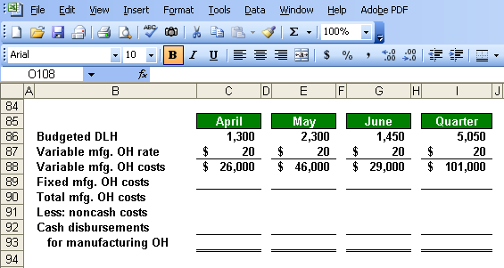
Manufacturing Overhead Budget
Direct Labor Budget.

Slide 62
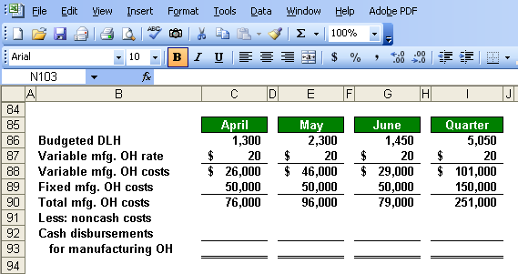
Manufacturing Overhead Budget
Total mfg. OH for quarter $251,000
Total labor hours required 5,050
= $49.70 per hour *
* rounded

Slide 63
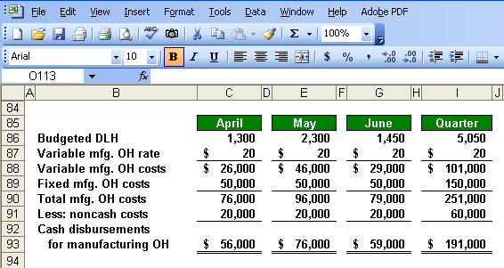
Manufacturing Overhead Budget
Depreciation is a noncash charge.

Slide 64
Ending Finished Goods Inventory Budget
Direct materials
budget and information.

Slide 65
Ending Finished Goods Inventory Budget
Direct labor budget.

Slide 66
Ending Finished Goods Inventory Budget
Total mfg. OH for quarter $251,000
Total labor hours required 5,050
= $49.70 per hour

Slide 67
Ending Finished Goods Inventory Budget
Production Budget.

Slide 68
Learning Objective 7
Prepare a selling and administrative expense budget.

Slide 69
Selling and Administrative Expense Budget
At Royal, the selling and administrative expense budget is divided into variable and fixed components.
The variable selling and administrative expenses are $0.50 per unit sold.
Fixed selling and administrative expenses are $70,000 per month.
The fixed selling and administrative expenses include $10,000 in costs – primarily depreciation – that are not cash outflows of the current month.
Let’s prepare the company’s selling and administrative expense budget.

Slide 70
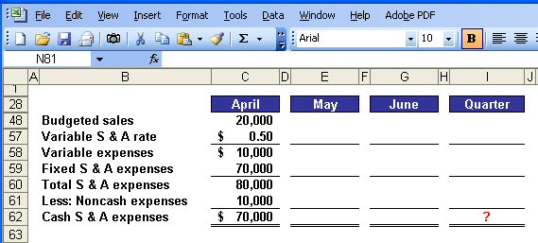
Selling and Administrative Expense Budget
Calculate the selling and administrative
cash expenses for the quarter.

Slide 71
Quick Check ✓
What are the total cash disbursements for selling and administrative expenses for the quarter?
  a. $180,000
  b. $230,000
  c. $110,000
  d. $ 70,000

Slide 72
Quick Check ✓
What are the total cash disbursements for selling and administrative expenses for the quarter?
  a. $180,000
  b. $230,000
  c. $110,000
  d. $ 70,000

Slide 73
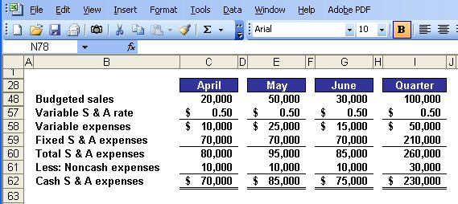
Selling Administrative Expense Budget

Slide 74
Learning Objective 8
Prepare a cash budget.

Slide 75
Format of the Cash Budget
The cash budget is divided into four sections:
Cash receipts section lists all cash inflows excluding cash received from financing;
Cash disbursements section consists of all cash payments excluding repayments of principal and interest;
Cash excess or deficiency section determines if the company will need to borrow money or if it will be able to repay funds previously borrowed; and
Financing section details the borrowings and repayments projected to take place during the budget period.

Slide 76
The Cash Budget
Assume the following information for Royal:
  Maintains a 16% open line of credit for $75,000.
  Maintains a minimum cash balance of $30,000.
  Borrows on the first day of the month and repays loans on the last day of the month.
  Pays a cash dividend of $49,000 in April.
  Purchases $143,700 of equipment in May and $48,300 in June (both purchases paid in cash).
  Has an April 1 cash balance of $40,000.

Slide 77
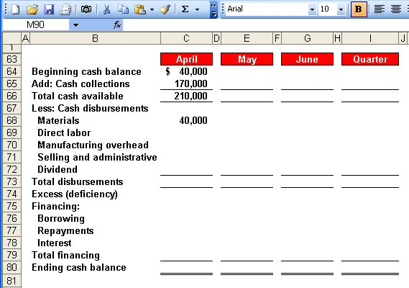
The Cash Budget
Schedule of Expected
Cash Collections.

Slide 78
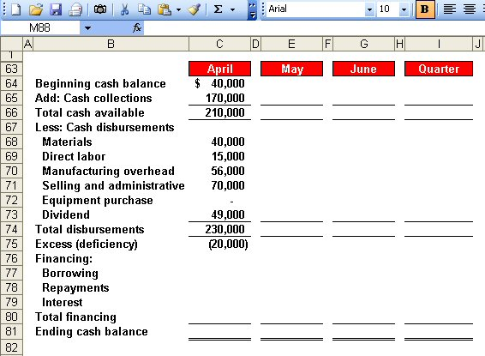
The Cash Budget
Schedule of Expected
Cash Disbursements.
Direct Labor
Budget.
Manufacturing
Overhead Budget.
Selling and Administrative
Expense Budget.

Slide 79
The Cash Budget
Because Royal maintains
a cash balance of $30,000,
the company must borrow $50,000 on its line-of-credit.

Slide 80
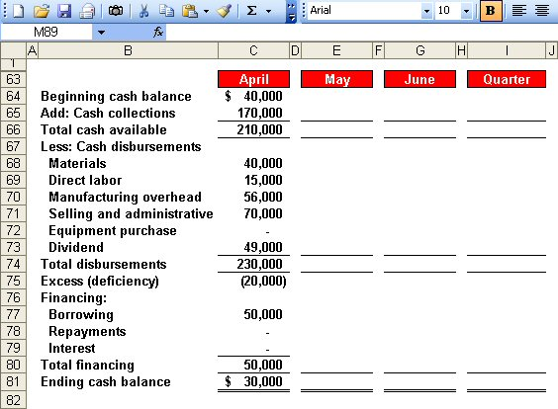
The Cash Budget
Because Royal maintains
a cash balance of $30,000,
the company must borrow $50,000 on its line-of-credit.
Ending cash balance for April
is the beginning May balance.

Slide 81
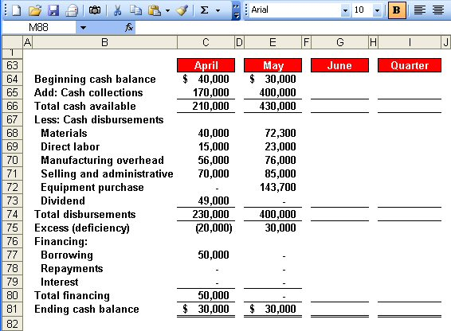
The Cash Budget

Slide 82
Quick Check ✓
What is the excess (deficiency) of cash available over disbursements for June?
  a. $ 85,000
  b. $(10,000)
  c. $ 75,000
  d. $ 95,000

Slide 83
Quick Check ✓
What is the excess (deficiency) of cash available over disbursements for June?
  a. $ 85,000
  b. $(10,000)
  c. $ 75,000
  d. $ 95,000

Slide 84
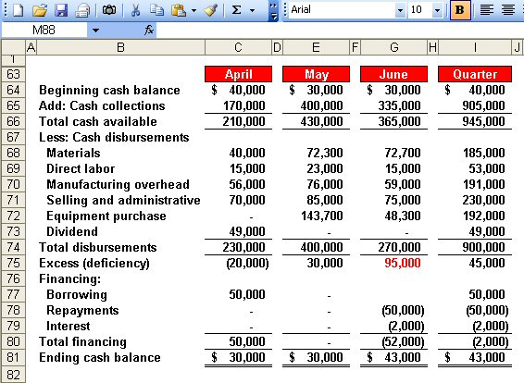
The Cash Budget
$50,000 × 16% × 3/12 = $2,000
Borrowings on April 1 and
repayment on June 30.

Slide 85
The Budgeted Income Statement
Cash
Budget
Budgeted
Income
Statement
Completed
With interest expense from the cash budget, Royal can prepare the budgeted income statement.

Slide 86
Learning Objective 9
Prepare a budgeted income statement.

Slide 87
The Budgeted Income Statement
Sales Budget.
Ending Finished
Goods Inventory.
Selling and
Administrative
Expense Budget.
Cash Budget.

Slide 88
Learning Objective 10
Prepare a budgeted balance sheet.

Slide 89
The Budgeted Balance Sheet
Royal reported the following account balances prior to preparing its budgeted financial statements:
  Land - $50,000
  Common stock - $200,000
  Retained earnings - $146,150 (April 1)
  Equipment - $175,000

Slide 90
25% of June
sales of
$300,000.
11,500 lbs.
at $0.40/lb.
5,000 units
at $4.99 each.
50% of June
purchases
of $56,800.

Slide 92

End of Chapter 8

