Slide 1
Capital Budgeting Decisions
Chapter 13

Slide 2
Typical Capital Budgeting Decisions
Plant expansion
Equipment selection
Equipment replacement
Lease or buy
Cost reduction

Slide 3
Typical Capital Budgeting Decisions
Capital budgeting tends to fall into two broad categories.
  Screening decisions. Does a proposed project meet some preset standard of acceptance?
  Preference decisions. Selecting from among several competing courses of action.

Slide 4
Cash Flows versus Operating Income
These methods focus on analyzing the cash flows associated with capital investment projects:
Payback Method
Net Present Value
Internal Rate of Return
The simple rate of return method focuses on incremental net operating income.

Slide 5
Typical Cash Outflows
Repairs and
maintenance
Working
capital
Initial
investment
Incremental
operating
costs

Slide 6
Typical Cash Inflows
Salvage
value
Release of
working
capital
Reduction
of costs
Incremental
revenues

Slide 7
Time Value of Money
A dollar today is worth more than a dollar a year from now.
Therefore, projects that promise earlier returns are preferable to those that promise later returns.

Slide 8
Time Value of Money
The capital budgeting techniques that best recognize the time value of money are those that involve discounted cash flows.

Slide 9
Learning Objective 1
Determine the payback period for an investment.

Slide 10
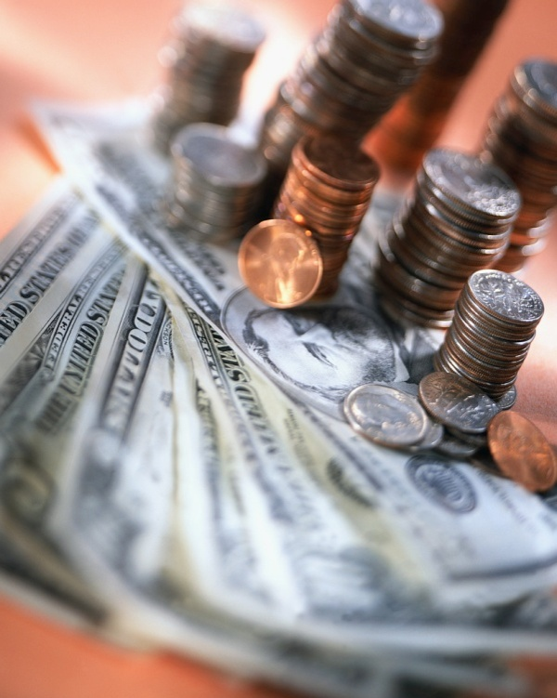
The Payback Method
The payback method focuses on the payback period, which is the length of time that it takes for a project to recoup its initial cost out of the cash receipts that it generates.

Slide 11
The Payback Method
The payback method analyzes cash flows; however, it does not consider the time value of money.
When the annual net cash inflow is the same each year, this formula can be used to compute the payback period:
Investment required
Annual net cash inflow
Payback period =

Slide 12
The Payback Method
Management at the Daily Grind wants to install an espresso bar in its restaurant that
  Costs $140,000 and has a 10-year life.
  Will generate annual net cash inflows of $35,000.
Management requires a payback period of 5 years or less on all investments.
What is the payback period for the espresso bar?

Slide 13
The Payback Method
Investment required
Annual net cash inflow
Payback period =
$140,000
$35,000
Payback period =
Payback period =
4.0 years
According to the company’s criterion, management would invest in the espresso bar because its payback period is less than 5 years.

Slide 14
Quick Check ✓
Consider the following two investments:
Project X Project Y
Initial investment $100,000 $100,000
Year 1 cash inflow $60,000 $60,000
Year 2 cash inflow $40,000 $35,000
Year 14-10 cash inflows $0 $25,000
Which project has the shortest payback period?
  a. Project X
  b. Project Y
  c. Cannot be determined

Slide 15
Quick Check ✓
Consider the following two investments:
Project X Project Y
Initial investment $100,000 $100,000
Year 1 cash inflow $60,000 $60,000
Year 2 cash inflow $40,000 $35,000
Year 14-10 cash inflows $0 $25,000
Which project has the shortest payback period?
  a. Project X
  b. Project Y
  c. Cannot be determined
Project X has a payback period of 2 years.
Project Y has a payback period of slightly more than 2 years.
Which project do you think is better?

Slide 16
Evaluation of the Payback Method
Ignores the
time value
of money.
Short-comings
of the payback
method.
Shorter payback period does not always mean a more desirable investment.
Ignores cash
flows after
the payback
period.

Slide 17
Evaluation of the Payback Method
Serves as screening tool.
Identifies investments that recoup cash investments quickly.
Strengths
of the payback
period.
Identifies products that recoup initial investment quickly.

Slide 18
Payback and Uneven Cash Flows
When the cash flows associated with an investment project change from year to year, the payback formula introduced earlier cannot be used.
Instead, the un-recovered investment must be tracked year by year.
$1,000
$0
$2,000
$1,000
$500
1
2
3
4
5

Slide 19
Payback and Uneven Cash Flows
For example, if a project requires an initial investment of $4,000 and provides uneven net cash inflows in years 1-5 as shown, the investment would be fully recovered in year 4.
$1,000
$0
$2,000
$1,000
$500
1
2
3
4
5

Slide 20
Learning Objective 2
Evaluate the acceptability of an investment project using the net present value method.

Slide 21
The Net Present Value Method
The net present value method compares the present value of a project’s cash inflows with the present value of its cash outflows. The difference between these two streams of cash flows is called the net present value.

Slide 22
The Net Present Value Method
Two Simplifying Assumptions
All cash flows other than the initial investment occur at the end of periods.
All cash flows generated by an investment project are immediately reinvested at a rate of return equal to the discount rate.

Slide 23
The Net Present Value Method
Lester Company has been offered a five year contract to provide component parts for a large manufacturer.

Slide 24
The Net Present Value Method
At the end of five years the working capital will be released and may be used elsewhere by Lester.
Lester Company uses a discount rate of 11%.
Should the contract be accepted?

Slide 25
The Net Present Value Method
Annual net cash inflow from operations

Slide 26
The Net Present Value Method

Slide 27
The Net Present Value Method
Present value of an annuity of $1
factor for 5 years at 11%.

Slide 28
The Net Present Value Method
Present value of $1
factor for 3 years at 11%.

Slide 29
The Net Present Value Method
Present value of $1
factor for 5 years at 11%.
Total present value of the release of the working capital and the salvage value of the equipment is $62,265.

Slide 30
The Net Present Value Method
Accept the contract because the project has a positive net present value.

Slide 31
Quick Check ✓
Denny Associates has been offered a four-year contract to supply the computing requirements for a local bank.
The working capital would be released at the end of the contract.
Denny Associates requires a 14% return.

Slide 32
Quick Check ✓
What is the net present value of the contract with the local bank?
  a. $150,000
  b. $ 28,230
  c. $ 92,340
  d. $132,916

Slide 33
Quick Check ✓
What is the net present value of the contract with the local bank?
  a. $150,000
  b. $ 28,230
  c. $ 92,340
  d. $132,916

Slide 34
The Net Present Value Method
Let’s look at another way to calculate the NPV.
Lester Company has been offered a five year contract to provide component parts for a large manufacturer.

Slide 35
The Net Present Value Method
At the end of five years the working capital will be released and may be used elsewhere by Lester.
Lester Company uses a discount rate of 11%.
Should the contract be accepted?

Slide 36
The Net Present Value Method
Since the investments in equipment ($160,000) and working capital ($100,000) occur immediately, the discounting factor used is 1.000.

Slide 37
The Net Present Value Method
The total cash flows for years 1-5 are discounted to their present values using the discount factors from Exhibit 13B-1.

Slide 38
The Net Present Value Method
For example, the total cash flows in year 1 of $80,000 are multiplied by the discount factor of 0.901 to derive this future cash flow’s present value of $72,080.

Slide 39
The Net Present Value Method
As another example, the total cash flows in year 3 of $50,000 are multiplied by the discount factor of 0.731 to derive this future cash flow’s present value of $36,550.

Slide 40
The Net Present Value Method
The net present value of the investment opportunity is $76,015. Notice this amount equals the net present value from the earlier approach.

Slide 41
The Net Present Value Method
Once you have computed a net present value, you should interpret the results as follows:
A positive net present value indicates that the project’s return exceeds the discount rate.
A negative net present value indicates that the project’s return is less than the discount rate.

Slide 42
The Net Present Value Method

Slide 43
Choosing a Discount Rate
The company’s cost of capital is usually regarded as the minimum required rate of return.
The cost of capital is the average return the company must pay to its long-term creditors and stockholders.

Slide 44

Recovery of the Original Investment
The net present value method automatically provides for return of the original investment.

Slide 45
Recovery of the Original Investment
Carver Hospital is considering the purchase of an attachment for its X-ray machine.
No investments are to be made unless they have an annual return of at least 10%.
Will we be allowed to invest in the attachment?

Slide 46
Recovery of the Original Investment
Notice that the net present value of the investment is zero.

Slide 47
Recovery of the Original Investment
This implies that the cash inflows are sufficient to recover the $3,169 initial investment and to provide exactly a 10% return on the investment.

Slide 48
Learning Objective 3
Evaluate the acceptability of an investment project using the internal rate of return method.

Slide 49
Internal Rate of Return Method
The internal rate of return is the rate of return promised by an investment project over its useful life. It is computed by finding the discount rate that will cause the net present value of a project to be zero.
It works very well if a project’s cash flows are identical every year. If the annual cash flows are not identical, a trial-and-error process must be used to find the internal rate of return.

Slide 50
Internal Rate of Return Method
General decision rule . . .
When using the internal rate of return, the cost of capital acts as a hurdle rate that a project must clear for acceptance.

Slide 51
Internal Rate of Return Method
Decker Company can purchase a new machine at a cost of $104,320 that will save $20,000 per year in cash operating costs.
The machine has a 10-year life.

Slide 52
Internal Rate of Return Method
Future cash flows are the same every year in this example, so we can calculate the internal rate of return as follows:
PV factor for the
internal rate of return
Investment required
Annual net cash flows
=
$104, 320
$20,000
= 5.216

Slide 53
Internal Rate of Return Method
Using the present value of an annuity of $1 table . . .
Find the 10-period row, move across until you find the factor 5.216. Look at the top of the column and you find a rate of 14%.

Slide 54
Internal Rate of Return Method
If Decker’s minimum required rate of return is equal to or greater than 14%, then the machine should be purchased.

Slide 55
Quick Check ✓
The expected annual net cash inflow from a project is $22,000 over the next 5 years. The required investment now in the project is $79,310. What is the internal rate of return on the project?
  a. 10%
  b. 12%
  c. 14%
  d. Cannot be determined

Slide 56
Quick Check ✓
The expected annual net cash inflow from a project is $22,000 over the next 5 years. The required investment now in the project is $79,310. What is the internal rate of return on the project?
  a. 10%
  b. 12%
  c. 14%
  d. Cannot be determined
$79,310/$22,000 = 3.605,
which is the present value factor for an annuity over five years when the interest rate is 12%.

Slide 57
Comparing the Net Present Value and
Internal Rate of Return Methods
NPV is often simpler to use.
Questionable assumption:
  Internal rate of return method assumes cash inflows are reinvested at the internal rate of return.

Slide 58
Comparing the Net Present Value and Internal Rate of Return Methods
If the internal rate of return is high, this assumption may be unrealistic.
It is more realistic to assume that the cash flows can be reinvested at the discount rate, which is the underlying assumption of the net present value method.

Slide 59
Expanding the Net Present Value Method
We will now expand the net present value method to include two alternatives. We will analyze the alternatives using the total cost approach.

Slide 60
The Total-Cost Approach
White Company has two alternatives:
  remodel an old car wash or,
  remove the old car wash and install a new one.
The company uses a discount rate of 10%.

Slide 61
The Total-Cost Approach
If White installs a new washer . . .
Let’s look at the present value
of this alternative.

Slide 62
The Total-Cost Approach
If we install the new washer, the investment will yield a positive net present value of $83,202.

Slide 63
The Total-Cost Approach
If White remodels the existing washer . . .
Let’s look at the present value
of this second alternative.

Slide 64
The Total-Cost Approach
If we remodel the existing washer, we will produce a positive net present value of $56,405.

Slide 65
The Total-Cost Approach
Both projects yield a positive net present value.
However, investing in the new washer will produce a higher net present value than remodeling the old washer.

Slide 66
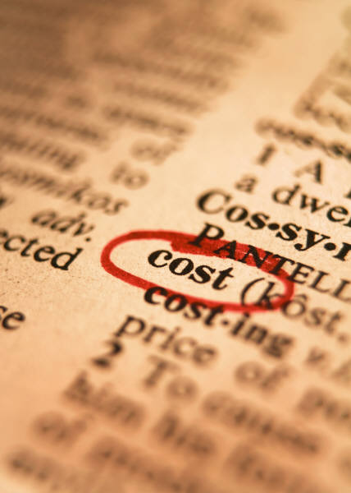
Least Cost Decisions
In decisions where revenues are not directly involved, managers should choose the alternative that has the least total cost from a present value perspective.

Slide 67
Least Cost Decisions
Home Furniture Company is trying to decide whether to overhaul an old delivery truck now or purchase a new one.
The company uses a discount rate of 10%.

Slide 68
Least Cost Decisions
Here is information about the trucks . . .

Slide 69

Least Cost Decisions

Slide 70
Least Cost Decisions
Home Furniture should purchase the new truck.

Slide 71
Learning Objective 4
Evaluate an investment project that has uncertain cash flows.

Slide 72
Uncertain Cash Flows – An Example
Assume that all of the cash flows related to an investment in a supertanker have been estimated, except for its salvage value in 20 years.
Using a discount rate of 12%, management has determined that the net present value of all the cash flows, except the salvage value is a negative $1.04 million.
How large would the salvage value need to be to make this investment attractive?

Slide 73
Uncertain Cash Flows – An Example
This equation can be used to determine that if the salvage value of the supertanker is at least $10,000,000, the net present value of the investment would be positive and therefore acceptable.

Slide 74
Quick Check ✓
Bay Architects is considering a drafting machine that would cost $100,000, last four years, provide annual cash savings of $10,000, and considerable intangible benefits each year. How large (in cash terms) would the intangible benefits have to be per year to justify investing in the machine if the discount rate is 14%?
  a. $15,000
  b. $90,000
  c. $24,317
  d. $60,000

Slide 75
Quick Check ✓
Bay Architects is considering a drafting machine that would cost $100,000, last four years, provide annual cash savings of $10,000, and considerable intangible benefits each year. How large (in cash terms) would the intangible benefits have to be per year to justify investing in the machine if the discount rate is 14%?
  a. $15,000
  b. $90,000
  c. $24,317
  d. $60,000
$70,860/2.914 = $24,317

Slide 76
Learning Objective 5
Rank investment projects in order of preference.

Slide 77
Preference Decision – The Ranking of Investment Projects
Screening Decisions
Preference Decisions
Pertain to whether or not some proposed investment is acceptable; these decisions come first.
Attempt to rank acceptable alternatives from the most to least appealing.

Slide 78
Internal Rate of Return Method
When using the internal rate of return method to rank competing investment projects, the preference rule is:
The higher the internal rate of return, the more desirable the project.

Slide 79
Net Present Value Method
The net present value of one project cannot be directly compared to the net present value of another project unless the investments are equal.

Slide 80
Ranking Investment Projects
Project Net present value of the project
profitability Investment required
index
=
The higher the profitability index, the
more desirable the project.

Slide 81
Learning Objective 6
Compute the simple rate of return for an investment.

Slide 82
Simple Rate of Return Method
Does not focus on cash flows -- rather it focuses on accounting net operating income.
The following formula is used to calculate the simple rate of return:
-
Annual incremental net operating income
Simple rate
of return
=
Initial investment*
*Should be reduced by any salvage from the sale of the old equipment

Slide 83
Simple Rate of Return Method
Management of the Daily Grind wants to install an espresso bar in its restaurant that:
  Cost $140,000 and has a 10-year life.
  Will generate incremental revenues of $100,000 and incremental expenses of $65,000 including depreciation.
What is the simple rate of return on the investment project?

Slide 84
Simple Rate of Return Method
Simple rate
of return
$35,000
$140,000
=
= 25%

Slide 85
Criticism of the Simple Rate of Return
Ignores the
time value
of money.
Short-comings
of the simple
rate of return.
The same project
may appear
desirable in some
years and
undesirable
in other years.

Slide 86

Behavioral Implications of the Simple Rate of Return
When investment center managers are evaluated using return on investment (ROI), a project’s simple rate of return may motivate them to bypass investment opportunities that earn positive net present values.

Slide 87
Postaudit of Investment Projects
A postaudit is a follow-up after the project has been completed to see whether or not expected results were actually realized.

Slide 88

End of Chapter 13

