Slide 1
Electric Power Generation Changes and Retirements
Dr. Peter Schwarz
Professor of Economics and Associate, Energy Production and Infrastructure Center, University of North Carolina Charlotte

Slide 2
https://www.routledge.com/Energy-Economics/Schwarz/p/book/9780415676786

Slide 3
Factors Affecting Generation Changes and Retirements
Change in Demand
Change in Supply
Private cost
Social cost
Environmental policies, especially greenhouse gas emissions
Other factors
Carbon, capture, use, and storage (CCUS)
Climate change (hydropower challenge)

Slide 4
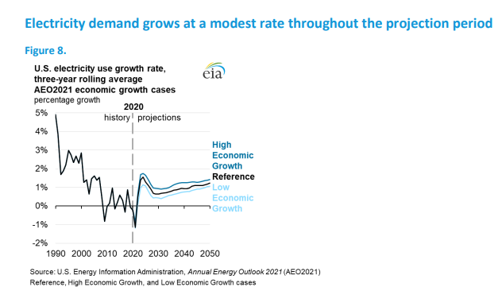
Growth in electricity demand

Slide 5
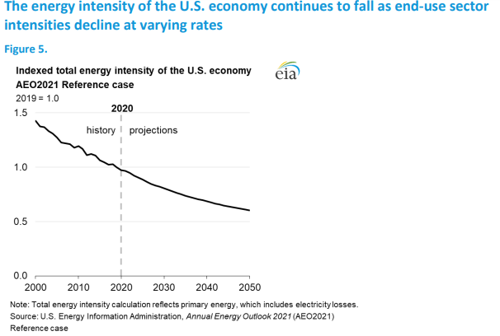
Energy Efficiency

Slide 6
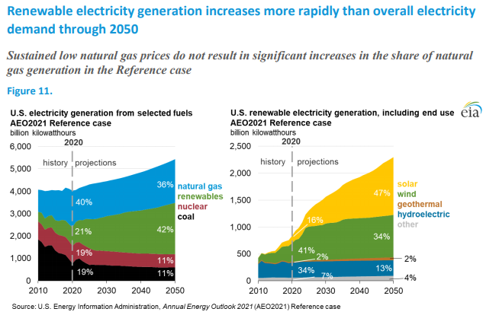
Rapidly increasing renewable electricity generation

Slide 7
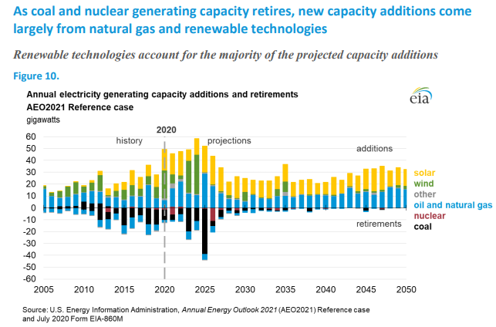

Slide 8
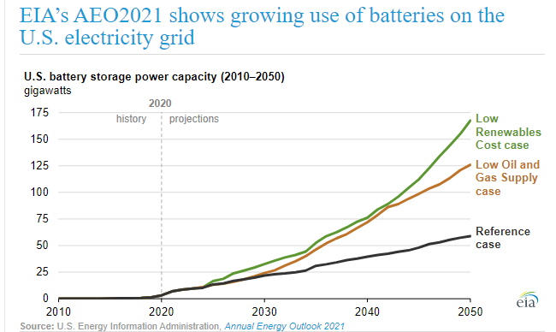
The future of batteries

Slide 9
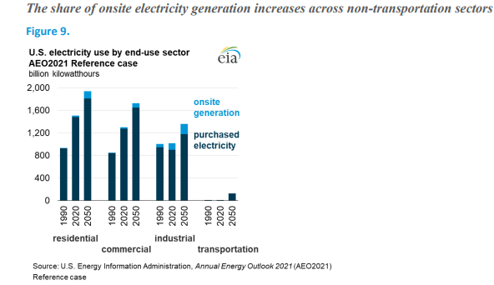
The share of onsite electricity generation

Slide 10
Levelized Cost of Energy
Minimum price at which energy must be sold to break even.
LCOE/
sLCOE = {(overnight capital cost * capital recovery factor + fixed O&M cost )/(8760 * capacity factor)} + (fuel cost * heat rate) + variable O&M cost.

Slide 11
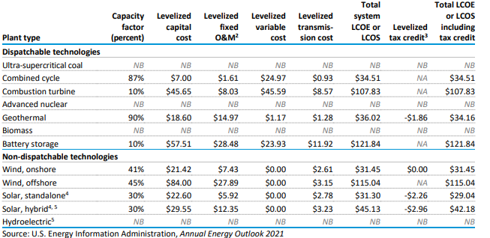
Levelized Cost

Slide 13
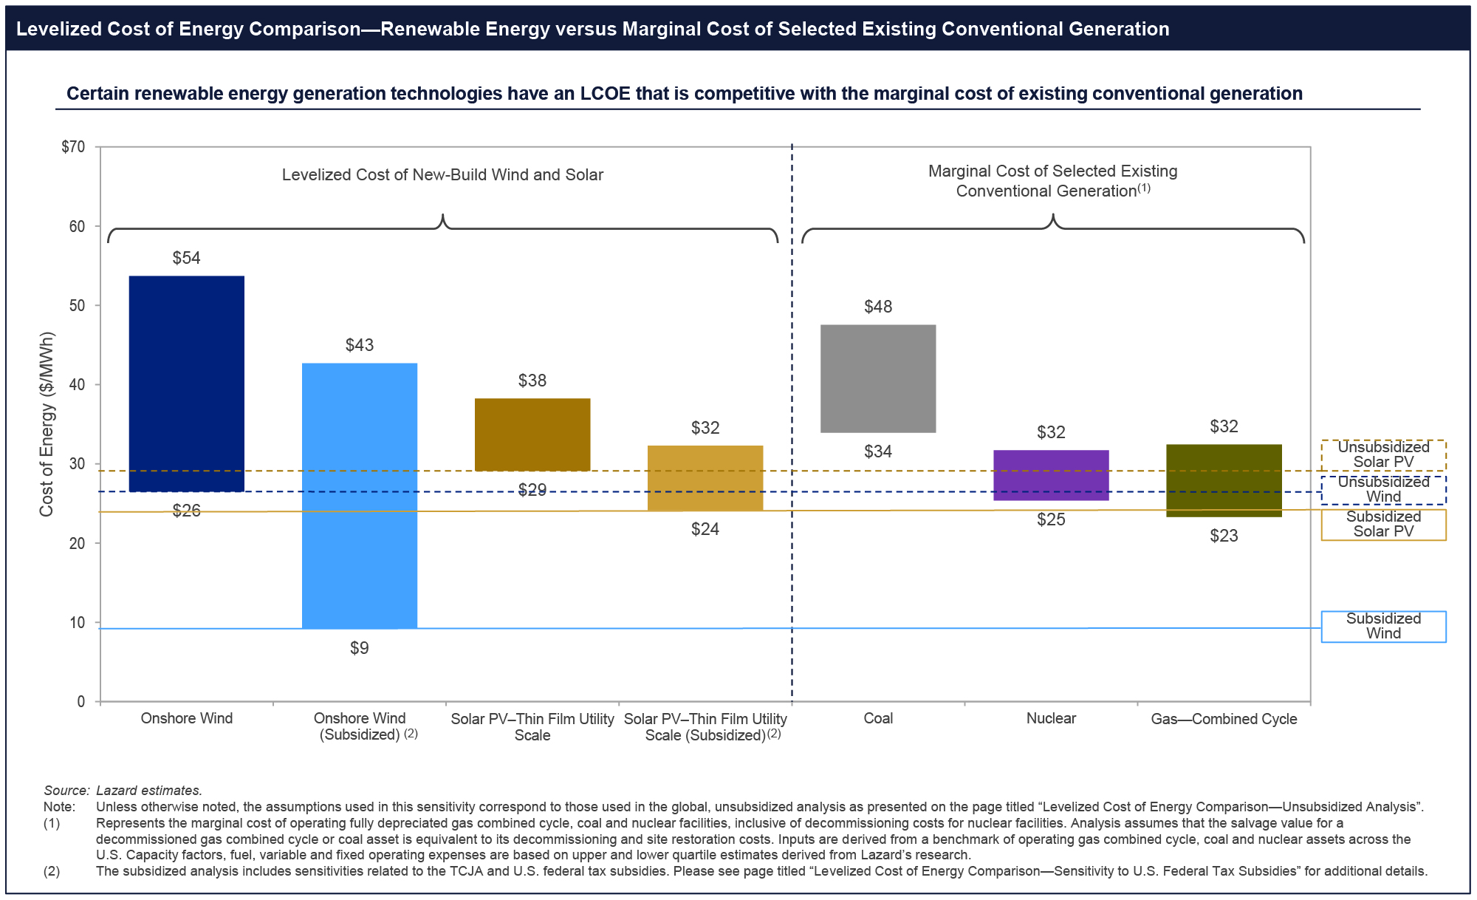

Slide 14
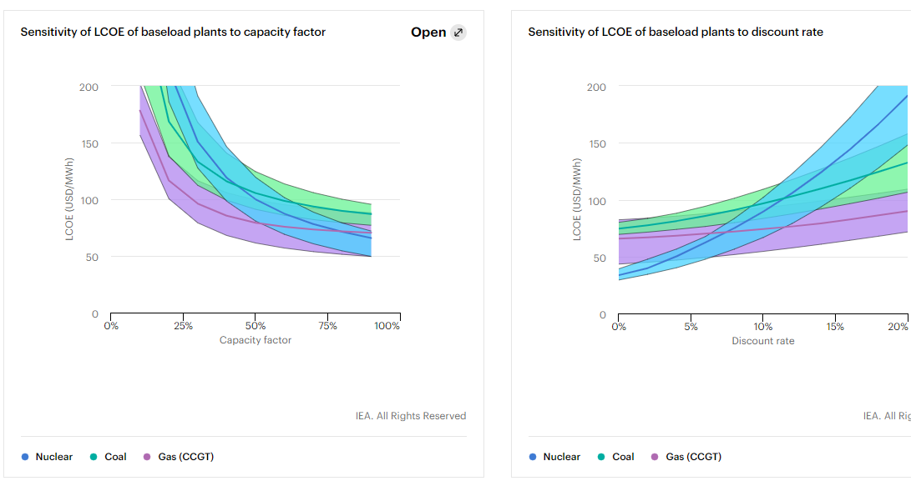

Slide 15
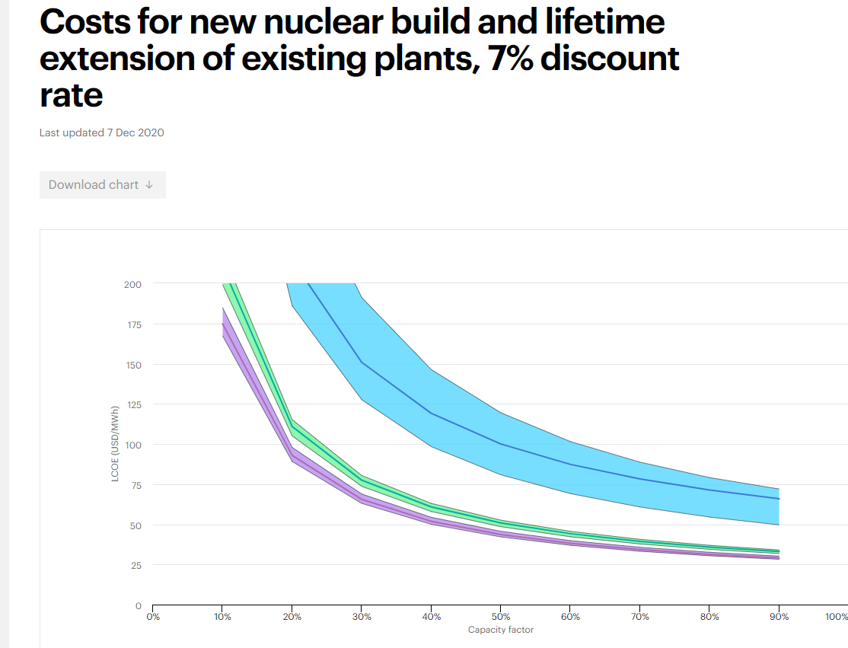
10-Year Extension
New Build
20-Year Extension

Slide 16
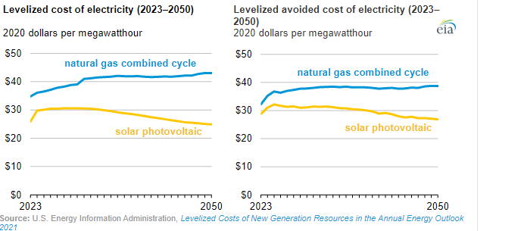
LCOE and LACE Forecast to 2050

Slide 17
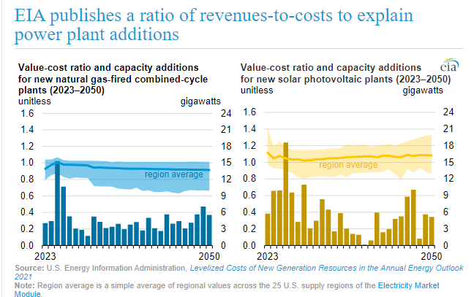
= LCAE/LCOE

Slide 18
Carbon price
Could be efficient if adopted
Economically better than command-and-control policies
Promotes innovative solutions
Challenge: Can it work if not adopted by most of the global emitters?
Challenge: Possible volatility
“Around 60% of carbon emissions from energy use in OECD and G20 countries remained entirely unpriced in 2018.”
OECD , Effective Carbon Rates 2021: Pricing Carbon Emissions through Taxes and Emissions Trading
https://www.eia.gov/todayinenergy/detail.php?id=48616

Slide 19
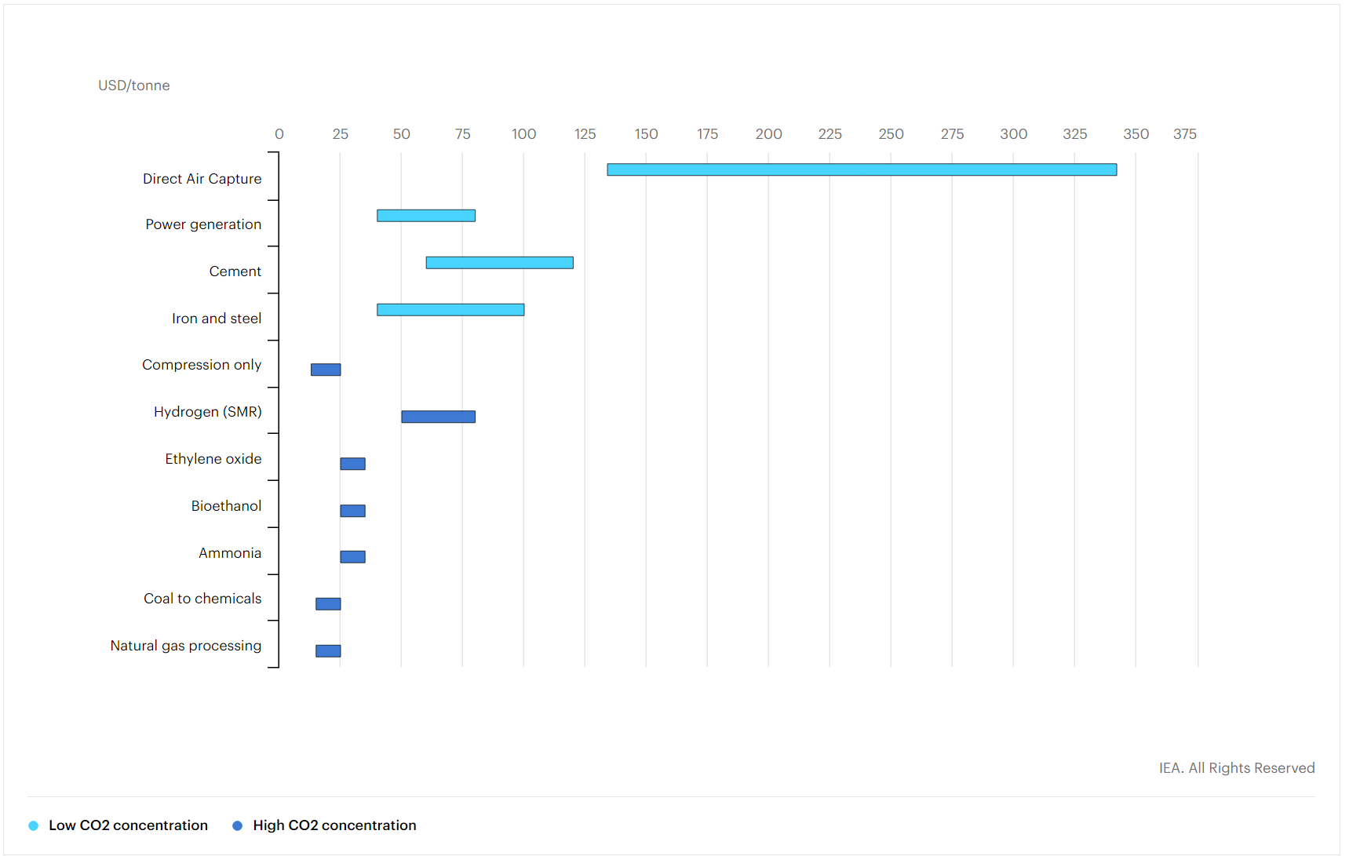
Levelised cost of CO2 capture by sector and initial CO2 concentration, 2019 – Charts – Data & Statistics - IEA

Slide 20
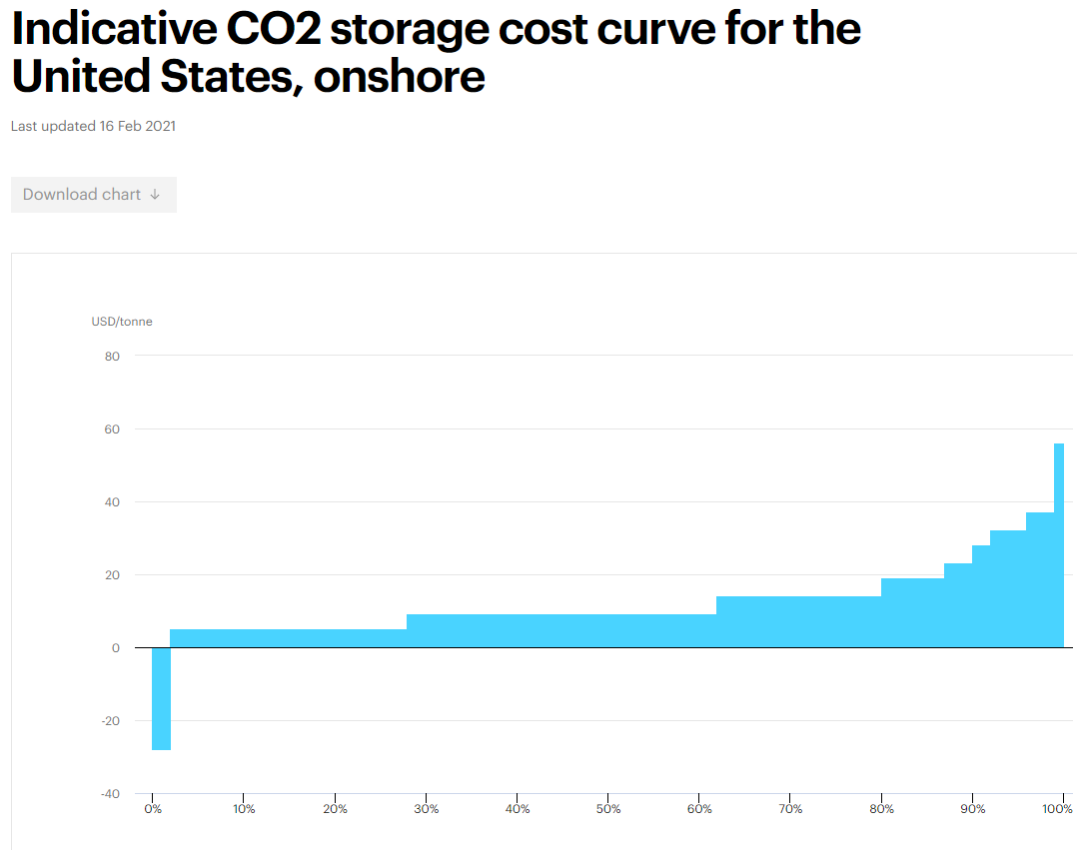

Slide 21
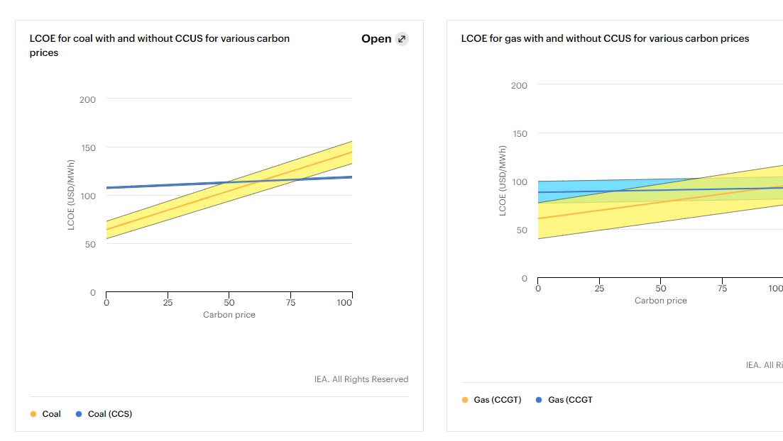

Slide 22
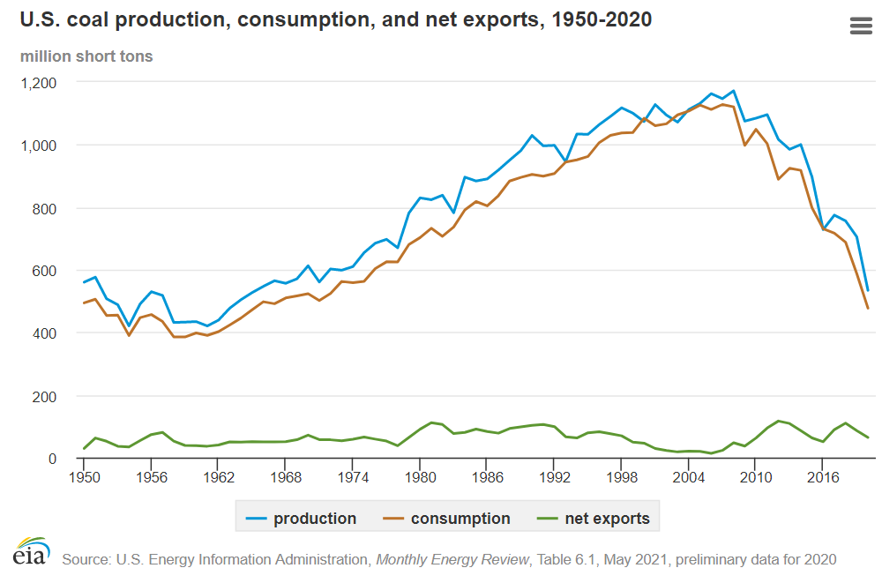
Coal – if US doesn’t use, will another country use it instead?
Will export be restricted?
Coal imports and exports - U.S. Energy Information Administration (EIA)

Slide 23
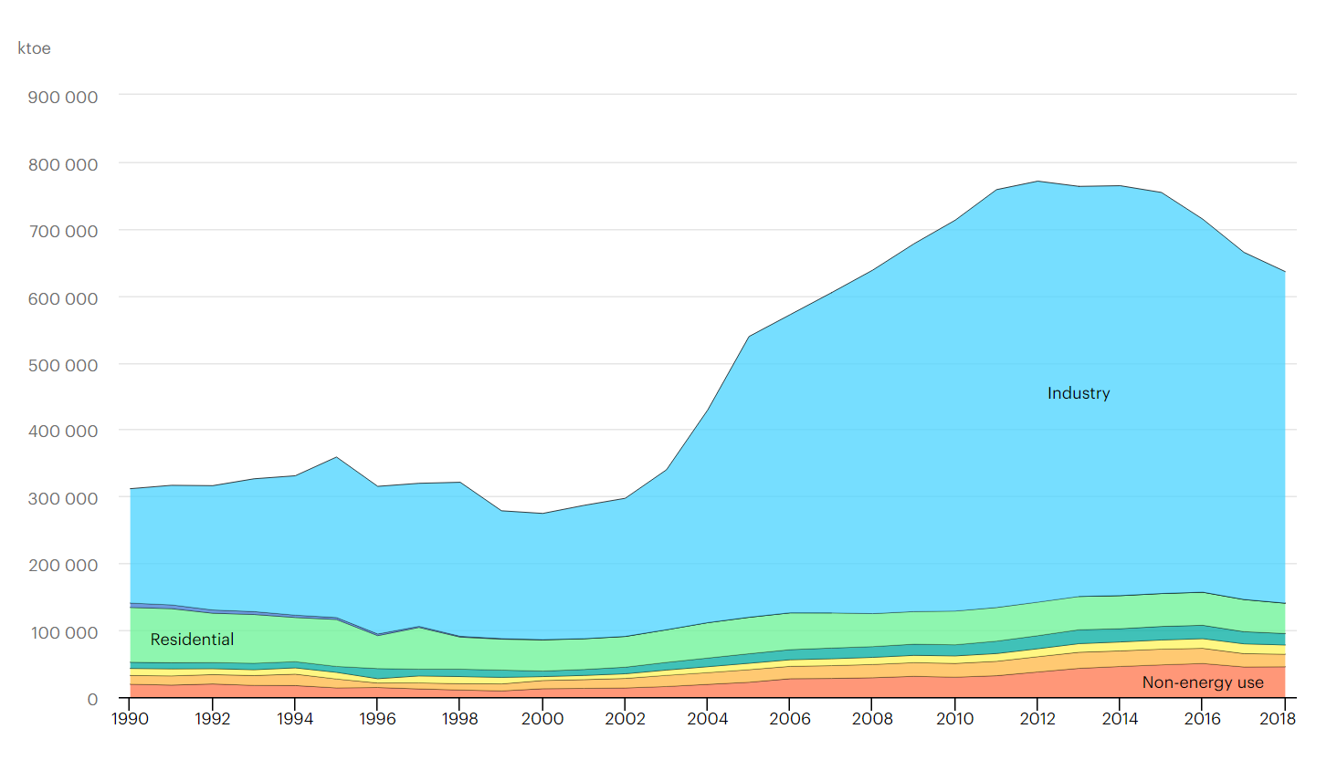
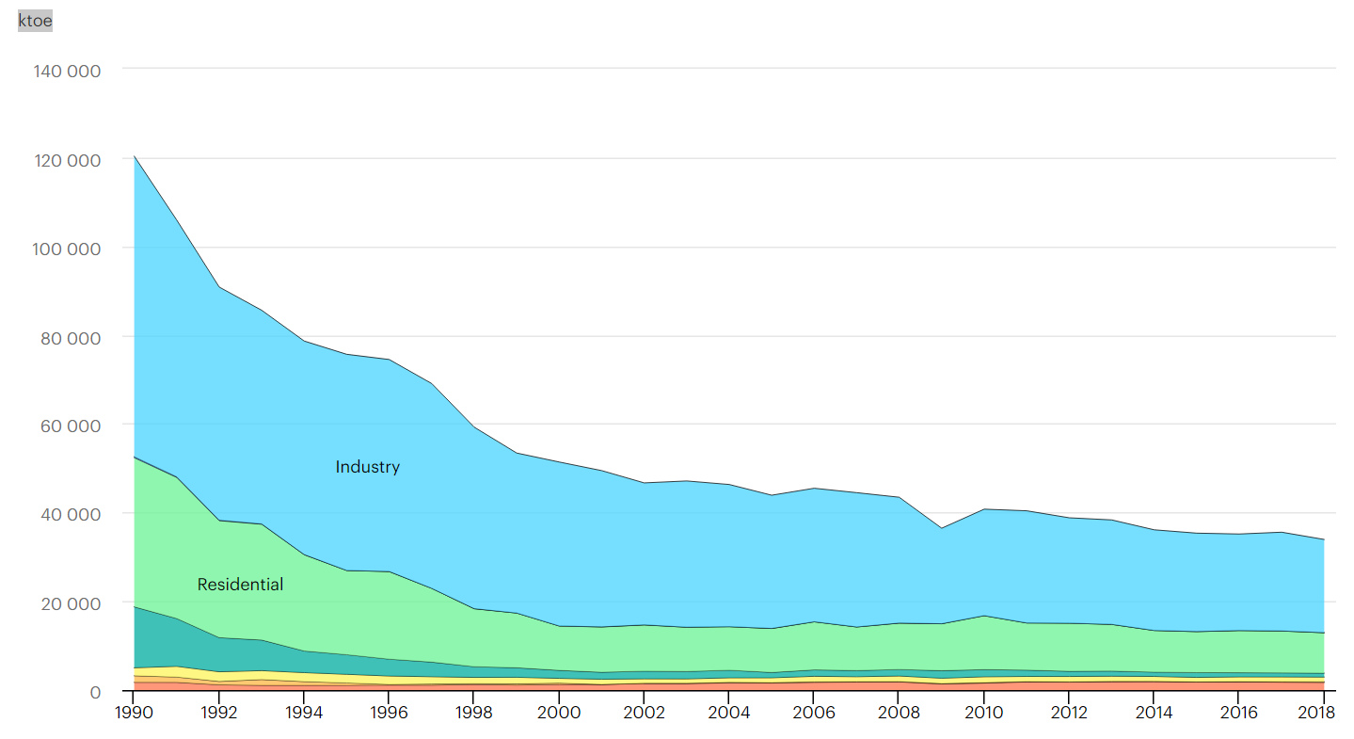
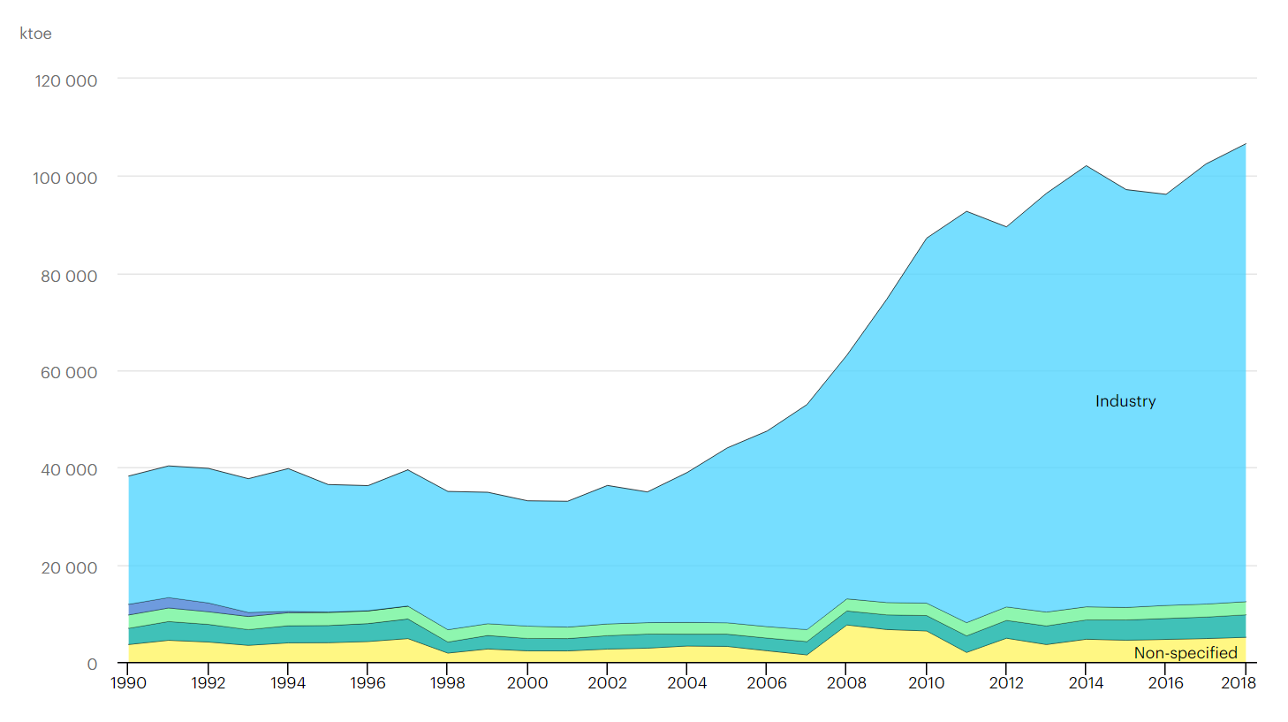
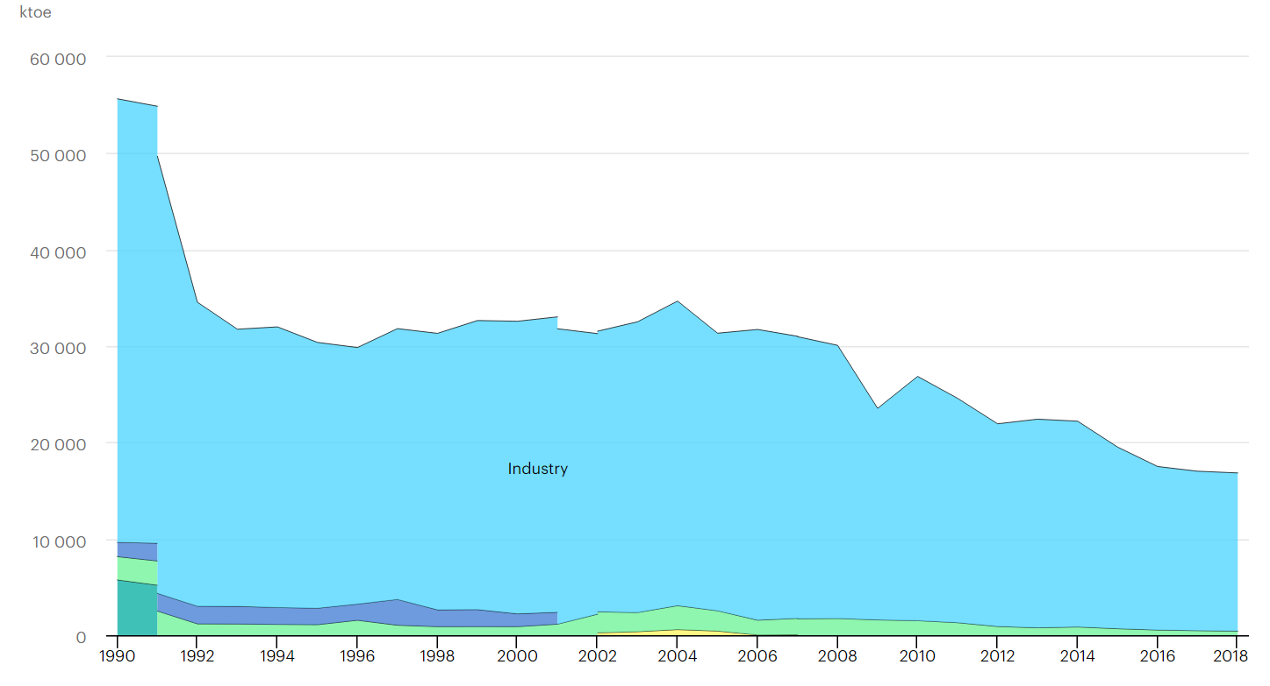
Coal – if US doesn’t use, will somebody else use it?
Coal final consumption by sector, IEA, Data & Statistics - IEA
China
EU-28
India
US

Slide 24
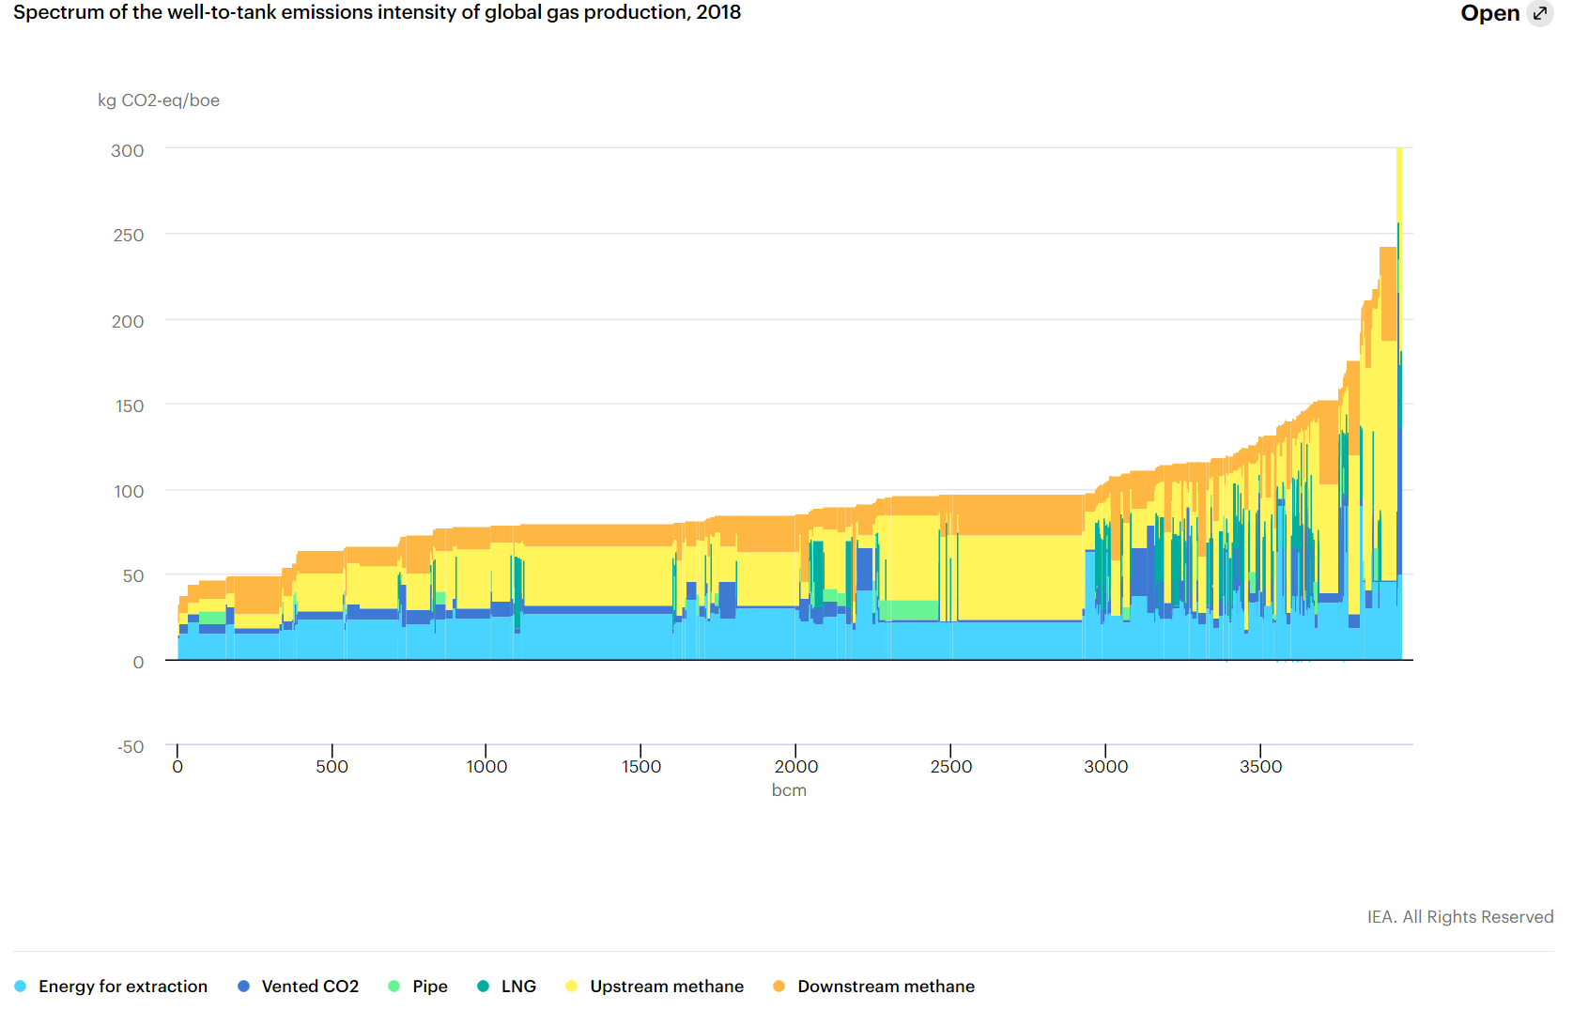
Natural gas – Methane emissions
Lower CO2 emissions (coal and oil emits more CO2)
However, a discussion about methane emissions continues.
Uncertainty in the calculation of methane emissions
Methane from oil & gas – Methane Tracker 2020 – Analysis - IEA

Slide 25
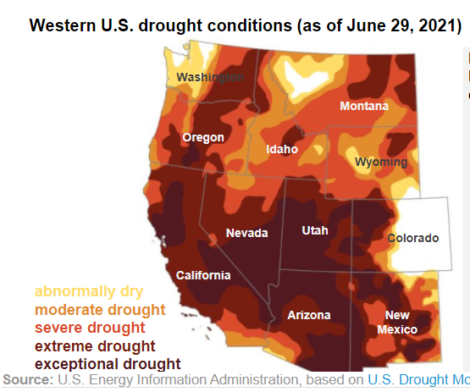
Rapidly Changing Conditions - Hydro
“In the first four months of 2021, hydroelectric generation in California was 37% less than in the same four months in 2020 and 71% less than during those months in 2019.” - EIA
https://www.eia.gov/todayinenergy/detail.php?id=48616

Slide 26
Texas crisis 2021
Letter of the governor that demand actions;
“Incentives within ERCOT to foster the development and maintenance of adequate and reliable sources of power, like NATURAL GAS, COAL AND NUCLEAR”
“Allocate reliability costs to generation resources that cannot guarantee their own availability, such as WIND AND SOLAR POWER”
“Instruct ERCOT to establish a maintenance schedule for NATURAL GAS, COAL NUCLEAR and other NON-RENEWABLE electricity generators to ensure that there is always an adequate supply of power…”
“Order ERCOT to accelerate the development of transmission projects that increases connectivity between existing or new dispatchable generation plants and areas of need.”
https://gov.texas.gov/uploads/files/press/SCAN_20210706130409.pdf

